Slide 1
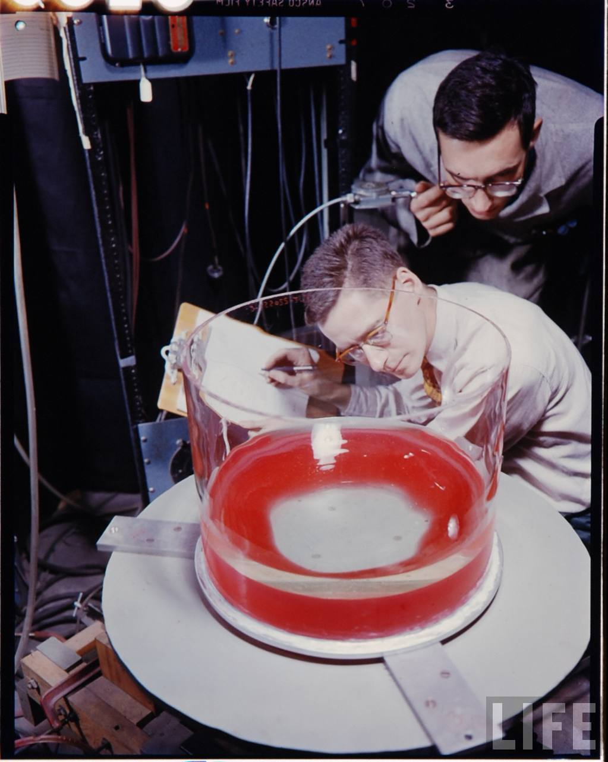
Notes:
http://www-news.uchicago.edu/releases/05/050601.fultzlab.shtml
This image on the right shows a close-up of the "weather patterns" forming in Earth's atmosphere in a laboratory. The "weather patterns" are forming in a large tank of water, which slowly spins in simulation of the Earth's rotation. The bucket of ice at the center represents the Earth's polar region, which is cooling the air, which, like water, is a fluid. Green and red dye are introduced into the water so that observers may see the formation of swirling vortices that cause Earth's weather

Slide 4
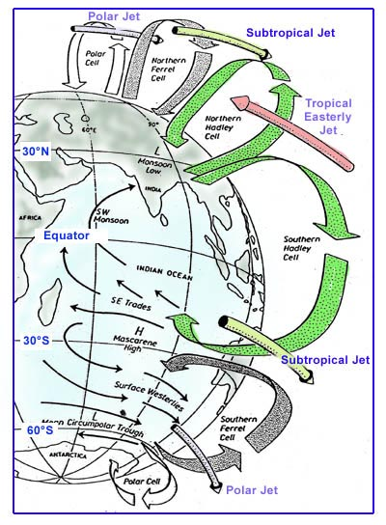
Global atmospheric circulation
List/describe factors that shape global atmospheric circulation
Describe/draw global atmospheric components (winds, pressure systems) of the three-cell model of global circulation
Explain how components shape adjacent patterns of weather climate

Slide 5
Global circulation without rotation (no Coriolis Force) on a uniform surface (no land/water surface contrasts) and no tilt (no differential heating between hemispheres)
Notes:
Note convective cell

Slide 6
Circulation with rotation on a uniform surface with no tilt
Notes:
Spin it like a basketball.
Describe basic difference between high and low pressure:
Low – rising air, instability, greater chance of clouds and precipitation
High – descending air, stability, less likely chance of clouds and precipitation
Name winds according to where they come from ---- the westerlies.

Slide 7
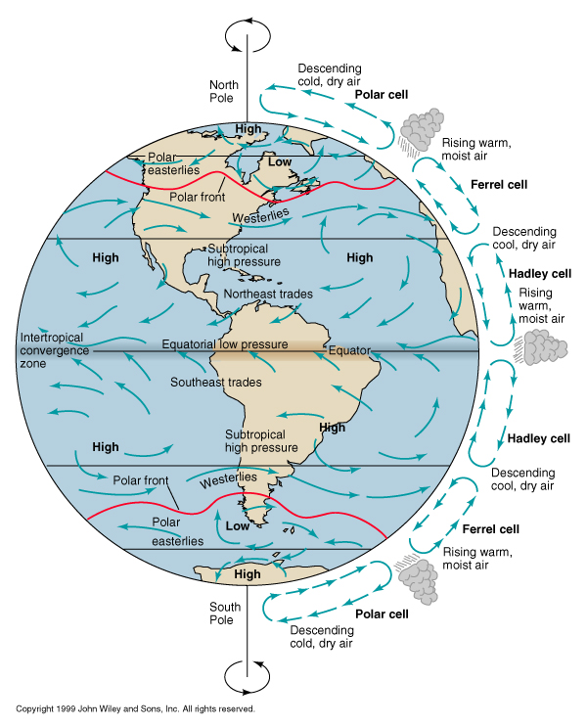
Circulation with rotation, on non-uniform surface, and tilt (the 3-cell model)
Notes:
With tilt.
Belts become cells.
Wind field break up.
Features are semi-permanent --- they persist, they may shift and weaken, but they are predictable components of the atmospheric circulation.

Slide 8
Notes:
1. Hadley cell 2. Ferrel cell
3. Polar cell

Slide 10
All of these features of global atmospheric circulation shift throughout the year with the seasons
What features you live near creates your patterns of weather and climate
Global atmospheric circulation redistributes heat from the tropics to the poles

Slide 12
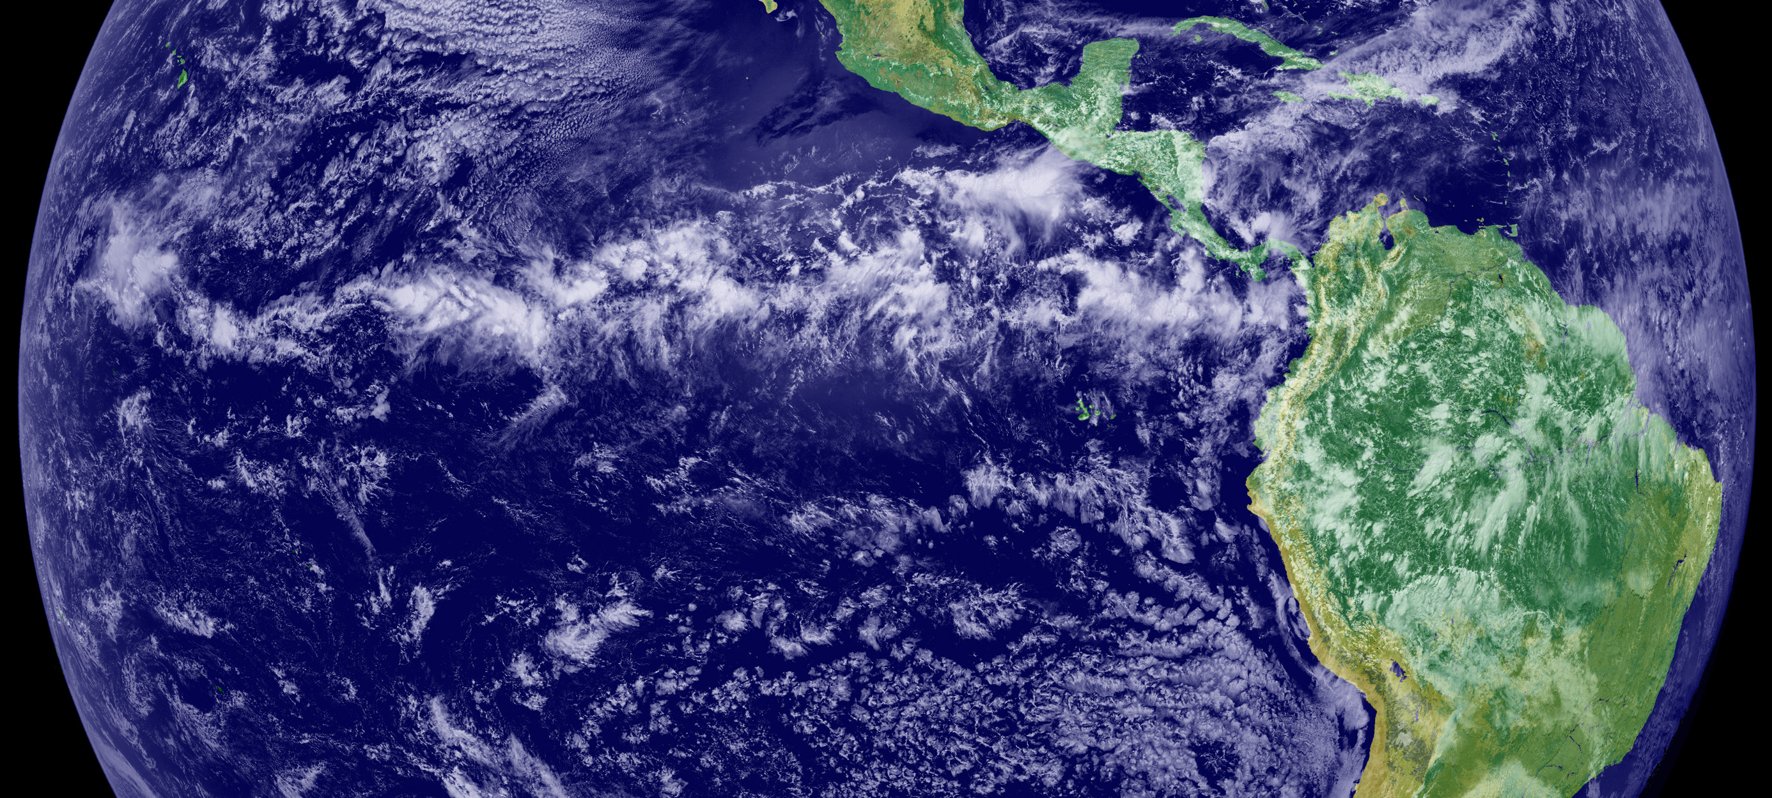
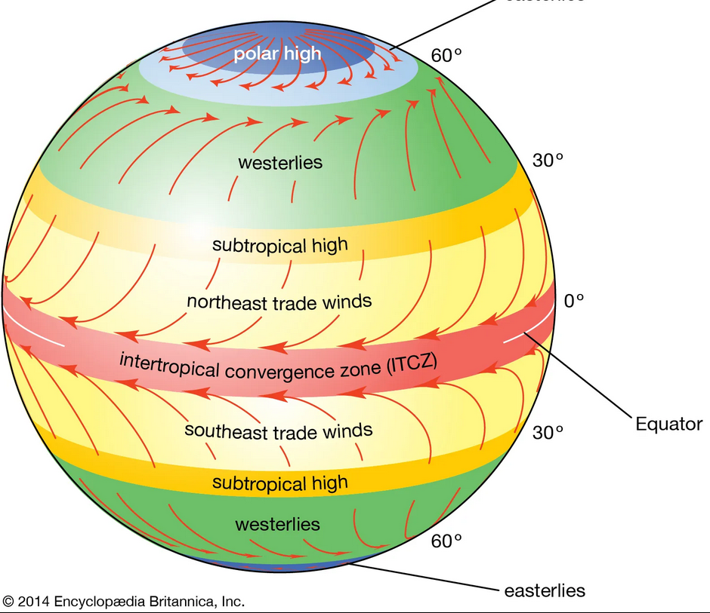
Intertropical convergence zone (ITCZ)

Slide 13
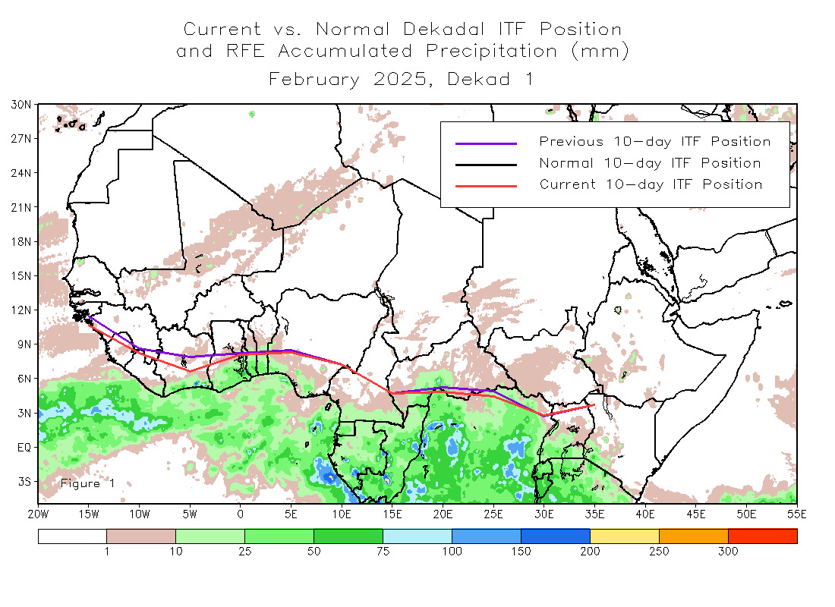
ITCZ
Semi-continuous belt of low air pressure around equator
Forms from surface heating and convergence of trade winds
Associated with clouds and rain
Shifts north and south each year with the seasons
Current global position
Notes:
https://www.noaa.gov/jetstream/tropical/convergence-zone ITF – Intertropical front, the same thing as the ITCZ

Slide 14
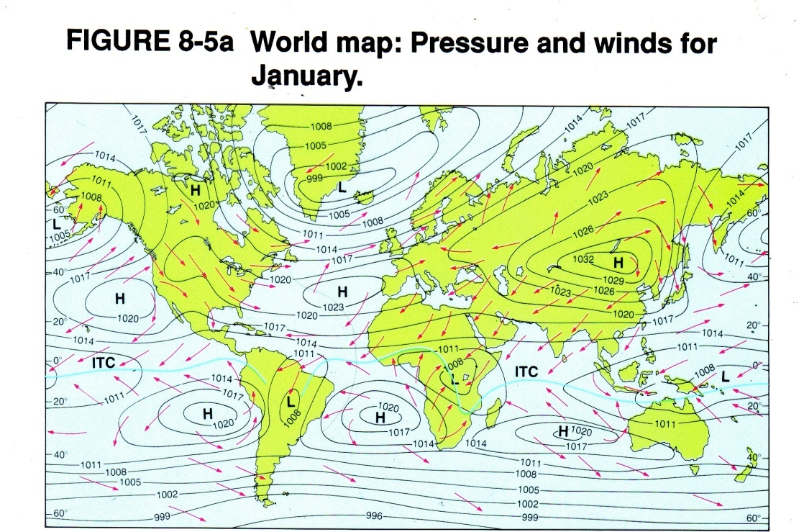
Subtropical high pressure
Semi-permanent high pressures along 20 - 35 degrees N and S latitude
Correspond to major hot deserts of the world
Notes:
Horse latitudes

Slide 15
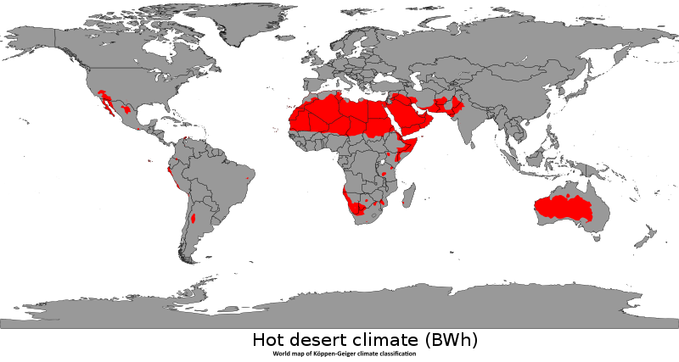
Notes:
Desert conditions are enhanced by the descending warming air of the STHP systems

Slide 16
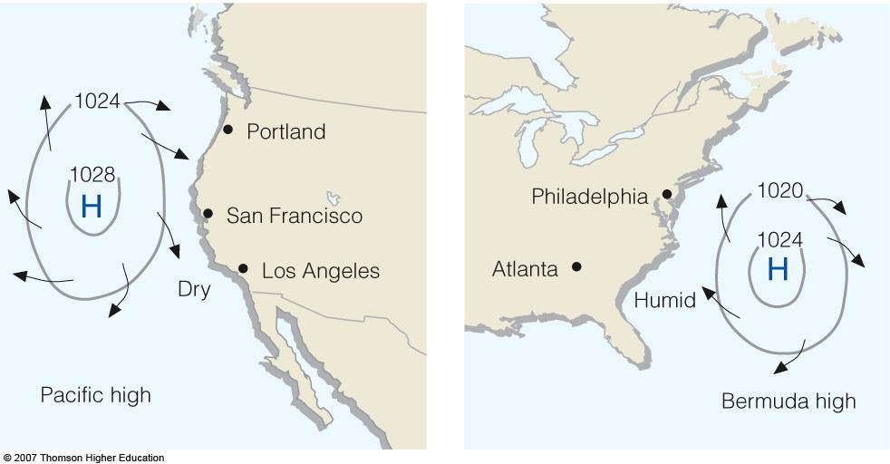
Atlantic and Pacific STHP

Slide 17
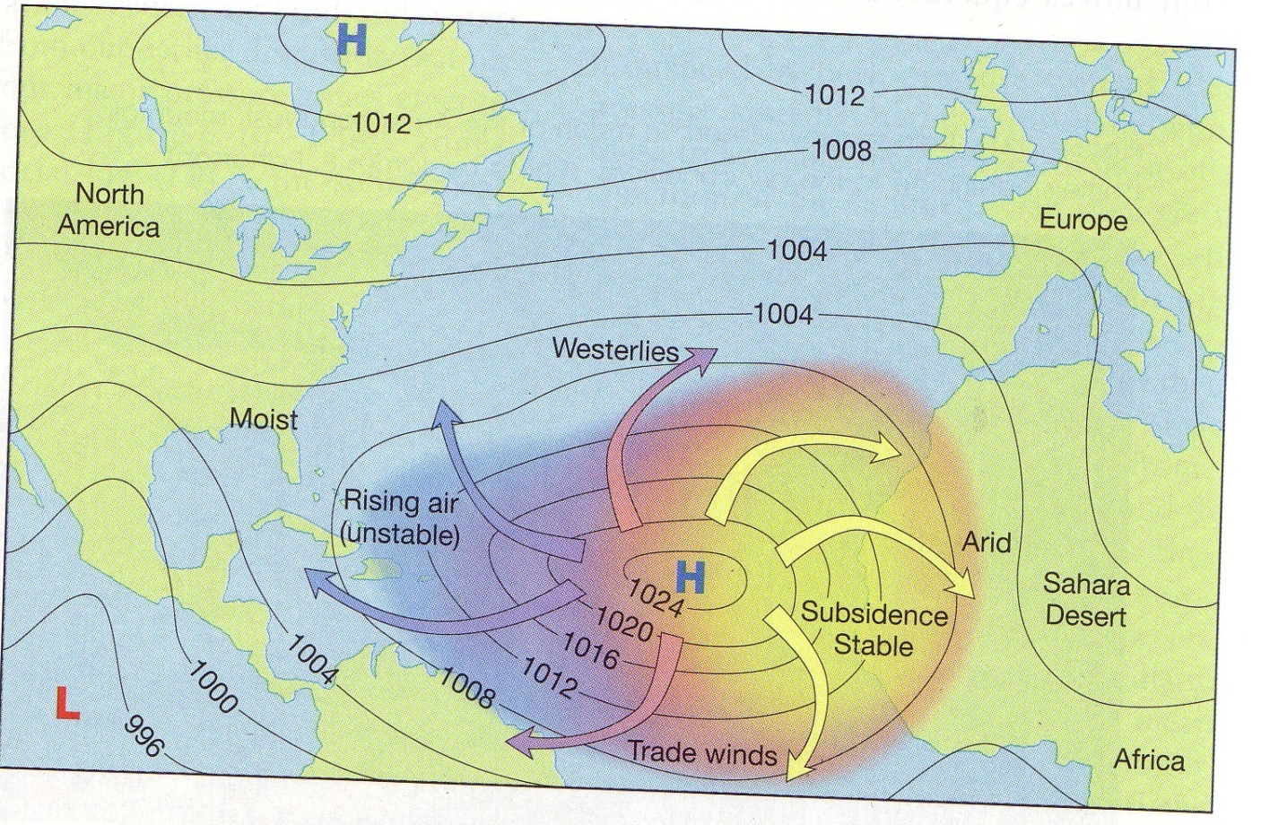
The Atlantic STHP can bring drought conditions to the southeastern US when it moves closer to the North American continent.
The Atlantic STHP can bring rainfall is its location is sufficiently offshore from North America to allow its winds to pick up moisture and become unstable.

Slide 18
Notes:
This is a map showing air pressure in mb and wind flow at the surface

Slide 19
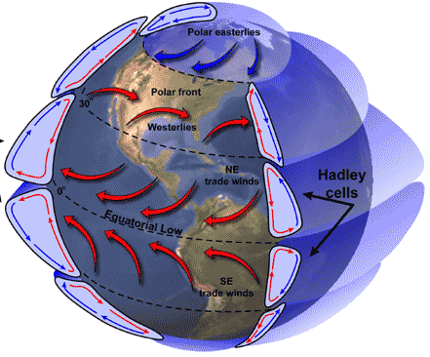
The tradewinds and the westerlies
Air descending out of the STHP becomes the tradewinds and the westerlies
The northern hemisphere tradewinds are called the northeast tradewinds and move in a generally east-southeast direction
The northern hemisphere westerlies blow from west to east
Notes:
Wind flow, aloft and at the surface is in general westerly across the US. Hence it is faster to travel when going from west to east, whether by bike or plane. The predominant wind flow in the lower 48 states is westerly.

Slide 20
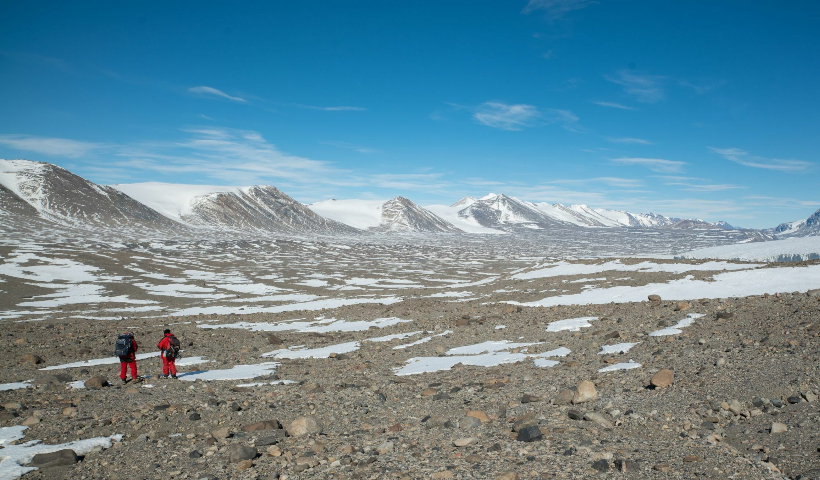
Polar highs
A cold high pressure over the north and south poles
Dry conditions, the areas under them are sometimes referred to as polar deserts
Descending air forms the polar easterlies
Notes:
Polar highs are areas of high atmospheric pressure, around the north and south poles; the south polar high being the stronger one because land gains and loses heat more effectively than sea, which the north has much less of Photo is an interior dry valley of Antarctica

Slide 21
Polar front
Position where two major winds collide, the westerlies and the polar easterlies

Slide 22
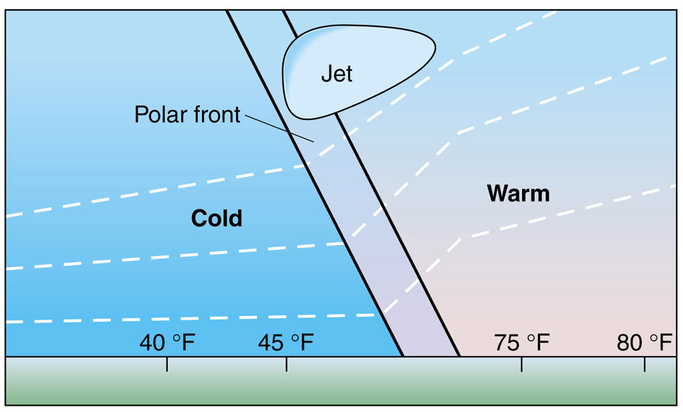
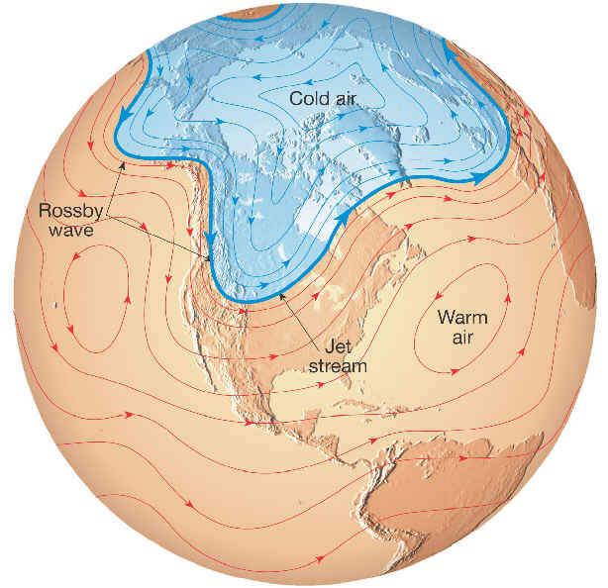
Polar front is characterized by very changeable weather
It marks the boundary between warm and cold air masses
Coincides with the position of the polar jet stream
Notes:
https://www.noaa.gov/jetstream/global/jet-stream

Slide 23
Rossby waves in the polar jet stream
Notes:
Rossby waves are the large planetary waves the form along the polar front and mark the shifting position of the polar jet stream. Zonal flow left, azonal flow right.

Slide 24
Notes:
Rossby waves in the polar jet stream

Slide 25
Current polar jet stream position
Notes:
https://www.netweather.tv/charts-and-data/global-jetstream#current/wind/surface/level/orthographic=-87.46,80.99,512

Slide 26
Notes:
The polar jet stream, like all the other features of the global circulation system moves north and south throughout the year in tandem with the shift back and forth with incoming radiation.

Slide 27
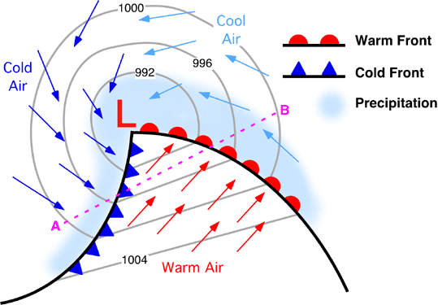
Midlatitude cyclones, low pressure systems that travel along the polar front
Notes:
Changeable weather with frontal passage

Slide 28
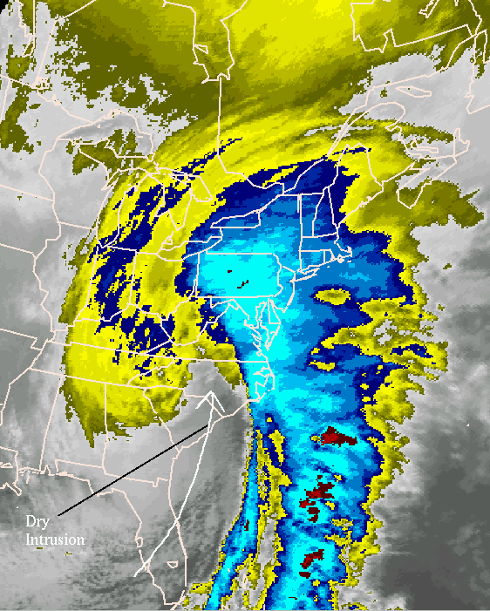
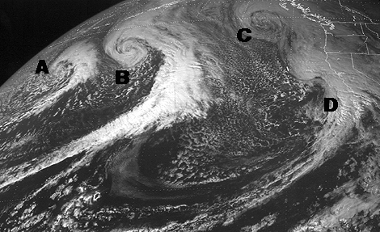
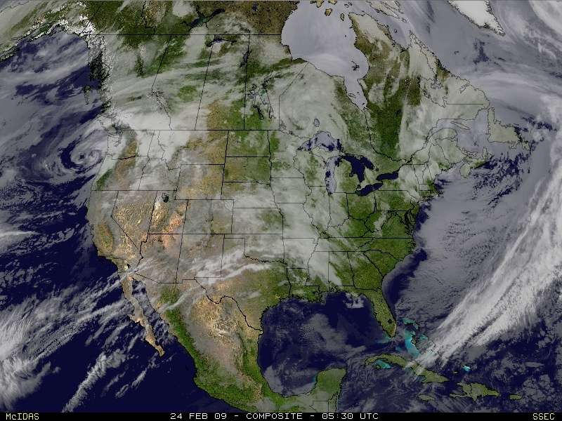
Midlatitude cyclones

Slide 29
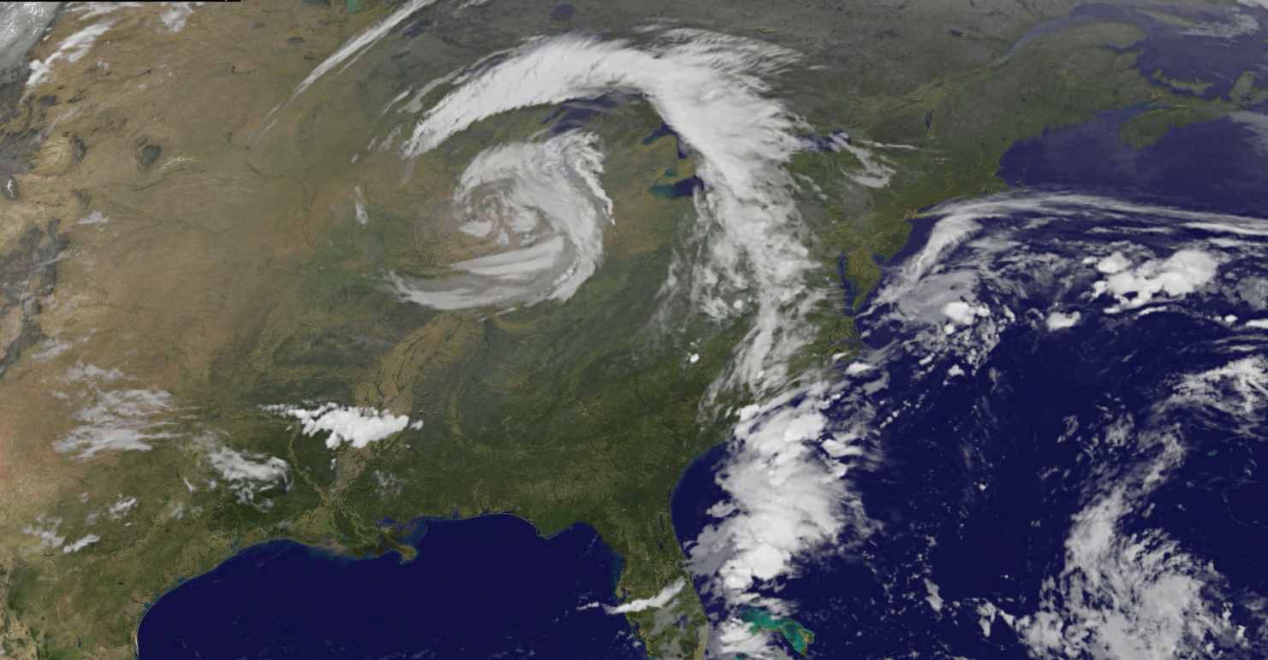
Notes:
https://eoimages.gsfc.nasa.gov/images/imagerecords/52000/52297/GOES_cyclone_20110927_lrg.mov

Slide 31
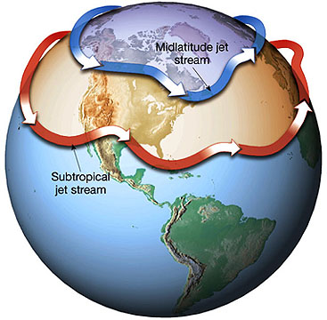
Subtropical jet stream
Located around 30 degrees north and south of the Equator
Stronger and more visible in the winter in the US
It can bring tropical moisture to the north where it can enhance midlatitude cyclone formation when it draws close to the position of the polar jet stream

Slide 32
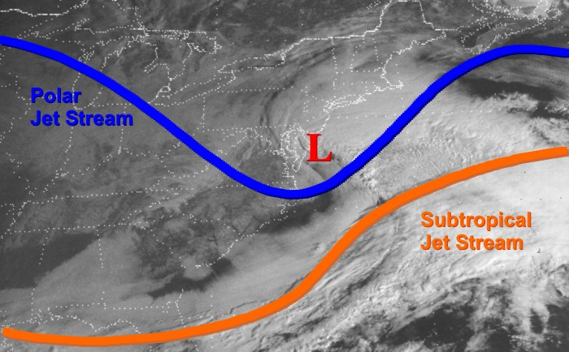

Slide 33
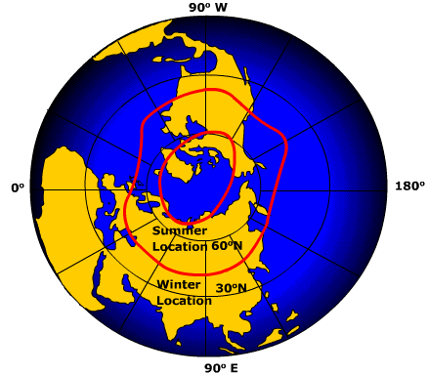
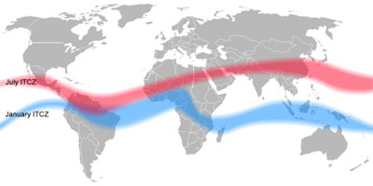
Components of global circulation shift throughout the year
Notes:
Why does it shift? Zone of most intense solar radiation and net radiation surplus shifts throughout the year

Slide 34
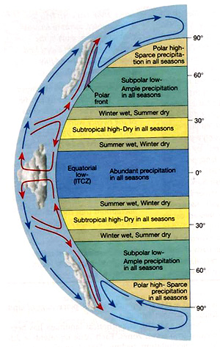
California coast (32 – 42 degrees N)
Summer drier
Pacific STHP dominant
Track of cyclones along polar jet stream is further north
Winter wetter
Pacific STHP weakens and shifts south and offshore
Midlatitude cyclones along the polar front bring precipitation

Slide 35
Pacific Northwest coast (40 – 50 degrees N)
Less dramatic difference in precipitation year round
Greater year-round influence of polar front in northern California, Oregon and Washington
More rainfall, more evenly distributed all seasons due to proximity of midlatitude cyclones
Weaker influence of STHP in the summer moving north, so summers are not as dry as in southern California
Notes:
Summer wet and winter wet
Ample precipitation all seasons
Weaker influence of STHP
Greater year-round influence of polar front

Slide 36
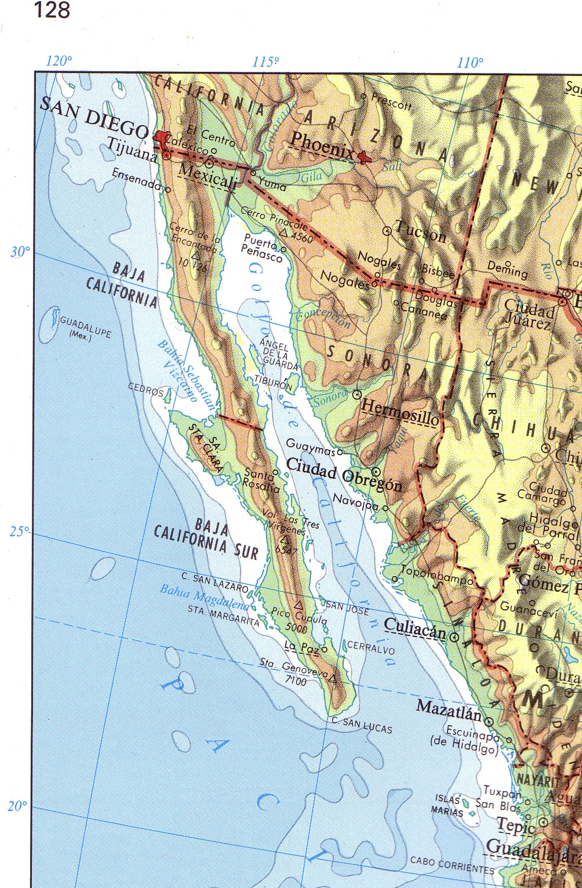
Baja Peninsula (22 – 35 N)
Dry all year but seasonal variability in rainfall along peninsula

Slide 37
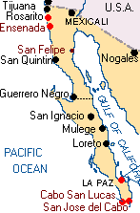
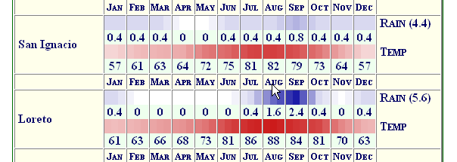
Northern Baja
Central Baja
Southern Baja

Slide 38
Baja Peninsula (22 – 35 N)
North
Winter months are a little wetter because of the occasional passing midlatitude cyclones
Summer months are dry from Pacific subtropical high pressure
Central
Dry all year because the Pacific STHP is always near
Southern
Winter dry from STHP
Summer is wetter because the ITCZ moves closer

Slide 39
Global controls of Kentucky weather and climate
Winter – polar front is dominant weather maker. Passing midlatitude cyclones in the polar jet stream bring periods of cold and warmer temperatures. Rainfall in winter is derived from the warm and cold fronts in midlatitude cyclones
Summer – weather and climate under more local controls. Far fewer fewer midlatitude cyclones as polar jet stream has shifted north into Canada. Rainfall from locally generated convective thunderstorms. These thunderstorms can be strong in spring and fall when the polar jet stream is in the right position to enhance their strength

Slide 40
Other components of global circulation
All of these are naturally occurring but can also interact with human-caused climate change
Stratospheric polar vortex
Atmospheric rivers
Global conveyor belt of thermohaline circulation
Climate oscillations

Slide 42
The stratospheric polar vortex
(Polar jet
stream)
Notes:
The stratospheric polar vortex is a high-altitude wind circulation that forms around the Arctic in winter.

Slide 43
Notes:
https://www.climate.gov/news-features/understanding-climate/understanding-arctic-polar-vortex The polar vortex is in the stratosphere, not the troposphere. However, changes in the polar vortex can create Rossby wave patterns that can bring exceptionally cold Arctic air far south.

Slide 45
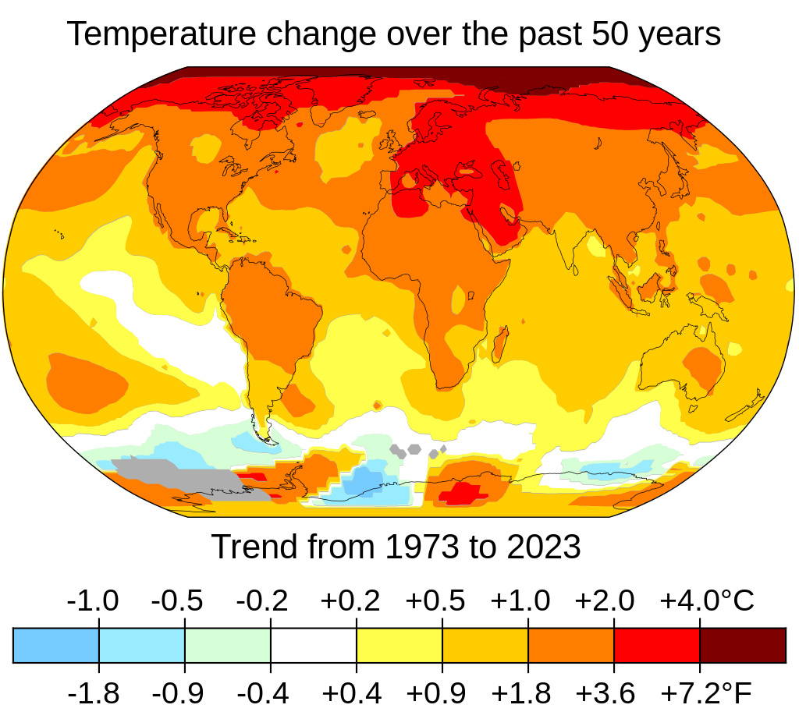
Cold air at the North Pole is needed to have a tight fast-spinning stratospheric polar vortex
Increased heat in the polar troposphere can warm the stratospheric vortex
This causes the vortex to slow down and stretch out
Polar jet stream changes its shape
Larger Rossby waves develop in the polar jet stream which allow very cold air to travel southward
This can happen naturally, but human climate change is also contributing to these events
The Arctic is the most rapidly warming place on the planet

Slide 46
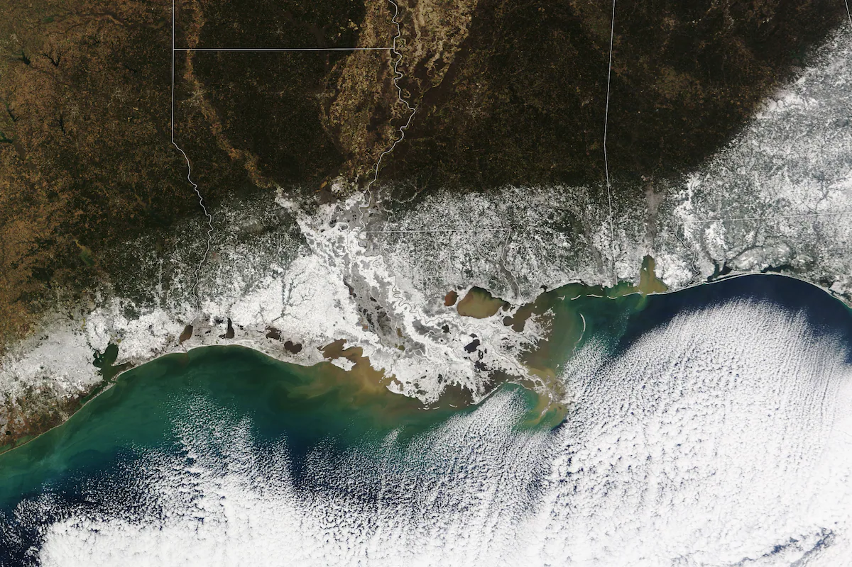
Despite these Arctic air outbreaks, far more record high temperatures observed globally than record lows.
Each of the past two years were significantly hotter, on average, since 1880.
Photo shows record snowfall in Louisiana and across the Gulf Coast from the Feb 2025 polar vortex event
Notes:
https://www.washingtonpost.com/weather/2025/01/30/polar-vortex-disruptions-warming-extreme-cold/
https://www.washingtonpost.com/weather/2025/02/17/polar-vortex-subzero-cold-forecast-snow-ice-storm/

Slide 48
Atmospheric rivers
Narrow corridors of moisture-rich air that transport large amounts of water vapor from tropical oceans into mid-latitude and polar regions
Responsible for heavy precipitation events, including those along the Pacific coast of North America.
Rivers are 250–375 miles wide and can stretch thousands of kilometers across the ocean.
Volumes of precipitable water in these rivers that impact the Pacific coast are as large as the Mississippi River
When these rivers hit the mountains of California, Oregon, and Washington, the air is forced to rise, causing the moisture to condense and produce heavy rain or snow.

Slide 51
Notes:
https://www.nytimes.com/interactive/2024/us/atmospheric-river-california-west-tracker.html

Slide 52
Thermohaline circulation and the global ocean conveyor system
Notes:
https://www.ces.fau.edu/nasa/resources/global-ocean-conveyor.php

Slide 54
Atlantic Meridional Overturning Current (AMOC)
As ocean water moves northward from the tropical Atlantic, some of it evaporates, which increases the salt concentration — and the density — of the water
By the time the water nears Greenland it has also cooled down, which makes it even more dense.
This cold, salty water sinks to the seafloor, ‘pushing’ the water that ahead of it. This higher density salty water starts to flow south along the ocean bottom.
This sinking of dense water drives the movement of the global conveyor belt

Slide 56
Potential shutdown of AMOC
Large volumes of freshwater are flowing off Greenland as its ice cap melts
This freshens the water, it become less salty and hence, less dense.
This can stop the sinking of cold salty water that acts as a force to drive the currents of the global conveyor belt
Consequently, the return flow of the Gulf Stream north may shut down
Europe would experience a sudden shift to a colder climate
Regions of the south Atlantic would experience even more rapidly warming temperatures because there is no longer any mechanism to transport heat out of the tropics and toward the poles through the Gulf Stream

Slide 57
Climate oscillations
Cyclical changes in the configuration of global circulation features
These can have a large impact on weather and climate
Used to make forecasts because weather and climate conditions
El Nino – La Nina (ENSO)
Madden-Julian Oscillation
Pacific Decadal Oscillation
North Atlantic Oscillation
Arctic Oscillation
Modokai El Nino

