Slide 1
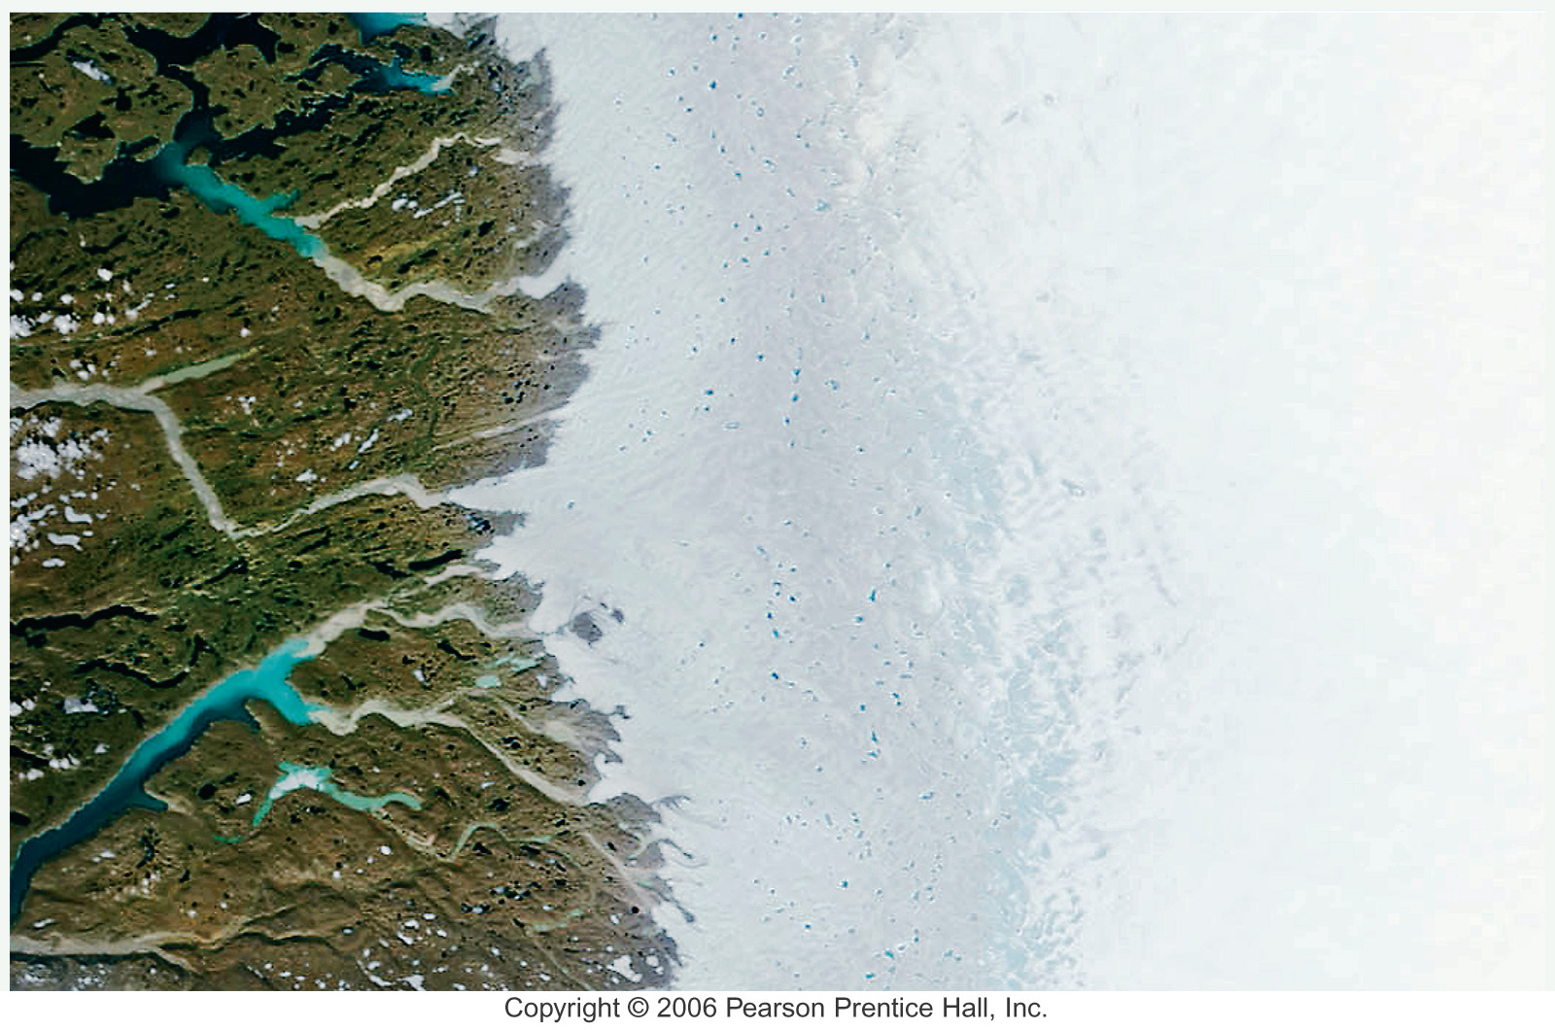
GEO 130
Earth’s Physical Environments
An introduction to Physical Geography
Dr. Tony Stallins

Slide 2
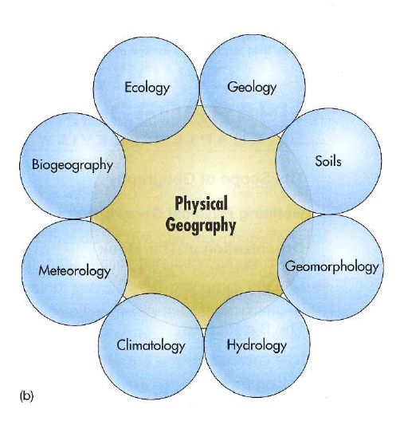
What is Physical Geography?
The integrated study of many sciences, but physical geography is typically divided into these fields of study:
  Meteorology
  Climatology
  Biogeography
  Geomorphology

Slide 3
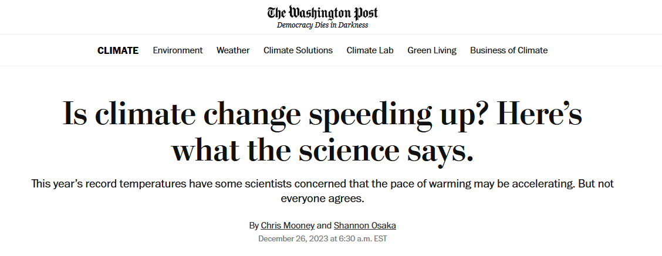
Why study physical geography?
To understand how the Earth’s biophysical systems work
To understand human impacts on the environment
Notes:
If you want to study global warming, its not all politics, economics, history, and technology. You have to know how the atmosphere, weather, and climate work.

Slide 4
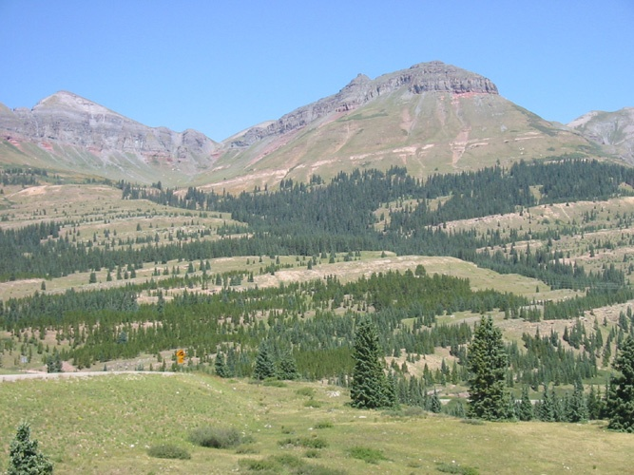
How do we do physical geography?
By describing the pattern and process relationship
It is not enough to describe patterns
Explanations of the processes that shape these patterns are also required
Notes:
Processes shape patterns and patterns shape processes

Slide 5
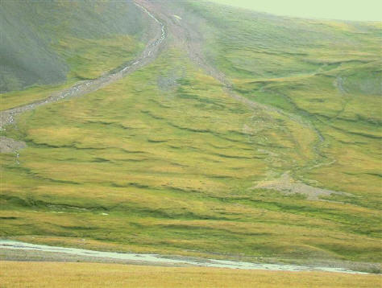
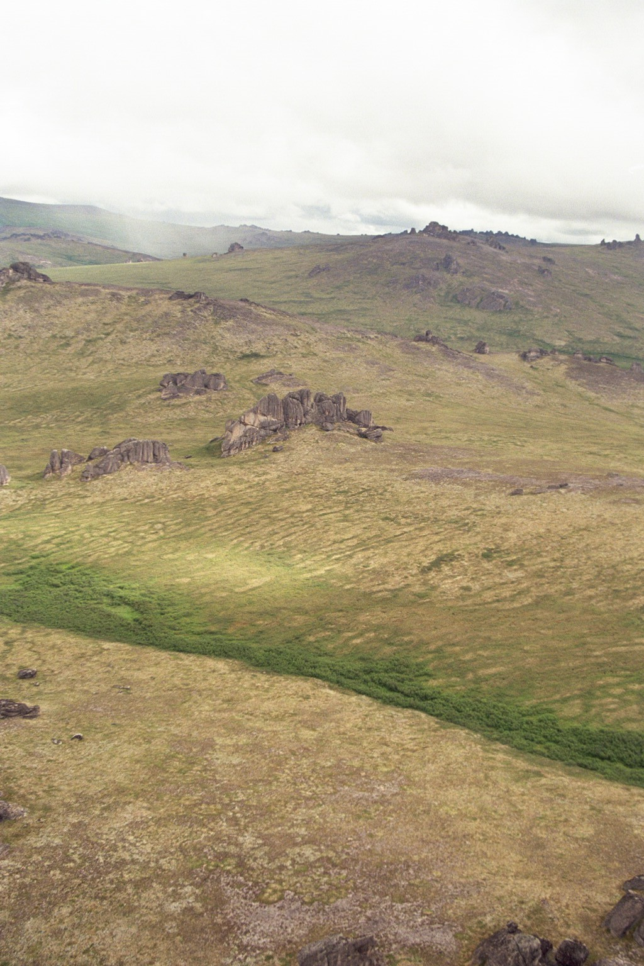
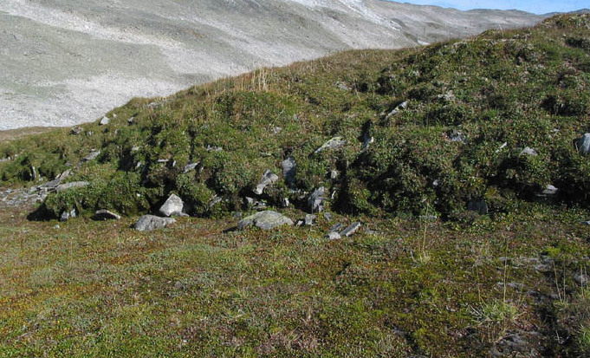
Notes:
Turf bank terraces

Slide 6
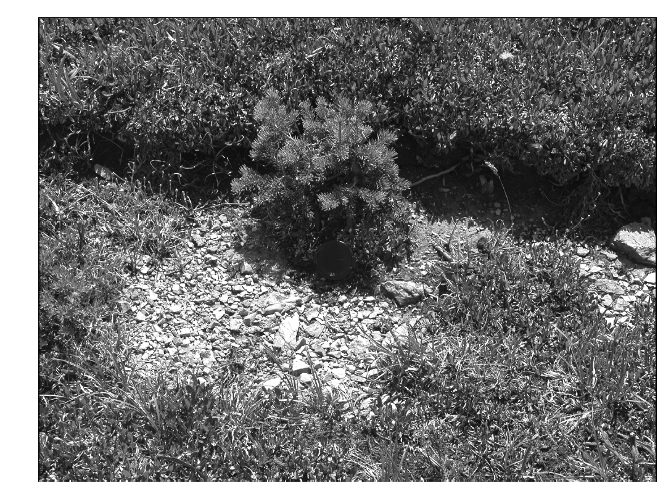
Notes:
Erosion at base of terrace landform creates protected mineral soil needed by germinating conifers.

Slide 7
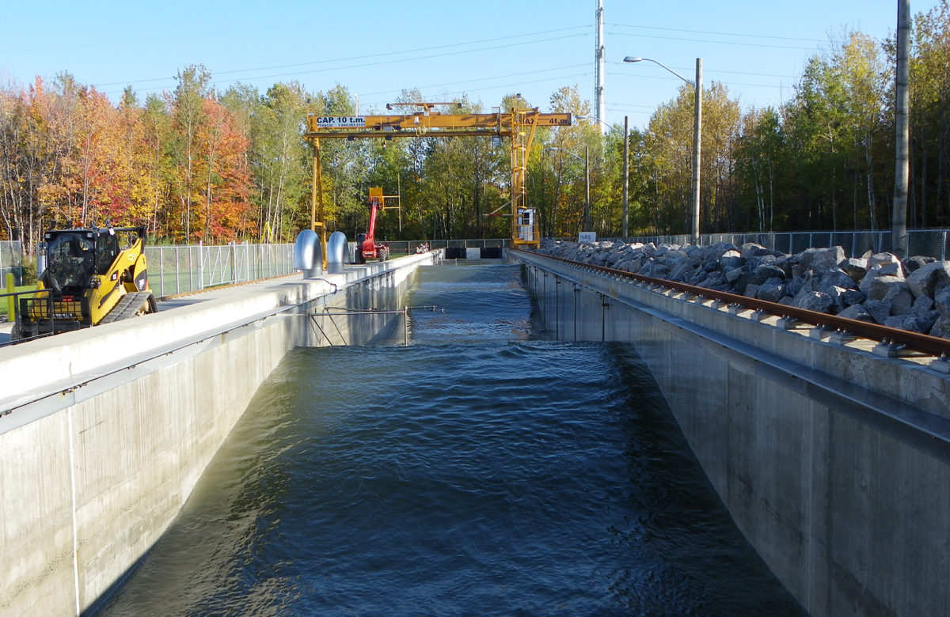
How do we study pattern and process?
We use models
Models are idealized representation of reality.
They isolate and simplify the pattern-process relationship to aid in our understanding

Slide 8
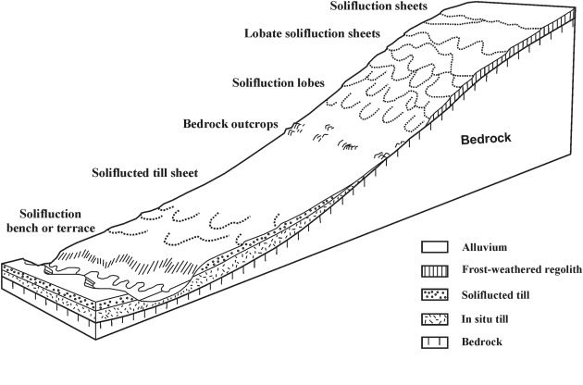
What are the types of models?
Graphical conceptual models like the drawing at right
Charts and graphs are models too

Slide 9
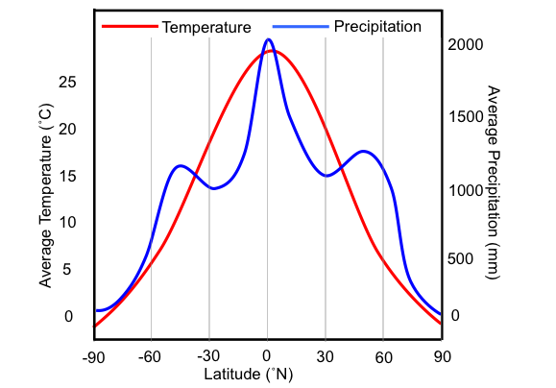
Charts and graphs are types of models

Slide 10
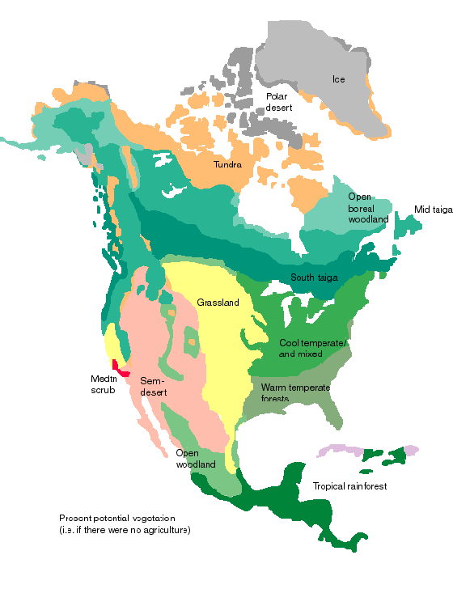
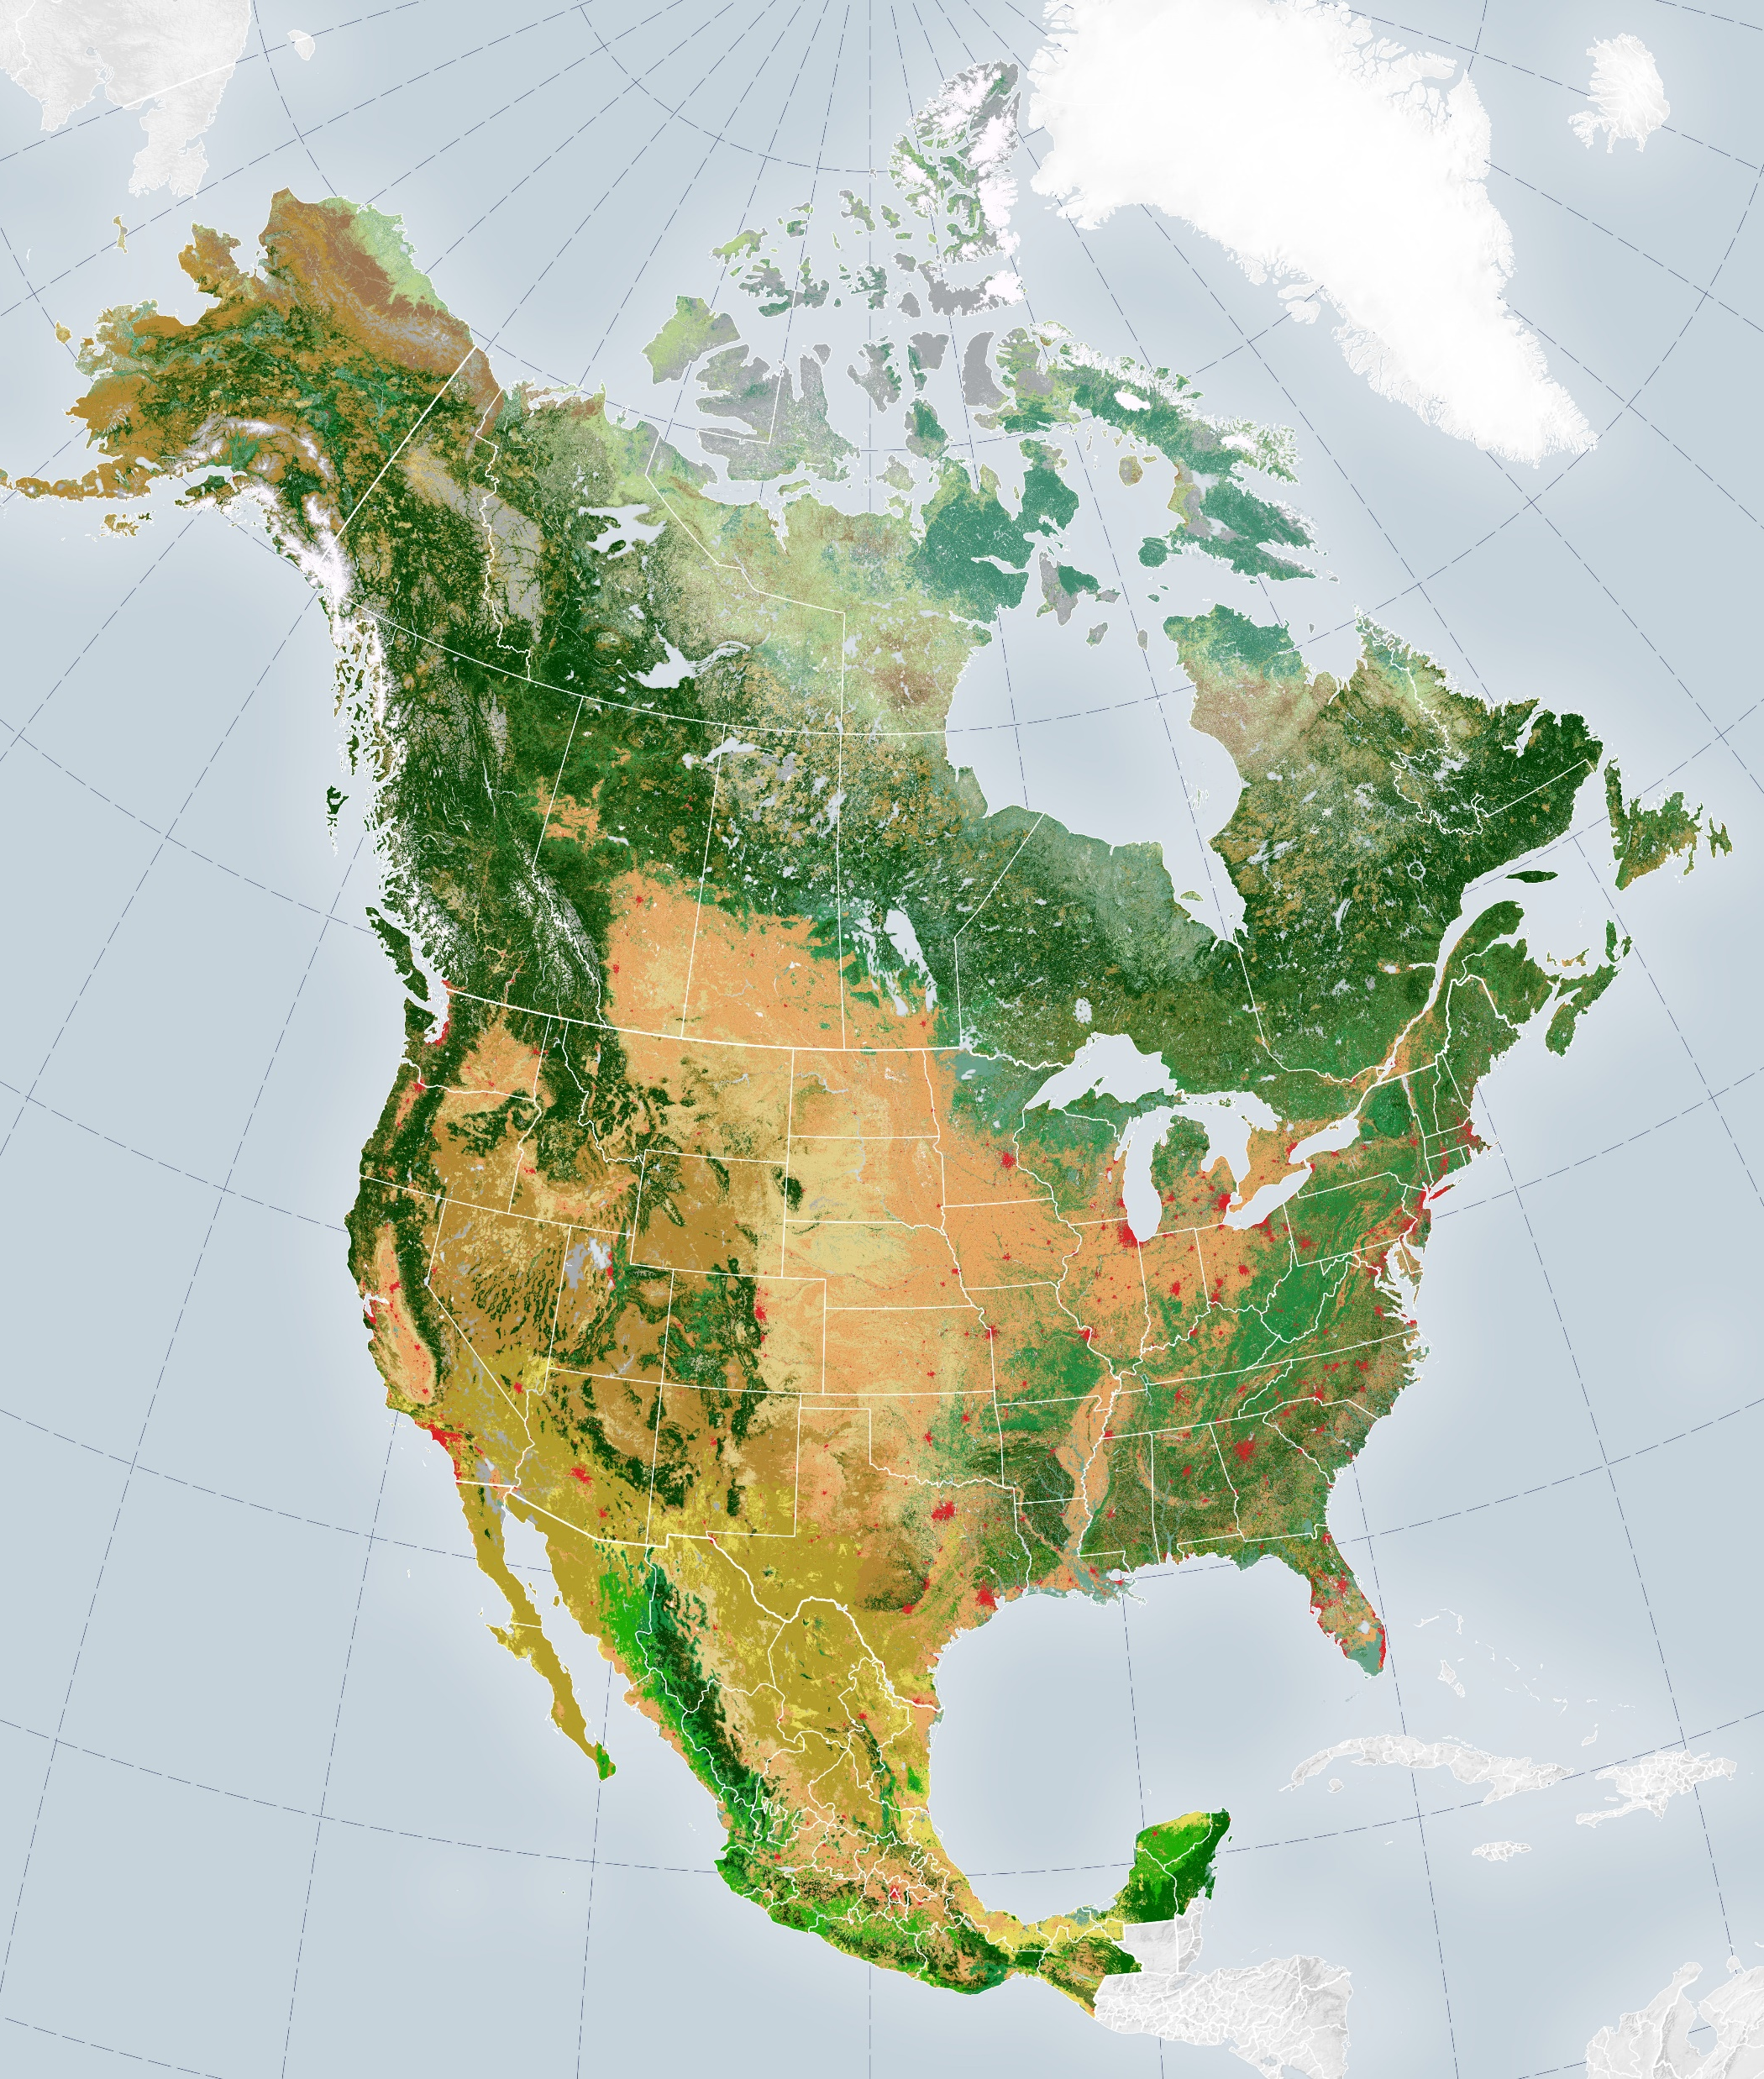
Types of models
Maps and photos are also models
Many other types of models:
  Computer simulations
  Animations
  Mathematical model

Slide 11
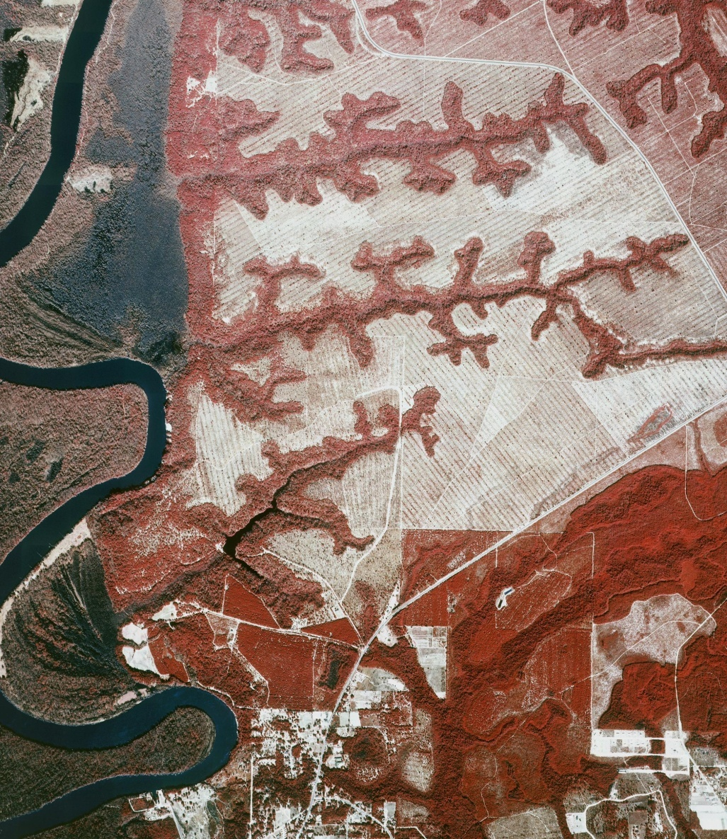
What complicates the study of pattern-process?
Multiple interacting variables
Contingencies
Feedbacks
Spatial and temporal scale
Threshold dynamics
Teleconnections
Different types of change in open systems
Notes:
It is difficult to model the phenomena of physical geography because it is an open system with many different interactions variables, different types of change, and challenges to interpreting pattern and process from the small, local and instantaneous to the global and across longer time intervals

Slide 12
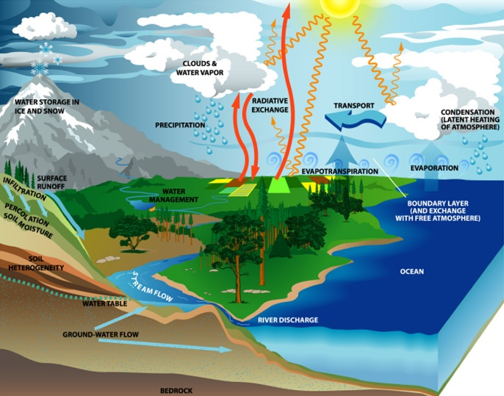
1. Multiple interacting variables in time and space, including human impacts
Notes:
If you were studying the distributional patterns of a tree species, river discharge, weather patterns, seasonality, proximity to coast, human impacts are all driving variables that interact to shape where it occurs in abundance

Slide 13
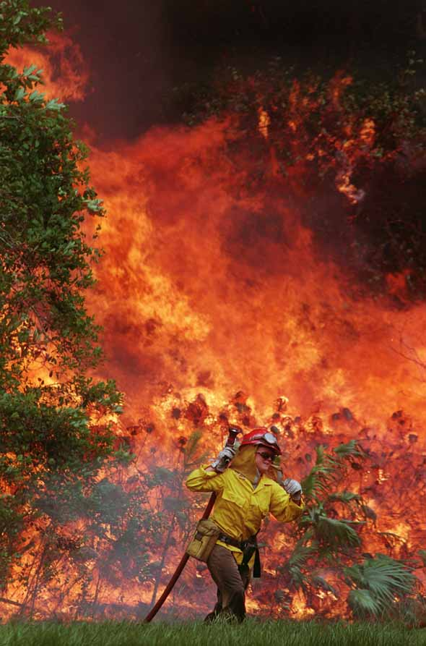
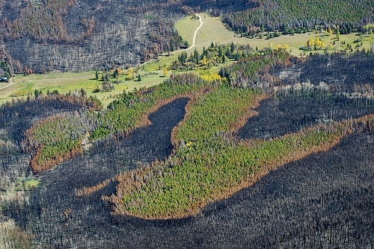
2. Contingencies – the role of chance
Notes:
What are the more predictable variables related to when and where wildfires occur? What are the more contingent variables?

Slide 14
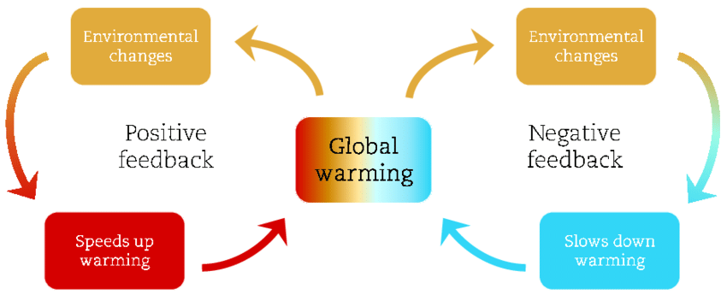
3. Feedbacks complicate the study of pattern and process
Positive feedback: externally generated change is reinforced
Negative feedback: externally generated change is minimized

Slide 15
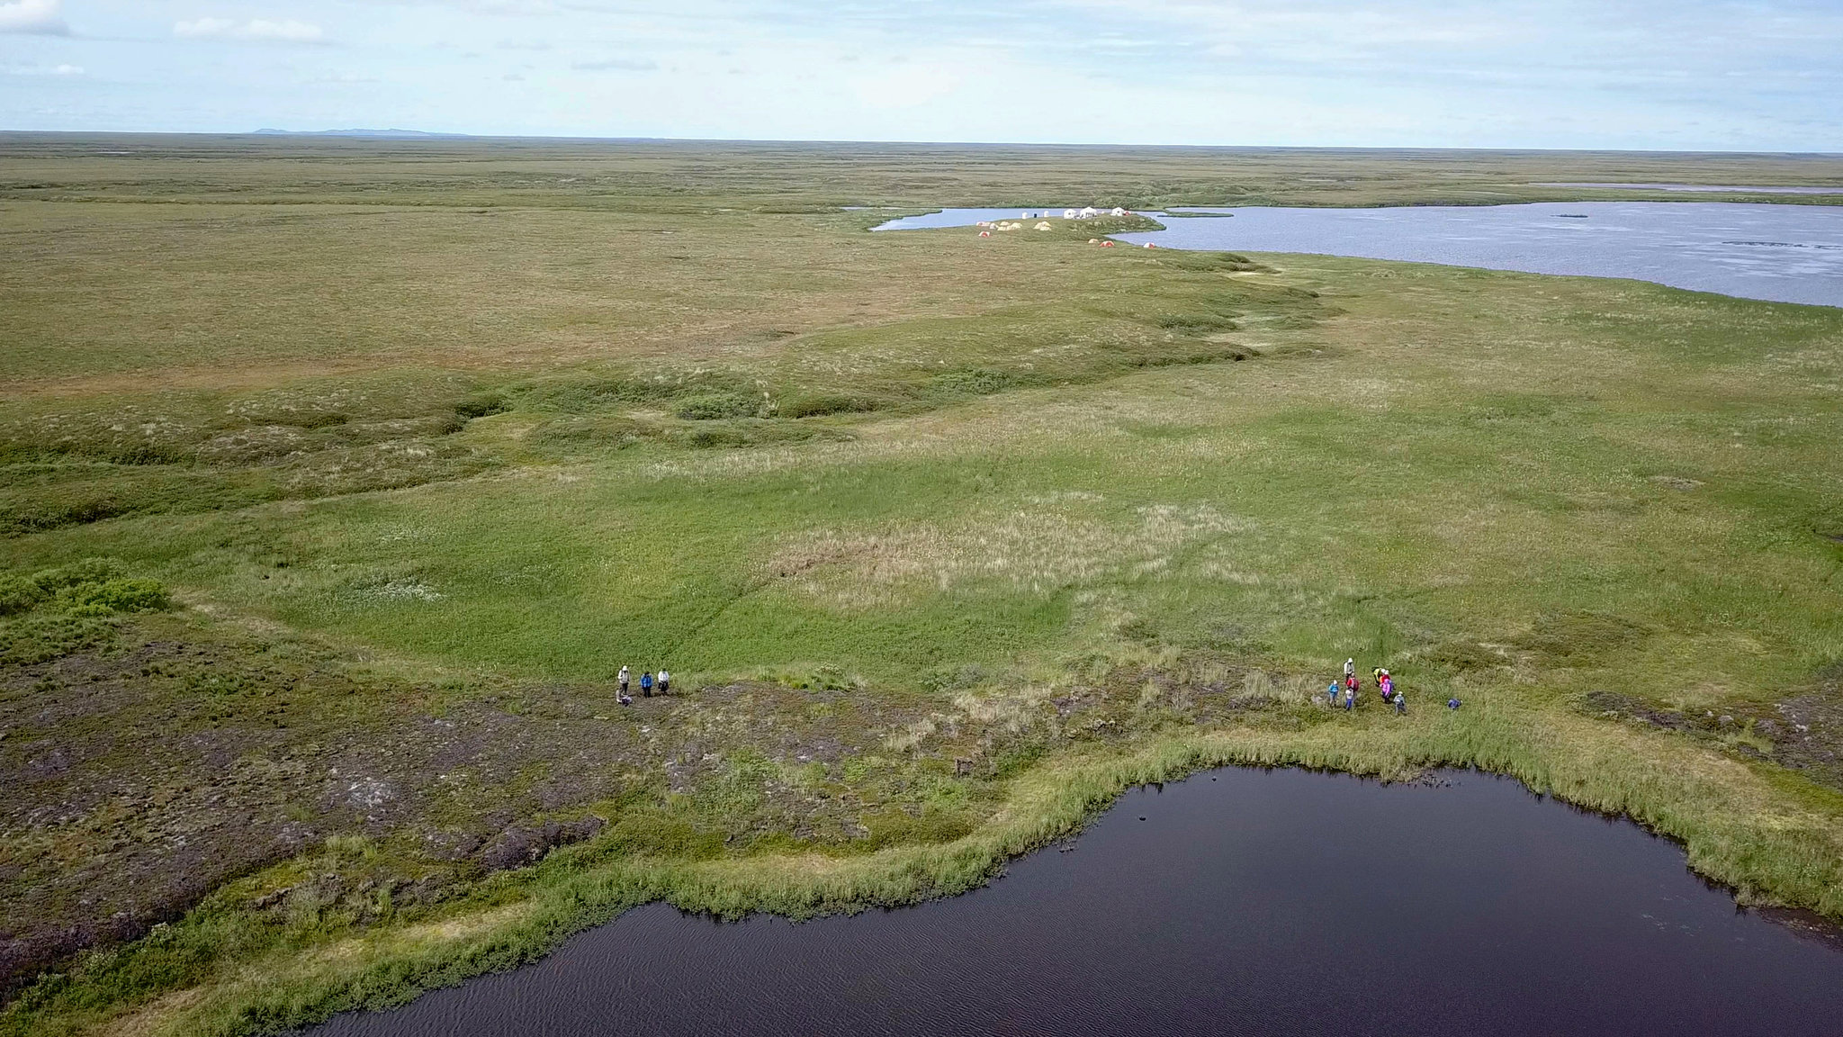
Alaskan Arctic
Notes:
Arctic Alaska

Slide 16
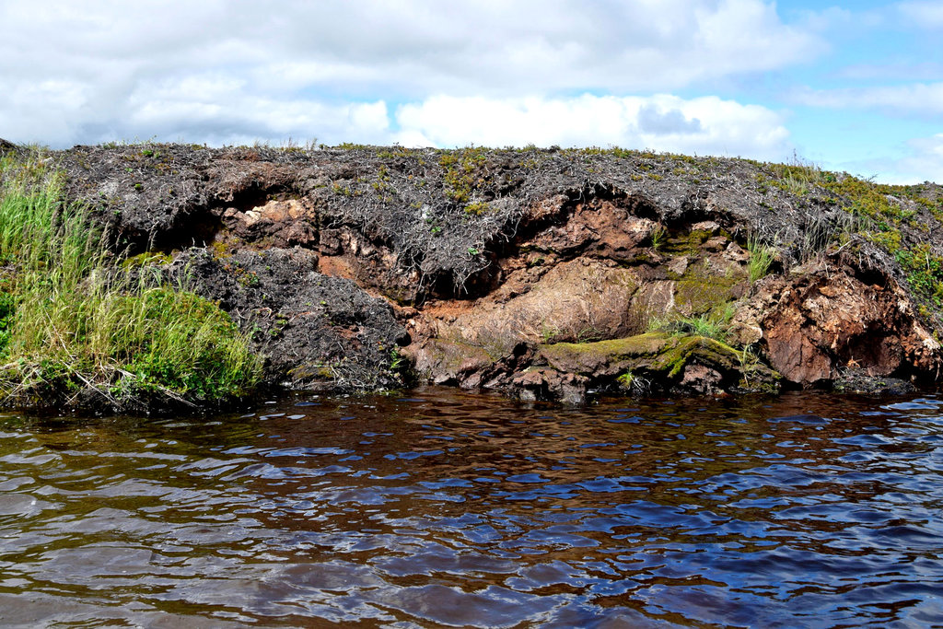
Permafrost

Slide 17
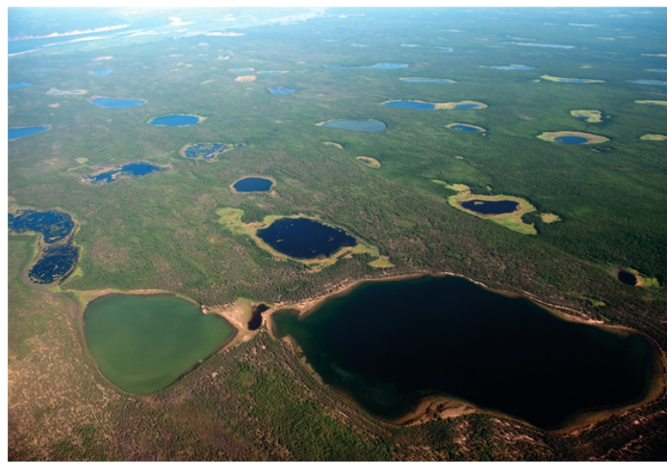
Thermokarst lakes
Notes:
Thermokarst lakes have positive and negative feedbacks associated with global warming.

Slide 18
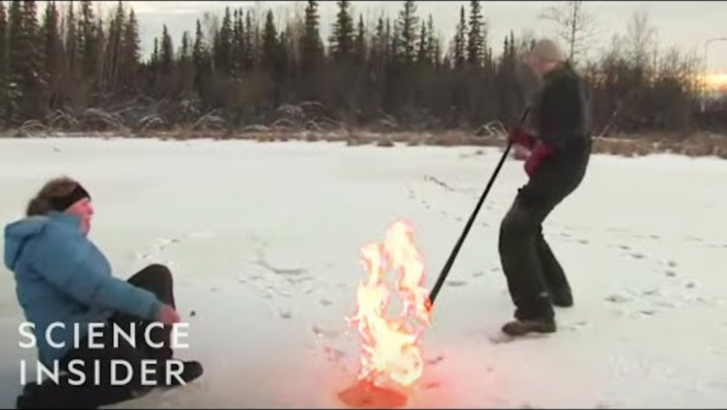

Slide 19
Examples of positive and negative feedbacks
Permafrost thawing initiates decomposition of organic matter in soil. This releases methane, which is a greenhouse gases (positive feedback).
Thermokarst lakes form from melting permafrost. These can become deep enough to store organic matter in sediments at their bottom in anoxic (low oxygen) conditions that prevent their decomposition (negative feedback).
Notes:
https://www.nytimes.com/interactive/2017/08/23/climate/alaska-permafrost-thawing.html

Slide 20
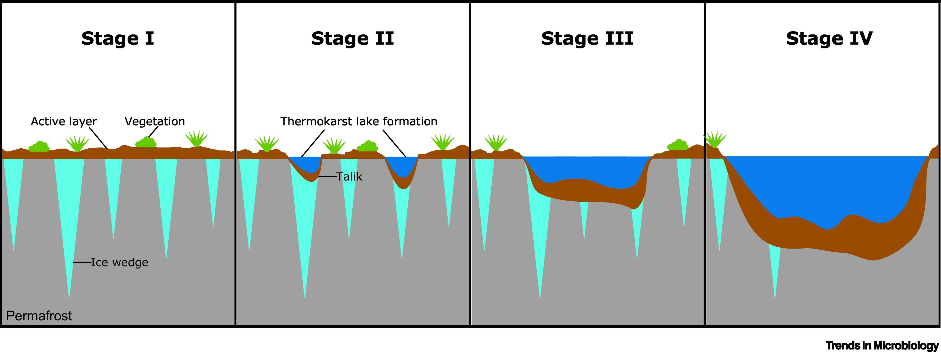
Notes:
Melting permafrost in the second and third stages leads to decomposition of soil organic matter by microbes in the soil and shallow lake sediments. These microbes are aerobic – they require oxygen but when they break down organic matter they produce methane, which are greenhouse gases. Thus the melting of the permafrost, the thawing of the soil, and the formation of shallow lakes sets up a positive feedback that increases the warming further.
However, with the formation of large deeper thermokarst lakes, these organic sediments can collect at the bottom of the lack where there is less oxygen and less microbial activity. This decreases the amount of methane they produce, thereby slowing the warming in a negative feedback. Plants may colonize the sides of the lake and they will take in carbon dioxide, thereby serving as a carbon sink and slowing warming. Phytoplankton in the water photosynthesize in the presence of nutrients like phosphorous and nitrogen, that are now available as the permafrost thaws. This too may help slow the release of carbon dioxide.

Slide 21
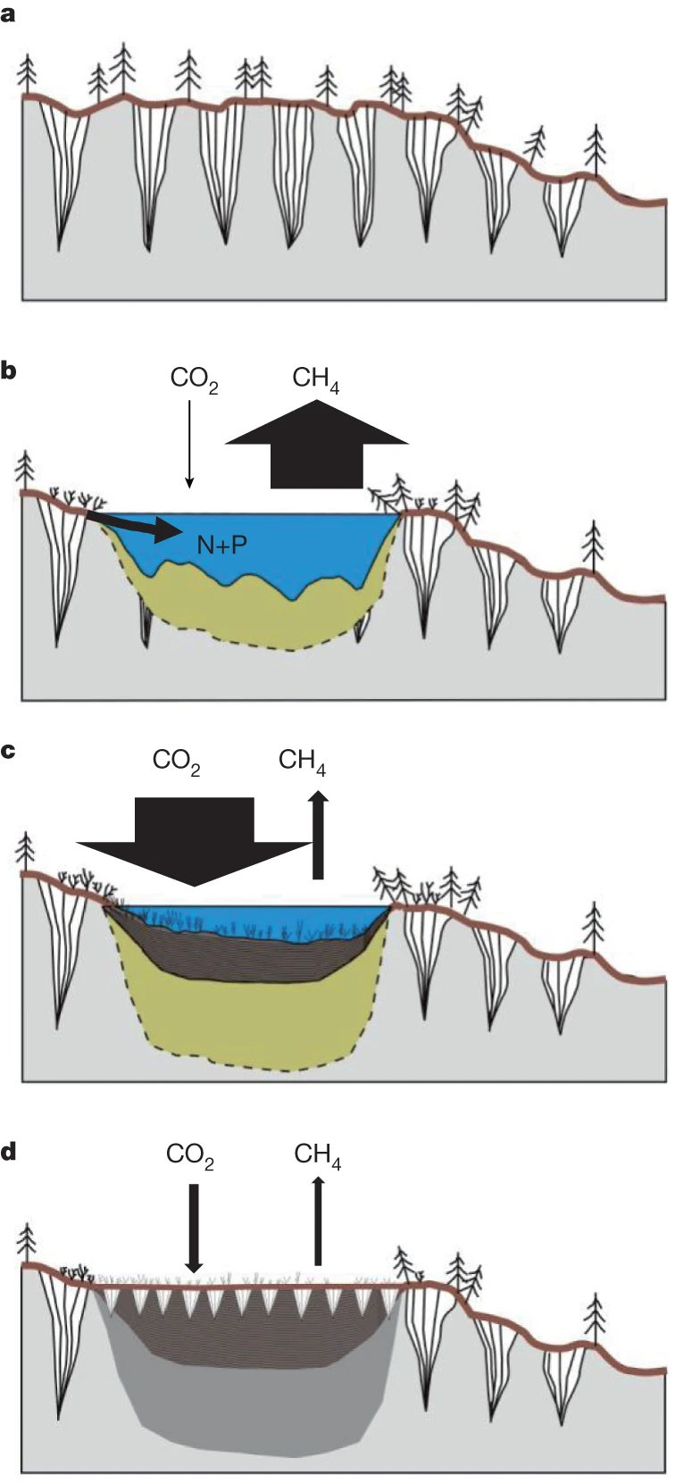
Positive feedbacks dominate in the first two sketches (a and b) as permafrost begins melting
Negative feedbacks begin operating in the two sketches at the bottom (c and d) that can slow the rate of warming
Negative feedbacks will not be strong and pervasive enough to limit net global warming due to permafrost melting and the formation of thermokarst lakes
Feedbacks are ubiquitous in the environment and make the study of pattern and process more challenging
Notes:
https://www.nature.com/articles/nature13560

Slide 22
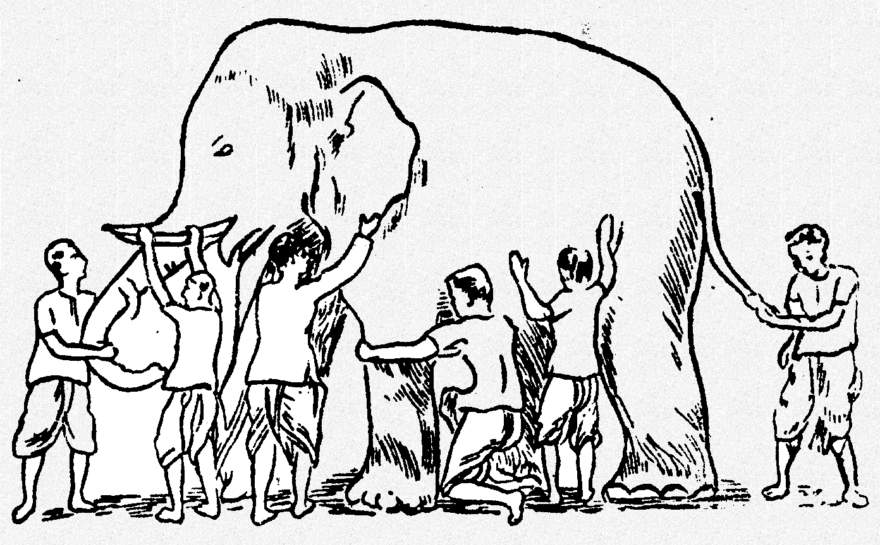
4. Patterns and processes occur across many different spatial and temporal scales
We can’t comprehend everything all at once – what we see or measure in time or space is scale dependent
For example, what makes the patterns of warm and cold temperatures?

Slide 23
The answer depends upon temporal and spatial scale
Cloud cover and humidity (minutes to hours)
Diurnal (day-night) cycles
Seasonal cycles (1 year)
Cyclical fluctuations due to sunspots (10-50 years)
Anthropogenic contribution of greenhouse gases (10-100 years)
Milankovitch orbital cycles (10,000 yrs)

Slide 24
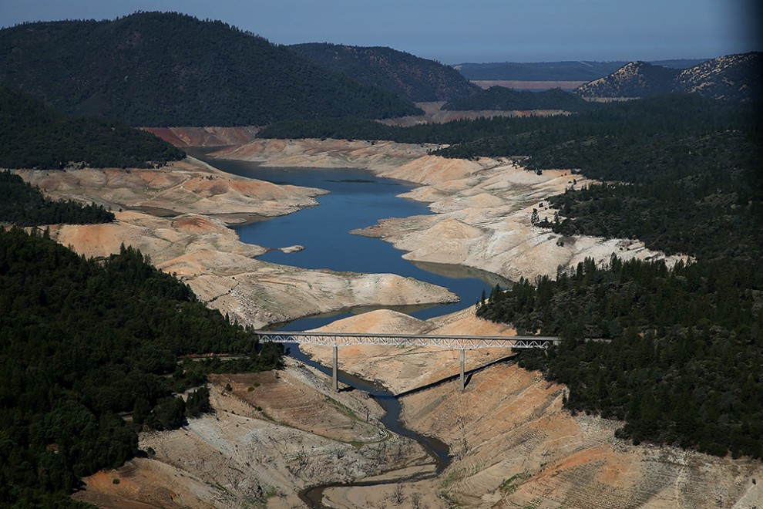
Notes:
California has experienced severe droughts in the last decade.

Slide 25
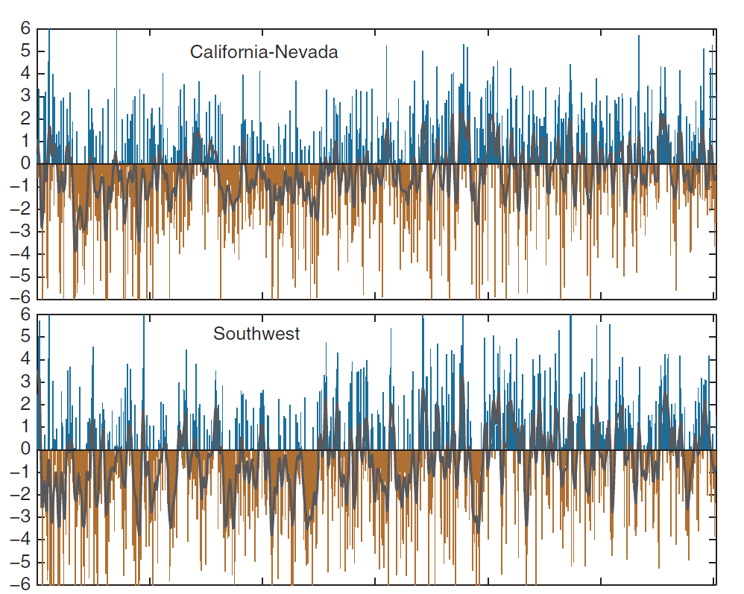
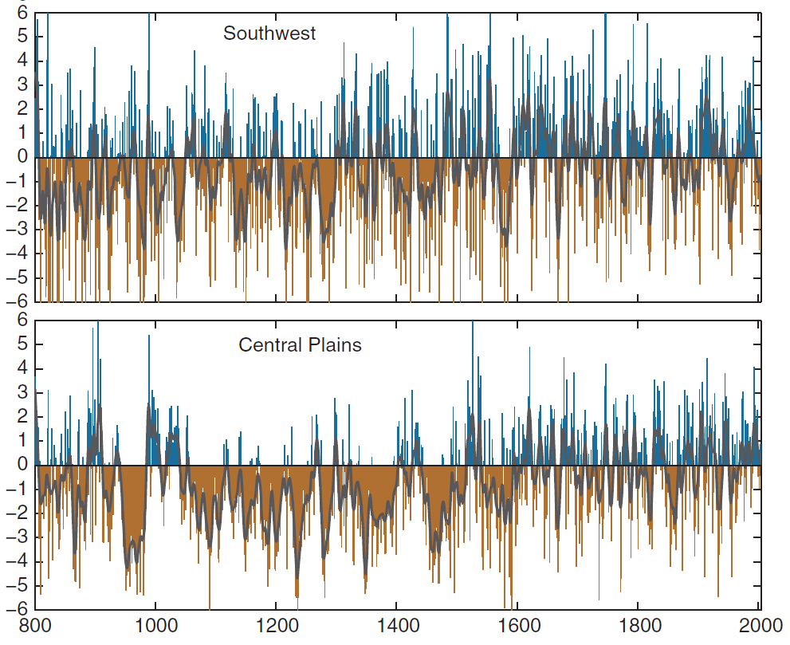
Wet
Drought index
Dry
Wet
Drought index
Dry
Notes:
When you look at a larger temporal scale, you see a different pattern than if you only consider the last decade
The western US was settled during the last 200 years. What can you tell me about the climate over that period? Was it wetter or drier than what the record shows over the last 400 years?

Slide 26
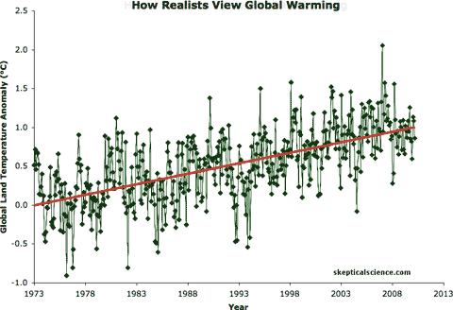

Slide 27
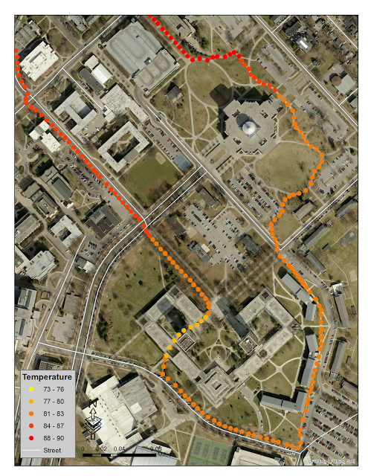
Notes:
Microclimates on the UK campus
This is a model, it is a representation of temperatures on campus. It is specifically a data visualization. You could also call it a map.

Slide 28
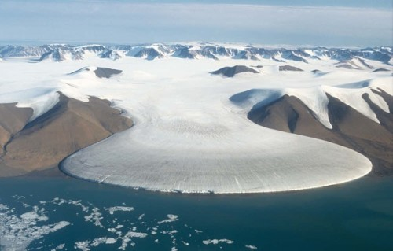
5. Thresholds also complicate inference of pattern and process
Notes:
Melting of Greenland ice sheet

Slide 29
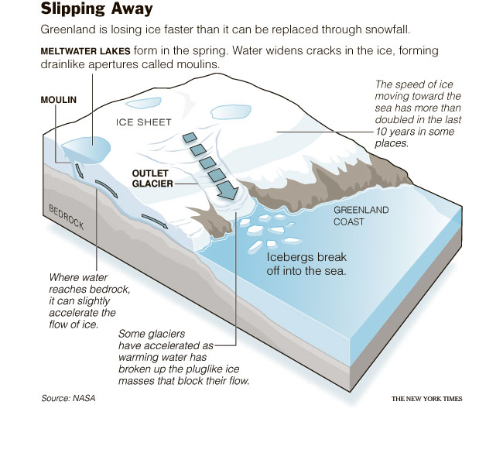
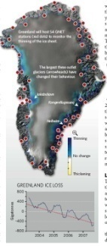

Slide 30
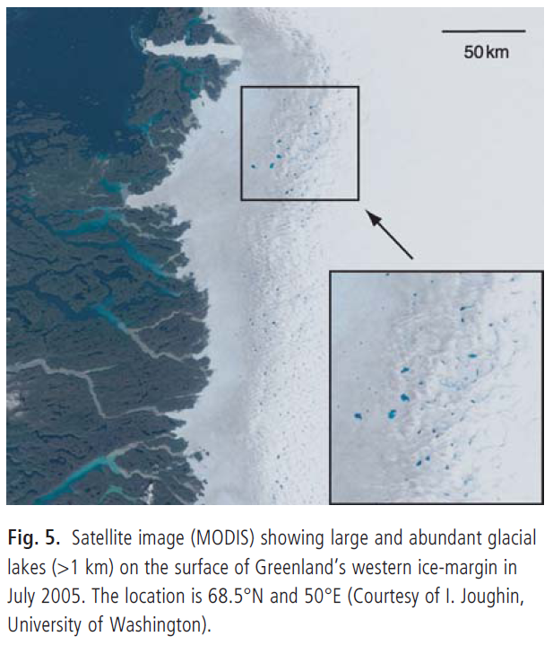
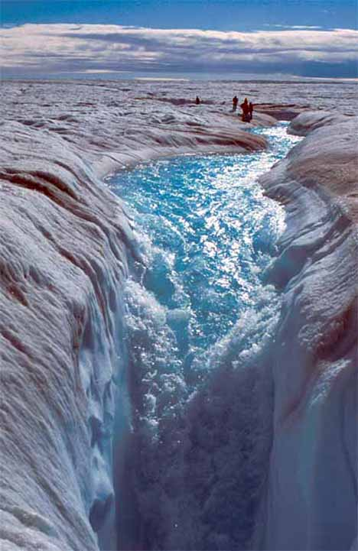
Supraglacial lake
Moulin
Notes:
http://www.youtube.com/watch?v=kYKKgn0GaY0&feature=related

Slide 31
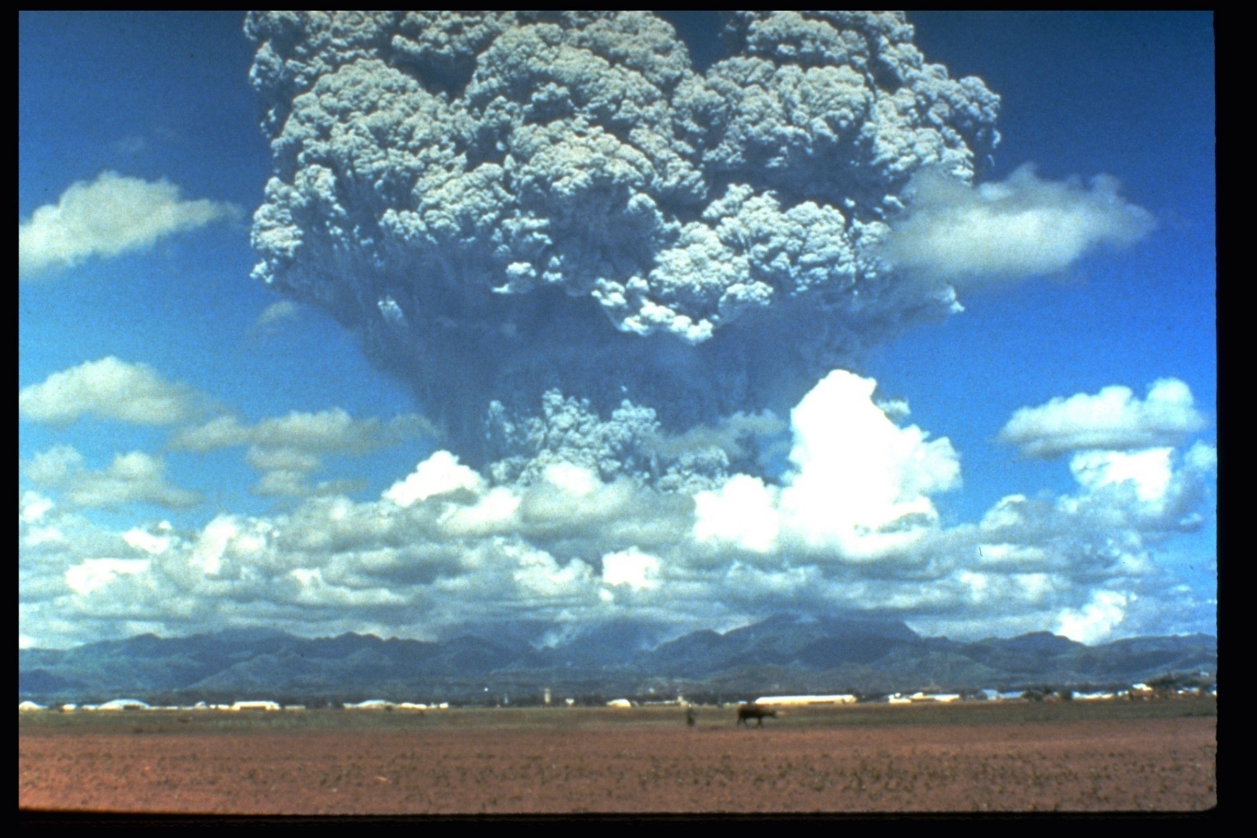
6. Teleconnections
Notes:
Teleconnections encompasses how events in one location can propagate through air, water, and the earth’s surface to shape patterns and processes in other places, often far away in space and later, after the triggering event

Slide 32
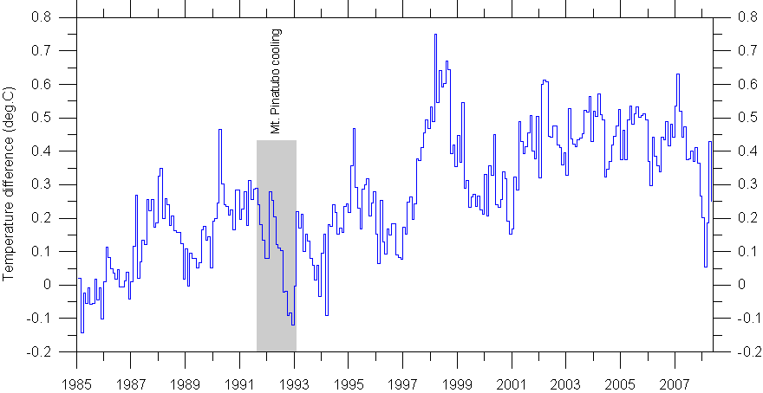
Notes:
Global monthly temperatures illustrating the effect of the June 1991 volcanic eruption of Mount Pinatubo in the Philippines. The temperature effect apparently lasted to the end of 1992, as indicated by the shaded area.
The Y axis represents the amount of temperature change, the difference in temperature from the historical average.

Slide 33
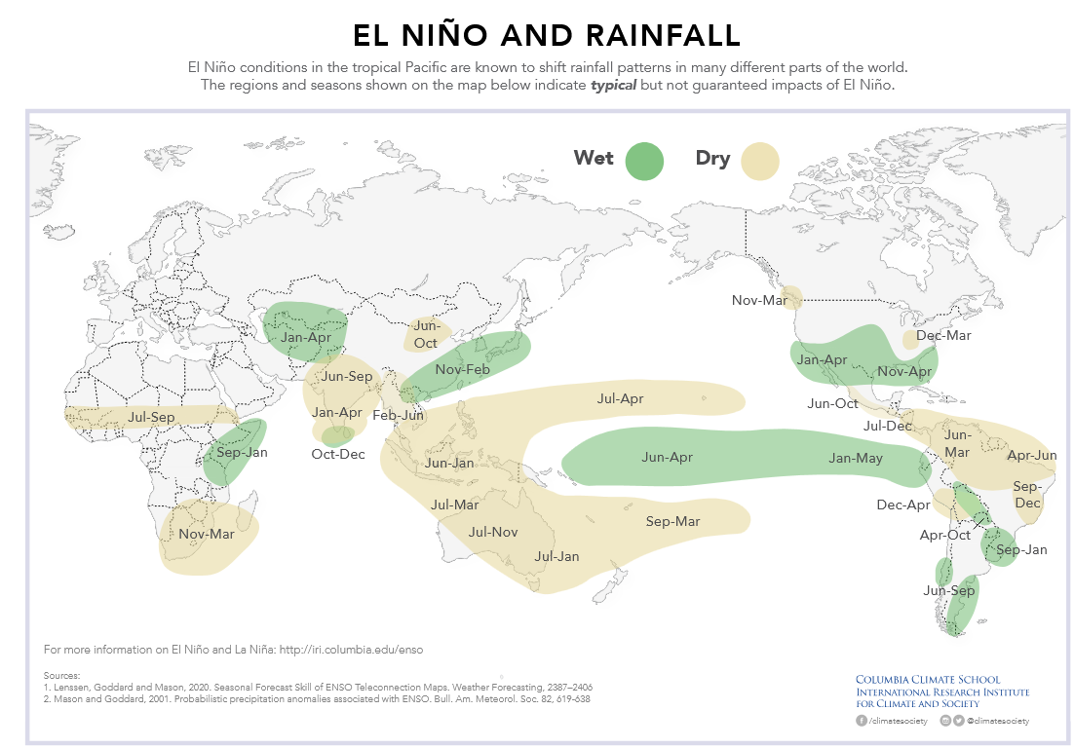
Notes:
El Nino initiates in the Pacific tropical ocean. However, the changes in water temperature in the Pacific associated with El Nino change rainfall and other weather patterns around the world. El Nino sets up these telectonnections.

Slide 34
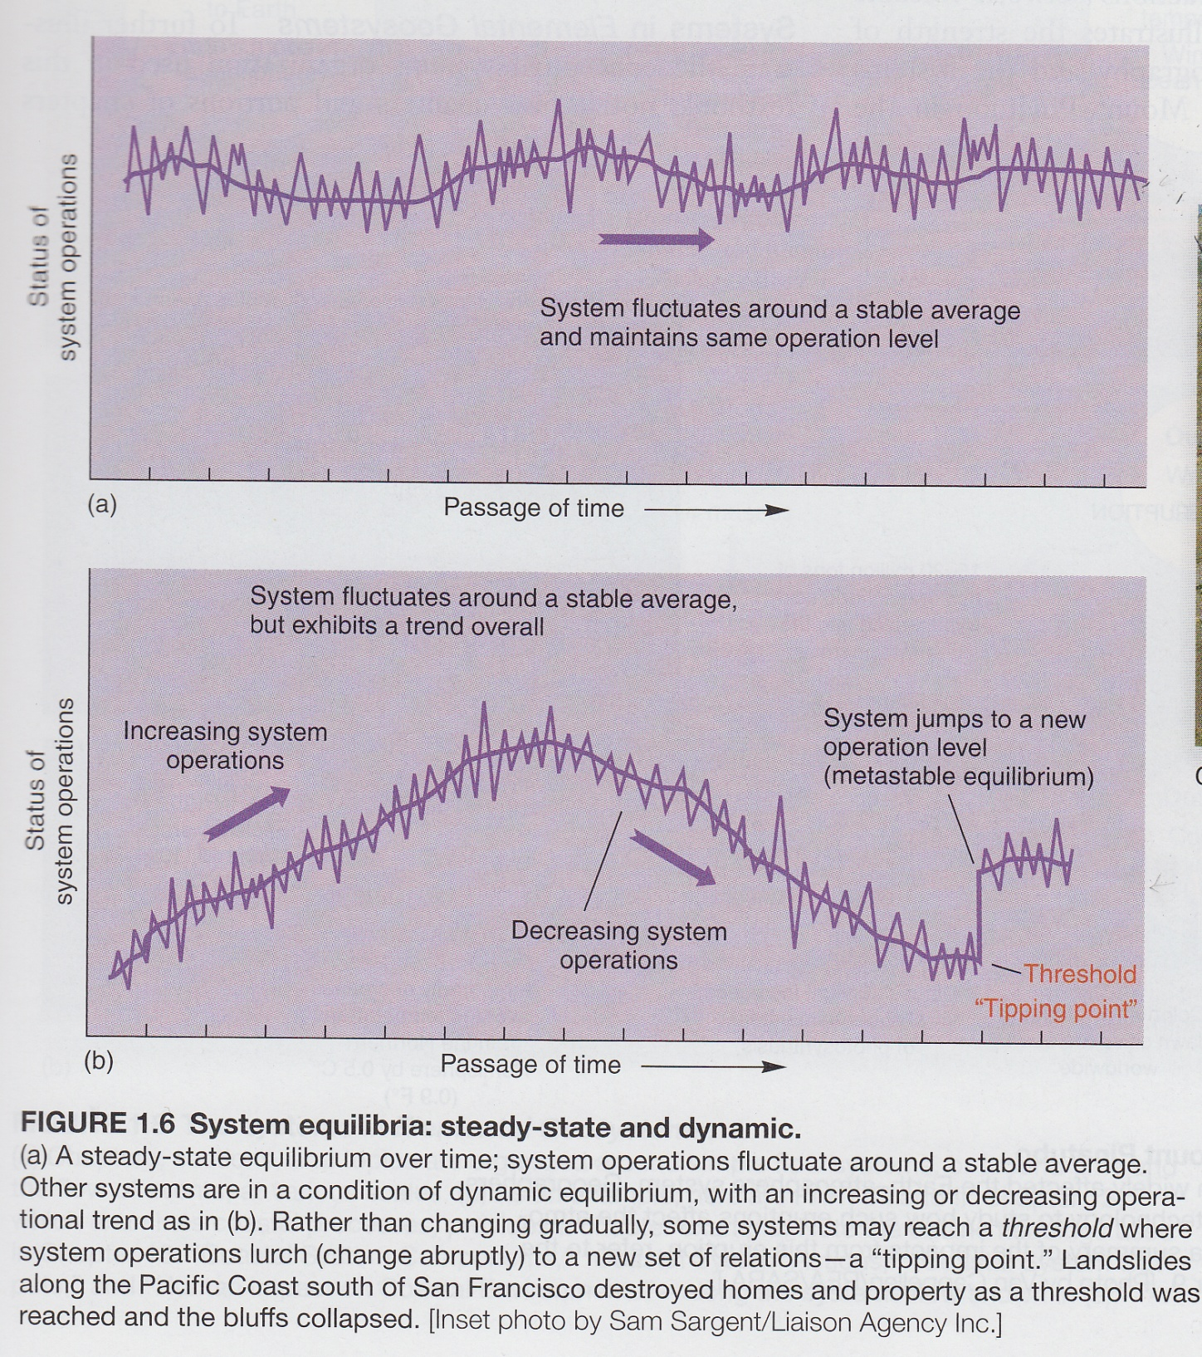
7. Different types of change in an open system
Steady state equilibrium
Dynamic equilibrium
Thresholds and tipping points

