Slide 1
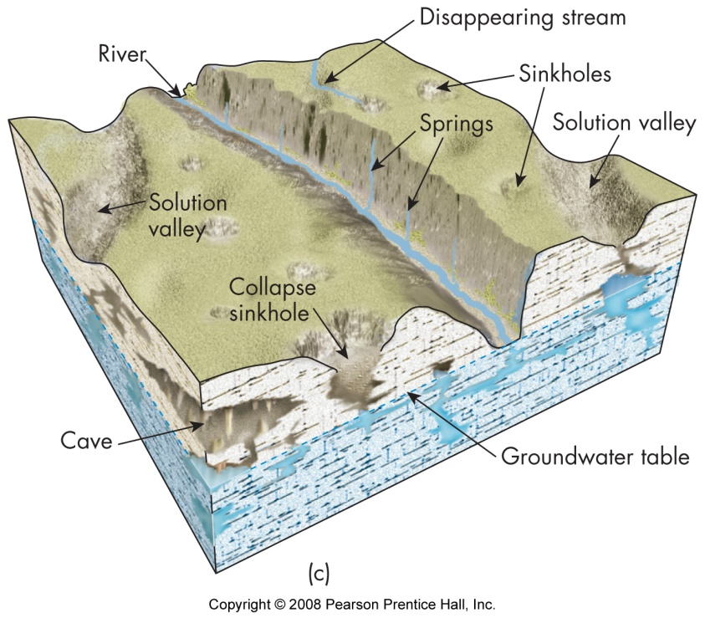
Karst as landscape and landform
A landscape underlain by limestone and chemically similar rocks, where surface topography and subsurface is shaped by carbonation, a chemical weathering process
Karst can also refer to the landforms that are formed through karstic processes
Notes:
Karst can also form through acidic water that percolates up from underground sources rather than through surface waters Epikarst refers to the near-surface layer of a karst landscape, typically characterized by enhanced dissolution and increased permeability due to the concentration of weathering processes. It acts as a transition zone between the surface and deeper karst systems. Exokarst refers to the visible, surface features of a karst landscape formed by the dissolution of rock at or near the surface. It includes a wide range of landforms that are often dramatic and visually distinctive.

Slide 2
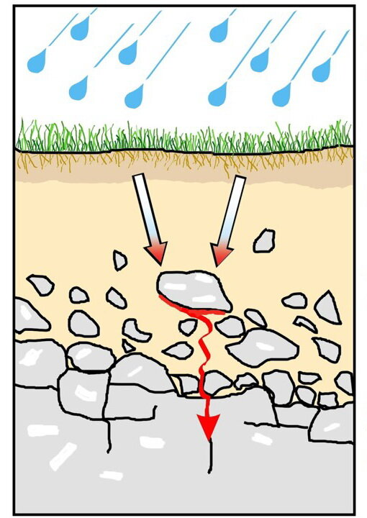
Carbonation begins when carbon dioxide dissolves in water within surface soils to form carbonic acid
When this slightly acidic water comes into contact with carbonate rocks like limestone, they are slowly dissolved and over time can weather large volumes of rock and create many different type of landforms.
Karst landforms best develop where there are carbonate rocks, warm climates, and ample precipitation
Notes:
Karst can also form through acidic water that percolates up from underground sources rather than through surface waters

Slide 3
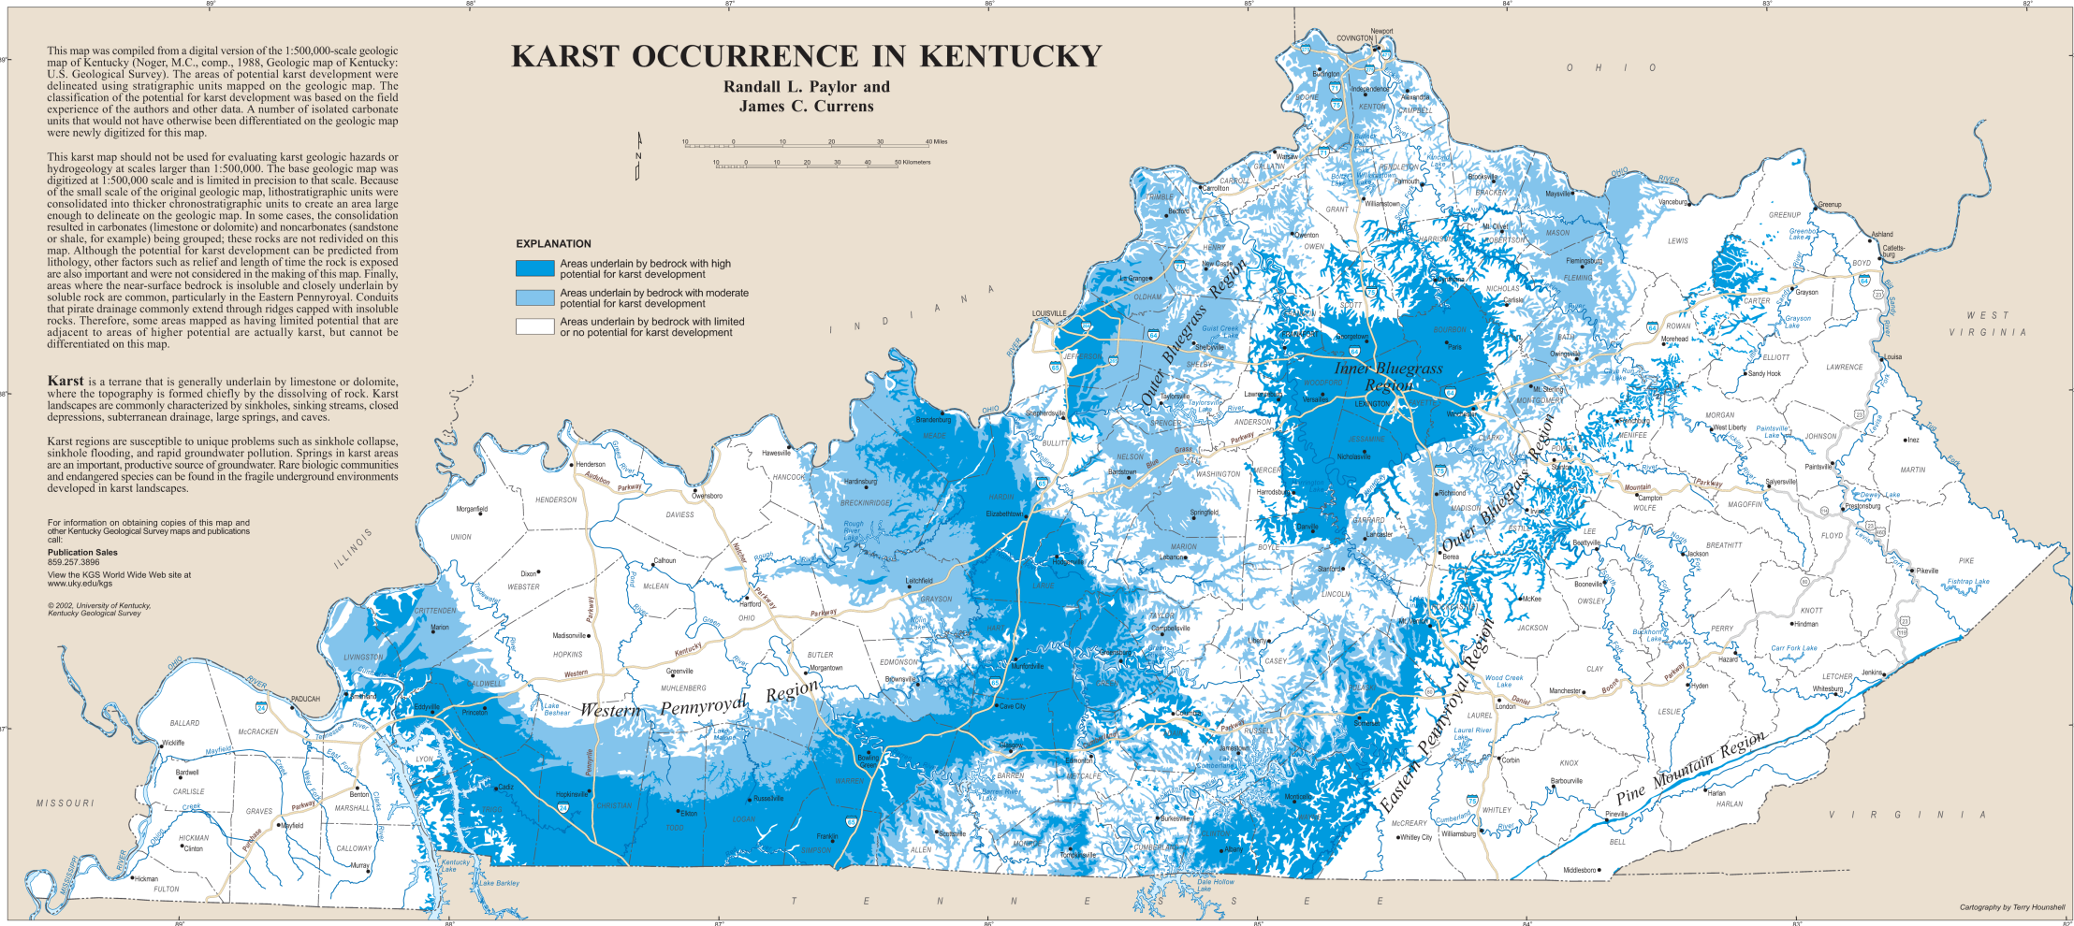

Slide 4
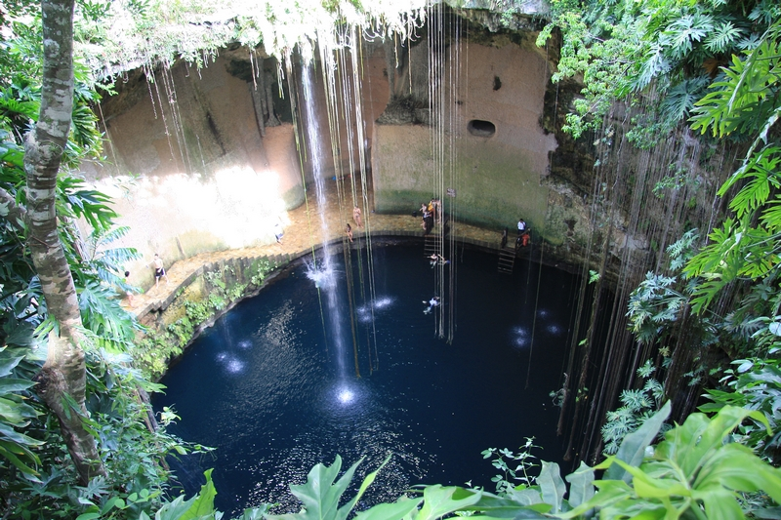
Sinkholes
Various names depending upon language and culture, can also be known as dolines (parts of Europe or cenotes (Mexico).
Notes:
Cenotes (Yucatan state, Mexico)

Slide 5
Notes:
Karst plain, Central Kentucky

Slide 6
Notes:
https://www.engr.uky.edu/news/2019/03/kgs-jacobs-collaborate-sinkhole-machine-learning-research Sinkholes in blue. There are lots of sinkholes in Kentucky because it has all the ingredients necessary for a karst landscape to form.

Slide 9
Notes:
Located in the heart of campus, W.T. Young serves as the central library in the university library system. Stormwater from this approximately 20 acre site primarily discharges via the University storm sewer system and travels to a larger LFUCG culvert that discharges to Town Branch. In the event that flows exceed the capacity of the lines leading to the LFUCG culvert, this system has been designed with two large detention basins (North and South) with a sink hole located at the base of each basin. As flow begins to back up into the detention basins, it diverts to the sink holes as a secondary point of discharge. Most rainfall events will bypass the sink holes and discharge to Town Branch via the LFUCG system. https://www.uky.edu/env/groundwater/class-v-injection-wells An injection well is a well that is used to place water and fluids underground into porous geologic formations. Regulated by the Safe Drinking Water Act, these wells are subject to federal requirements in order to protect public health and prevent contamination of underground sources of drinking water. The EPA regulates injection wells. Injection wells are grouped into six categories or classes based on use. Class V wells are used for the injection of Non-Hazardous fluids into or above underground sources of drinking water. At the University, Class V wells are used to discharge stormwater from portions of campus into existing modified sinkholes.

Slide 10
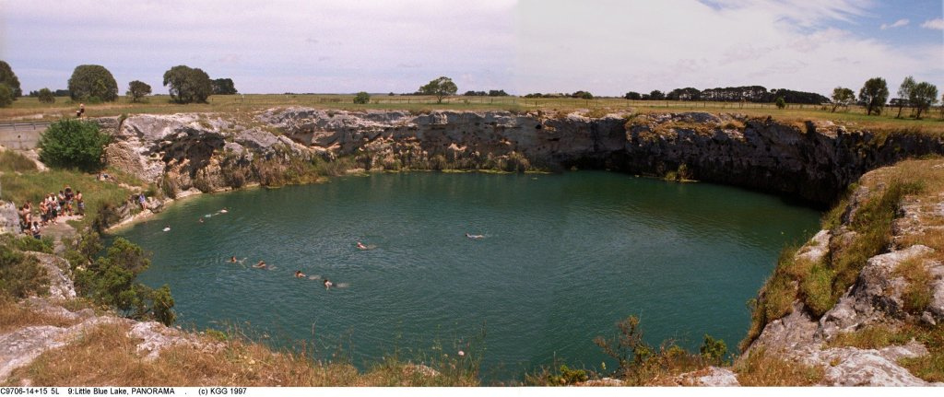
Notes:
Collapse doline with water-table lake in Gambier Karst, South Australia

Slide 11
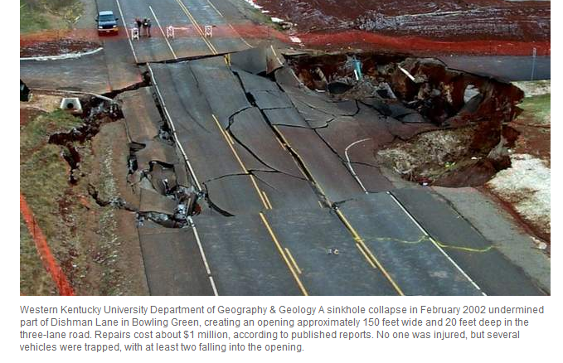

Slide 14
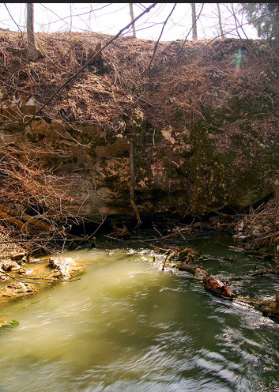
Fluviokarst landscapes and landforms
Shaped by both fluvial processes and karst processes.
Disappearing streams return to vadose passages
Blind valleys develop where a river abruptly disappears underground, usually into a sinkhole, rather than flowing to a visible downstream location.

Slide 15
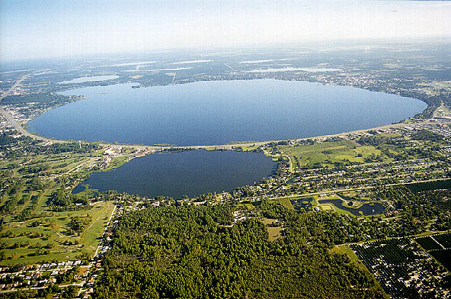
Karstic lake (Tallahassee, FL)
Notes:
Lake Jackson, near Tallahassee, Florida This is an example of a karstic lake

Slide 16
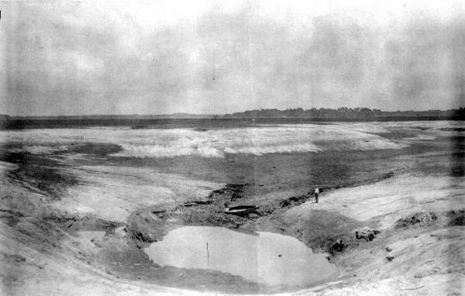
Notes:
This photo of Lime Sink was taken on 20 July 1932, over a week after the drawdown, which occurred over the night of 9-10 July.

Slide 17
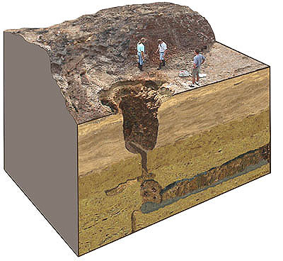
Notes:
When Lake Jackson’s sinks rupture and the lake water drains out, the process is referred to as a dry down. It has occurred many times during the last century.

Slide 18
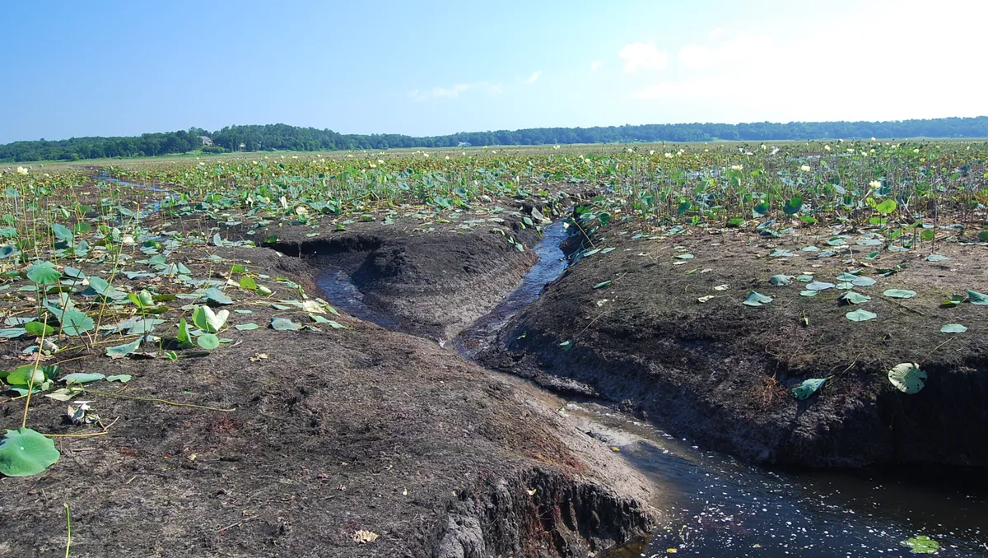
Lake Jackson emptied

Slide 20
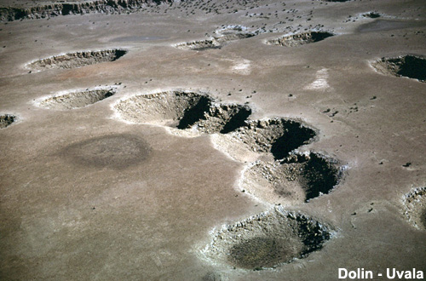
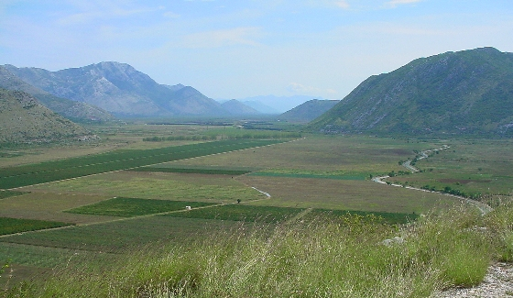
Uvalas and poljes
Uvalas (top)
Compound sinkholes, coalescence of many smaller sinkholes
Poljes (bottom)
Broad flat alluvial floor formed from coalescence of uvalas

Slide 21
Clints and grikes
Corrosive drainage along joints and cracks in the limestone can produce slabs called "clints" isolated by deep fissures called "grikes“ Photo of is from County Clare, northwest Ireland)

Slide 22
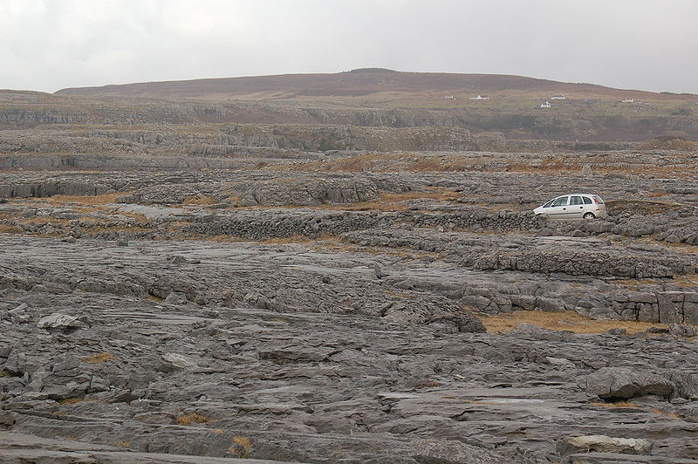
Notes:
Karren landscape composed of clint and grike features in limestone (County Clare, northwestern Ireland, the Barrens).

Slide 23
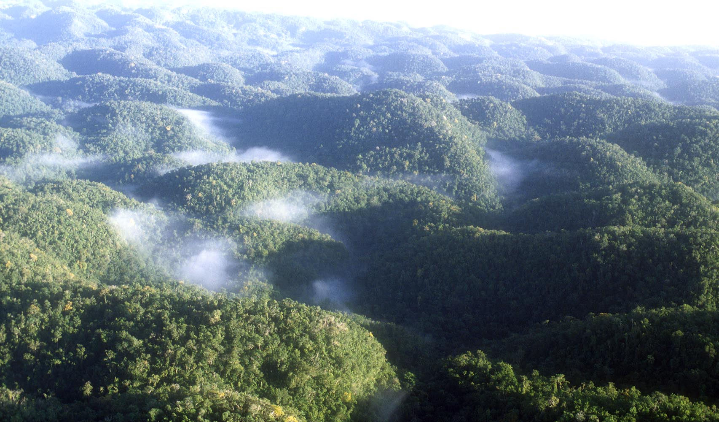
Cockpit karst (Jamaica)
Notes:
Cockpit karst, Jamaica

Slide 24
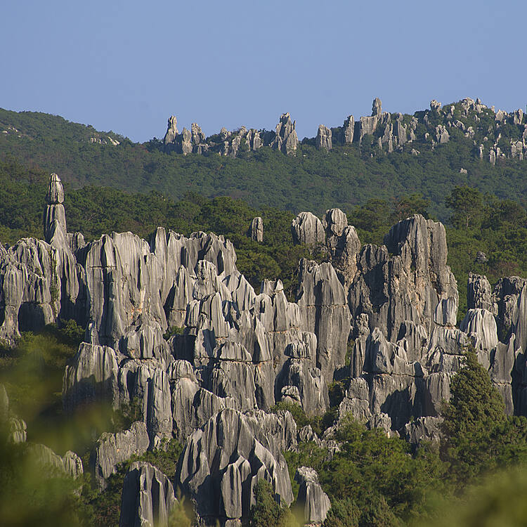
Tower karst, Guangxi province of southern China
Karst towers, China
Notes:
Tower karst, Guangxi province of southern China https://whc.unesco.org/en/list/1248/

Slide 25
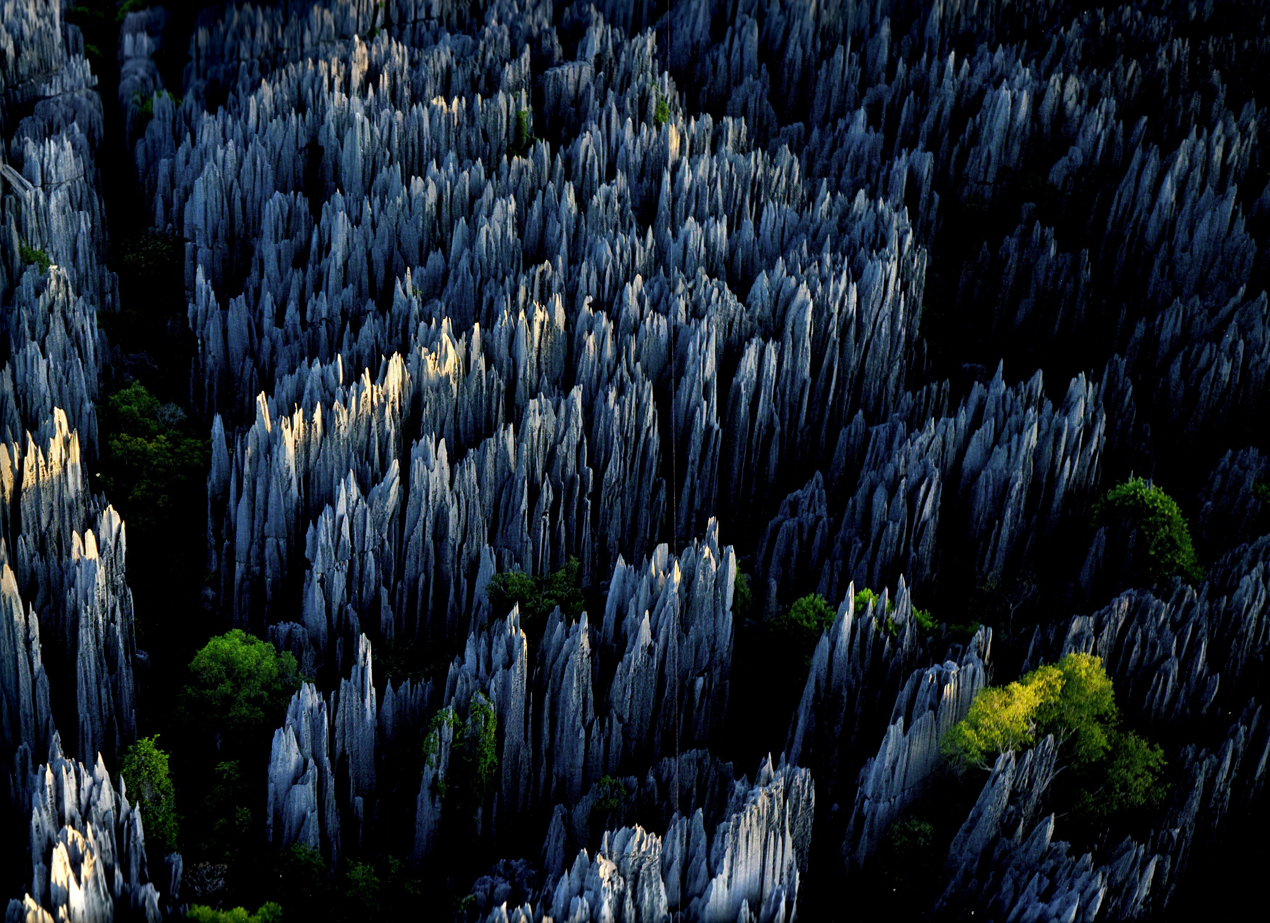
Tower karst, Madagascar
Notes:
Tower karst, Madagascar

Slide 26
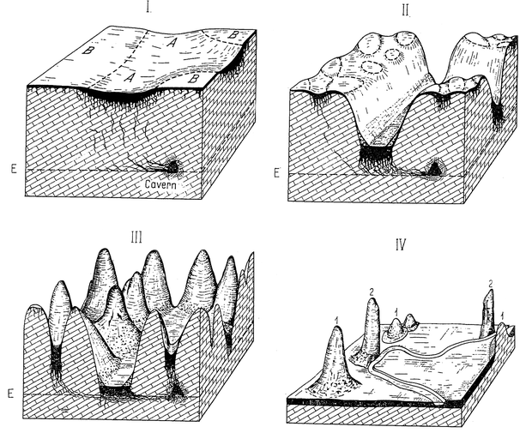

Slide 27
Caves, a karst landform
Notes:
Mammoth Cave National Park

Slide 28
Type of cave passages related to location relative to the vadose and phreatic zone
Notes:
Surface and subsurface water

Slide 29
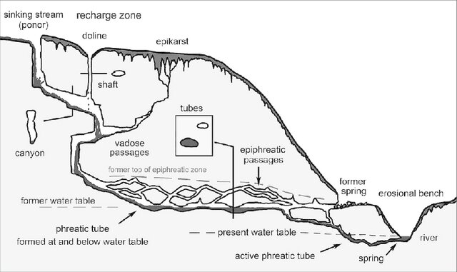
Notes:
vadose passages – formed via surface water epiphreatic passages – formed in phreatic zone but because of water table lowering are now air-filled phreatic tube – contains flowing water Water tables fluctuate through time, so it is possible to have a passage that has been wet and then dry and then wet again, depending upon the local geology and position of the cave relative to the water table

Slide 30
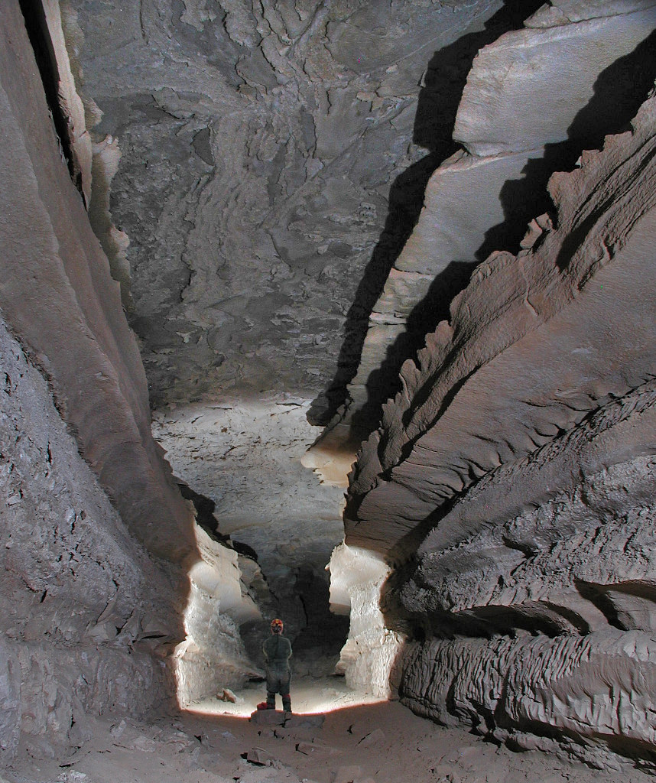
Types of cave passages
Vadose passages form above the water table in the vadose zone, where water flows mainly vertically due to gravity, through cracks and fissures.
Dominated by downward percolation of water.

Slide 31
Vadose passage
Notes:
Vadose passage

Slide 32
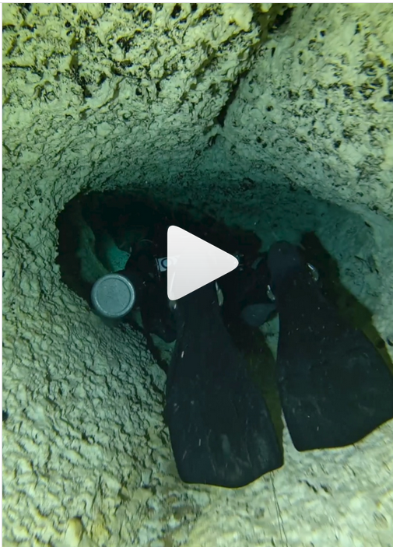
Phreatic passage
Phreatic passages form entirely below the water table in the phreatic zone, where water flow is primarily horizontal and under pressure. Circular or elliptical cross-sections, often forming tunnels. Water dissolves the rock evenly in all directions, creating smooth passage walls.
Notes:
https://www.instagram.com/maurocaveworld/reel/DDN7JxXRAnz/

Slide 33
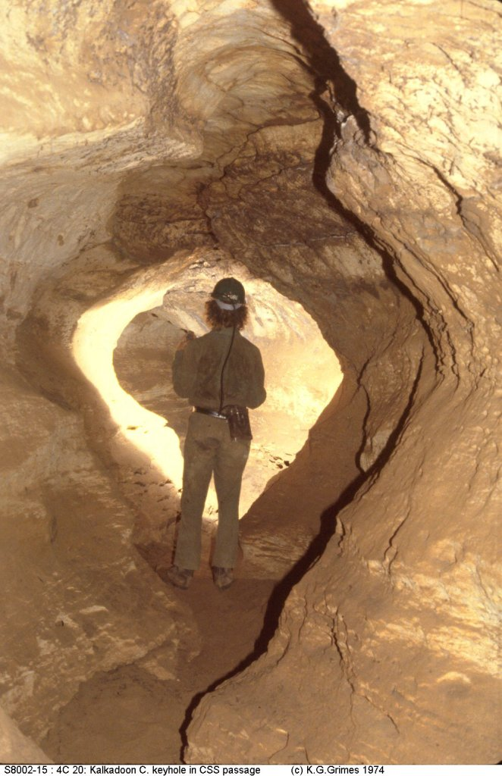
Epiphreatic passages
Phreatic passages that fill with air to air when the water table drops are known as epiphreatic passages.
The smooth walls and circular to oval shapes indicates a formation when below the water table.
If water flows on the floor of an epiphreatic passage it can develop a keyhole shape

Slide 34
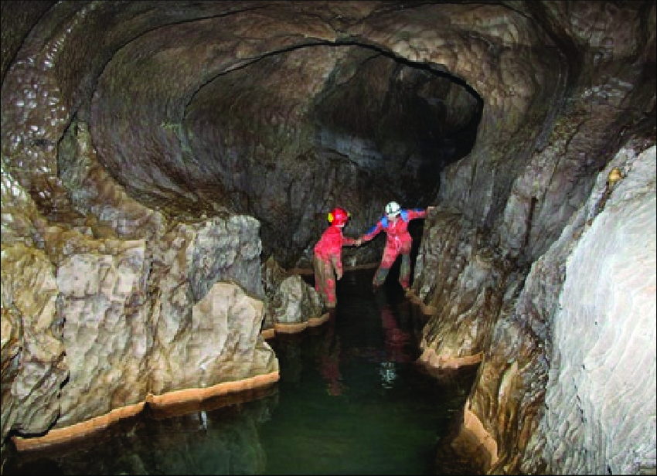
Keyhole shape of an epiphreatic passage
Notes:
Keyhole shape of the epiphreatic zone

Slide 35
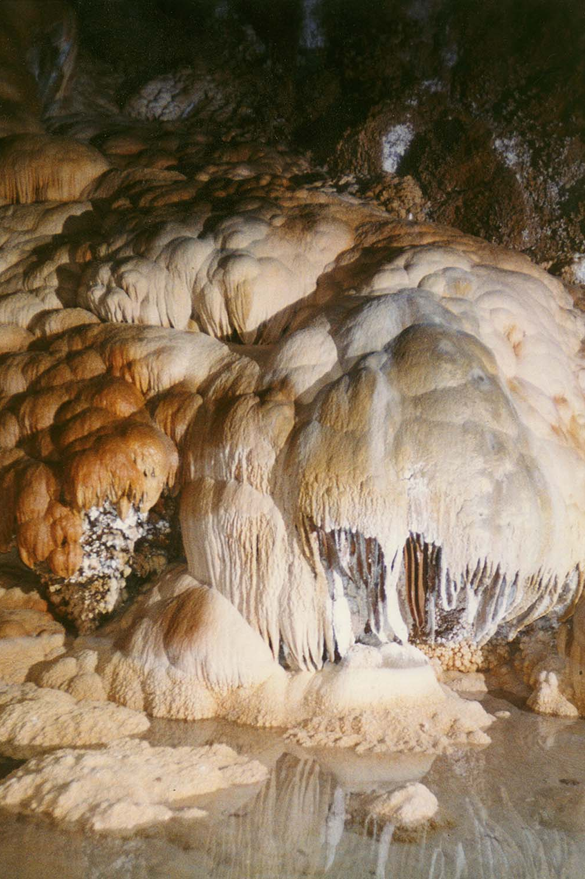
Speleothems
Speleothems is the name now used for stalactites, stalagmites, and similar cave features
Speleothems form only when caves are exposed to air either in the vadose zone, or when a former phreatic passage is exposed to air when the water table drops
Carbonate minerals precipitate out of water dripping in the cave to create these features
Notes:
Speleothems is the name given to stalactites and stalagmites. Speleothems form from the precipitation of minerals out of solution when caves are dry. They will not form underwater, so the only type of cave they can form in is a vadose passage. Right, this passage formed as a phreatic cave and is now above the water table in the vadose zone.

Slide 36
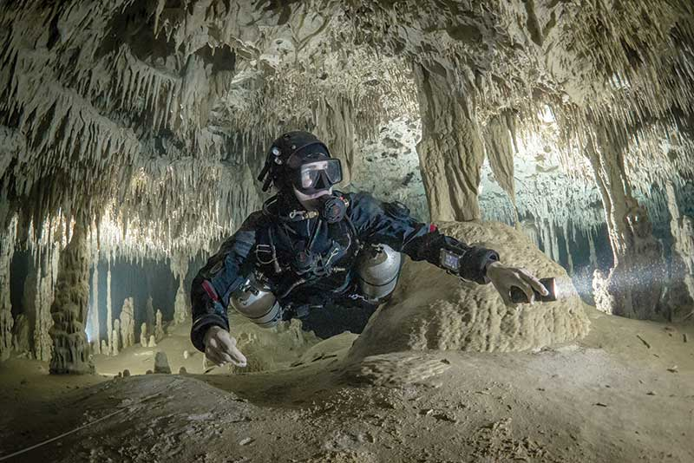
Notes:
This passage had to be exposed to air for a period of time for the speleothems to form. Then the water table rose and refilled the cave. Fluctuations in water table position give caves and their passages their defining shape and features.

Slide 37
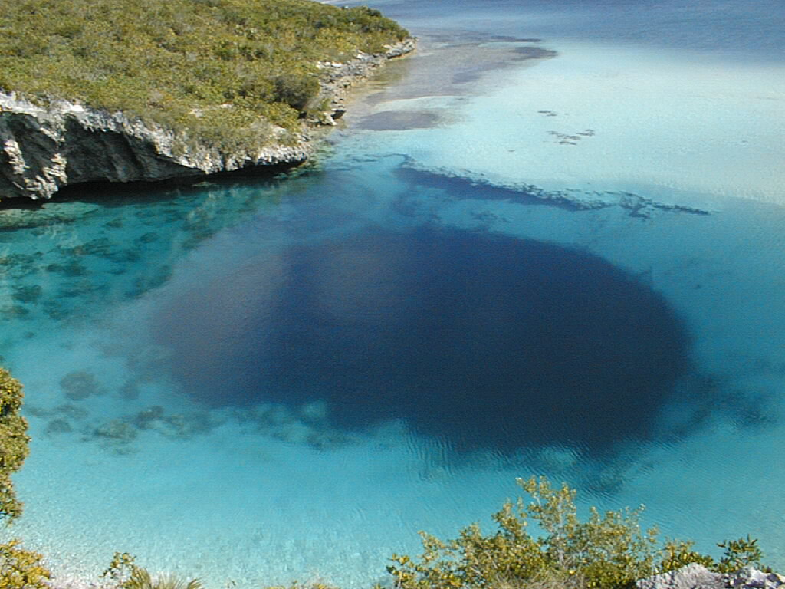
Blue hole (Bahamas)
Notes:
Blue hole, Bahamas

Slide 38
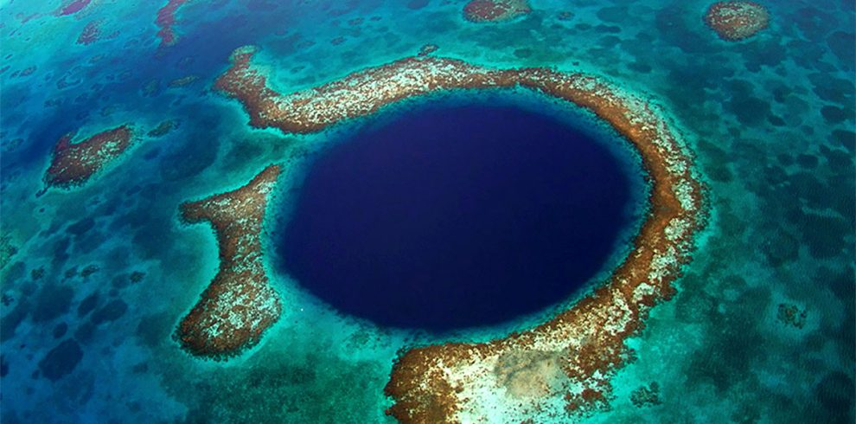
Blue hole (Belize)

Slide 39
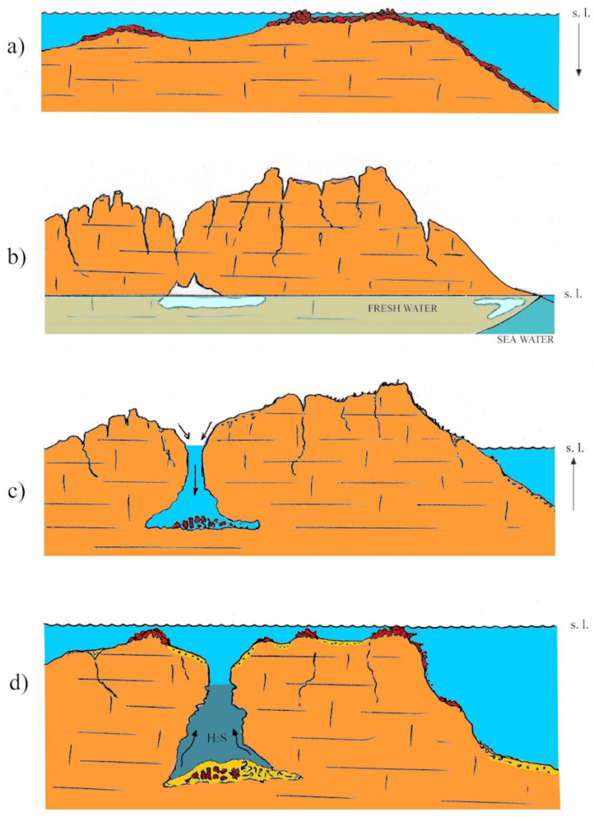
Formation of a blue hole
Begins when sea levels are higher and limestone rock forms out of marine sediments
Sea level drops exposing the land to weathering from carbonation
Over time a large collapse sinkhole develops
Sea level rises and inundates the former sinkhole to become a blue hole

Slide 41
Notes:
https://www.ajc.com/news/photos-few-metro-atlanta-biggest-sinkholes/BQo0BCR60jFobPgCvJ7zyI/

Slide 42
Pseudokarst
Landforms that look like they were formed from karstic processes but aren’t
Thermokarst can form when permafrost melts and create landforms and topography that resemble karstic sinkholes and lakes
Sinkholes and ground subsidence are not always associated with karst and karstic processes. Groundwater and oil extraction, as well as aging pipes and water infrastructure can also cause sinkholes

Slide 43
Notes:
https://www.seattletimes.com/nation-world/huge-sinkholes-are-now-appearing-in-the-wrong-places/

Slide 44
Pseudokarst ‘sinkholes’ formed from underground mining (China)

