Slide 1
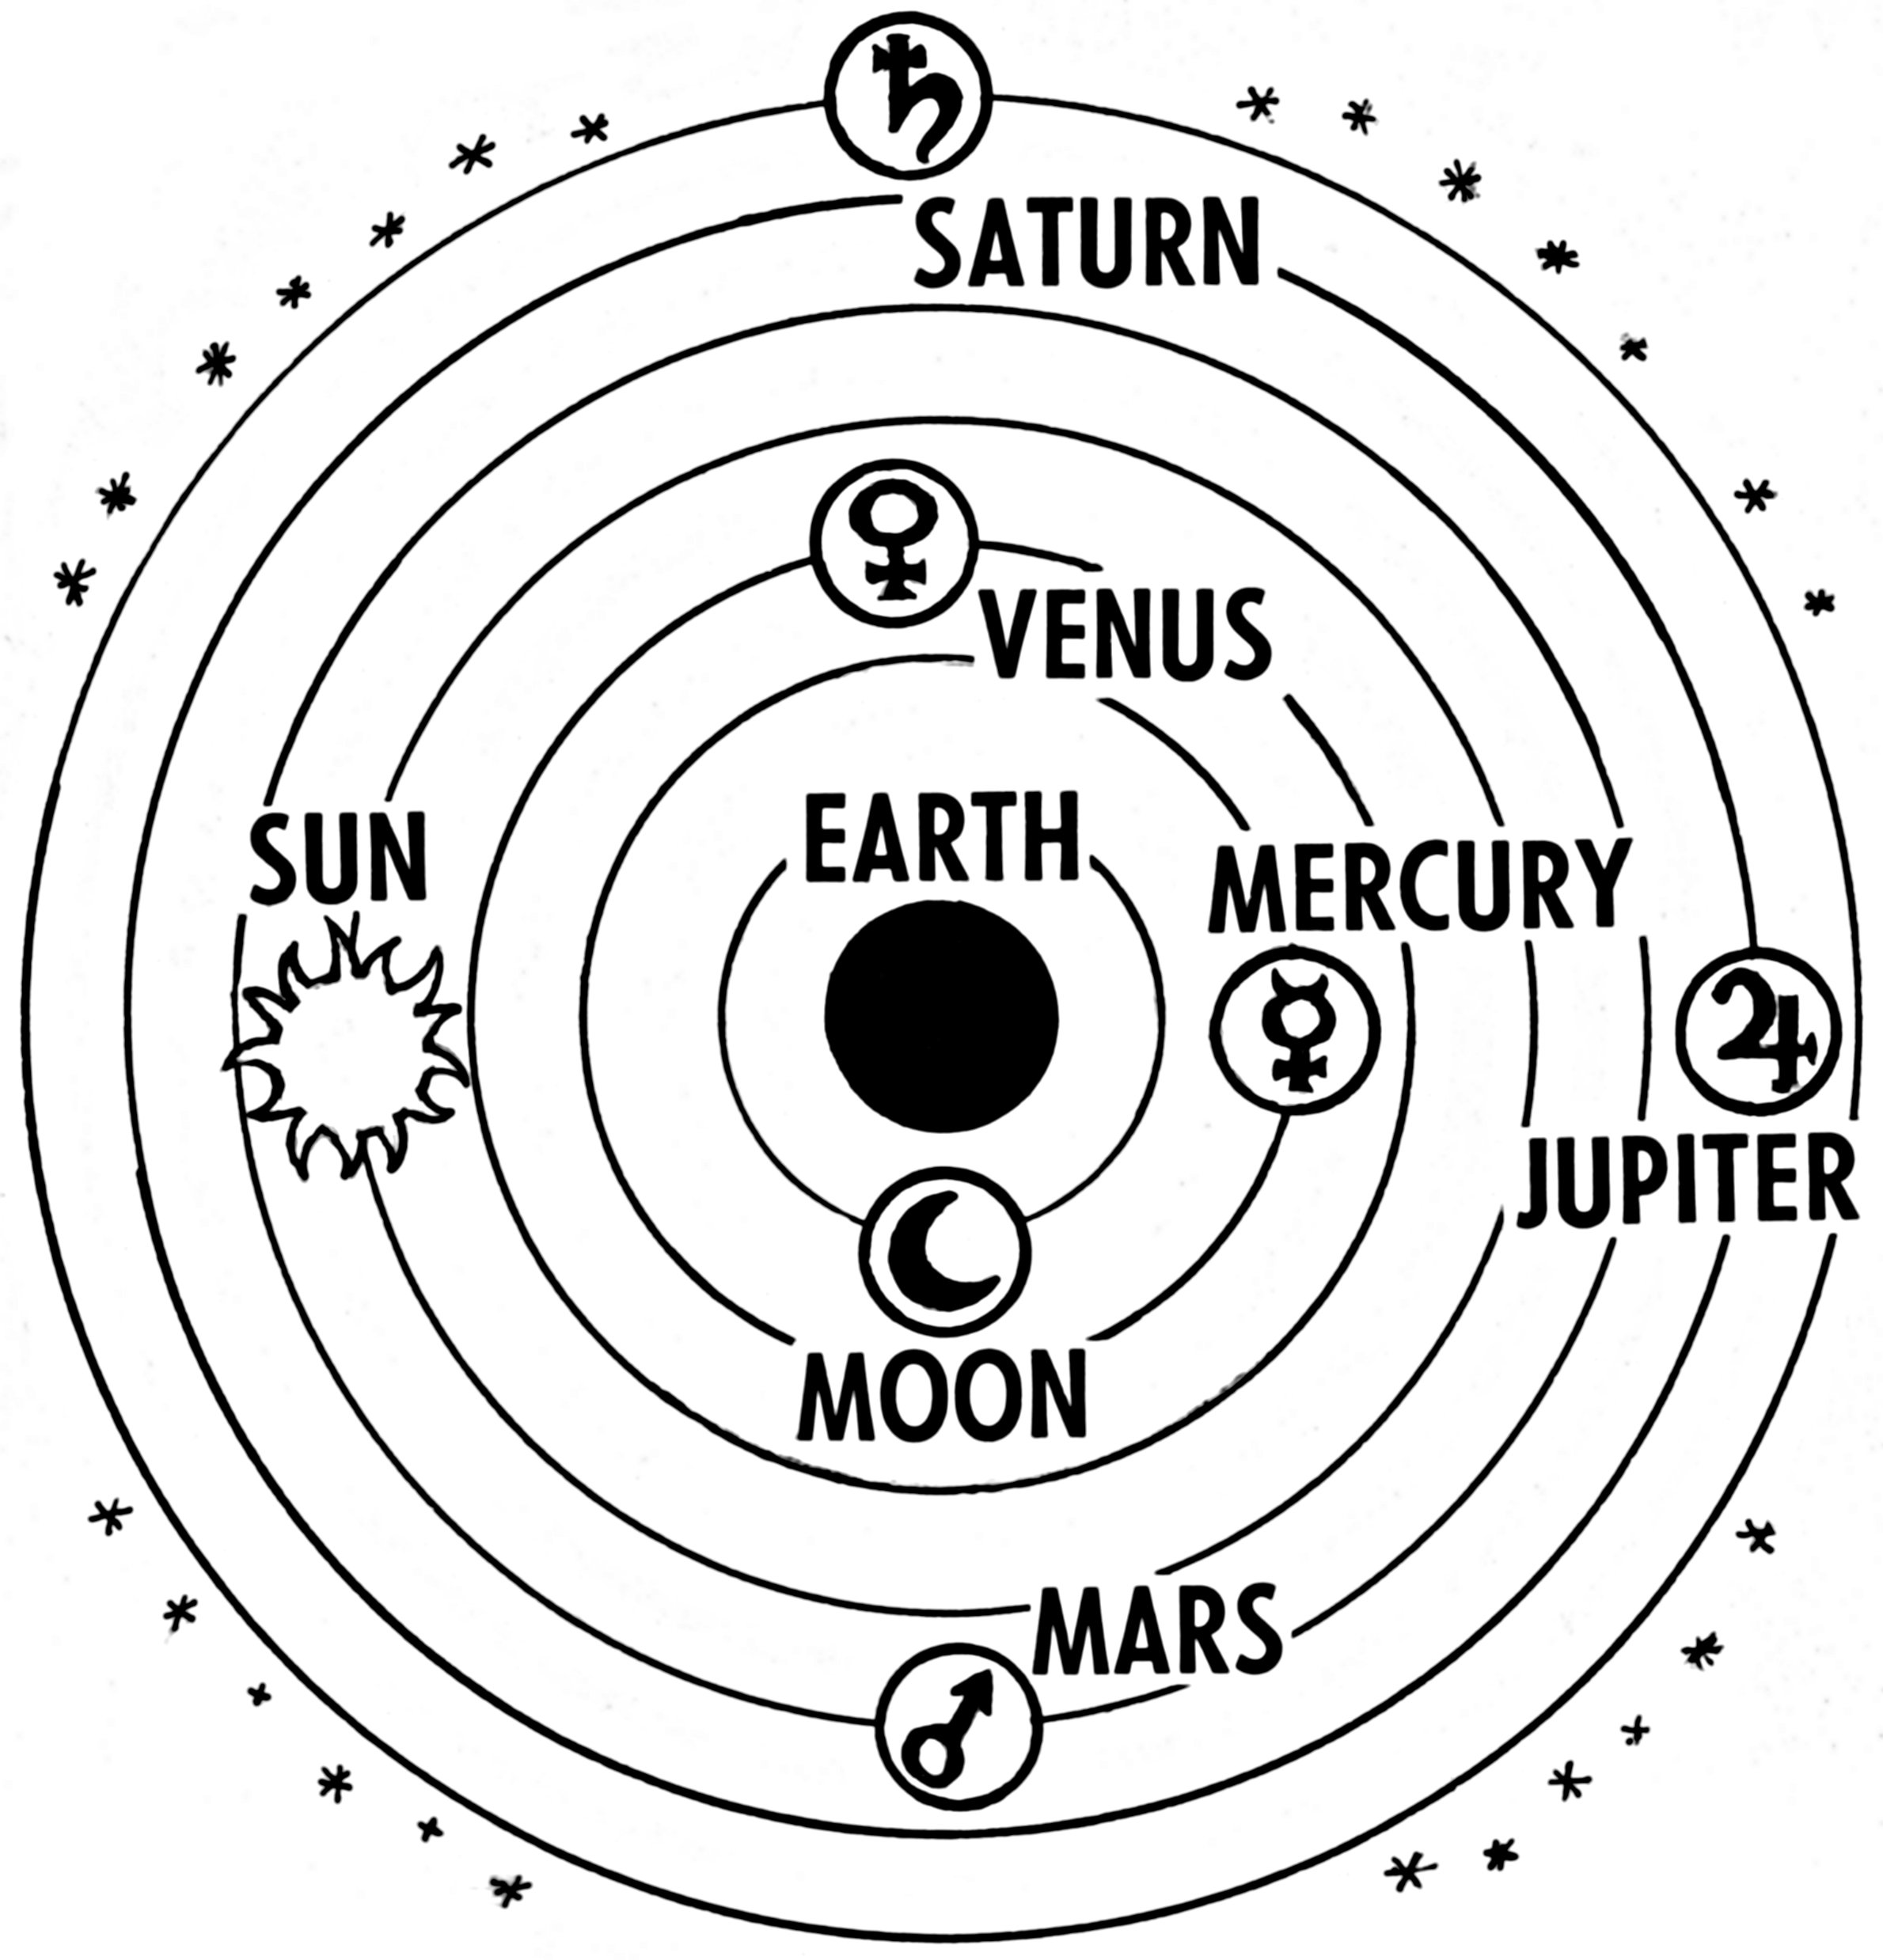
Earth-Sun Geometry
Determines the amount and intensity of incoming solar radiation (insolation) reaching earth
Changes in Earth-Sun geometry produce:
  March of the seasons (at the scale of a single year)
  Glacial (cold) and interglacial (warm) phases (at the scale of thousands of years). These phases were very well developed in the Pleistocene.
Notes:
Line art drawing of Ptolemaic system that put the Earth at the center of solar system. It was not until Copernicus that the Sun was recognized as the center of the solar system, and the planets rotate around it.
1

Slide 2
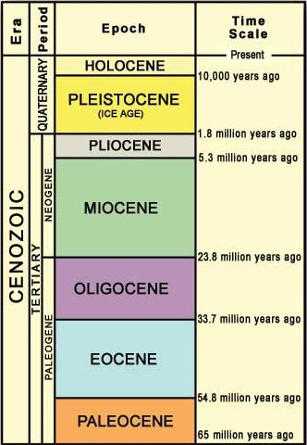
  Earth-Sun geometry over thousands of years
Interglacial climate phases (warm)
Glacial climate phases (cold)
The Pleistocene: a 2 million year period of strongly alternating glacial and interglacial phases
These alternating climates had a large impact on sea level, landforms, and the distribution of animals and plants – even today

Slide 3
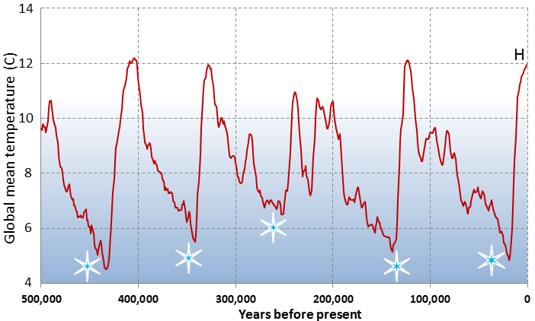
Glacials and interglacial phases over the past 500,000 years
Notes:
3

Slide 4
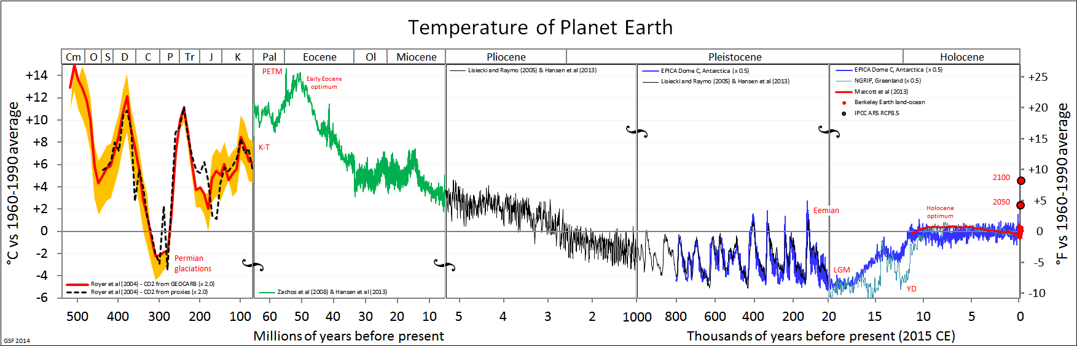
Notes:
Note the cyclical glacial and interglacial phases of the Pleistocene that began about 2 million years ago (demarcated in red box. Also not the sharp increase in global temperature in the last century on the far right.
https://socialsci.libretexts.org/Courses/Fresno_City_College/ANTH_1%3A_Introduction_to_Biological_Anthropology_%28Taylor%29/11%3A_Archaic_Homo/11.01%3A_Archaic_Homo/11.1.02%3A_The_Changing_Environment

Slide 5
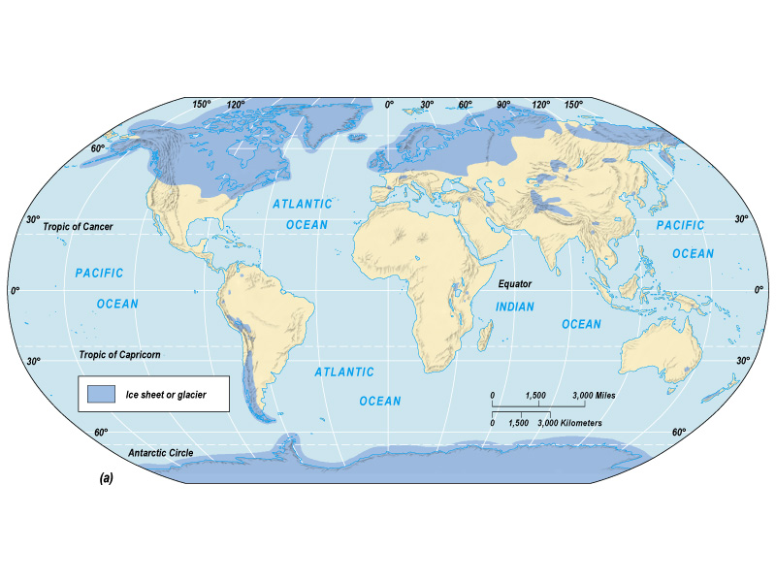
Maximum extent of glaciation during the Pleistocene covered 1/3 of the Earth’s land surface

Slide 6
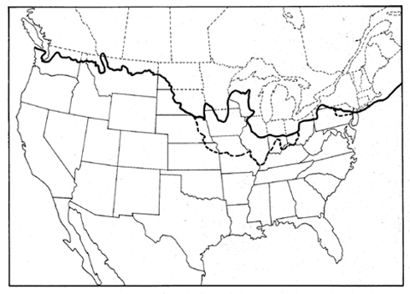
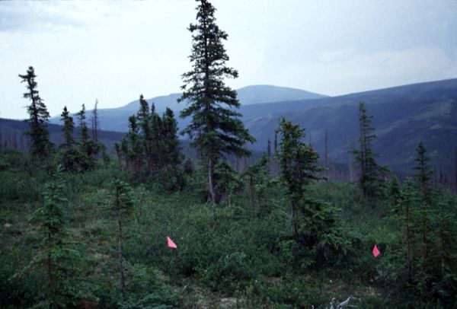
The Last Glacial Maximum
Occurred approximately 20,000 years ago in the Pleistocene
Boreal forests extended as far south as Atlanta and Birmingham, Alabama.
Ice thousands of feet thick covered much of Canada and parts of US
Sea levels fell globally
Notes:
Boreal forests – imagine the forests of Maine or interior Alaska and you have a good idea of what a boreal (northern) forest is.

Slide 7
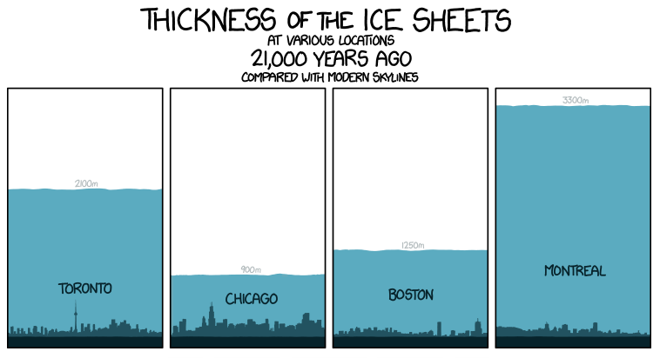

Slide 8
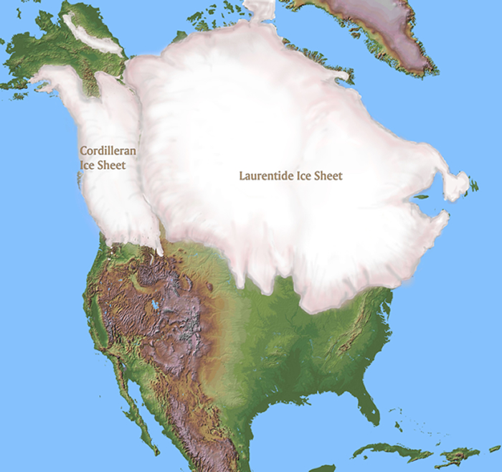

Slide 9
The Holocene interglacial
Started approximately 10,000 years before present
Marks the end of the Pleistocene and the beginning of the Holocene period
Return of warmer climate
Retreat of ice sheets northward
Sea levels begin rising
Notes:
9

Slide 10
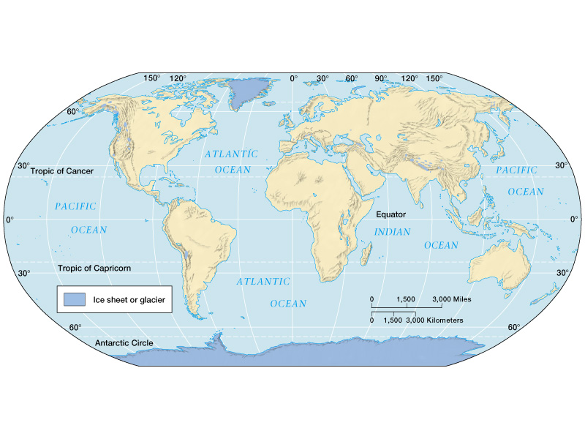
Notes:
Current extent of glaciation is about 10% of land surface

Slide 11
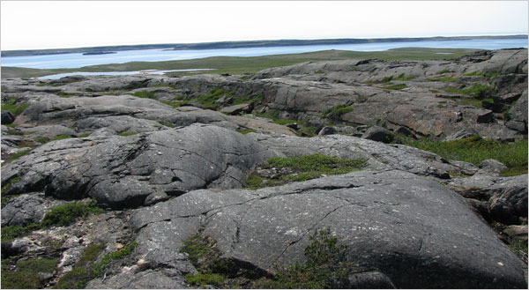
Notes:
Canadian Shield, Eastern Canada

Slide 12
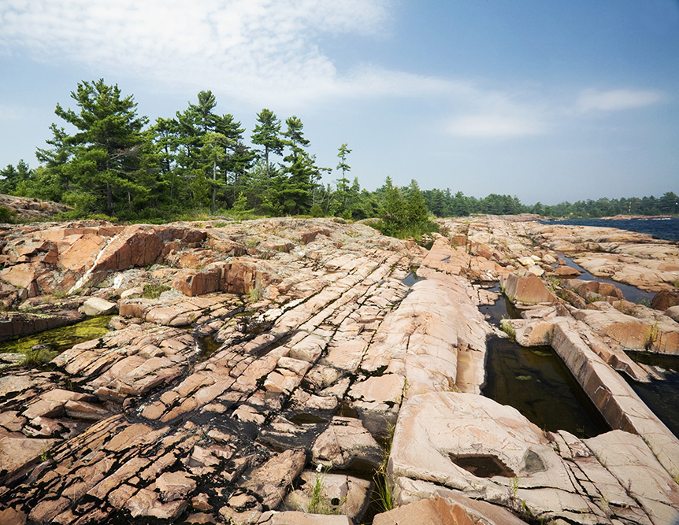
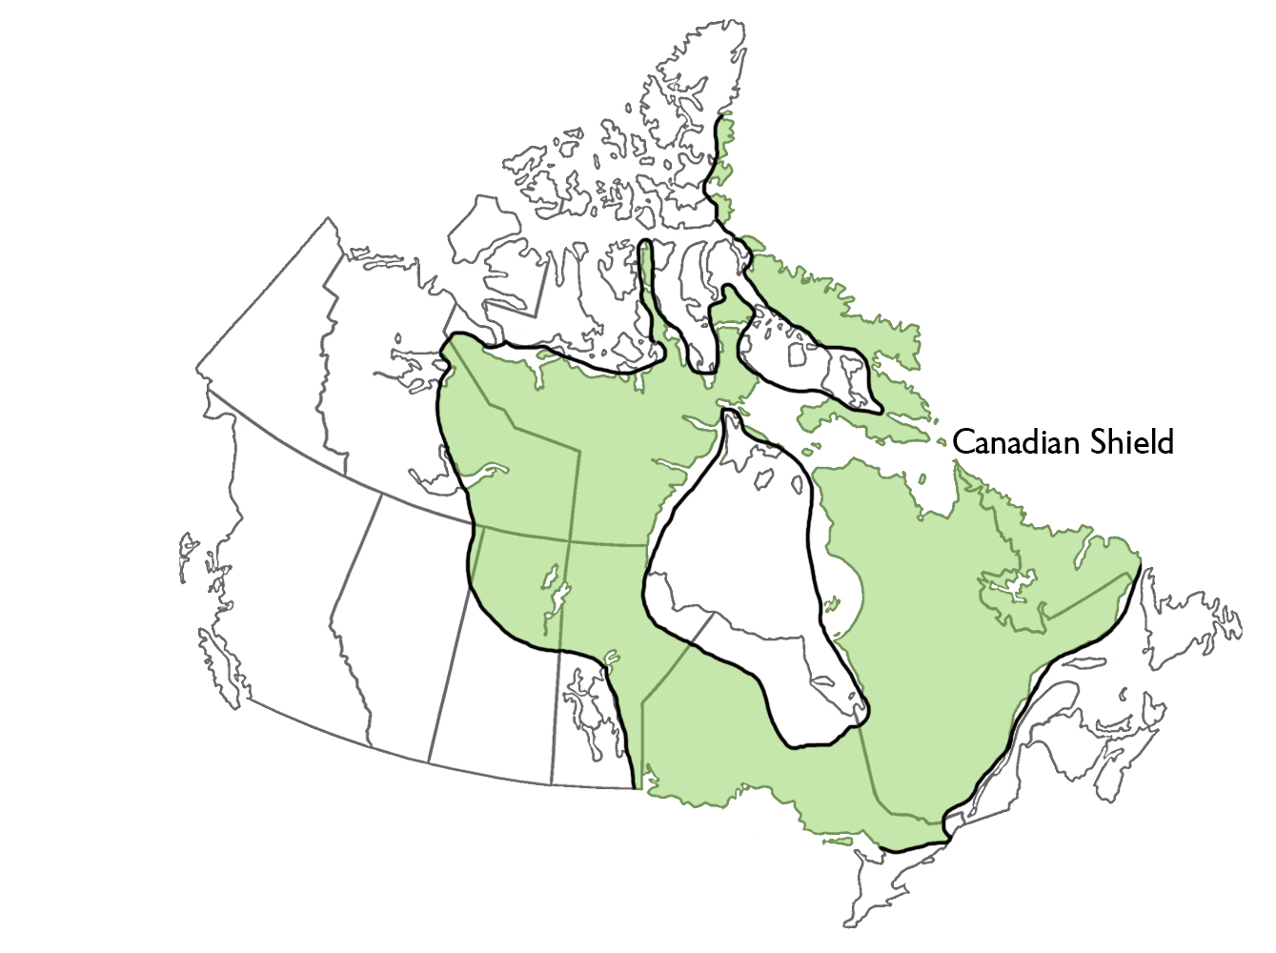

Slide 13
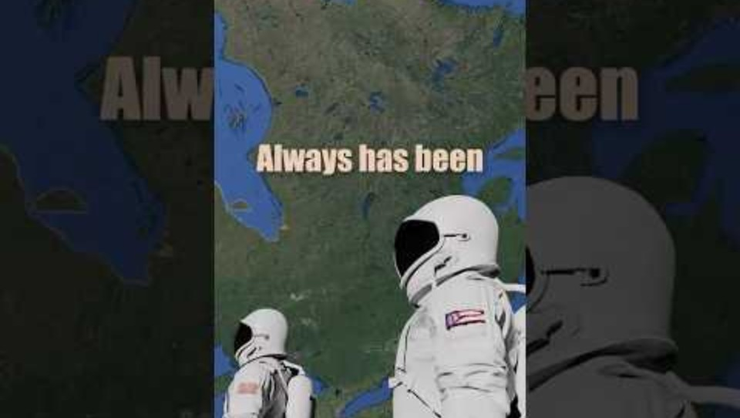

Slide 14
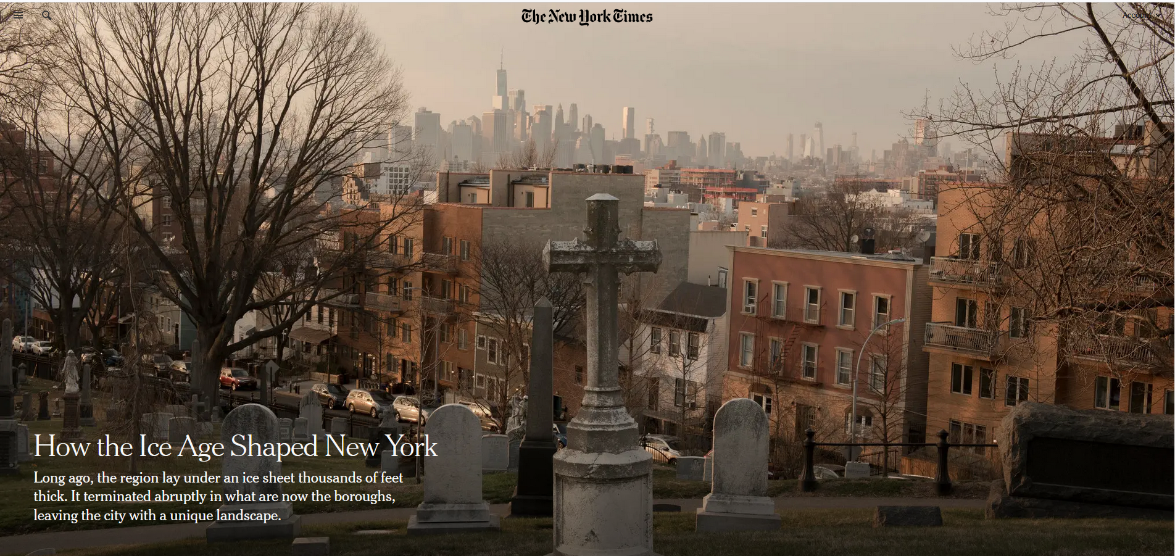
Notes:
https://www.nytimes.com/2018/06/05/science/how-the-ice-age-shaped-new-york.html
The terminal moraine in New York City is a ridge of debris that stretches from Staten Island through Brooklyn and Queens. It's the southern edge of the Laurentide Ice Sheet, which shaped the city's topography

Slide 15
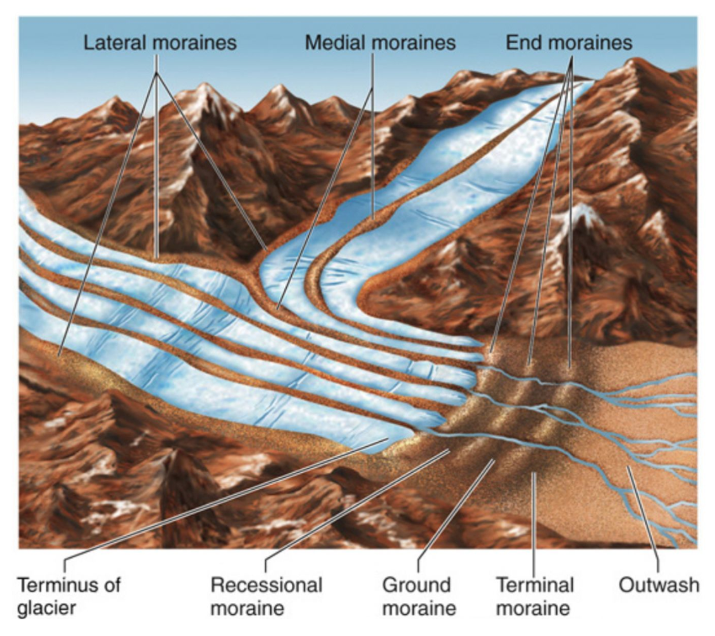

Slide 16
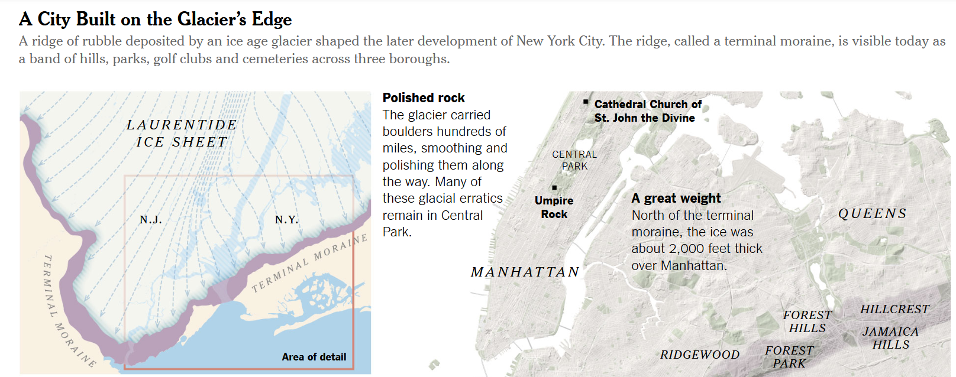
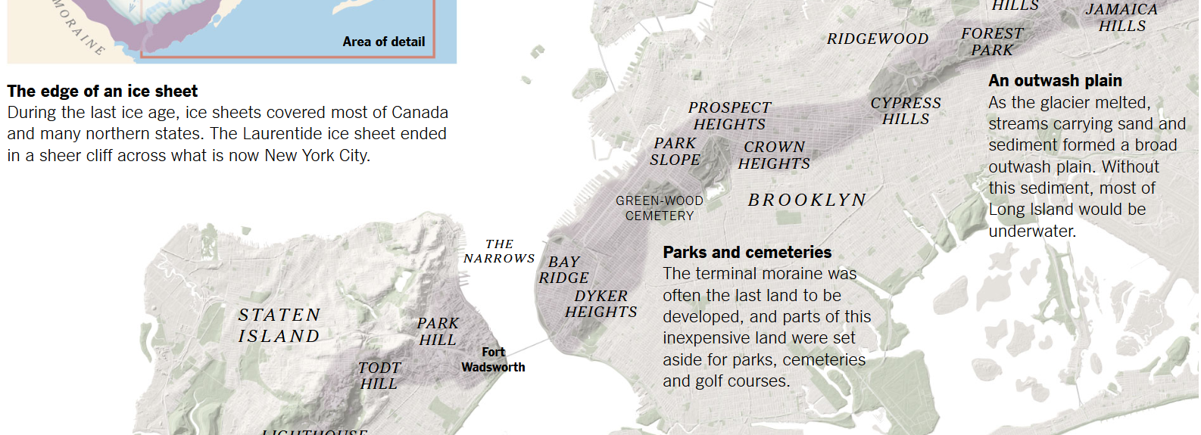

Slide 17
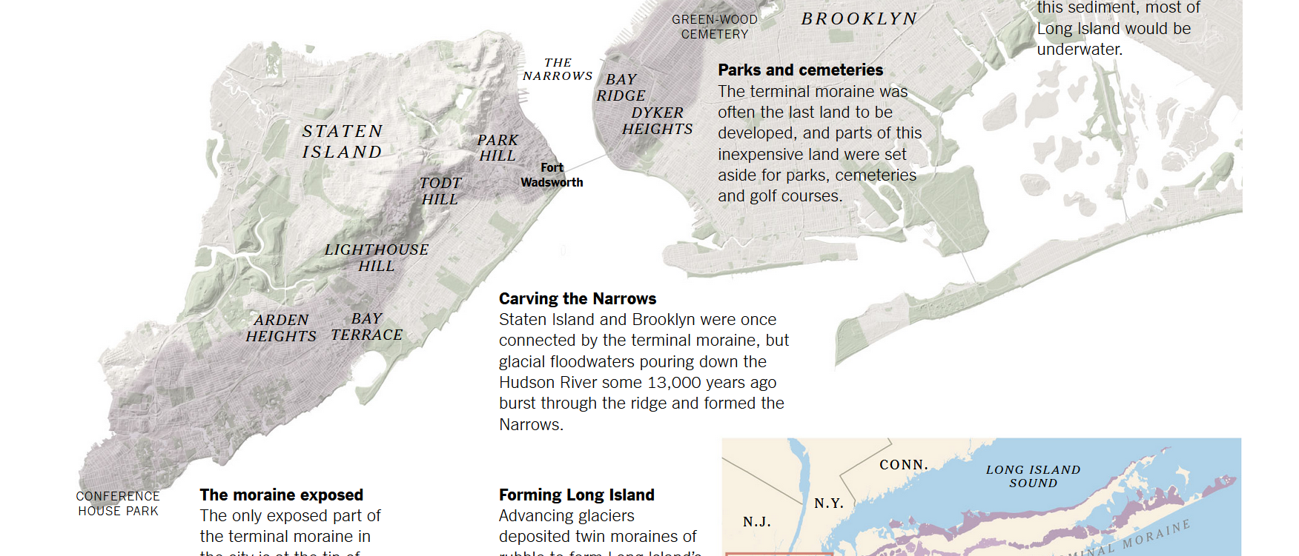
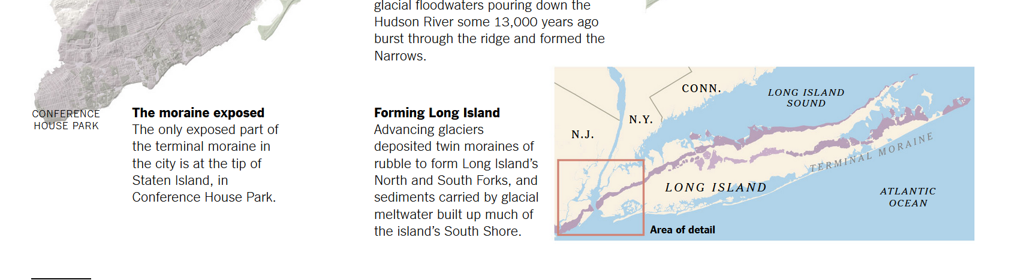

Slide 18
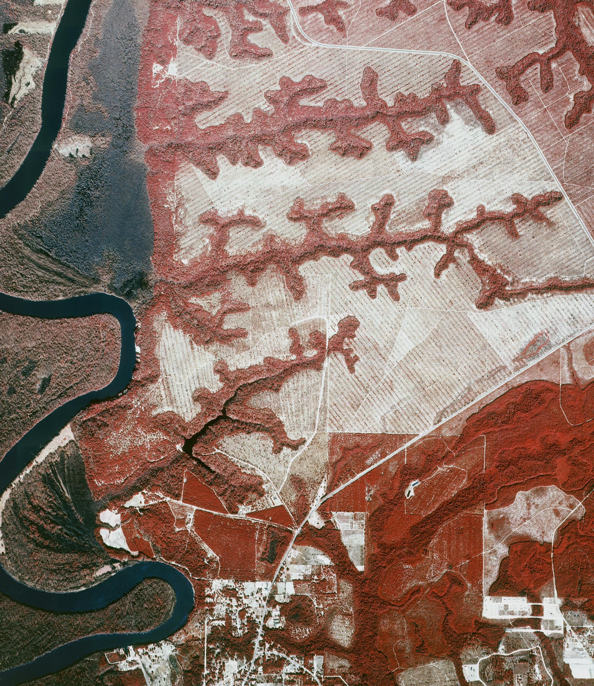
Notes:
Ravines of north Florida along the Apalachicola River. This is about an hour and half northeast of Panama City and about an hour west of Tallahassee. The springs start where the green boxes are located. These small springs form streams that erode the sandy soil and form ‘steephead’ ravines. These ravines and the streams in them eventually drain to the Apalachicola River at the left of the photo.
This photo is an infrared color photo. It helps bring out the contrasts in the land cover and vegetation.
The ravines are cool and have forest trees that can thrive in cooler climates. There are even American beech, a tree more common further north.

Slide 19
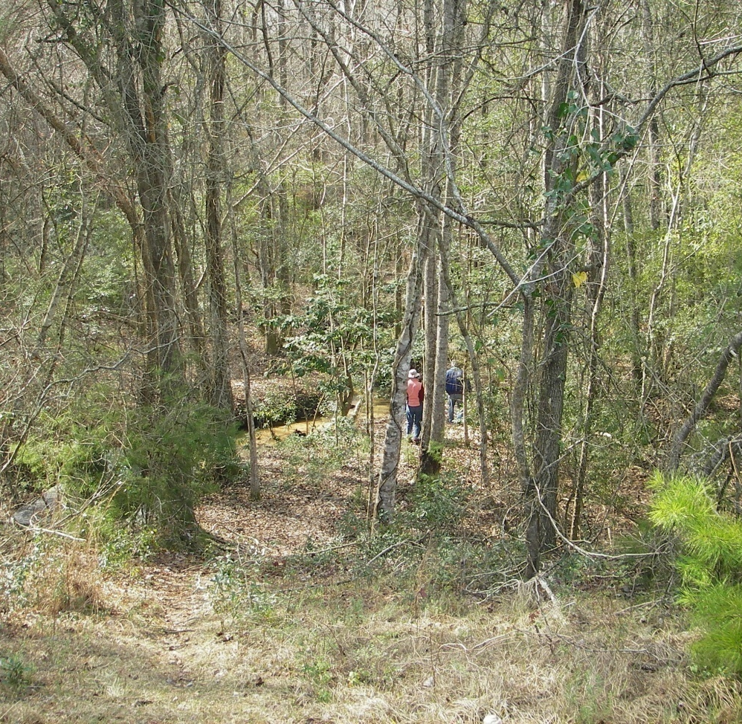
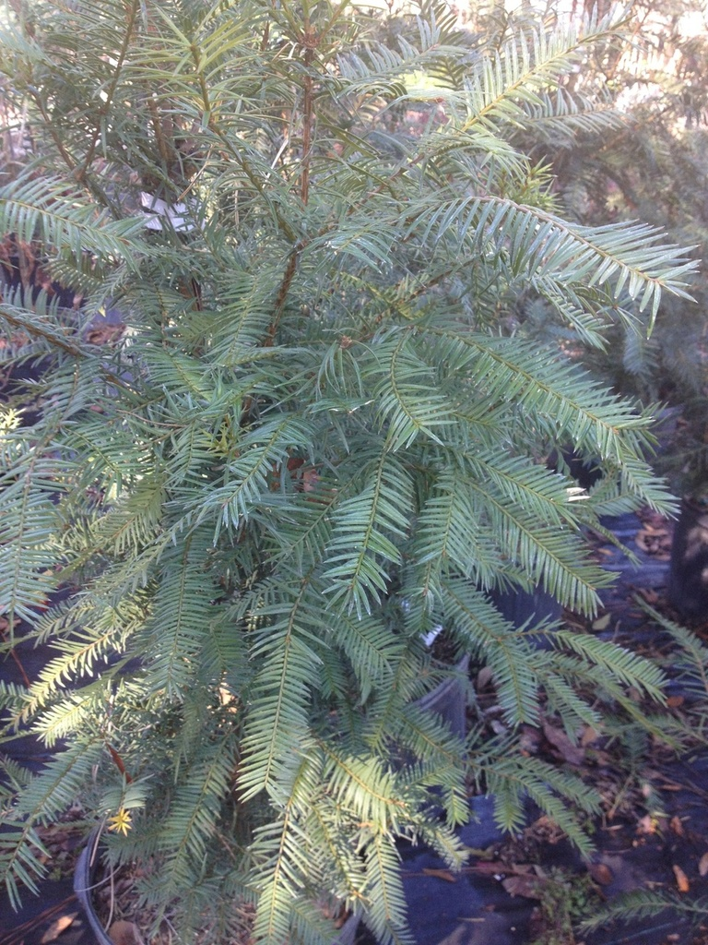
Notes:
Florida torreya (Torreya taxifolia) at left is a paleoendemic species. It was once widespread during cooler glacial climates but is now restricted in distribution to the cool ravines along the Apalachicola River in north Florida. It is effectively isolated in these ravines, with little chance of dispersing north on its won. Climate relicts like Torreya taxifolia have limited opportunities for dispersing to alternative favorable sites as climate warms.
The Torreya tree is here because during the last glacial maximum it grew in this area, but has now managed to survive only in the ravines as temperatures warmed into the Holocene.

Slide 20
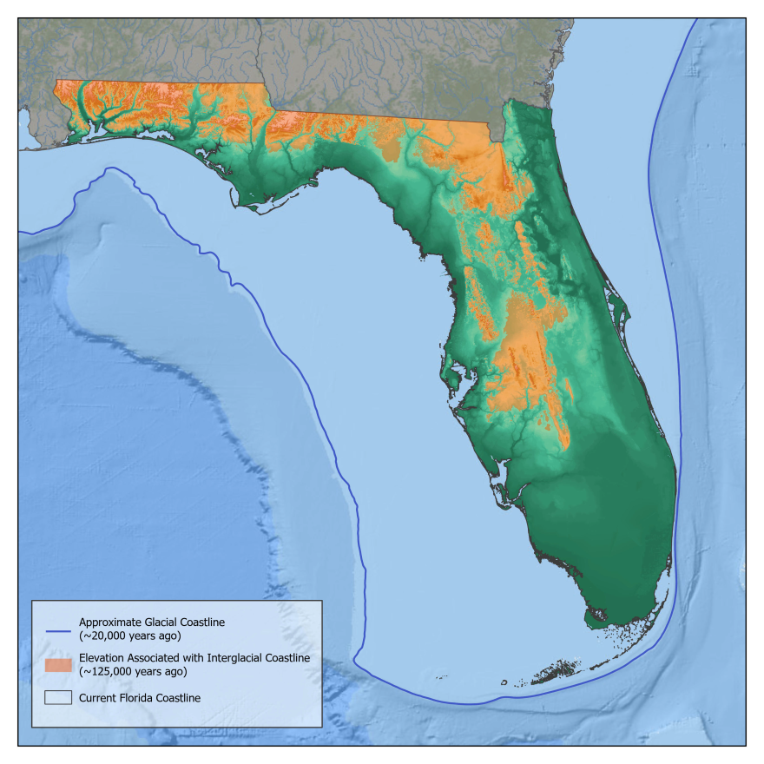
Notes:
The orange areas represent the islands of Florida that formed during the Pleistocene interglacial periods when sea level rose.

Slide 21
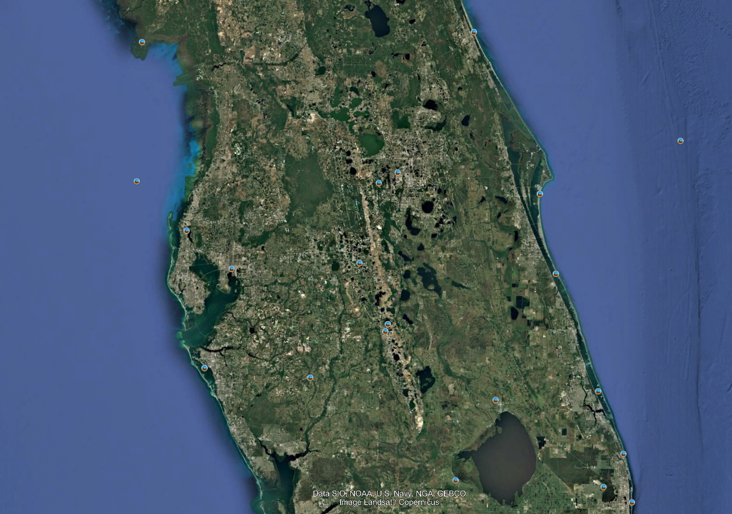
Notes:
Lake Wales Ridge, a remnant of those former islands. These islands were isolated off and on during the Pleistocene. Their isolation led to the evolution of distinctive plants and animals, much like what happens in the Galapagos, or any isolated island habitat over time.

Slide 22
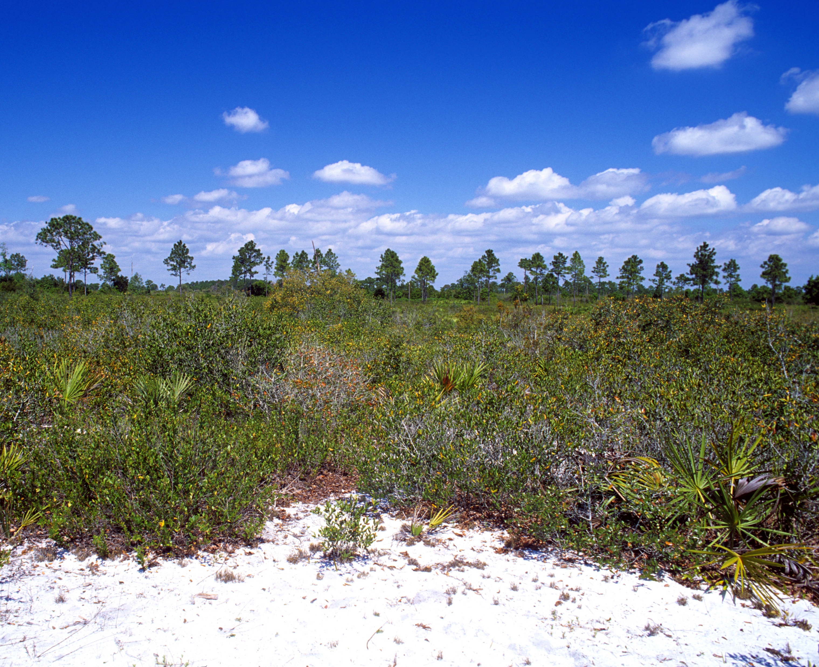

Notes:
Isolation of plant and species on higher ground in Florida during > 2 million years of climate oscillations led to evolution of unique flora and fauna
The Florida scrub jay is only one of 15 birds endemic to the US mainland, and the only one endemic to Florida. It is called a neoendemic because it is newly evolved locally, a native species of recent origin.
The Florida scrub-jay is highly specialized to live in the xeric oak scrub habitats found on sandy ridges. These habitats became isolated as sea levels rose, leading to geographic separation of populations. Over time, isolated populations of ancestral jays in different scrub patches experienced limited gene flow, leading to genetic divergence. Eventually, the Florida scrub-jay became distinct from other species of scrub-jays found in western North America.

Slide 23

Milankovitch cycles create oscillating glacial-interglacial periods
Milankovitch cycles involve cyclical changes in Earth-Sun geometry
Milankovitch cycles do not account for the rapid warming in the last couple of centuries. It is human-caused.
Notes:
Return to a glacial period is not going to lessen the impacts of human-caused climate change

Slide 24
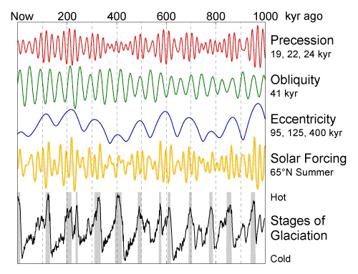
Three components of Milankovitch cycles
Orbital eccentricity
Obliquity
Precession

Slide 25
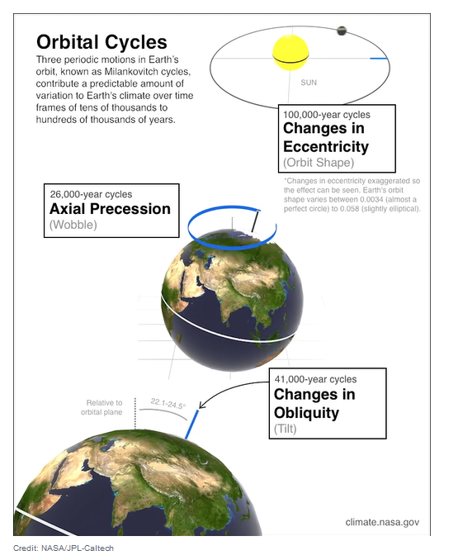
1. Orbital eccentricity
Distance between Earth & Sun changes over scale of ~100,000 years
This changes length of seasons
Notes:
https://climate.nasa.gov/explore/ask-nasa-climate/2949/why-milankovitch-orbital-cycles-cant-explain-earths-current-warming/

Slide 26
2. Obliquity
Tilt varies between 22.1 to 24.5 degrees over a time scale of ~41,000 years.
Present tilt of 23.5 degrees can be considered unchanging from your scale of observation
Notes:
https://climate.nasa.gov/explore/ask-nasa-climate/2949/why-milankovitch-orbital-cycles-cant-explain-earths-current-warming/

Slide 27
3. Precession
Earth wobbles on its axis as a consequence of the physics of a spinning object
Point in orbit where aphelion and perihelion varies slightly
Occurs over times scales of ~26,000 years
Notes:
https://climate.nasa.gov/explore/ask-nasa-climate/2949/why-milankovitch-orbital-cycles-cant-explain-earths-current-warming/
27

Slide 28
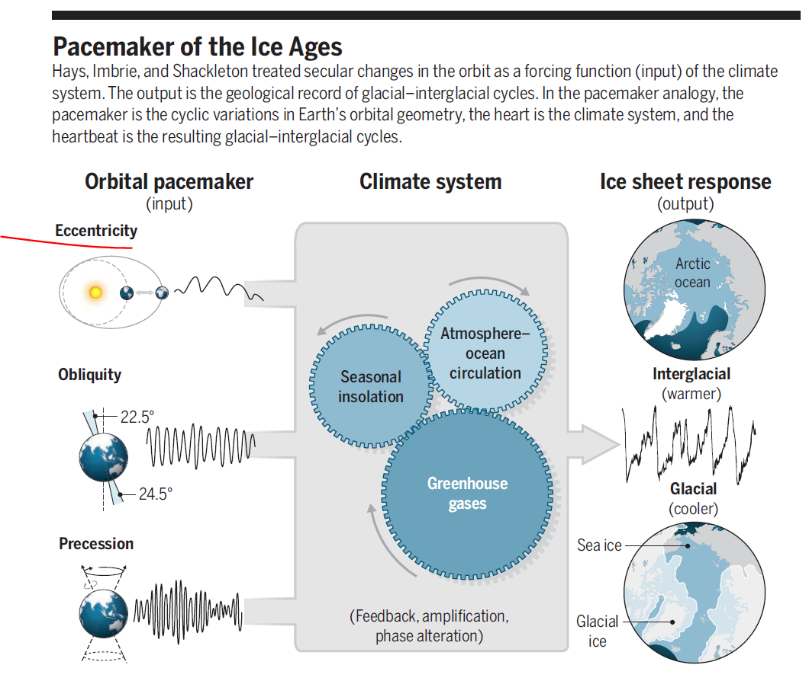

Slide 29
Interglacial (warm) phases
Strong seasonal contrasts
  Highly elliptic orbit and large tilt
  Cold winters: less evaporation: less snow: less glacial ice accumulation
  Hot summers: more glacial melting
  Net loss of glacial extent
  Higher sea levels
  More absorption of insolation because there is less ice to reflect it
  Warmer overall temperatures

Slide 30
Glacial (cold) epoch
Weak seasonal contrasts
  Less elliptic orbit and small tilt
  Warm winters: more evaporation: more snow: more glacial accumulation
  Cool summers: less glacial melting
  Net gain of ice sheet extent
  Sea levels drop
  More ice to reflect insolation
  Cooler temperatures

Slide 31
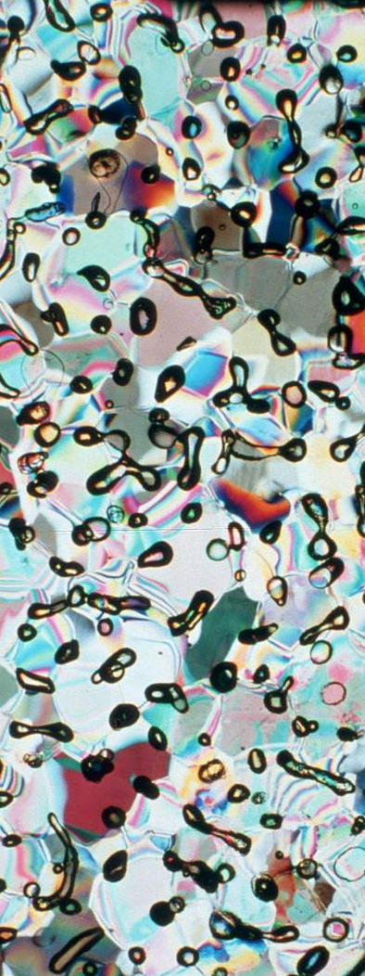
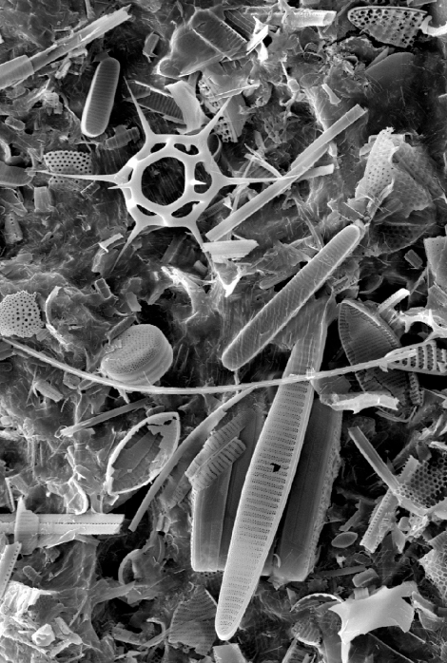
Notes:
Microfossils in deep sea sediments have chemical compositions that can indicate past temperature conditions and carbon dioxide concentrations in the atmosphere
https://rnorris.scrippsprofiles.ucsd.edu/deep-sea-sediments-and-microfossils/
Atmospheric gases trapped in glacial ice can also reveal temperature and carbon dioxide concentrations in the past

Slide 32
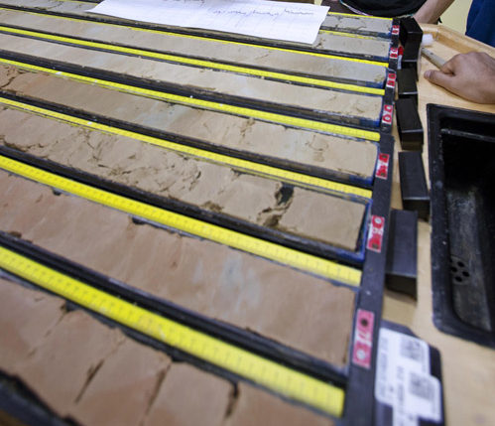
Deep sea sediment cores contain microfossils that can be used to infer past temperatures and how they changed through time
Single-celled marine organisms shift in abundance as water temperature changes
They often have shells that can be chemically analyzed to infer past temperatures
Ratio of oxygen isotopes provides information to reconstruct past temperature changes
Notes:
Deep see cores of sediments containing microfossils that can be used to interpret past climates as well as other environmental and ecological conditions in the past
https://geobites.org/deep-sea-sediment-cores-tell-us-about-past-fish/

Slide 33
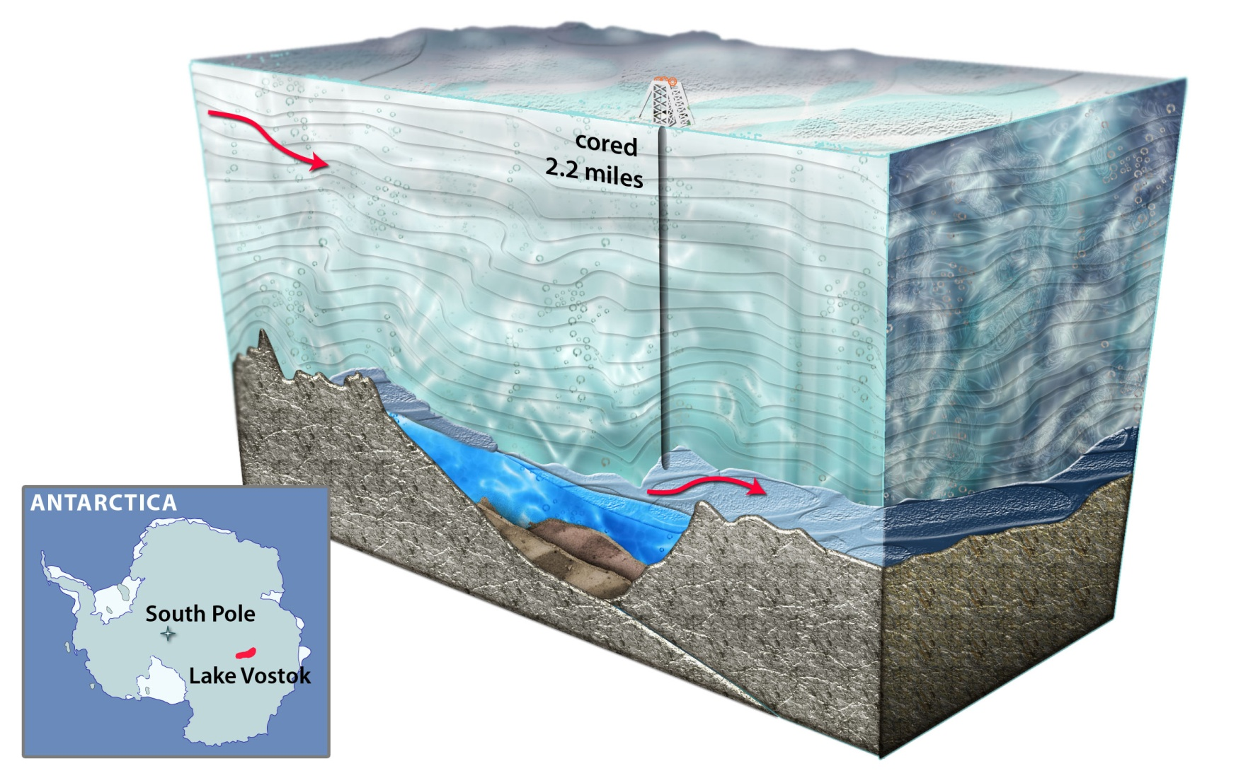
Notes:
However ice layers get harder to date the deeper you go – ice layering becomes deformed under the mass of overlying ice

Slide 34
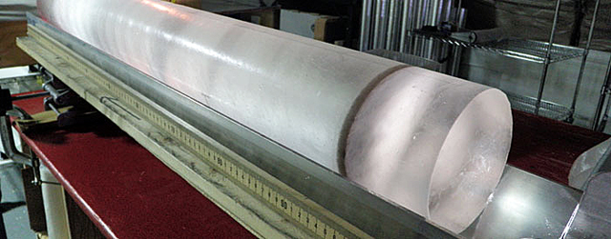

Slide 35
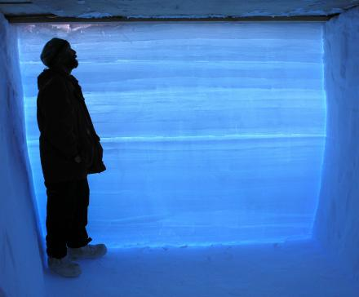
Notes:
A researcher standing next to an ice core extracted from the West Antarctic Ice Sheet. Each of the horizontal lines represents one year’s worth of snowfall. The ice core contains detailed climate data from the past 68,000 years.
Ice has annual summer-winter layers that can aid in deriving dates

Slide 36
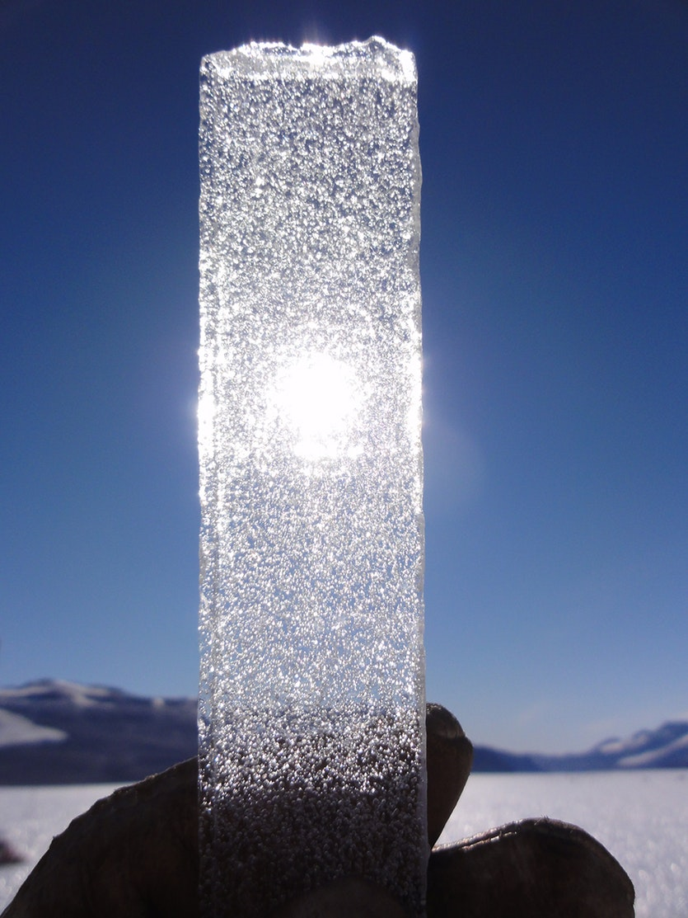
The ice is brought back to a laboratory and heated carefully in a vacuum chamber (to avoid contamination by modern air), releasing the ancient air for analysis.
Chemical composition (carbon dioxide, methane, and ratio of oxygen isotopes) of trapped air can provide information to reconstruct past temperatures

