Slide 1
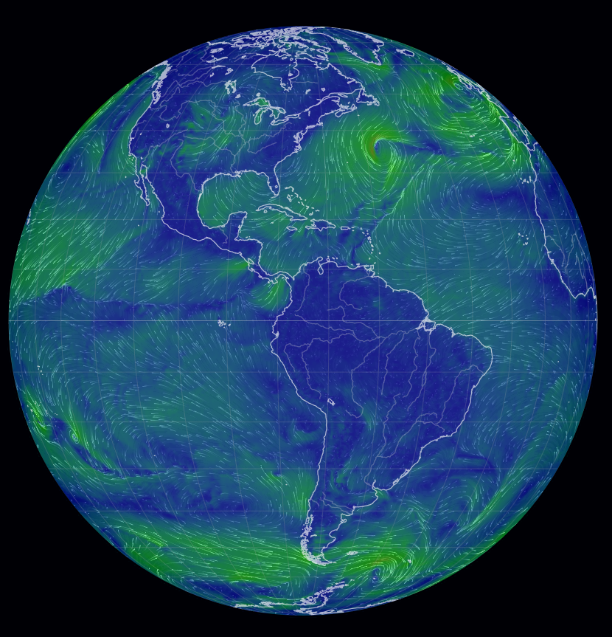
Air pressure and atmospheric motion
Questions: What makes the wind blow?
Answer: Differences in atmospheric air pressure
Notes:
https://earth.nullschool.net/#current/wind/surface/level/orthographic

Slide 2
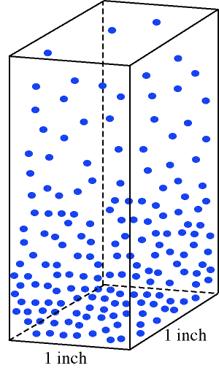
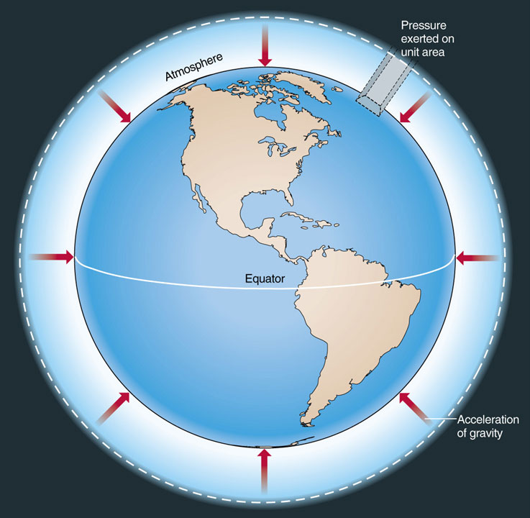
Air pressure
Force exerted by molecules in atm due to gravity and temperature
Air pressure decreases with height

Slide 3
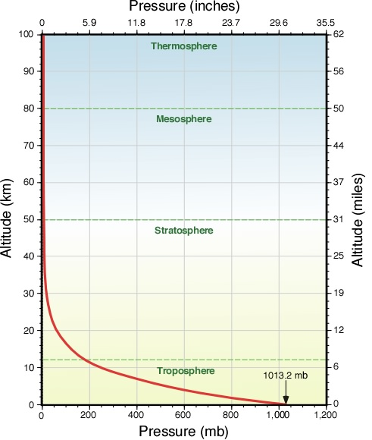
Notes:
Most of weather and climate take place in the troposphere, the lowermost 10 km

Slide 4
Surface air pressure variability
Average sea level pressure 1013 mb
High pressure is generally associated with clear conditions
Lower pressure is generally associated with cloudy conditions and potentially severe weather

Slide 5
Surface air pressure maps
Air pressure maps are also called isobaric maps
They show air pressure using isobars, lines representing levels of air pressure
Where the isobars are close together, air pressure changes over a short distance and winds are fastest

Slide 6
Pressure systems
Two types: high and low
Note the 3-dimensional structure
Low: associated with clouds and instability.
High: associated with clear conditions and stability

Slide 7
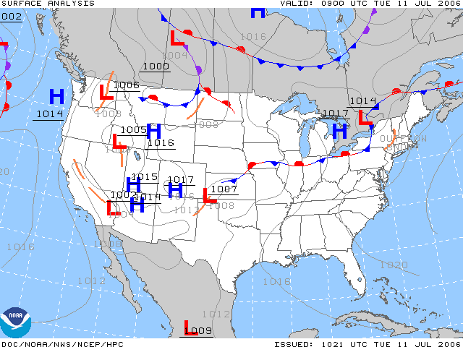
High pressure
Also called an anticyclone
Converging air aloft
Diverging sinking air at surface
Winds rotate clockwise in NH
Areas of “heavy” atmosphere; air is forced out of these locations
Stable surface conditions
Low pressure
Also called a cyclone
Converging rising air at surface
Diverging air aloft
Winds rotate counterclockwise in NH
Unstable surface conditions

Slide 8
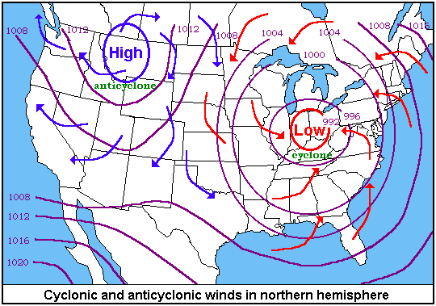

Slide 9
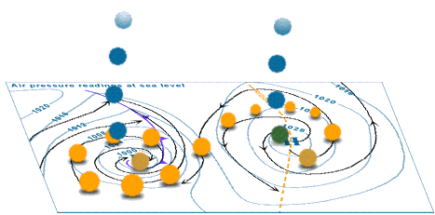
Notes:
Is the location for these pressure systems the northern or the southern hemisphere?

Slide 10
Types of low and high pressure systems
High and low pressure systems occur on a variety of spatial and temporal scales
Some pressure systems may be stationary for an extended period of time, others propagate through the atmosphere
Some are always present while others can be very ephemeral
Notes:
Tornadoes, thunderstorms, and hurricanes

Slide 11
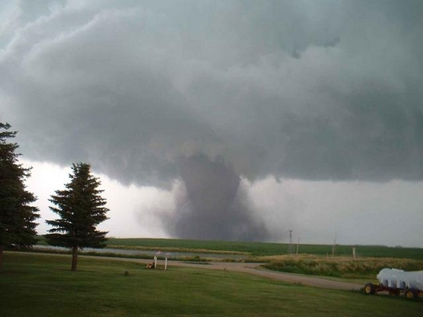
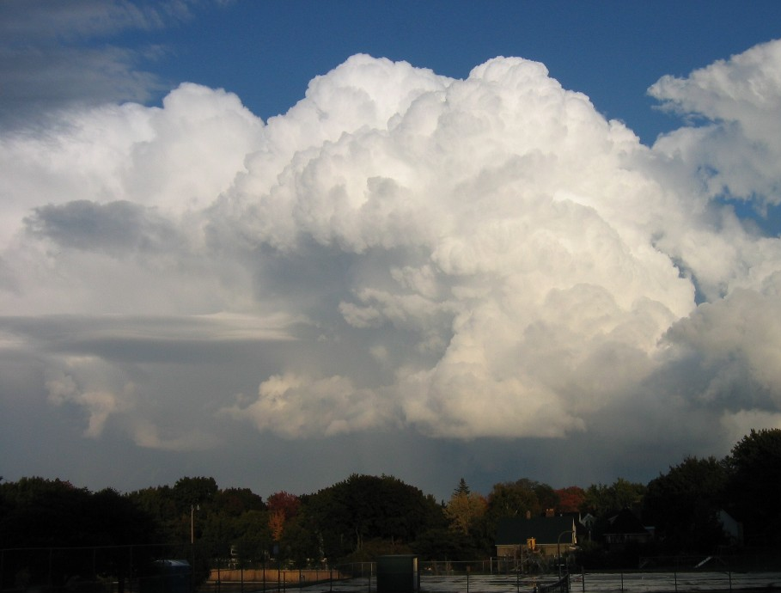
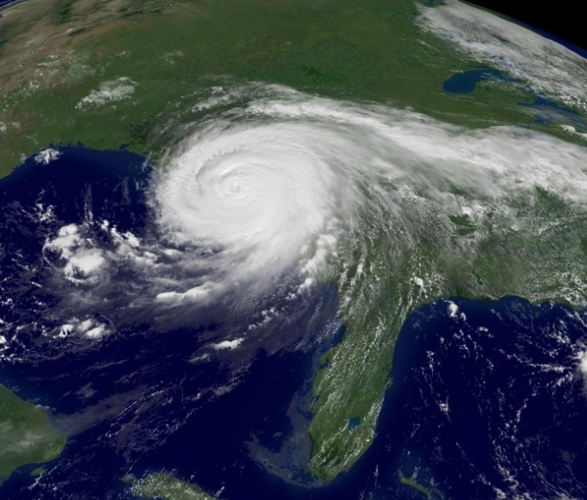
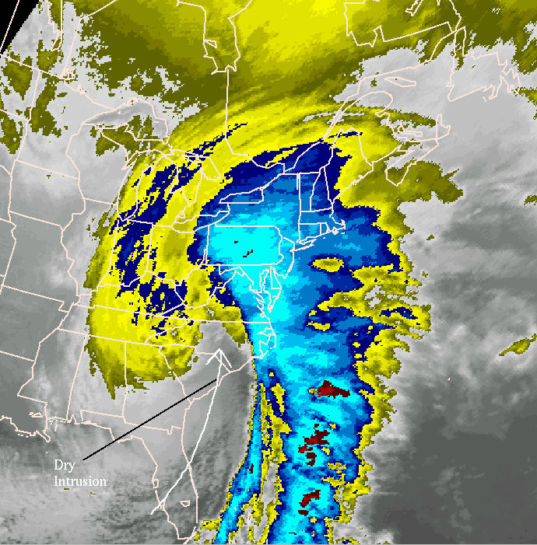
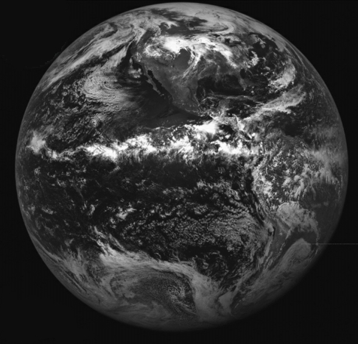
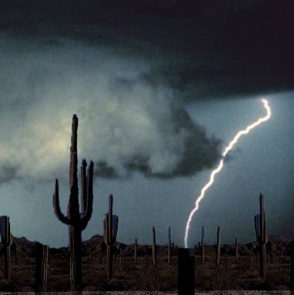
Notes:
Tornadoes, thunderstorms, and hurricanes (top) Midlatitude cyclones, the ITCZ, thermal lows (bottom)

Slide 12
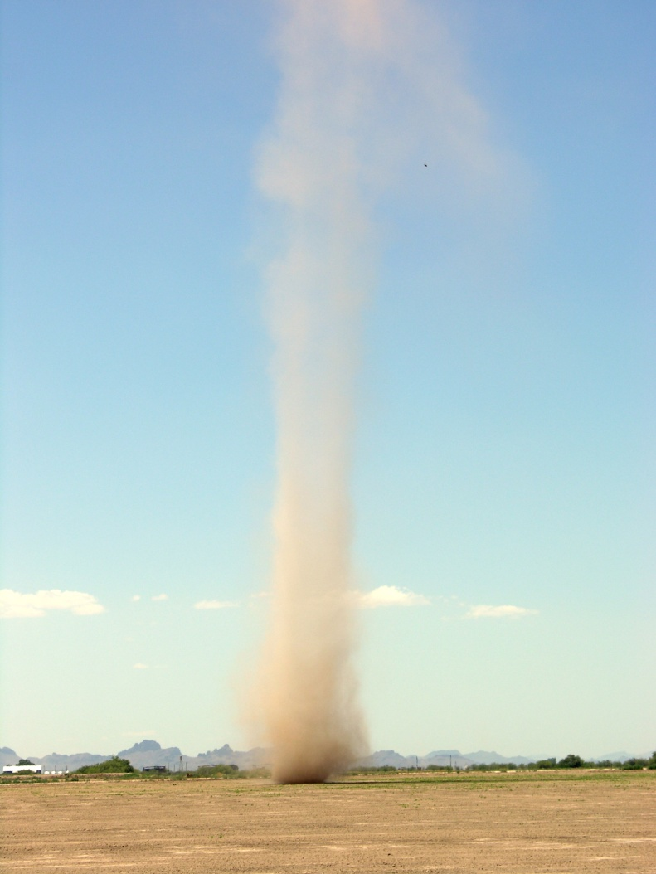
Low pressure systems: dust devil versus ITCZ
Notes:
Dust devil versus ITCZ – both are low pressure systems but one in small and lasts only minutes, the other spans the tropics and is always present

Slide 13
Weather forecasting
Knowing if the air is being lifted or is descending is a central task of weather forecasting – this motion indicates the stability of the atmosphere and the potential for clouds
Weather forecasting involves looking at surface conditions as well as upper level conditions (aloft, in the upper troposphere) to determine motion of the atmosphere.
Conditions in the upper atmosphere can enhance lifting. For example, the polar jet stream can ‘pull’ air up from the lower levels of the atmosphere and create instability.

Slide 14
Winds
Named according to the direction they blow from
Winds can blow at different directions at different altitudes in the atm
Forces that act on winds:
Pressure gradient force
Coriolis force
Surface friction

Slide 16
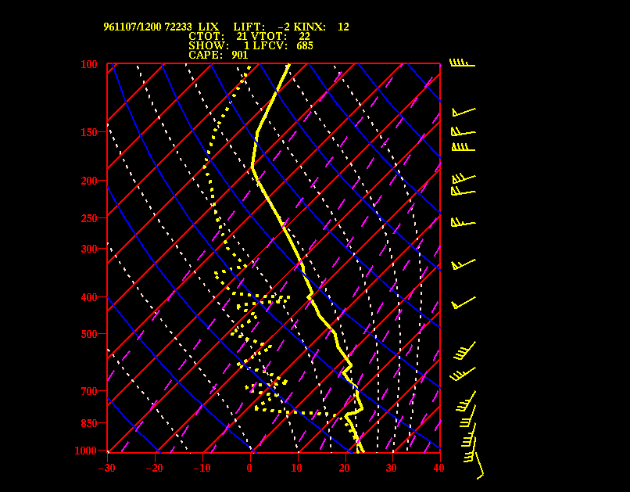

Slide 17
1. PGF: Pressure gradient force – winds blow from high to low
Where are winds the fastest?

Slide 18
Notes:
March 3, 2023 surface weather map. Note the packed isobars. This event produced hurricane-force winds. https://www.wpc.ncep.noaa.gov/html/sfc-zoom.php

Slide 19
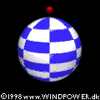
2. Coriolis Force (CF)
Once the winds are in motion due to the pressure gradient force, the Coriolis force exerts its influence. The Coriolis force is the apparent deflection of the winds due to rotation of the Earth. N. hemisphere winds are deflected to the right, S. hemisphere winds are deflected left

Slide 20
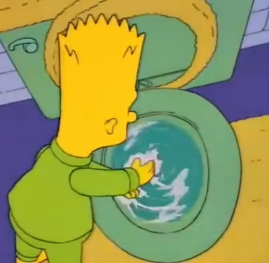
Coriolis Force
CF is not a true force; it is an apparent force arising from the effect of the Earth’s rotation
Deflection is strongest at poles and zero at the Equator
CF acts perpendicular to the direction of motion
The CF does not determine the rotation in a drain. Eggs do not balance only on the Equator

Slide 21
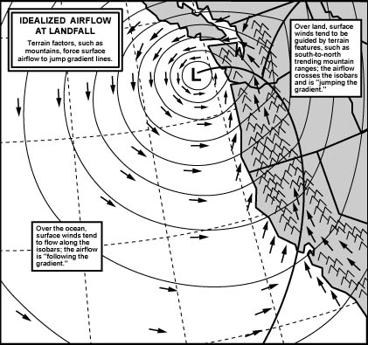
3. Surface friction (SF)
Topography (mountains, elevated plateaus) deflect winds
Notice how the wind arrows do not flow parallel to the isobars when they contact land and the mountains

Slide 22
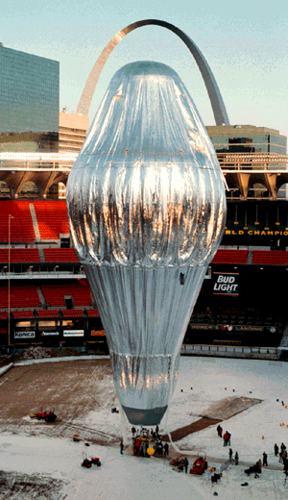
Two major categories of winds
Geostrophic (upper troposphere winds)
Influenced by PGF and CF only
Wind flow is parallel to geopotential heights
Geostrophic flow is westerly (west to east) in N. hemisphere
These types of winds are evident on geopotential height maps

Slide 23
Notes:
The is a map of the upper troposphere. The lines represent the distance to a given air pressure level. The lines are called geopotential heights. The numbers by the lines represent the altitude in meters where you would decrease to 300 mb. For example, the 8940 by the lines at the center top represent an altitude of 8940 meters or 29,329 feet. This is at the altitude that jet airliners travel.
Geostrophic winds can only be mapped on a geopotential height map Note that wind barbs flow parallel and do not cut across the geopotential height lines. This is because there is no surface friction at this altitude. It is just the pressure gradient force and the Coriolis force acting on the wind. Numbers on lines in an geopotential height map indicate the elevation of a specific air pressure. This is a geopotential height map for the 300 mb pressure level, about where jet liners fly. You would have to go up around 8880 meters just north of Minnesota to get to that pressure level. However, in Florida, you would have to go up to 9600 meters to get to that same pressure surface.

Slide 24
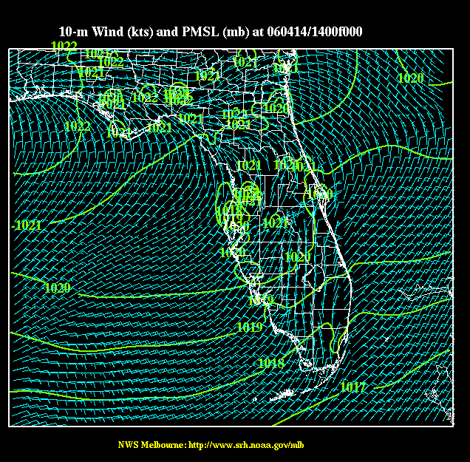
2. Surface winds
Influenced by PGF, CF, and SF
Winds cross isobars
Surface maps show isobars instead of geopotential heights

Slide 25
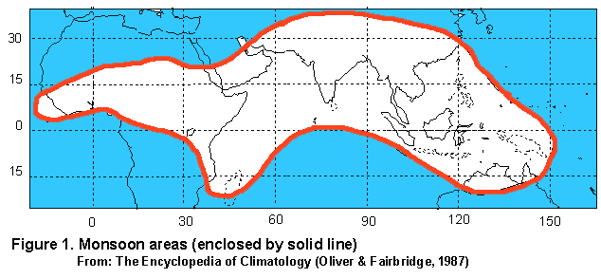
Specific kinds of surface winds: monsoonal flow
Creates extreme wet and dry seasons where well developed
Notes:
Approximately half the worlds population impacted by monsoonal flow

Slide 26
Location of winter thermal high and summer thermal low associated with monsoonal flow over Asia
Winds bring moisture from off the ocean onto the Asian continent in the wet season
Winds blow out toward the ocean during the dry season. Winds that come off the continent are dry.

Slide 27
Surface winds
Land-sea breeze circulation is another common type of surface wind pattern
Many other different types of surface winds based on local physiography, arrangement of pressure cells, and local cultures that name them.

Slide 28
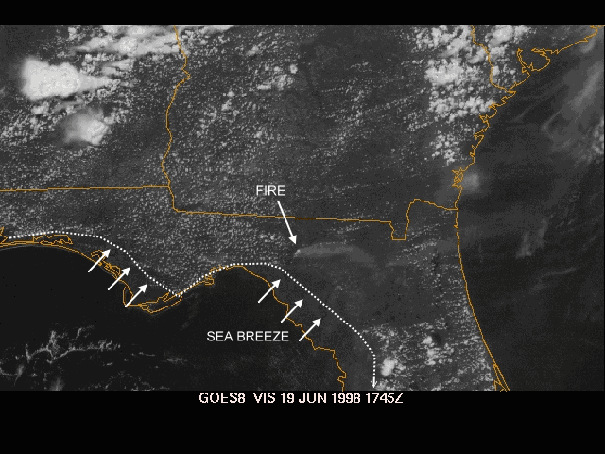
Notes:
Sea breeze blowing from ocean to land

