Slide 2
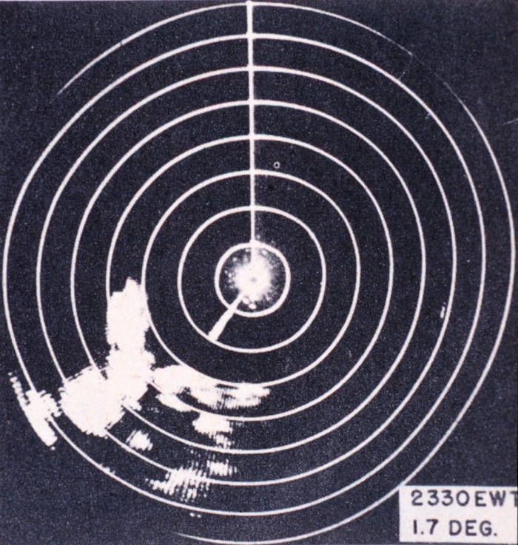
Notes:
Thunderstorms in Florida detected with WW 2 radar technology

Slide 3
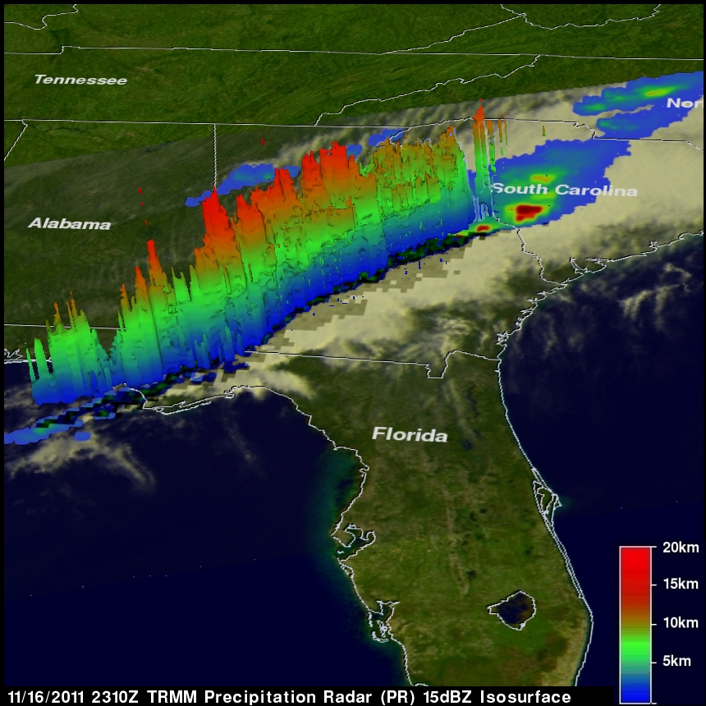
Notes:
TRMM data showing three-dimensional radar imaging of thunderstorms

Slide 4
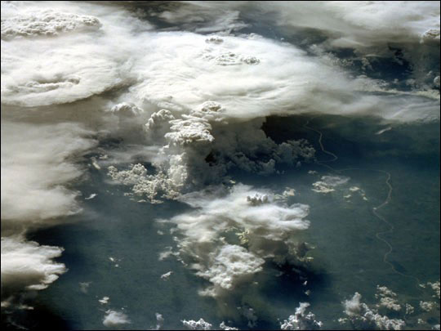

Slide 6
North American thunderstorm climatology
Spring, summer and fall sees active thunderstorms in southeastern and eastern US, Plains states, Rocky Mts and southwestern US
New England, Pacific northwest, coastal California, Hawaii have low thunderstorm frequencies
Thunderstorms can occur throughout the year, but are not typically a cold-season phenomena unless associated with a very strong cold front

Slide 7
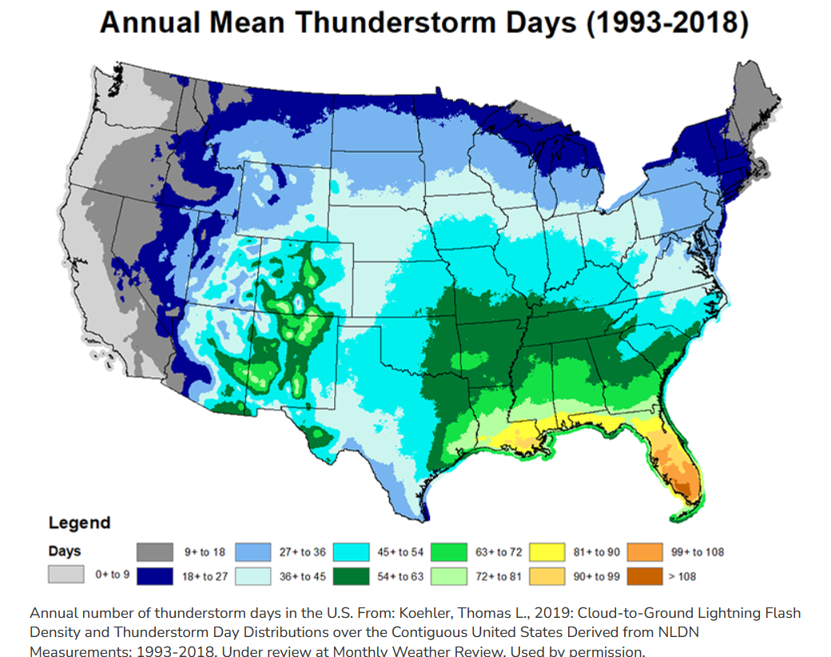

Slide 8
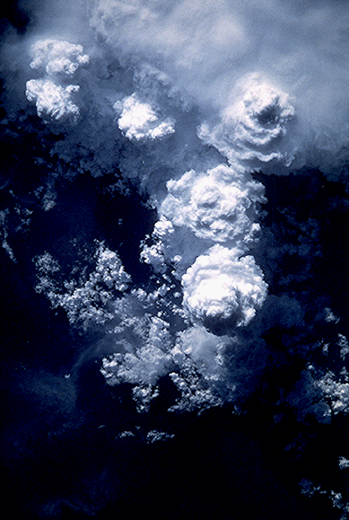
Requirement for thunderstorm formation:
Warm humid from the south air at lowest altitudes
Mid-level layer or dry, warm continental air from southwest
Fast, cold, dry air in the upper atmosphere, blowing out of the northwest
Notes:
Dry air is denser than warm air.
Water vapor is a relatively light gas when compared to oxygen and nitrogen. Thus, when water vapor increases, the amount of oxygen and nitrogen decrease per unit volume and thus density decreases because mass is decreasing. Water vapor, a lighter molecule, displaces heavier atoms if air gets moister. If air is drier, there are more atoms of heavier oxygen and nitrogen.

Slide 9
Notes:
https://youtu.be/bfRyGgqD7QI?si=iMcZTE3EUNM5Ahnx

Slide 10
Three stages of a thunderstorm
Notes:
Cumulus stage – dominated by updrafts Mature stage – updrafts and downdrafts coexist, gust front develops out of downdrafts
Dissipating stage – downdrafts predominate

Slide 11
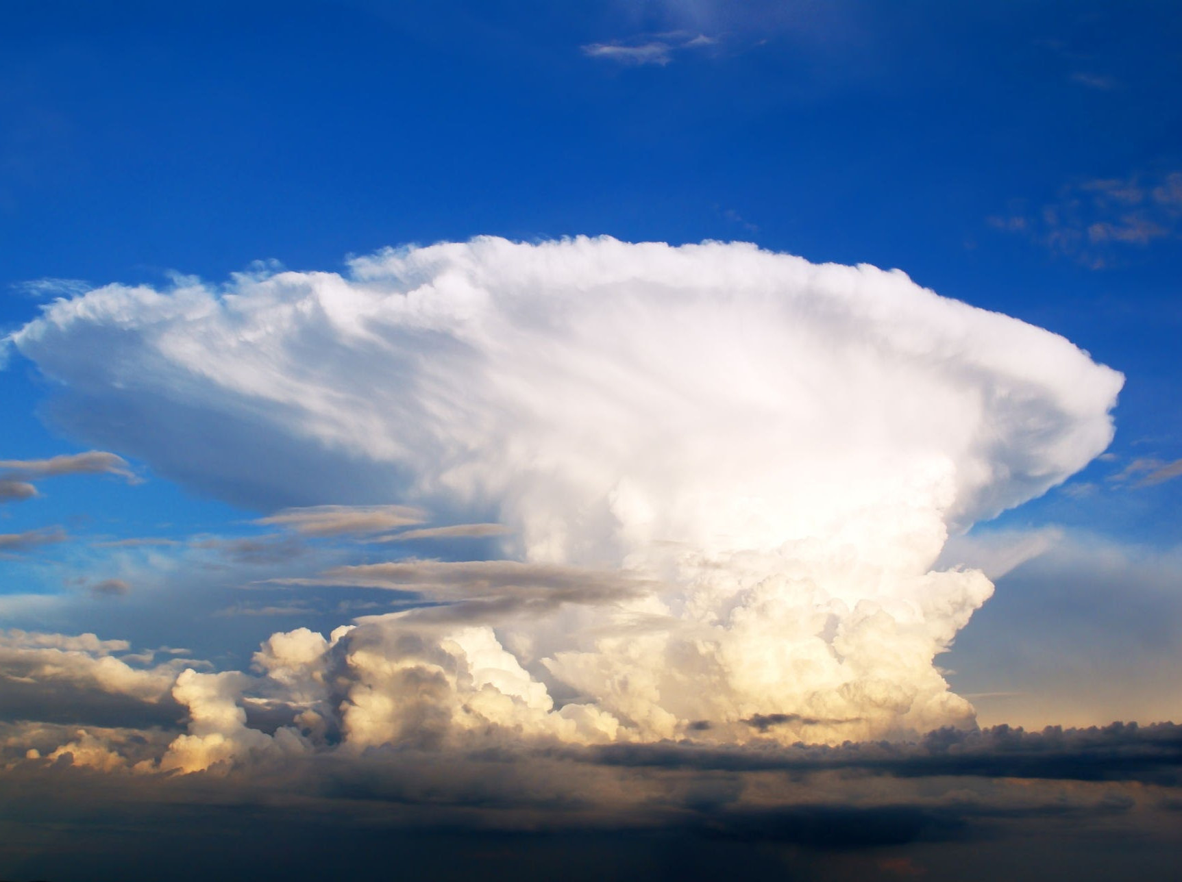
Thunderstorm types
Single cell or air mass tstorms
Multi cell cluster tstorms
Squall line tstorms (also called front-line or gust front tstorms. A derecho is a strong type of squall line storm
Supercell tstorms
Mesoscale convective systems

Slide 12
One-time updraft and one-time downdraft
Small, brief (an hour or two)
Driven by surface heating during summer
Short interval of heavy rain and small amounts of lightning.
Low severe weather potential
Single-cell thunderstorm
Notes:
Single cell air mass thunderstorms. These are self-extinguishing. Their outlflow boundaries do not set off other thunderstorms

Slide 13
Tstorm outflow boundaries
Notes:
Multi-cell cluster thunderstorms When downdrafts and the outflow boundaries they form trigger new thunderstorms, then we have multi-cell cluster thunderstorms

Slide 15
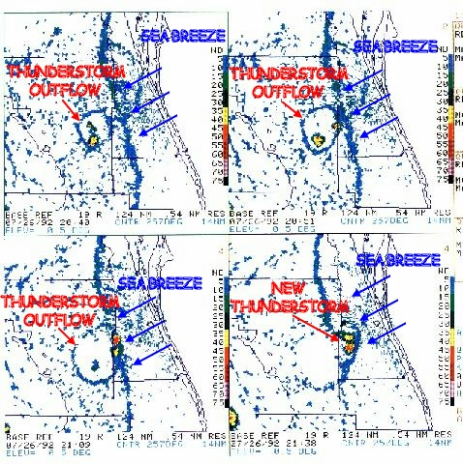
Outflow boundaries from single cells can initiate thunderstorm development nearby
In this image, a sea breeze and a tstorm outflow boundary collide and form another thunderstorm.

Slide 16
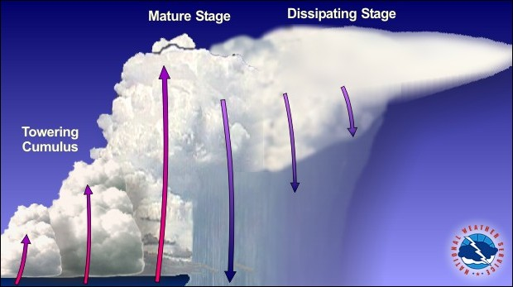
One thunderstorms sets up the formation of another
As the first cell matures, it is carried downstream by the upper level winds and a new cell forms upwind of the previous cell to take its place
Formation is initiated by outflow boundaries
Multi cell cluster tstorms

Slide 17
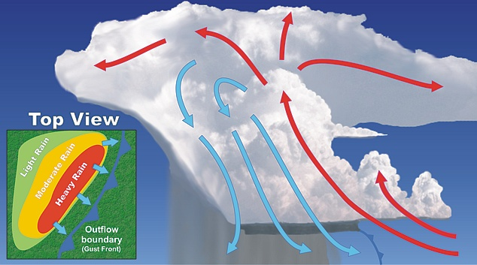
Notes:
The outflow boundary is shown as a cold front because the air is often cool, having just descended from high in the atmosphere. These outflow boundaries can trigger new thunderstorms. If these thunderstorms move in a long linear line they can form a squall line thunderstorms. These are also called gust front thunderstorms.

Slide 19
Squall line tstorms
Typically develops out ahead of a cold front and travels as long line of tstorms.
New cells continually re-form at leading edge due to lift of gust front
May produce strong front- line winds and tornadoes
Notes:
Self propagating

Slide 20
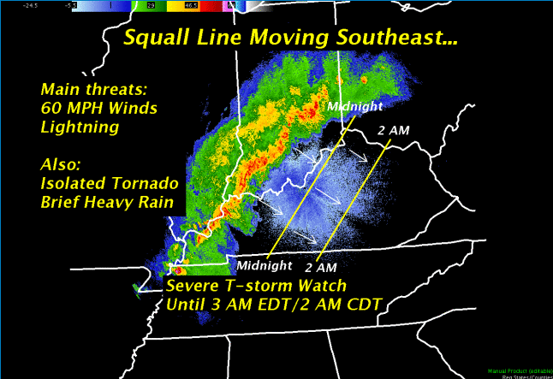

Slide 21
Notes:
Squall line severe thunderstorm

Slide 22
Supercell thunderstorm
Long-lived thunderstorm of several hours with a distinctive rotating updraft (mesocyclonic rotation).
Form in regions of strong vertical wind shear and wind divergence
Vertical wind shear: wind speeds up as you go higher in the atmosphere
Wind divergence: wind changes direction as you go higher in the atmosphere. For thunderstorms, divergence is from southerly winds at the surface to northwesterly in the upper levels.
Potential to produce powerful, long-lived tornadoes, hail, and high winds

Slide 23
Notes:
Mesocyclonic rotation in a supercell thunderstorm

Slide 24
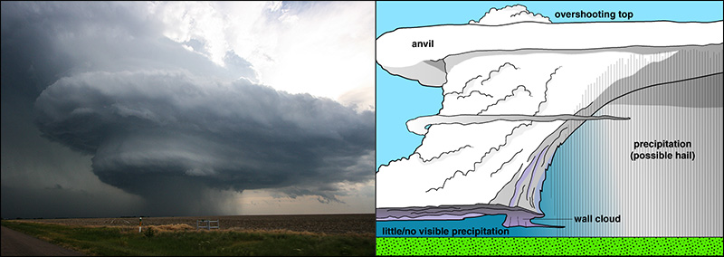

Slide 25
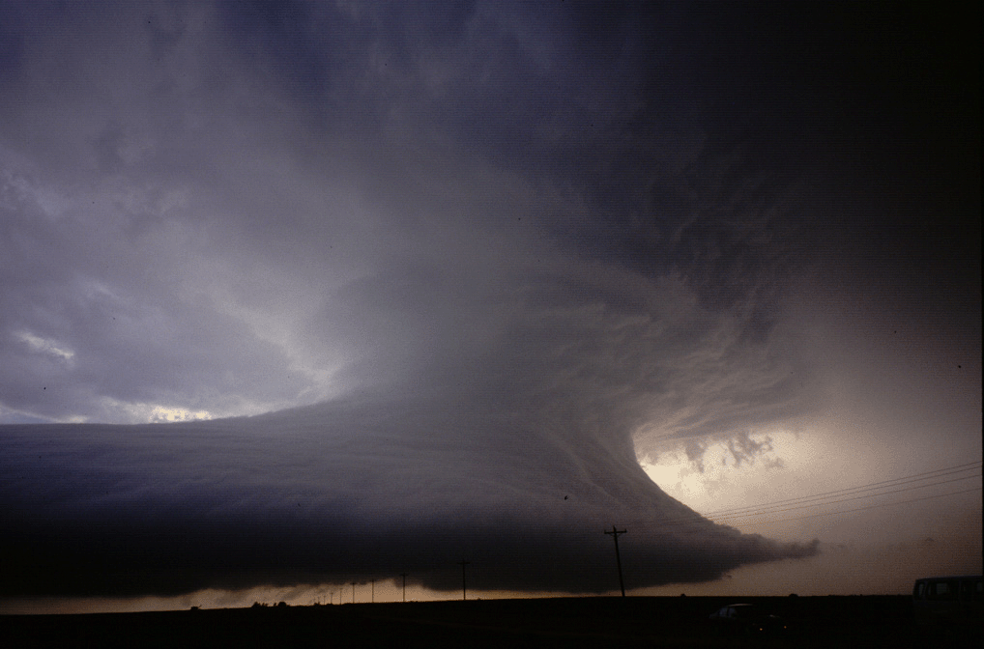
Notes:
Although supercells are relatively infrequent, they account for a large percentage of weather related destruction and deaths. Supercells often engender large hail, severe wind gusts, flooding rains, and destructive tornadoes.
The radar structure of a supercell is markedly different from its multicellular counterpart. A supercell in radar reflectivity imagery often contains a ‘hook echo'

Slide 26
Notes:
Video of supercell

Slide 27
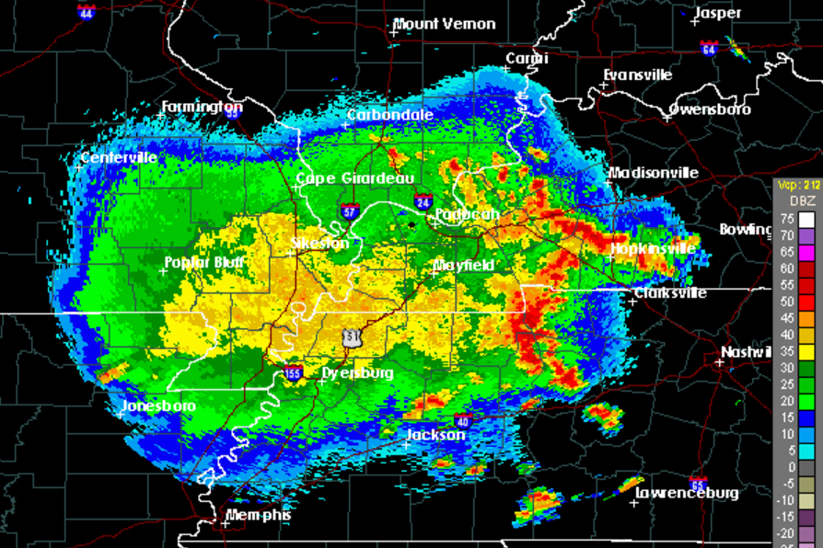
Mesoscale convective systems
Clusters of tstorms which are self propagating
Individual cells create downdrafts which interact to form new cells.
Largest systems can extend over several hundred square miles and persist for more than 12 hours
MCSs account for 30-70% of the warm season precipitation in the central United States.

Slide 28
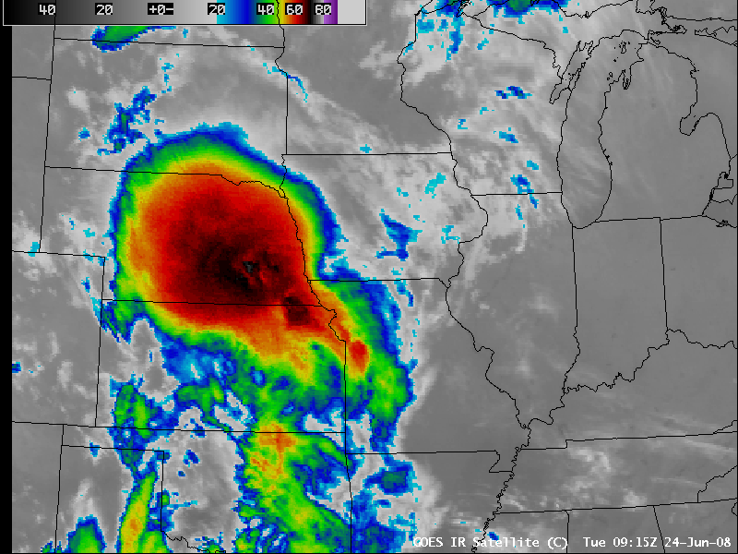
Notes:
MCS

Slide 29
Notes:
Schumacher, R.S., Rasmussen, K.L. The formation, character and changing nature of mesoscale convective systems. Nat Rev Earth Environ 1, 300–314 (2020). https://doi.org/10.1038/s43017-020-0057-7

Slide 30
Severe thunderstorm criteria and threat issuance from National Weather Service
Criteria: hail of at least 1 inch or severe (storm-force) winds of 58 mph or greater
Severe thunderstorm watch: conditions are favorable for their formation
Severe thunderstorm warning; detected and potential impact
Particularly Dangerous Situation (PDS): applied to severe thunderstorm watches and tornado watches that have the potential to be unusually severe
The Current Convective Outlook provides information about the likelihood of severe thunderstorms

Slide 31
Notes:
March 2012 tornado outbreak had numerous PDS issuances for severe thunderstorms and tornados. UK closed the campus in anticipation of these storms.

Slide 32
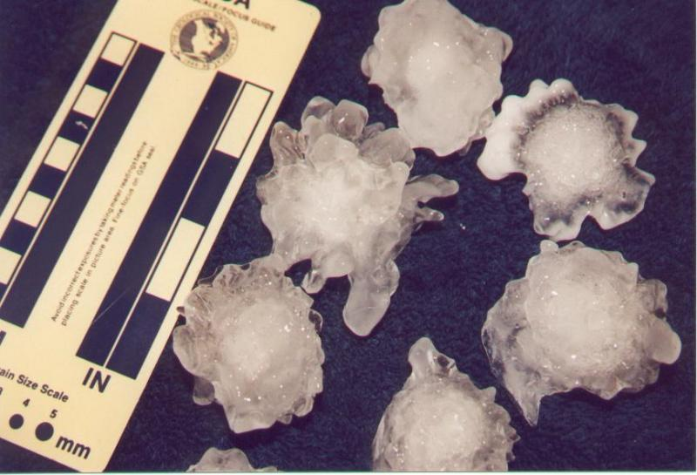
Notes:
Hailstones

Slide 33
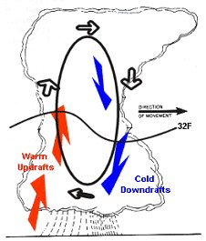
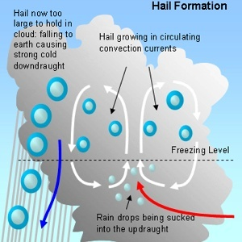
Hail
Occurs in strong to severe thunderstorms
Hail develops as updrafts and downdrafts circulate frozen droplets above and below the freezing line
Notes:
Each trip above and below the freezing level allows a layer of ice to accrete

Slide 34
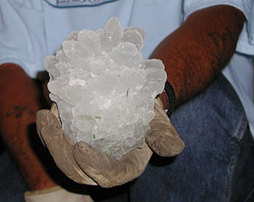
Notes:
Grapefruit-sized hailstone

Slide 35
Notes:
https://www.youtube.com/watch?v=DuMX9AM9BrE

Slide 36
Notes:
https://www.youtube.com/watch?v=Rzg0o1NmyPI

Slide 37
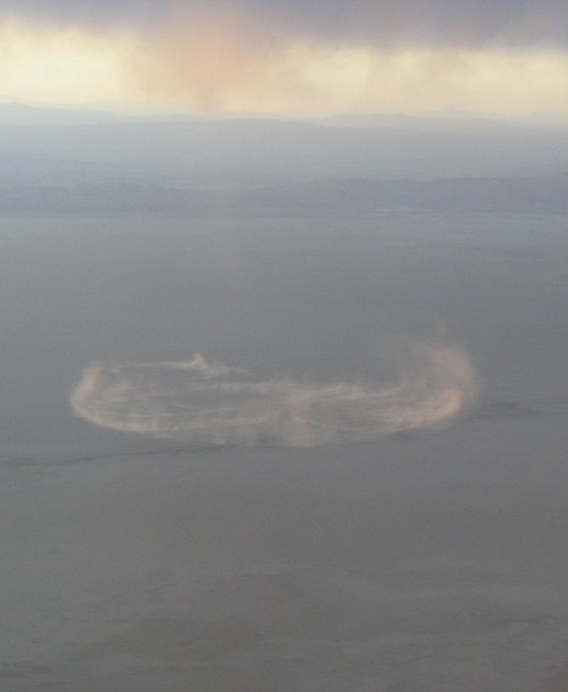
Downbursts
Strong downward and then outward moving winds that occur in the dissipating stages of a thunderstorm as outflow from thunderstorm lowers to the ground.
Microburst or macroburst: designation depends on size of area impacted.

Slide 38
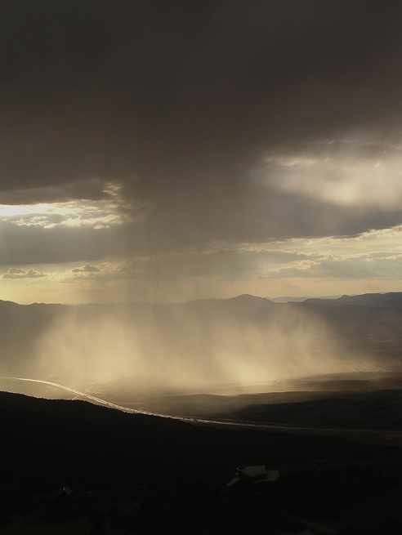
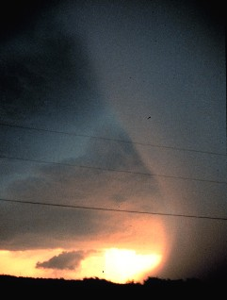

Slide 39
Notes:
The Delta Air Lines Flight 191 airplane crash at Dallas/Fort Worth International Airport (DFW) occurred around 6:05 P.M. CDT on August 2, 1985. The National https://www.weather.gov/fwd/delta191 Transportation Safety Board's (NTSB) Accident Board determined that the cause of the incident was wind-shear associated with an intense thunderstorm downdraft that occurred at the north end of the airport along runway 17 Left (17L). Today we know this intense, localized downburst as a microburst, a weather phenomenon that was not well understood at the time of the accident. For information on an intense, but slightly larger downburst, see macroburst. The table below lists several aircraft incidents in which weather played a major role or was the direct cause for the loss of life and/or the loss of the airplane. The Delta Air Lines Flight 191 accident marked the 3rd event between 1975 and 1985 in which more than 100 fatalities occurred in an aircraft incident due to a microburst in the United States. The events on August 2, 1985, as well as other dates (see table below) likely helped to drive the need to reform aviation weather safety. These needs included the improved the detection of hazardous weather to aircraft using remote sensing instruments, equipping pilots and aircraft with tools to identify weather hazards to aircraft and continued collaboration between the National Weather Service (NWS) and Federal Aviation Administration (FAA).

Slide 40
Notes:
https://www.youtube.com/watch?v=a_G2KRzha7o

Slide 41
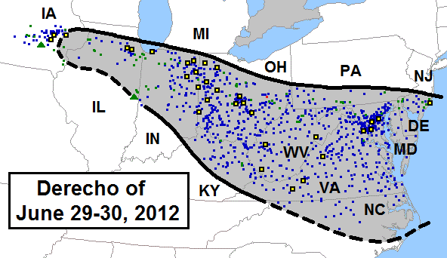
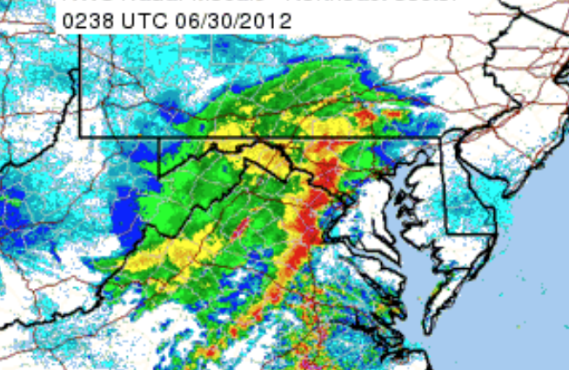
Derechos
A straight-line wind event originating from the outflow boundary ahead of a gust front
Appears as a bow-shaped image in Doppler radar
These front-line winds can extend over hundreds of miles
Derechos are capable of producing winds of 100 miles per hour, downing trees and power lines

Slide 42
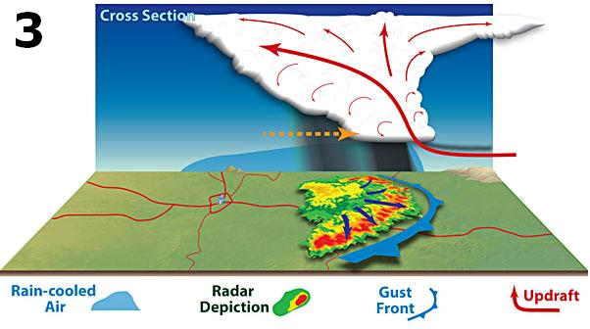

Slide 43
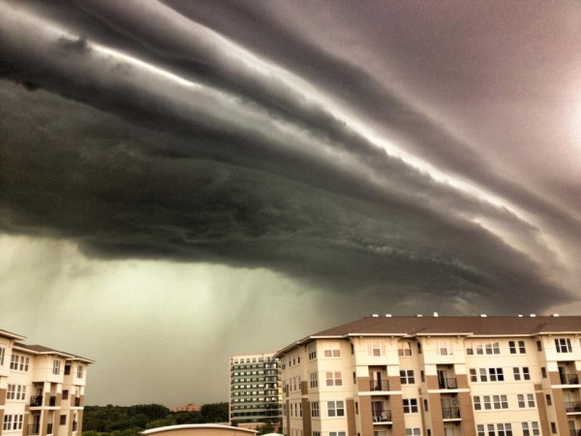
Notes:
Approaching gust front and derecho in Chicago in June 2012

Slide 44
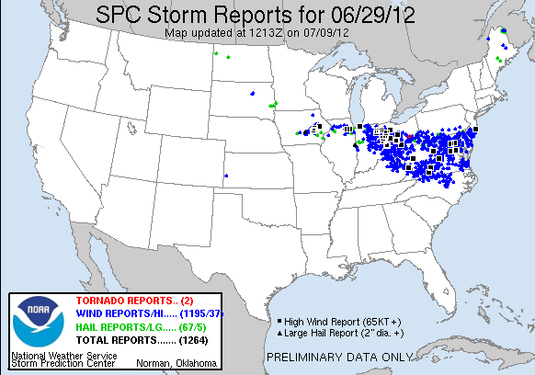
Notes:
June 29, 2012 Eastern US- Mid Atlantic Derecho https://earthsky.org/earth/videos-and-images-violent-us-storm-of-june-29-2012/

Slide 45
Notes:
https://youtu.be/0MG7aOjZciY?si=tEMTTPPxwRWrHN7D

Slide 46
Notes:
https://youtu.be/ZtauyyeF-mo?si=pNkOuGxYSJFBqrqt

Slide 47
Tornadoes
Notes:
https://youtu.be/2GuCguODZbY?si=l7-IBVDDnsGX3beR

Slide 48
April 2011 Tornado outbreak (Joplin, Missouri)
Notes:
https://youtu.be/cQnvxJZucds?si=YTzL2xpK9ISwgF-7

Slide 49
Notes:
https://youtu.be/W-P4P68YyNM?si=cFZAbCSkg18qE-TD

Slide 50
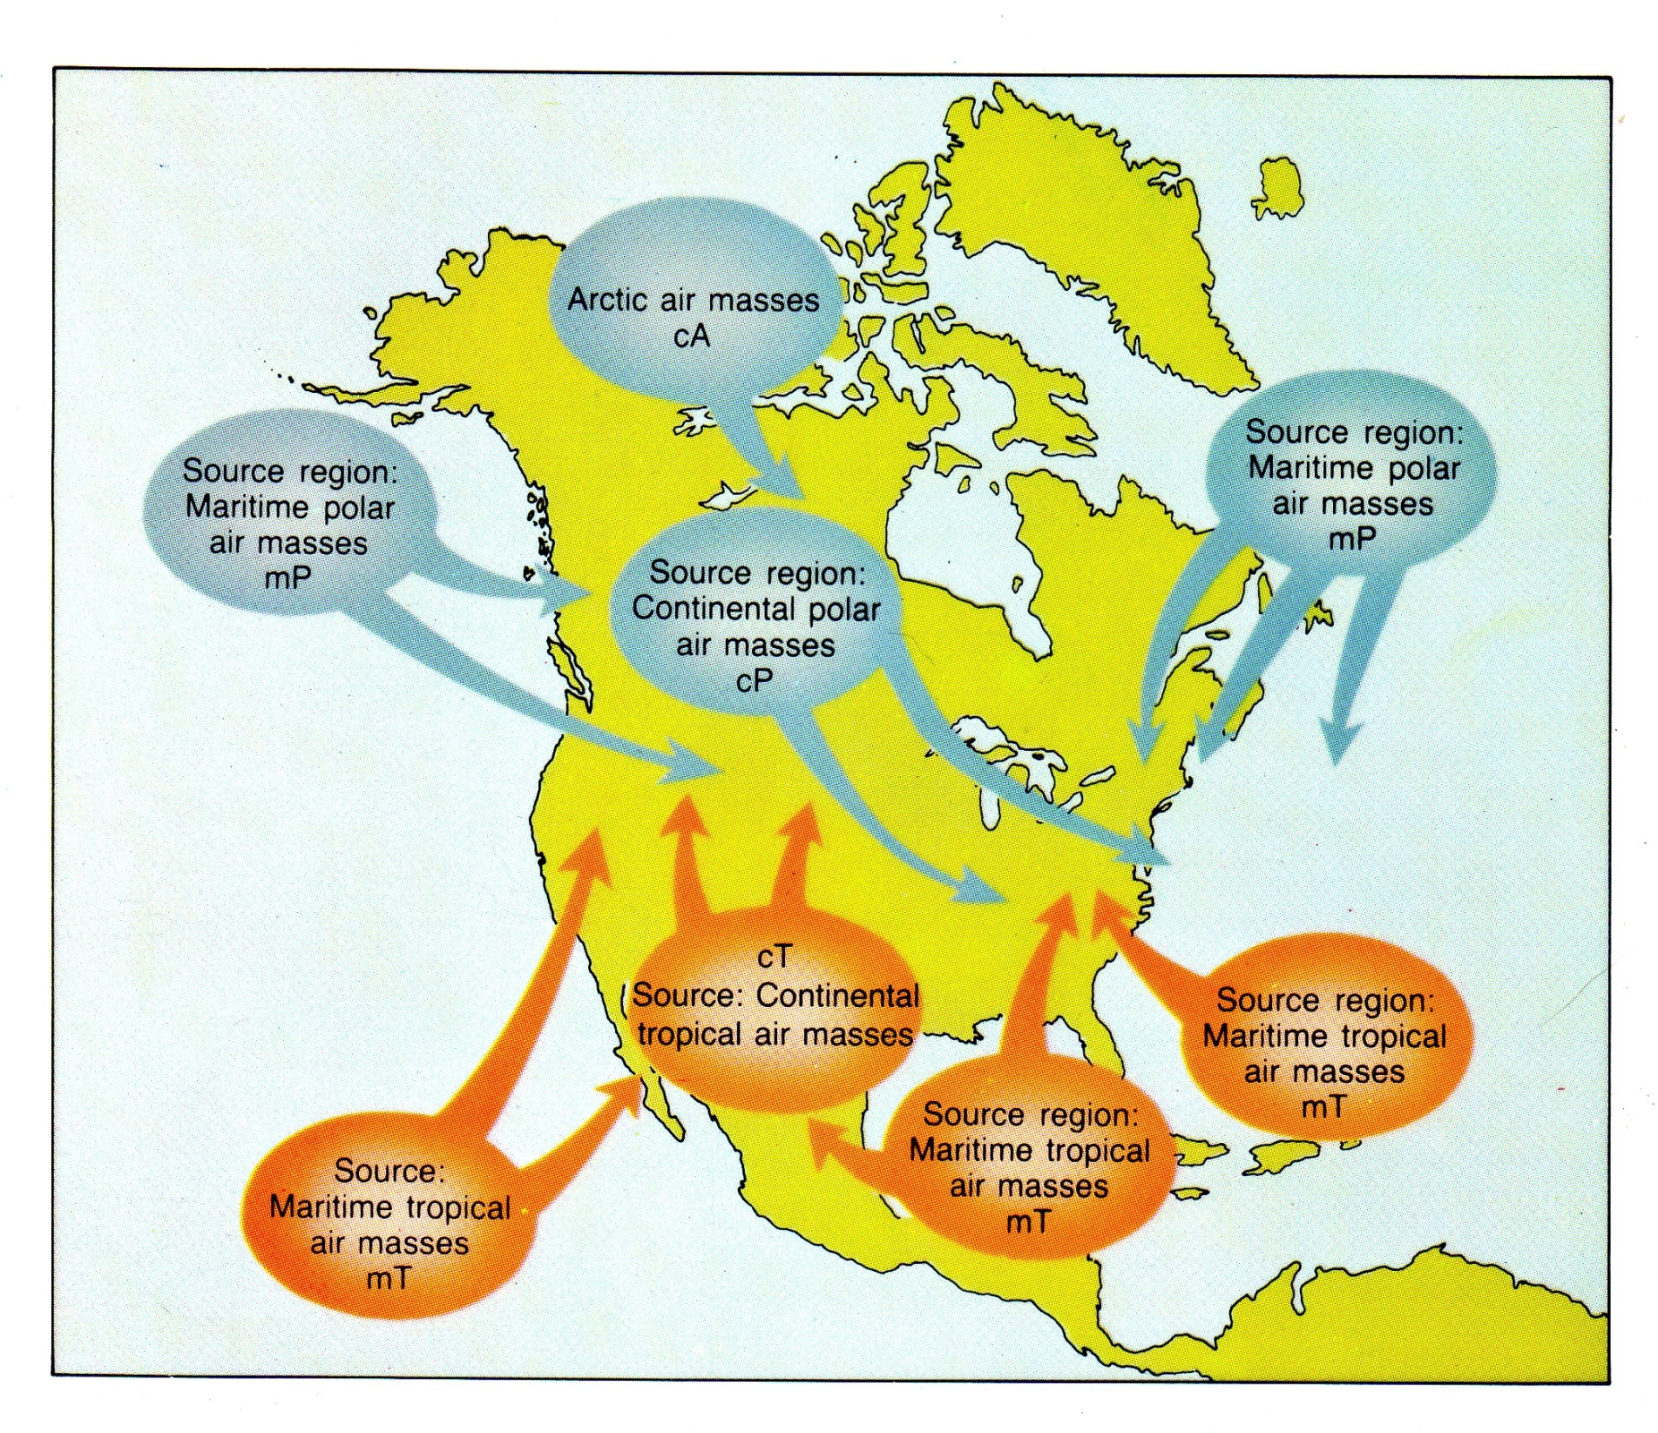
Conditions needed for tornadoes
A location where severe thunderstorms can form
North America is excellent location for tornadic thunderstorms because of how continental polar air masses and maritime tropical airmasses can collide in the central US unimpeded by mountain ranges
Tornado season is typically in the spring for North America, but tornadoes can occur throughout the year

Slide 52
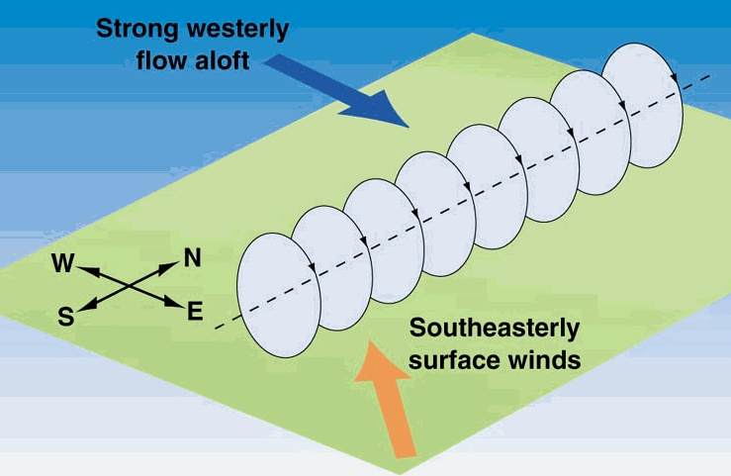
Tornadogenesis
Horizontal vorticity develops because of wind shear (wind speeds increase with altitude)
Horizontal vorticity sets up the initial basic rotational motion
Horizontal vorticity is entrained in an updraft
When vorticity is stretched and pulled up into the updraft, the winds rotate faster

Slide 53
Supercells are the best type of tstorm for tornadogenesis of its mesocyclonic circulation
This rotational component of supercells enhances likelihood of a tornado and the potential for it to be large and to maintain its structure
Notes:
Keep in mind that the mesocyclonic circulation of a supercell is not the tornado

Slide 54
Notes:
Downdrafts warm adiabatically as they descend and pick up heat at the surface, which in turn enhances uplift

Slide 55
Notes:
https://youtu.be/lHBZylcxIvw?si=Bmd0qTYXFVeuu34z

Slide 56
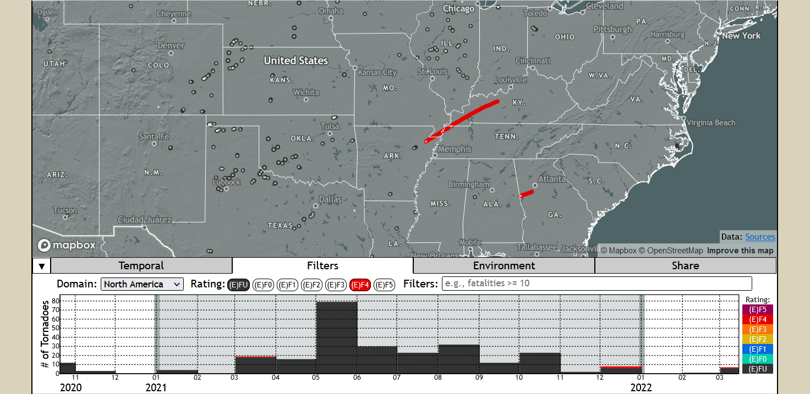
More tornadoes are occurring on days when there are large tornado outbreaks
April 1974 outbreak, 148 tornadoes and $5.26 billion in damages (13 states)
April 2011 outbreak: 362 tornadoes and $10 billion in damages (21 states)
Notes:
https://tornadoarchive.com/
A little over 300 people died in each of these two events over multistate areas
Researchers have recently documented an an upward trend in the annual mean number of tornadoes per US tornado outbreak. Tippett, M. K., Lepore, C., & Cohen, J. E. (2016). More tornadoes in the most extreme US tornado outbreaks. Science, 354(6318), 1419-1423.
Tippett, M. K., & Cohen, J. E. (2016). Tornado outbreak variability follows Taylor’s power law of fluctuation scaling and increases dramatically with severity. Nature Communications, 7(1), 10668.

Slide 57
April 2011 Tornado outbreak (Tuscaloosa, Alabama)
Notes:
Tuscaloosa, Alabama 2011 outbreak https://youtu.be/FyszJj0VEVU?si=SnN1F47TX6pm2kSB

Slide 58
Notes:
https://youtu.be/7k153ho6vFU?si=o_Rn5BPuDYwBiNyf

Slide 59
Notes:
https://youtu.be/fQkFgF5O7H8?si=TyNPMibYnyTeEqek

Slide 60
Dec 2021 tornado outbreak: Arkansas, Tennessee, Kentucky

Slide 61
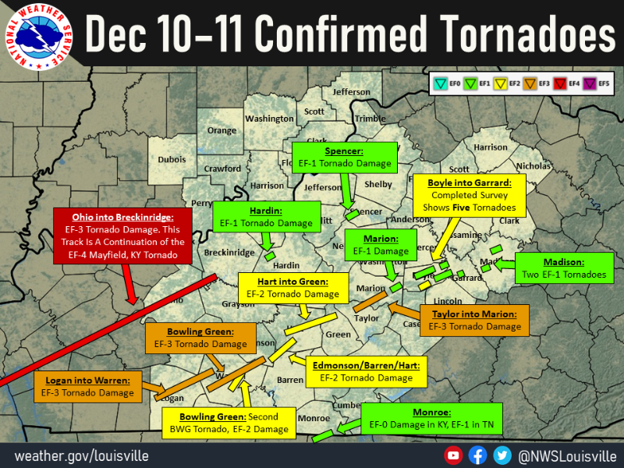
Notes:
https://www.weather.gov/lmk/December112021Tornadoes

Slide 62
Notes:
Near West Liberty Kentucky

Slide 63
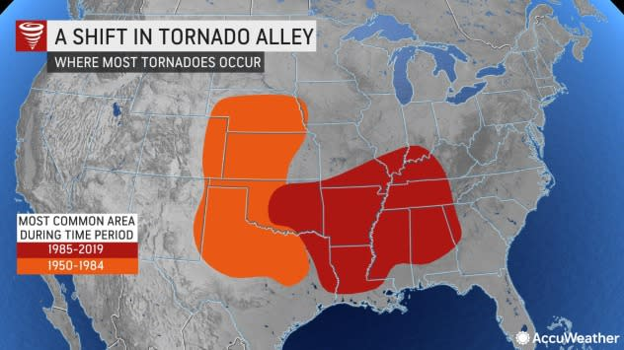
Notes:
Both locations offer a mountain free zone for continental polar air masses from the north to collide with marine tropical airmass from the south. The location of this tornado ‘alley’ has shifted in the last few decades toward the southeastern US

Slide 64
Notes:
Blue areas indicate where tornados have decreased since 1979. Yellow and red areas are where they have increased. Hatched lines indicate statistically significant changes. doi:10.1038/s41612-018-0048-2 Severe thunderstorms accompanied by tornadoes, hail, and damaging winds cause an average of 5.4 billion dollars of damage each year across the United States, and 10 billion-dollar events are no longer uncommon. This overall economic and casualty risk—with over 600 severe thunderstorm related deaths in 2011—has prompted public and scientific inquiries about the impact of climate change on tornadoes. We show that national annual frequencies of tornado reports have remained relatively constant, but significant spatially-varying temporal trends in tornado frequency have occurred since 1979. Negative tendencies of tornado occurrence have been noted in portions of the central and southern Great Plains, while robust positive trends have been ocumented in portions of the Midwest and Southeast United States. This temporal change of spatial patterns in tornado activity for successive cold and warm periods may be suggestive of climate change effects yet warrants the climatological study of meteorological parameters responsible for tornado formation

Slide 65
Gustnado
Develops along a tstorm gust front – not a true tornado
They are typically weak and short-lived since they are not associated with an intense deeply rotating updraft
They can produce damage locally restricted damage.
Notes:
http://www.accuweather.com/en/weather-news/indiana-stage-collapse-gustnad/53798?partner=

Slide 66
Waterspouts
Waterspouts arise over warm seas and ttypically occur during the developing stage of small single-cell thunderstorms that have very little vertical wind shear.
Although winds are weaker than in a tornado, they still have the potential to do damage if they move ashore

