Slide 2
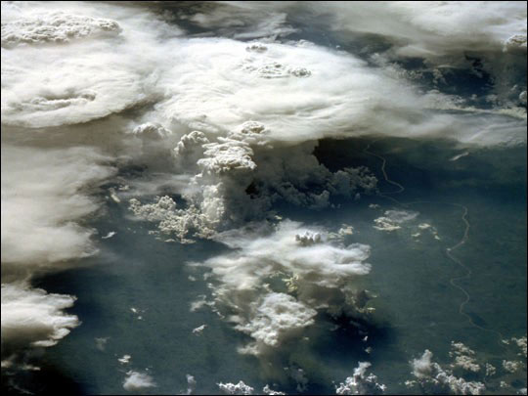

Slide 4
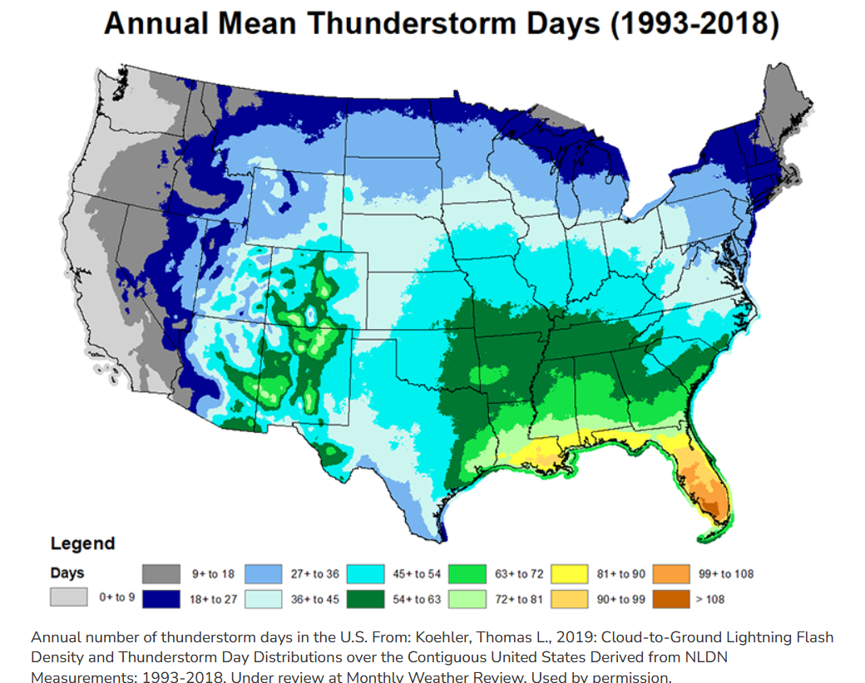

Slide 5
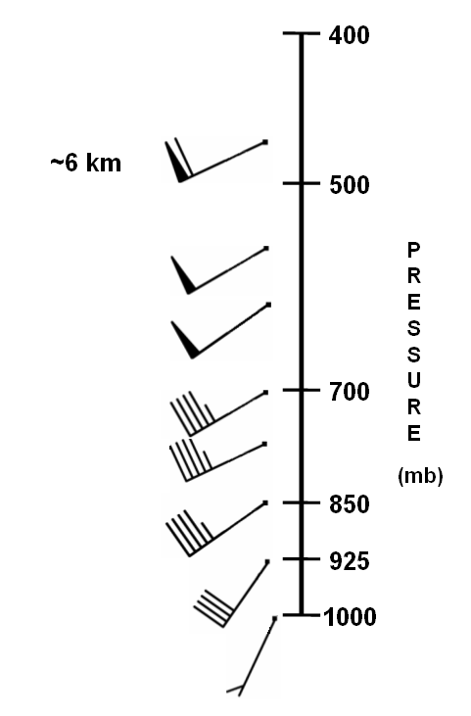
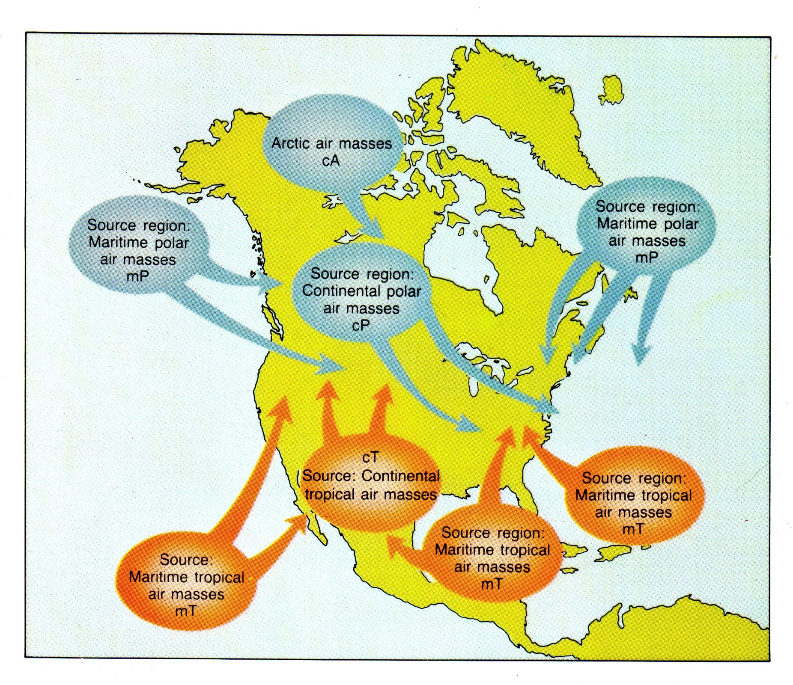
Notes:
Dry air is denser than warm air.
Water vapor is a relatively light gas when compared to oxygen and nitrogen. Thus, when water vapor increases, the amount of oxygen and nitrogen decrease per unit volume and thus density decreases because mass is decreasing. Water vapor, a lighter molecule, displaces heavier atoms if air gets moister. If air is drier, there are more atoms of heavier oxygen and nitrogen.

Slide 6
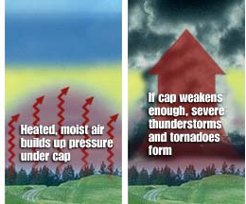

Slide 7
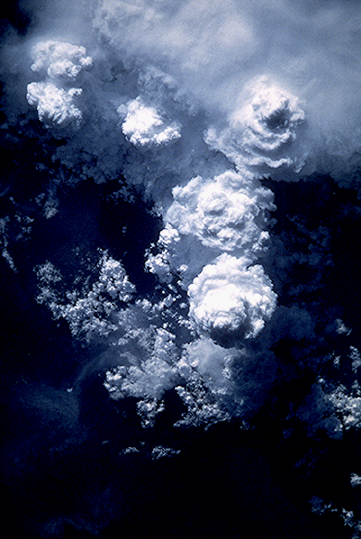
Notes:
https://youtu.be/bfRyGgqD7QI?si=iMcZTE3EUNM5Ahnx

Slide 8
Notes:
Cumulus stage – dominated by updrafts Mature stage – updrafts and downdrafts coexist, gust front develops out of downdrafts
Dissipating stage – downdrafts predominate

Slide 9
Notes:
Single cell air mass thunderstorms. These are self-extinguishing. Their outlflow boundaries do not set off other thunderstorms

Slide 10
Notes:
Multi-cell cluster thunderstorms When downdrafts and the outflow boundaries they form trigger new thunderstorms, then we have multi-cell cluster thunderstorms

Slide 12
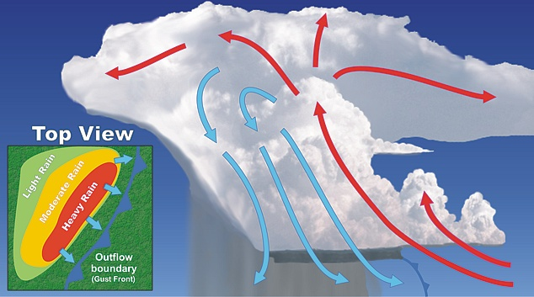
Notes:
The outflow boundary is shown as a cold front because the air is often cool, having just descended from high in the atmosphere. These outflow boundaries can trigger new thunderstorms. If these thunderstorms move in a long linear line they can form a squall line thunderstorms. These are also called gust front thunderstorms.

Slide 14
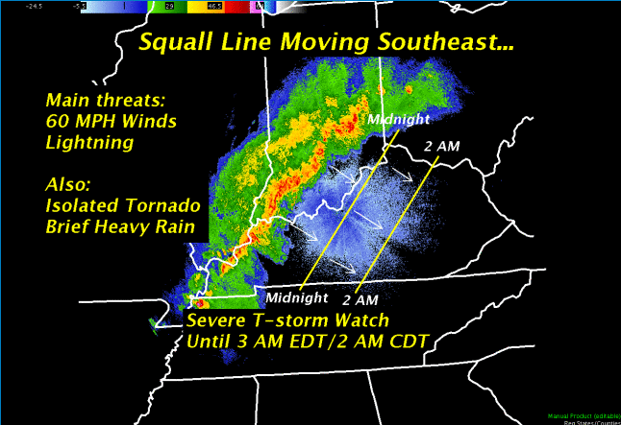

Slide 15
Notes:
Squall line severe thunderstorm

Slide 16
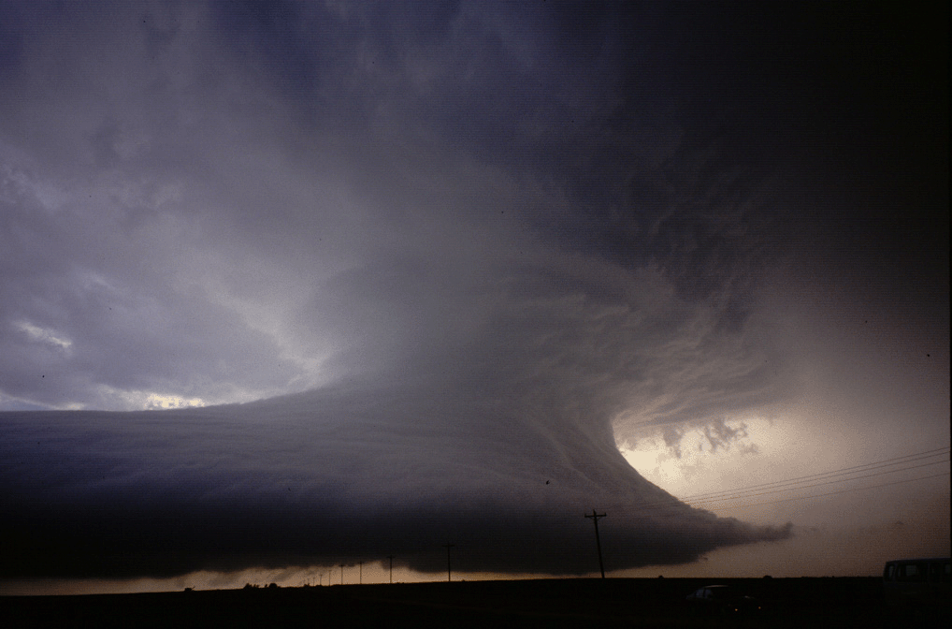
Notes:
Although supercells are relatively infrequent, they account for a large percentage of weather related destruction and deaths. Supercells often engender large hail, severe wind gusts, flooding rains, and destructive tornadoes.
The radar structure of a supercell is markedly different from its multicellular counterpart. A supercell in radar reflectivity imagery often contains a ‘hook echo'

Slide 17
Notes:
Video of supercell

Slide 18
Notes:
Mesocyclonic rotation in a supercell thunderstorm

Slide 19
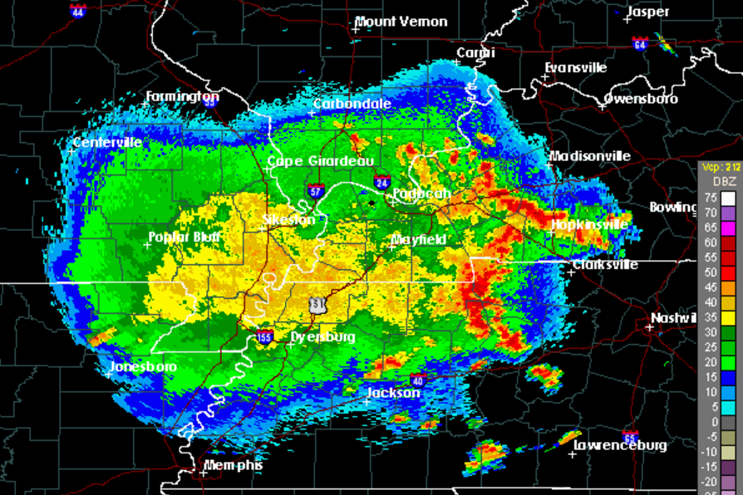

Slide 20
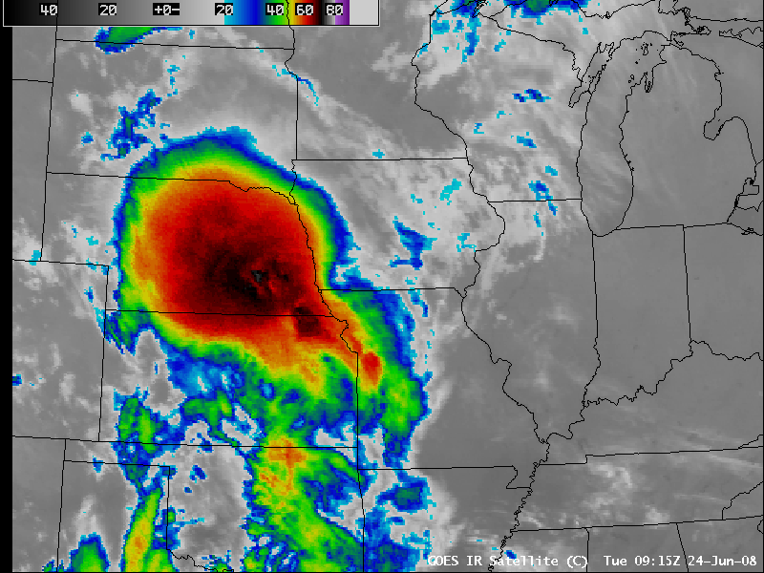
Notes:
MCS

Slide 21
Notes:
Schumacher, R.S., Rasmussen, K.L. The formation, character and changing nature of mesoscale convective systems. Nat Rev Earth Environ 1, 300–314 (2020). https://doi.org/10.1038/s43017-020-0057-7

Slide 22
Notes:
March 2012 tornado outbreak had numerous PDS issuances for severe thunderstorms and tornados. UK closed the campus in anticipation of these storms.

Slide 23
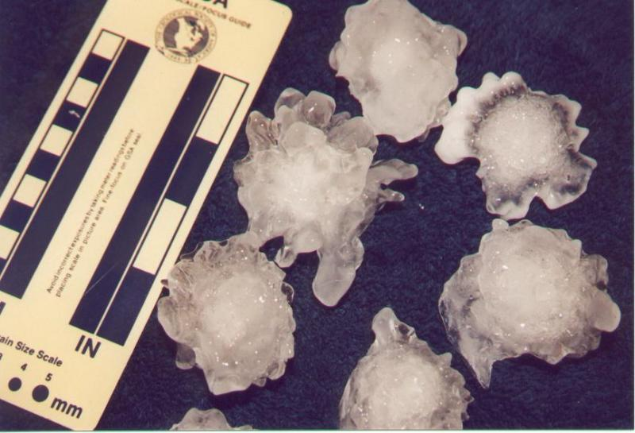
Notes:
Hailstones

Slide 24
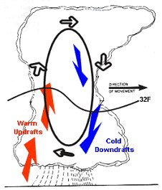
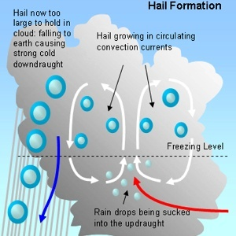
Notes:
Each trip above and below the freezing level allows a layer of ice to accrete

Slide 25
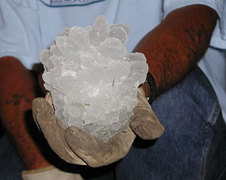
Notes:
Grapefruit-sized hailstone

Slide 26
Notes:
https://www.youtube.com/watch?v=DuMX9AM9BrE

Slide 27
Notes:
https://www.youtube.com/watch?v=Rzg0o1NmyPI

Slide 28
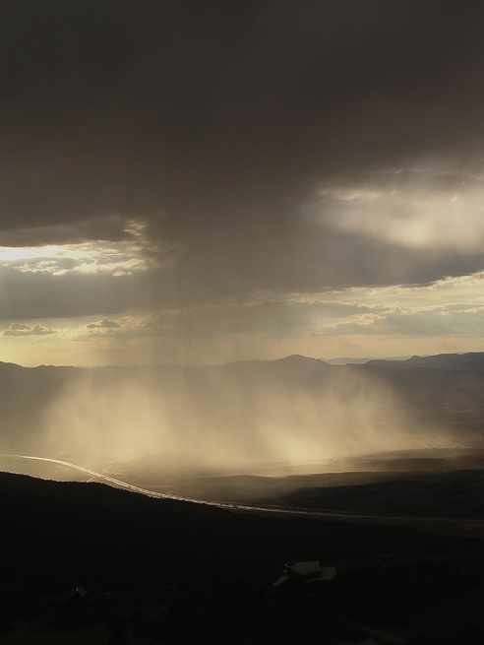
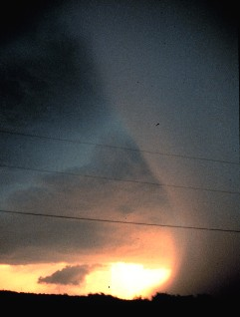

Slide 29
Notes:
The Delta Air Lines Flight 191 airplane crash at Dallas/Fort Worth International Airport (DFW) occurred around 6:05 P.M. CDT on August 2, 1985. The National https://www.weather.gov/fwd/delta191 Transportation Safety Board's (NTSB) Accident Board determined that the cause of the incident was wind-shear associated with an intense thunderstorm downdraft that occurred at the north end of the airport along runway 17 Left (17L). Today we know this intense, localized downburst as a microburst, a weather phenomenon that was not well understood at the time of the accident. For information on an intense, but slightly larger downburst, see macroburst. The table below lists several aircraft incidents in which weather played a major role or was the direct cause for the loss of life and/or the loss of the airplane. The Delta Air Lines Flight 191 accident marked the 3rd event between 1975 and 1985 in which more than 100 fatalities occurred in an aircraft incident due to a microburst in the United States. The events on August 2, 1985, as well as other dates (see table below) likely helped to drive the need to reform aviation weather safety. These needs included the improved the detection of hazardous weather to aircraft using remote sensing instruments, equipping pilots and aircraft with tools to identify weather hazards to aircraft and continued collaboration between the National Weather Service (NWS) and Federal Aviation Administration (FAA).

Slide 30
Notes:
https://www.youtube.com/watch?v=a_G2KRzha7o

Slide 31
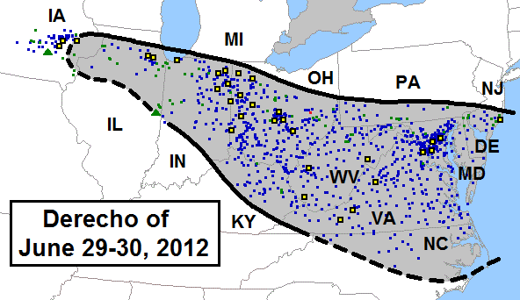
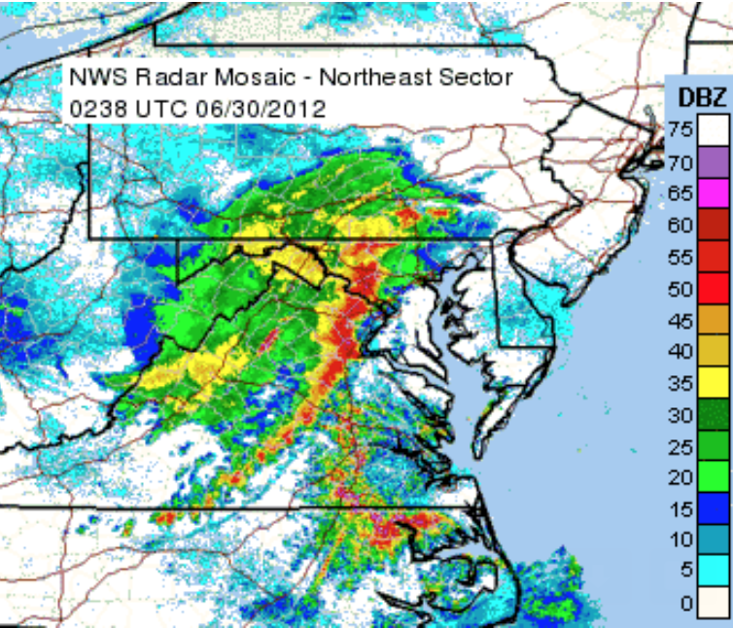

Slide 32
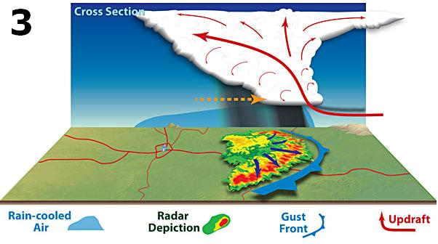

Slide 33
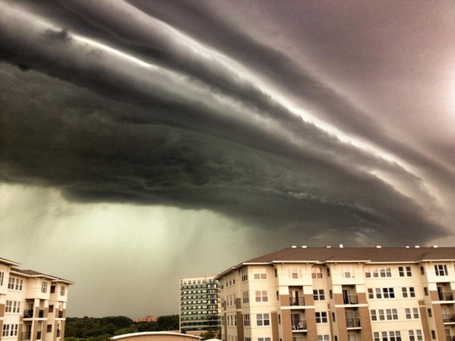
Notes:
Approaching gust front and derecho in Chicago in June 2012

Slide 34
Notes:
https://youtu.be/0MG7aOjZciY?si=tEMTTPPxwRWrHN7D

Slide 35
Notes:
https://youtu.be/ZtauyyeF-mo?si=pNkOuGxYSJFBqrqt

Slide 36
Tornadoes
Notes:
https://youtu.be/2GuCguODZbY?si=l7-IBVDDnsGX3beR

Slide 37
April 2011 Tornado outbreak (Joplin, Missouri)
Notes:
https://youtu.be/cQnvxJZucds?si=YTzL2xpK9ISwgF-7

Slide 38
Notes:
https://youtu.be/W-P4P68YyNM?si=cFZAbCSkg18qE-TD

Slide 40
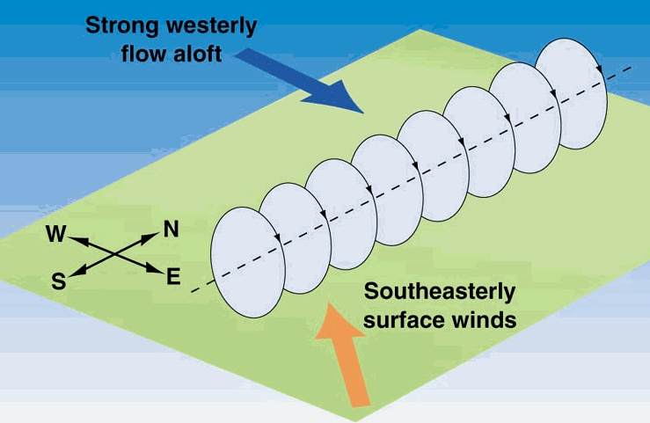

Slide 41
Notes:
Keep in mind that the mesocyclonic circulation of a supercell is not the tornado

Slide 42
Notes:
https://youtu.be/lHBZylcxIvw?si=Bmd0qTYXFVeuu34z

Slide 43
Notes:
Tuscaloosa, Alabama 2011 outbreak https://youtu.be/FyszJj0VEVU?si=SnN1F47TX6pm2kSB

Slide 44
Notes:
https://youtu.be/7k153ho6vFU?si=o_Rn5BPuDYwBiNyf

Slide 45
Notes:
https://youtu.be/fQkFgF5O7H8?si=TyNPMibYnyTeEqek

Slide 46
Notes:
Near West Liberty Kentucky

Slide 47
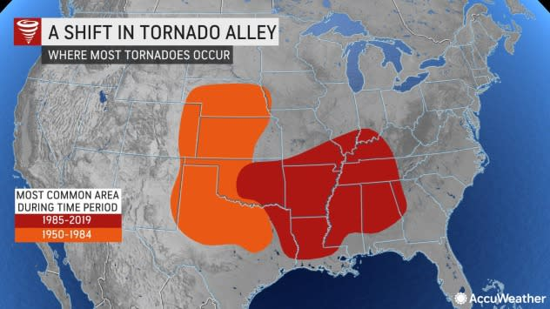
Notes:
Both locations offer a mountain free zone for continental polar air masses from the north to collide with marine tropical airmass from the south. The location of this tornado ‘alley’ has shifted in the last few decades toward the southeastern US

Slide 48
Notes:
Blue areas indicate where tornados have decreased since 1979. Yellow and red areas are where they have increased. Hatched lines indicate statistically significant changes. doi:10.1038/s41612-018-0048-2 Severe thunderstorms accompanied by tornadoes, hail, and damaging winds cause an average of 5.4 billion dollars of damage each year across the United States, and 10 billion-dollar events are no longer uncommon. This overall economic and casualty risk—with over 600 severe thunderstorm related deaths in 2011—has prompted public and scientific inquiries about the impact of climate change on tornadoes. We show that national annual frequencies of tornado reports have remained relatively constant, but significant spatially-varying temporal trends in tornado frequency have occurred since 1979. Negative tendencies of tornado occurrence have been noted in portions of the central and southern Great Plains, while robust positive trends have been ocumented in portions of the Midwest and Southeast United States. This temporal change of spatial patterns in tornado activity for successive cold and warm periods may be suggestive of climate change effects yet warrants the climatological study of meteorological parameters responsible for tornado formation

Slide 49
Notes:
http://www.accuweather.com/en/weather-news/indiana-stage-collapse-gustnad/53798?partner=

