Slide 1
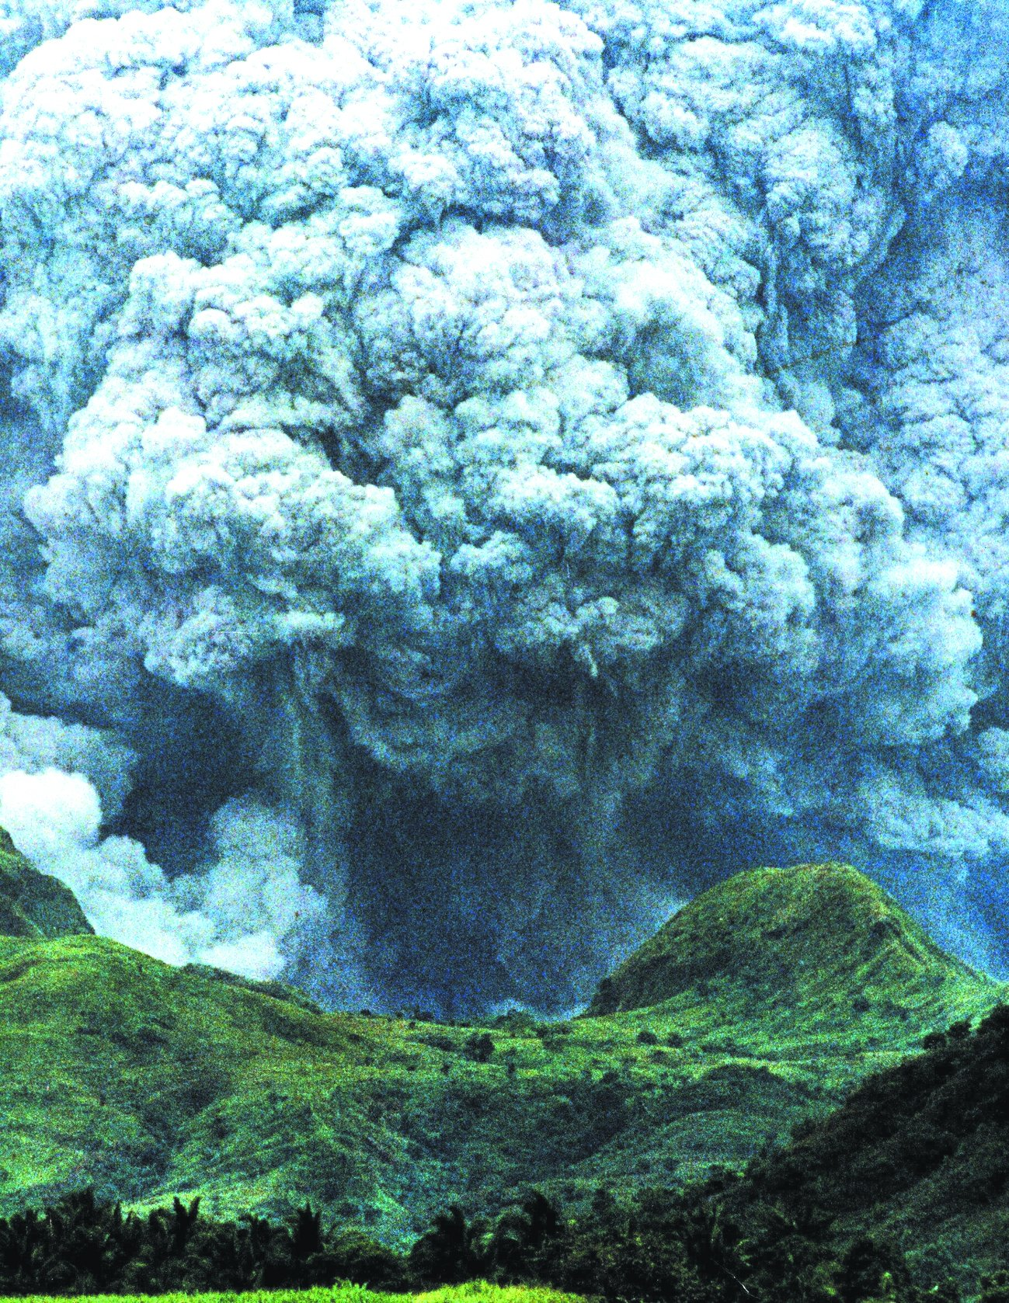
Volcanic landforms and processes

Slide 3
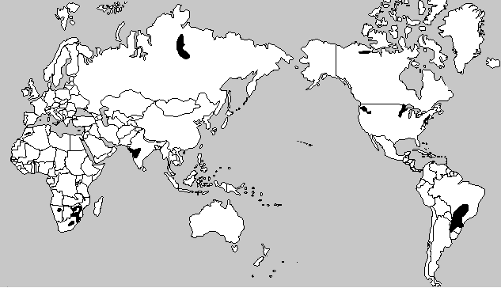
Within-plate volcanics: flood basalts
Notes:
Black areas are flood basalts

Slide 4
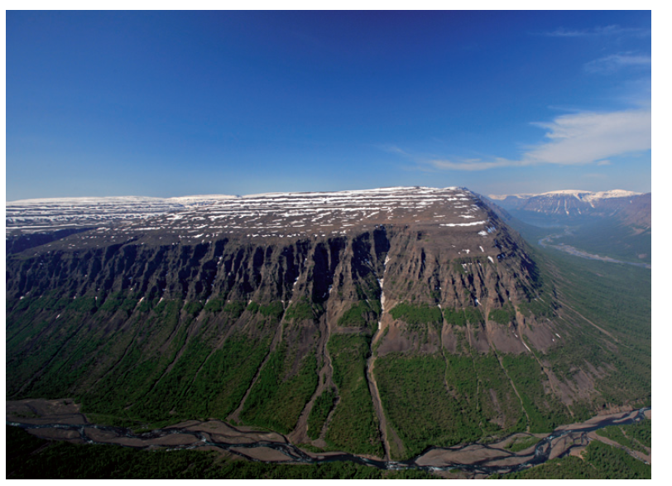
Notes:
Siberian Traps

Slide 5
Flood basalts
Huge volcanic eruptions that cover large areas with thick, flat layers of lava.
Not from one volcano, but many cracks and fissures in the ground.
Low-viscosity basalt: lava is runny and spreads far and wide.
Builds up in layers: over time, creates large plateaus.
Not at plate boundaries: often linked to deep mantle plumes (i.e., hotspots)

Slide 6
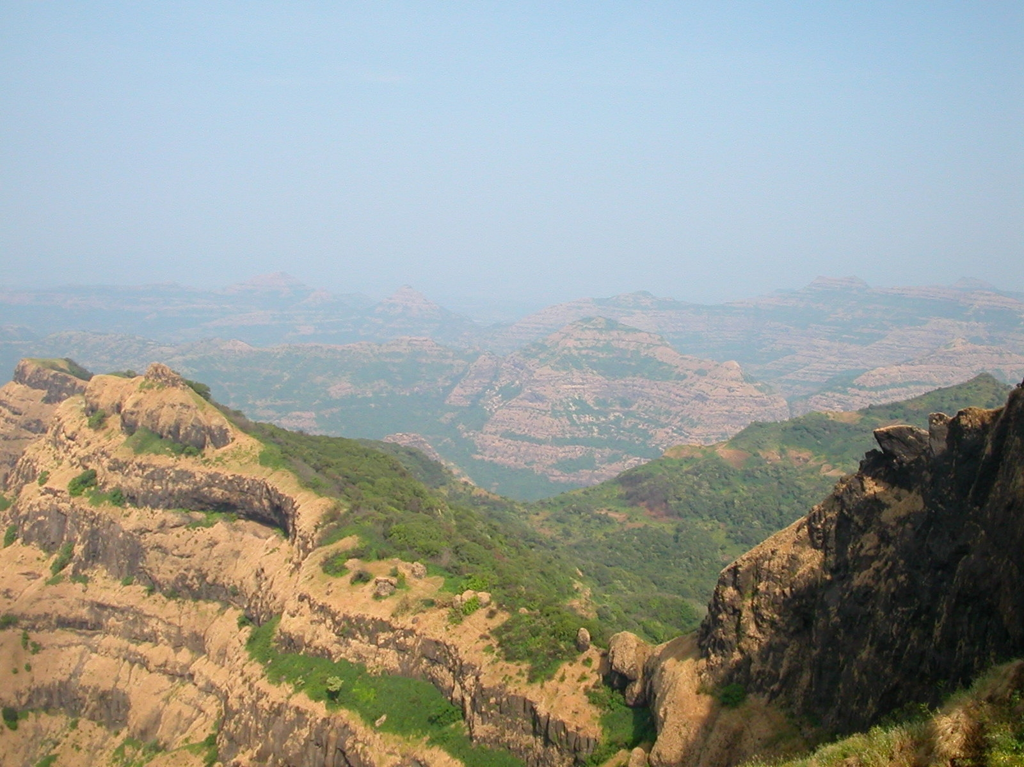
Notes:
The Deccan Traps are one of the largest volcanic provinces in the world. It consists of more than 6,500 feet (>2,000 m) of flat-lying basalt lava flows and covers an area of nearly 200,000 square miles (500,000 square km) (roughly the size of the states of Washington and Oregon combined) in west-central India. Estimates of the original area covered by the lava flows are as high as 600,000 square miles (1.5 million square km). The volume of basalt is estimated to be 12,275 cubic miles (512,000 cubic km)(the 1980 eruption of Mount St. Helens produced 1 cubic km of volcanic material).

Slide 7
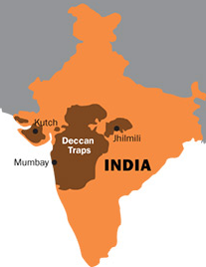
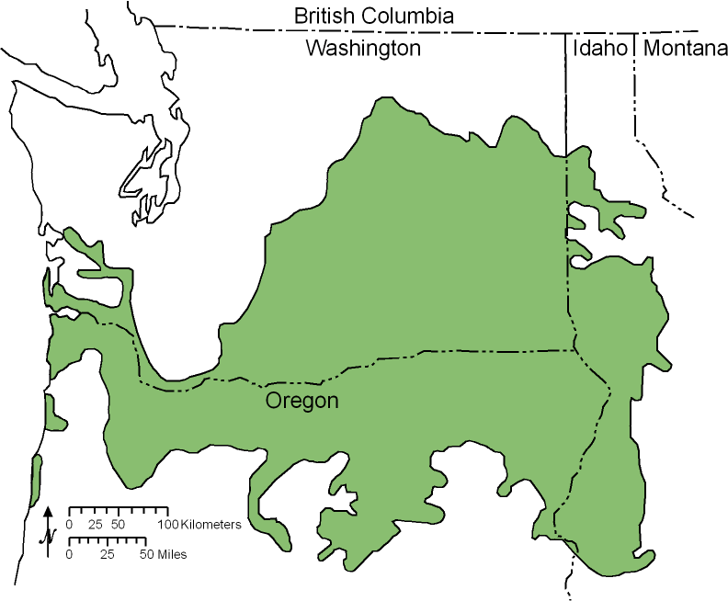
Notes:
Deccan Traps (left) and Columbia River Basalts (right) are flood basalts

Slide 8
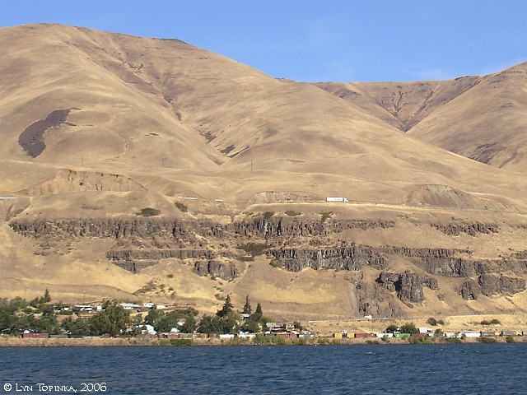
Notes:
Columbia River Basalts, Oregon

Slide 9
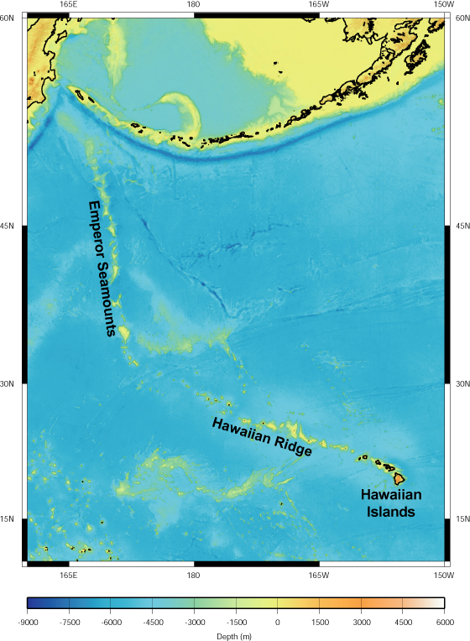
Within-plate volcanics: hotspots
Area of upwelling magma from a source deep in the mantle.
Magma melts through overlying oceanic crust (Hawaiian Islands) or continental crust (Yellowstone National Park)
Hotspot stays in the same general vicinity, they do not move with the plate because their source is deep in the mantle below the plate

Slide 10
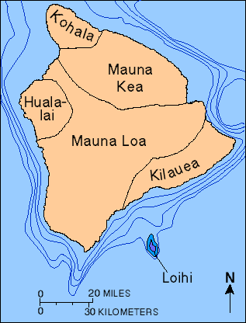
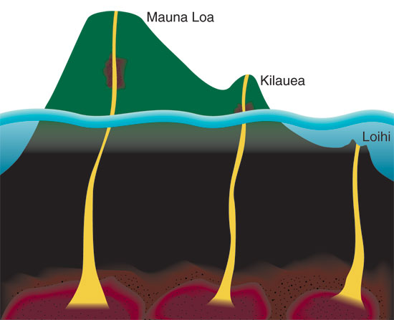
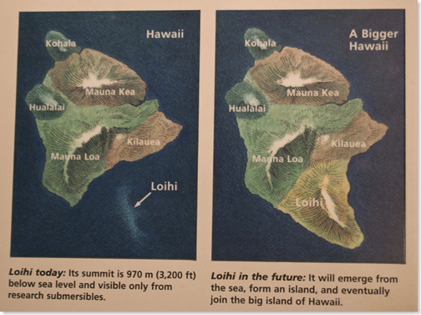
Notes:
All the volcanoes on Hawaii are active. The only other active volcano in Hawaii is on Maui and it is Mount Haleakala.
Loihi is the next island to form in the Hawaiian islands. It is still beneath the surface

Slide 11
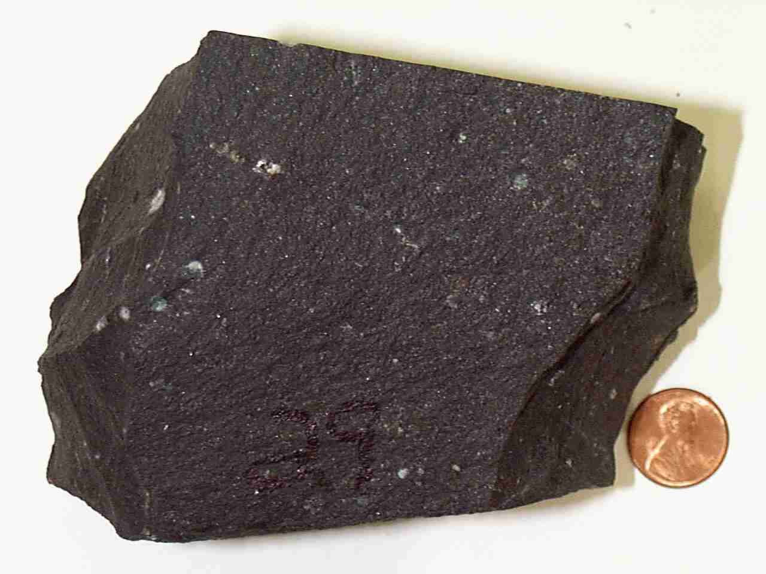
Basaltic magma
Basalt is the most common rock type of the oceanic crust
Forms low viscosity magma – it is more fluid and volcanic eruptions flow instead of explode
Notes:
http://hvo.wr.usgs.gov/multimedia/index.php?display=default

Slide 13
Shield volcanoes
Form from magma rich in basalt
Best developed where there is a hotspot underneath oceanic crust, like the Hawaiian islands.
Broad, gently sloping volcano
Magma can flow outward over long distances before solidifying
Volcano does not explode
Notes:
Hawaii has five main volcanoes that are considered active. Four of these active volcanoes are located on the big islands of Hawaii. They include Kilauea, Mauna Loa, Mauna Kea, and Hualalai. The other is located on Maui and it is Mount Haleakala.

Slide 14
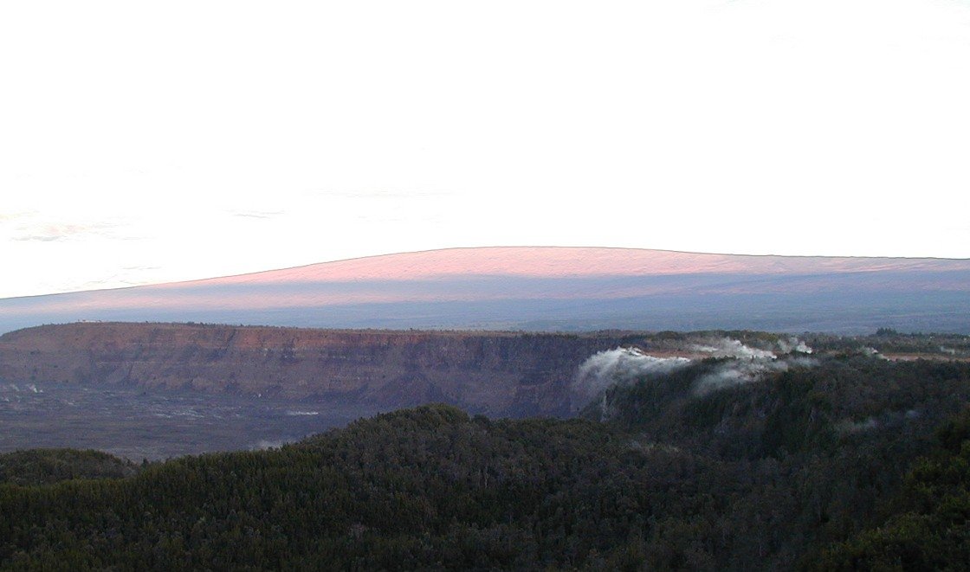
Notes:
Hawaii's Mauna Loa, a shield volcano

Slide 15
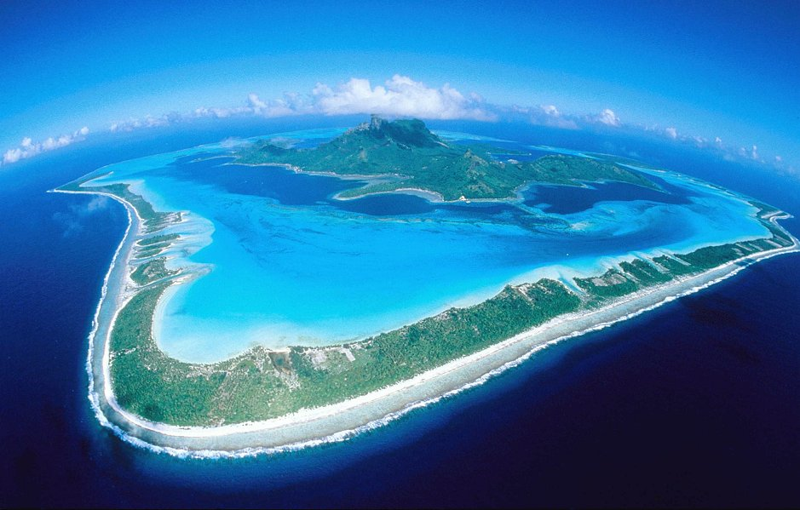
Notes:
Bora Bora

Slide 16
Atolls
Ring of coral surrounding eroding volcanic island
Found in tropical seas from fringing coral reef
Island may be a hotspot volcano or a volcanic island arc

Slide 17
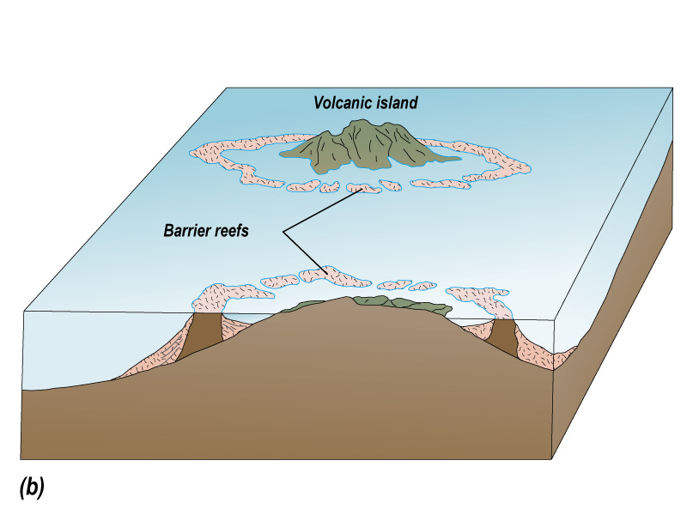

Slide 18
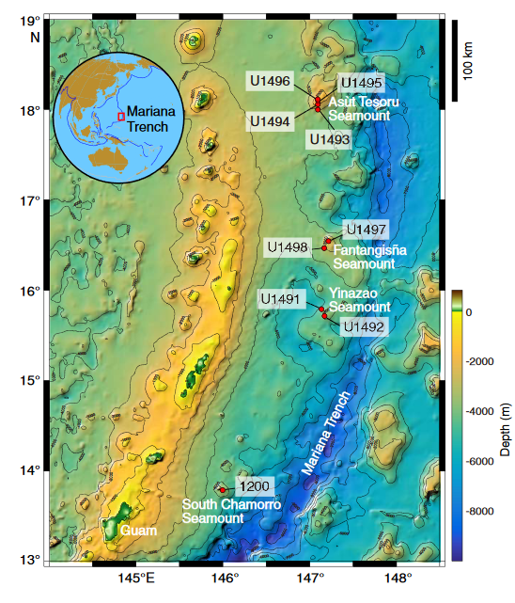
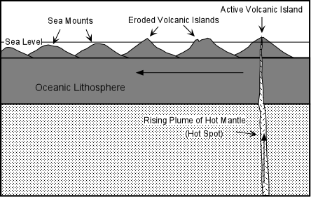
Seamounts
Volcanic island that has eroded to a level below the ocean’s surface.
Notes:
https://par.nsf.gov/servlets/purl/10281973

Slide 19
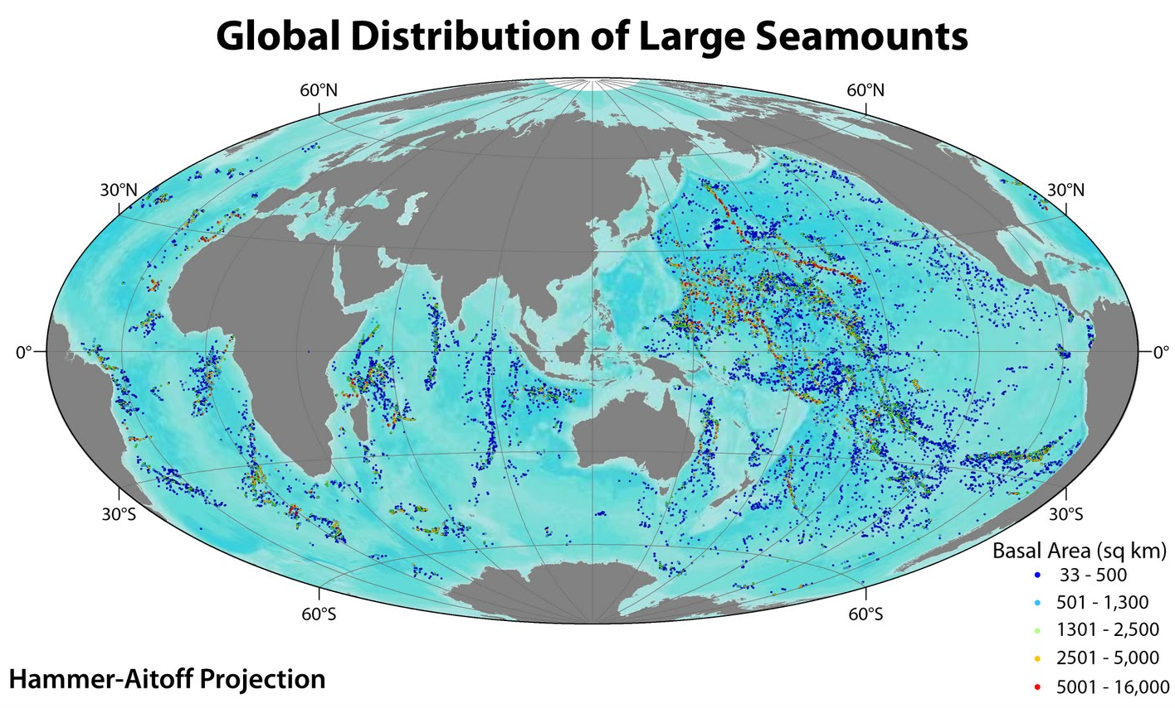

Slide 20
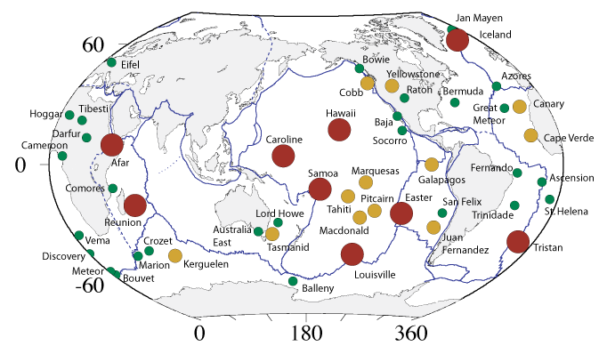
Notes:
Yellowstone is a hotspot in the middle of the North American plate. These are all mantle plume hotspots. Size and color are indicative of volume of magma of hotspot.

Slide 21
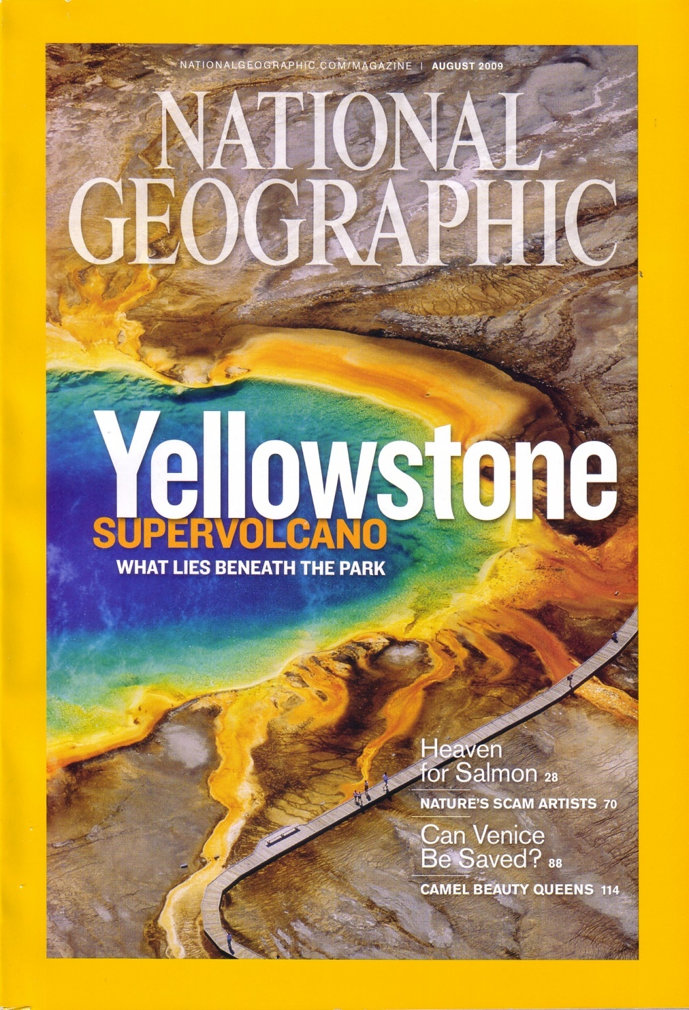
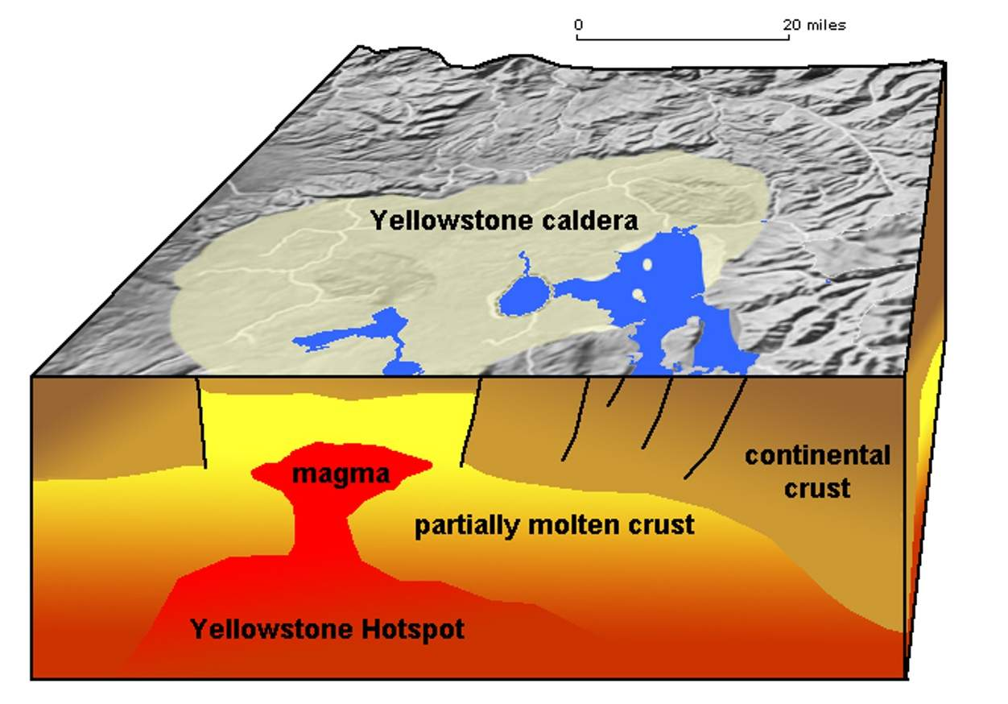
Hotspot underneath continental crust

Slide 22
Notes:
https://www.nps.gov/yell/learn/nature/volcano.htm Movement of North American plate over the Yellowstone hotspot

Slide 23
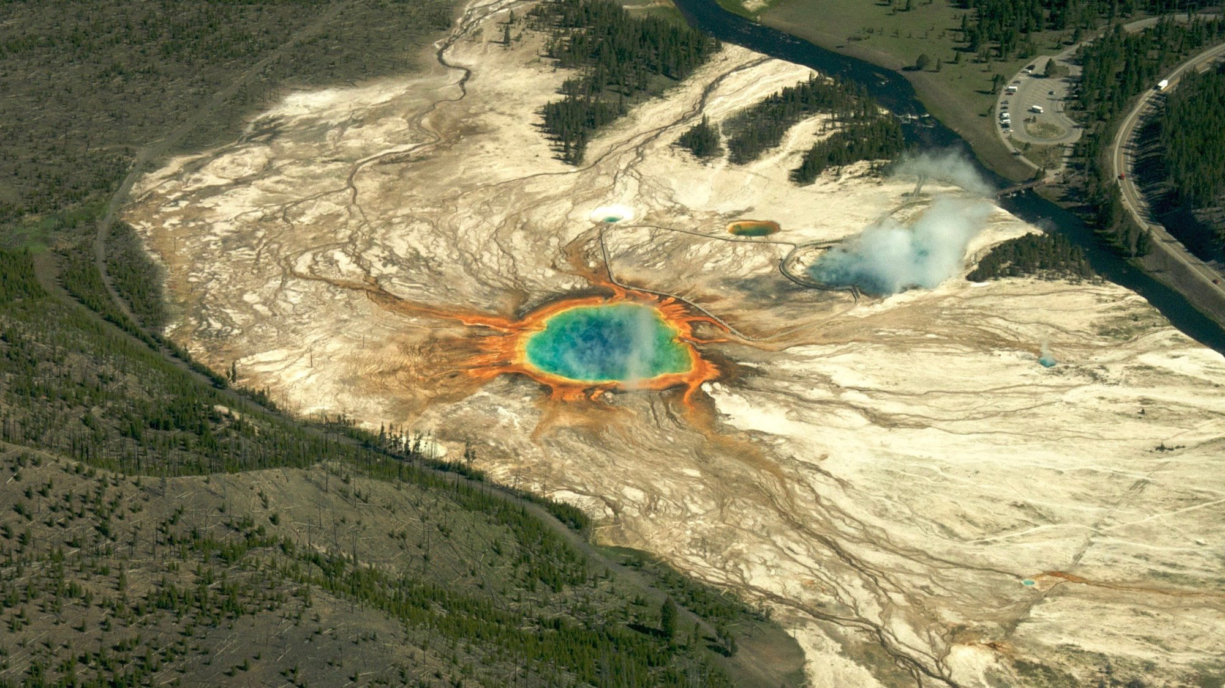
Magma in YNP is less basaltic and chemically more like continental crust that overlies the hotspot, which is composed of granite and andesite
Magma from these rock types create a different type of volcano – a composite volcano – and a potentially much more explosive eruption
This hotspot has produced very large eruptions in the past
Notes:
Center of Yellowstone Caldera

Slide 26
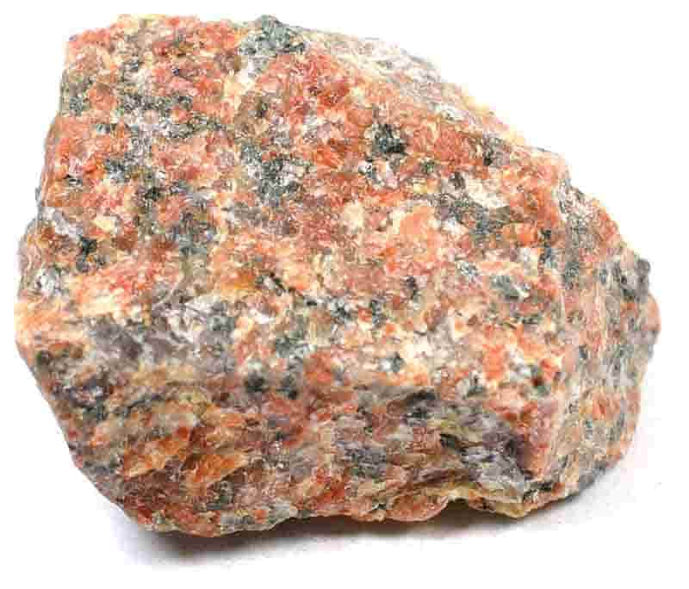
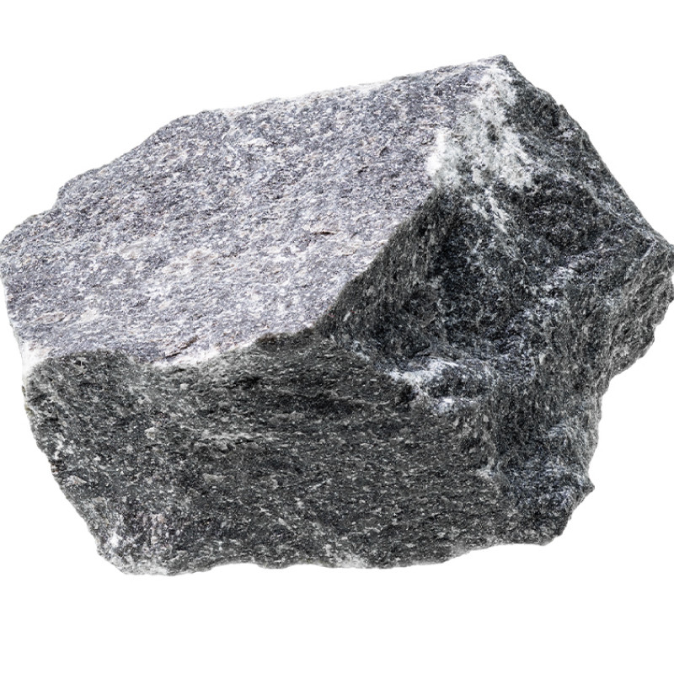
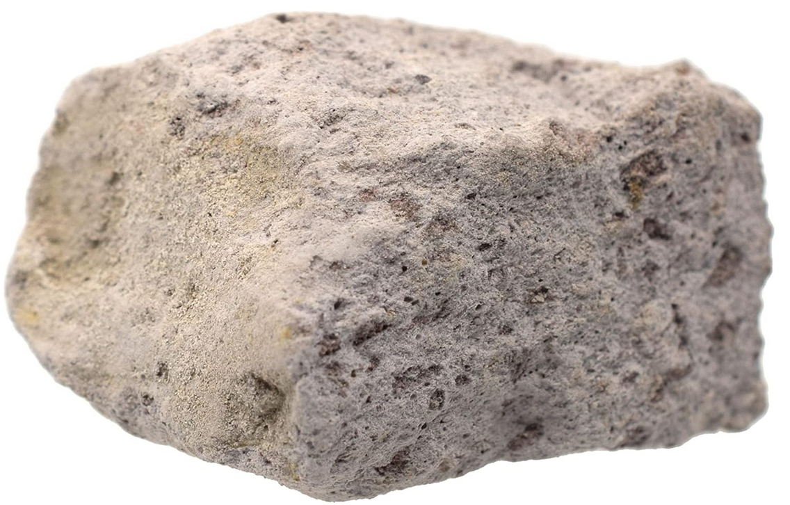
Andesitic and rhyolitic magma
Granite (top) is an intrusive igneous rock. It forms from magma rich in the minerals comprising continental crust. Granite forms when magma cools and solidifies slowly underground
Andesite (middle) and rhyolite (bottom) are extrusive igneous rocks. They form from molten continental crust that is extruded onto the surface by volcanoes.
Andesitic and rhyolitic magma have a high viscosity – they do not flow well. As a result these magmas form composite volcanoes.
Andesitic and rhylotic magma tend to trap gas and pressure instead of letting it vent to the surface, so eruptions are explosive..
,

Slide 27
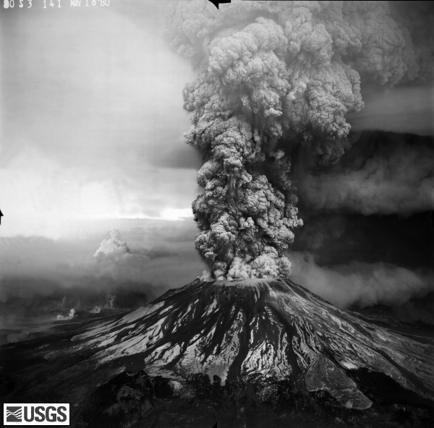
Composite volcanoes
Produced from andesitic or rhyolitic magma (instead of basaltic magma)
Also called stratovolcanoes
Develop at continental hotspots, and along convergent plate boundaries where subduction is occurring
Eruptions can be explosive
Examples
Mt. St Helens (1980) (right) of the Cascade Mountains
Yellowstone hotspot volcano
Sunda-Banda volcanoes
Aleutian island volcanoes
Notes:
http://vulcan.wr.usgs.gov/Volcanoes/MSH/Images/may18_images.html

Slide 28
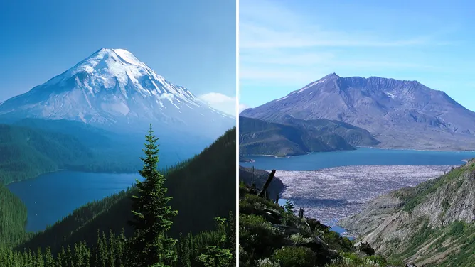
Convergent plate boundary volcanism
Notes:
Mount St. Helens before and after 1980 eruption

Slide 29
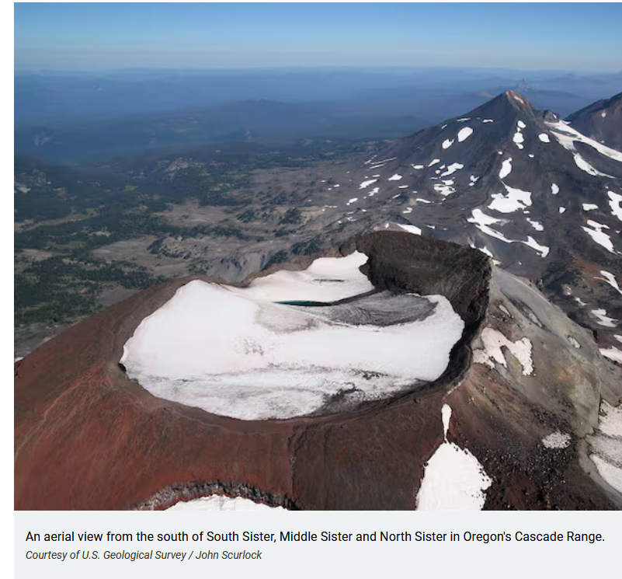
Convergent plate boundary composite volcanoes
Volcanic arc mountain chains like the Cascades, Andes, and the Sunda-Banda Arc
Island arc mountain chains like the Aleutian Islands and the Japanese Archipelago

Slide 30
Notes:
Mt Hood and Portland Oregon

Slide 31
Notes:
Sunda volcanic arc comprises the volcanoes seen in the image above. The Australian plate with its oceanic crust is being subducted underneath the Eurasian plate, which is comprised of continental crust at the subduction zone in some places, oceanic crust at other locations.

Slide 32
Notes:
Mt Tambora, a composite volcano in Indonesia Convergent plate boundary where oceanic crust of the Australian plate is subducted under continental crust of the Eurasian plate

Slide 33
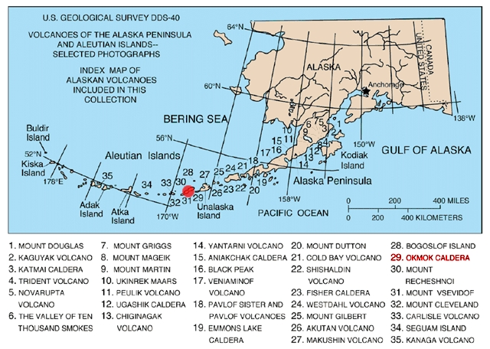
Island arc mountain chain: Aleutian Islands

Slide 34
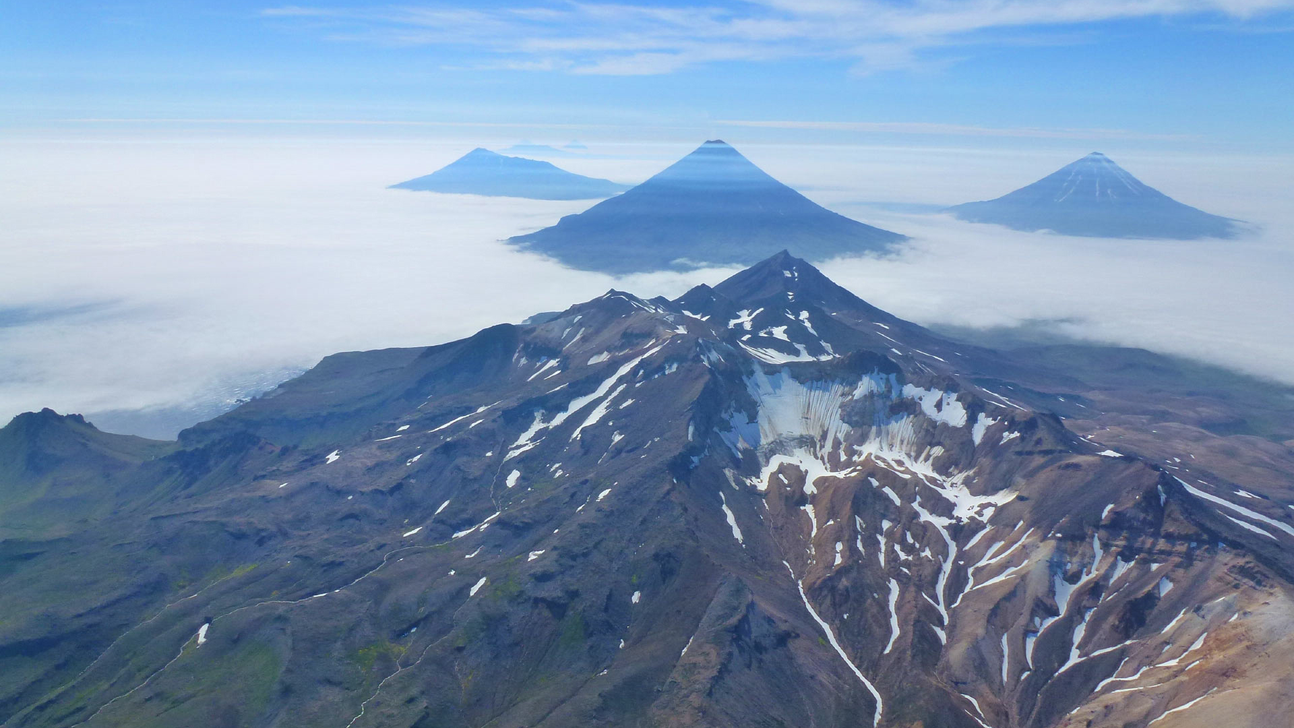
Notes:
Aleutian Islands, ocean crust is subducted underneath ocean crust to create a volcanic island arc. Composite volcanoes form because of the depth at which subduction occurs and the melting and change in the magma as it rises to the surface. The magma becomes enriched in andesite and rhyolite, which create more explosive, steep-sloped volcanoes

Slide 35
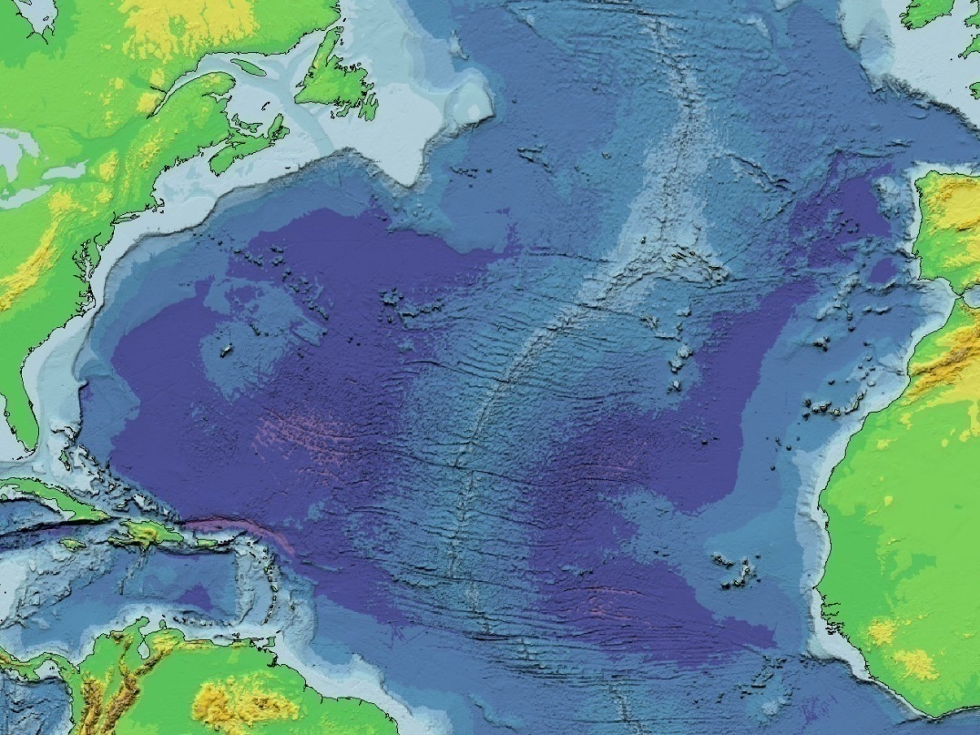
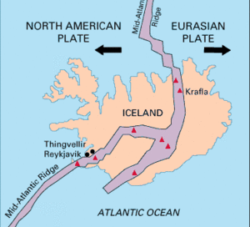
Divergent plate boundary volcanism: mid-ocean ridges
Type of eruptions: fluid, rarely explosive, magma is more basaltic
Shield volcanoes can form on mid-ocean ridges
Fissure eruptions are also common – no volcano, lava flows out of fissures in the ground
Because Iceland is also a hotspot, it has a large variety of volcanic features, but they are mostly basaltic. Some can produce large amounts of ash
Notes:
35

Slide 36
Notes:
Fissure eruption in Iceland, 2023

Slide 37
Notes:
Fissure eruption in Iceland, 2023 Laki is the name of a fissure volcano in Iceland

Slide 38
Notes:
Skjaldbreiður, a shield volcano in Iceland

Slide 39
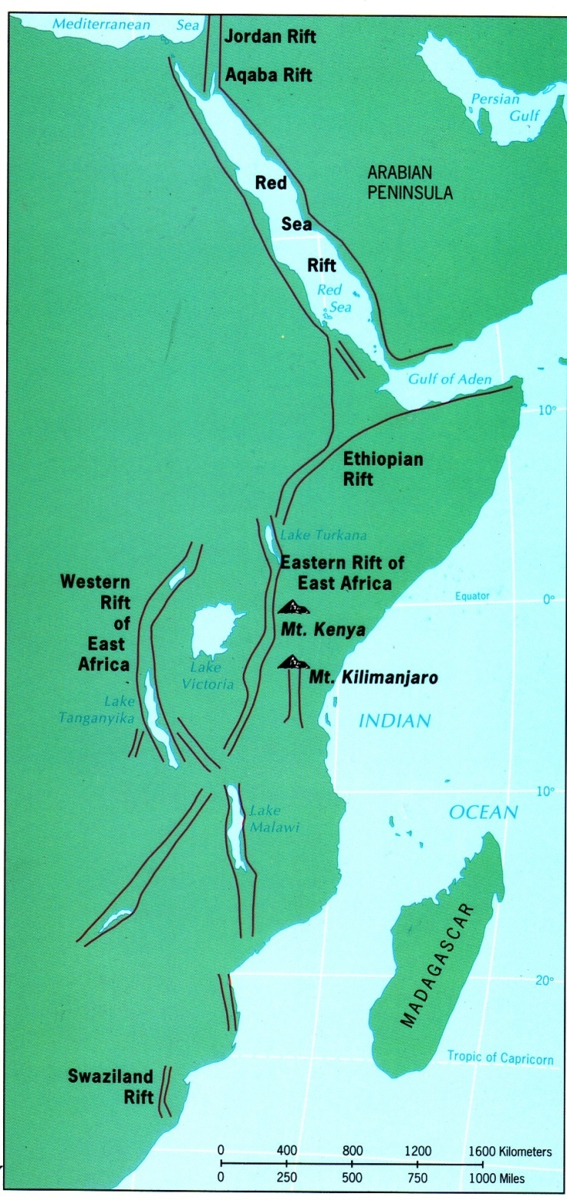
Divergent plate boundary volcanism: continental rift valleys
Rift Valley of East Africa
Spreading ridge forming underneath East Africa that will ultimately rift (break) a portion of east Africa away from the rest the rest of the continent
Rift Valley Lakes (Lake Tanganyika, Lake Victoria, Lake Malawi
Associated with composite volcanoes (Mt Kilimanjaro)
Notes:
39

Slide 40
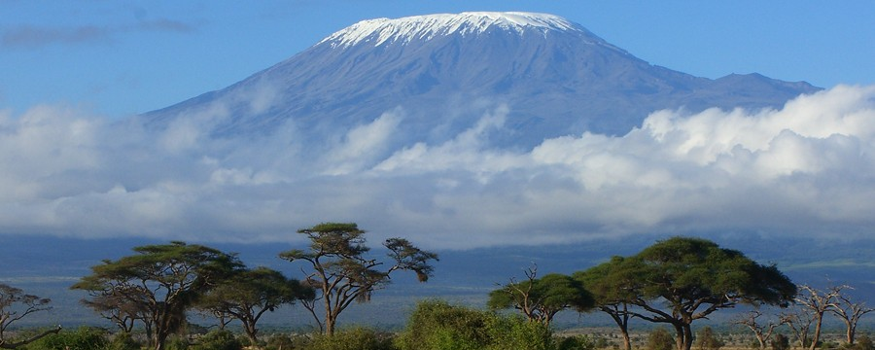
Notes:
Mt Kilimanjaro, a composite volcano, in Tanzania

Slide 41
Other volcanic landforms and processes
Limnic eruptions
Caldera
Cinder cone
Lahar
Pyroclastic flow

Slide 42
Limnic eruptions

Slide 45
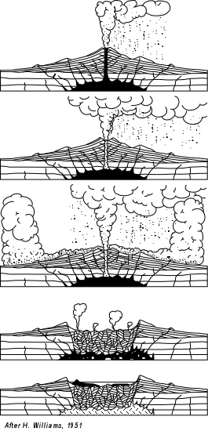
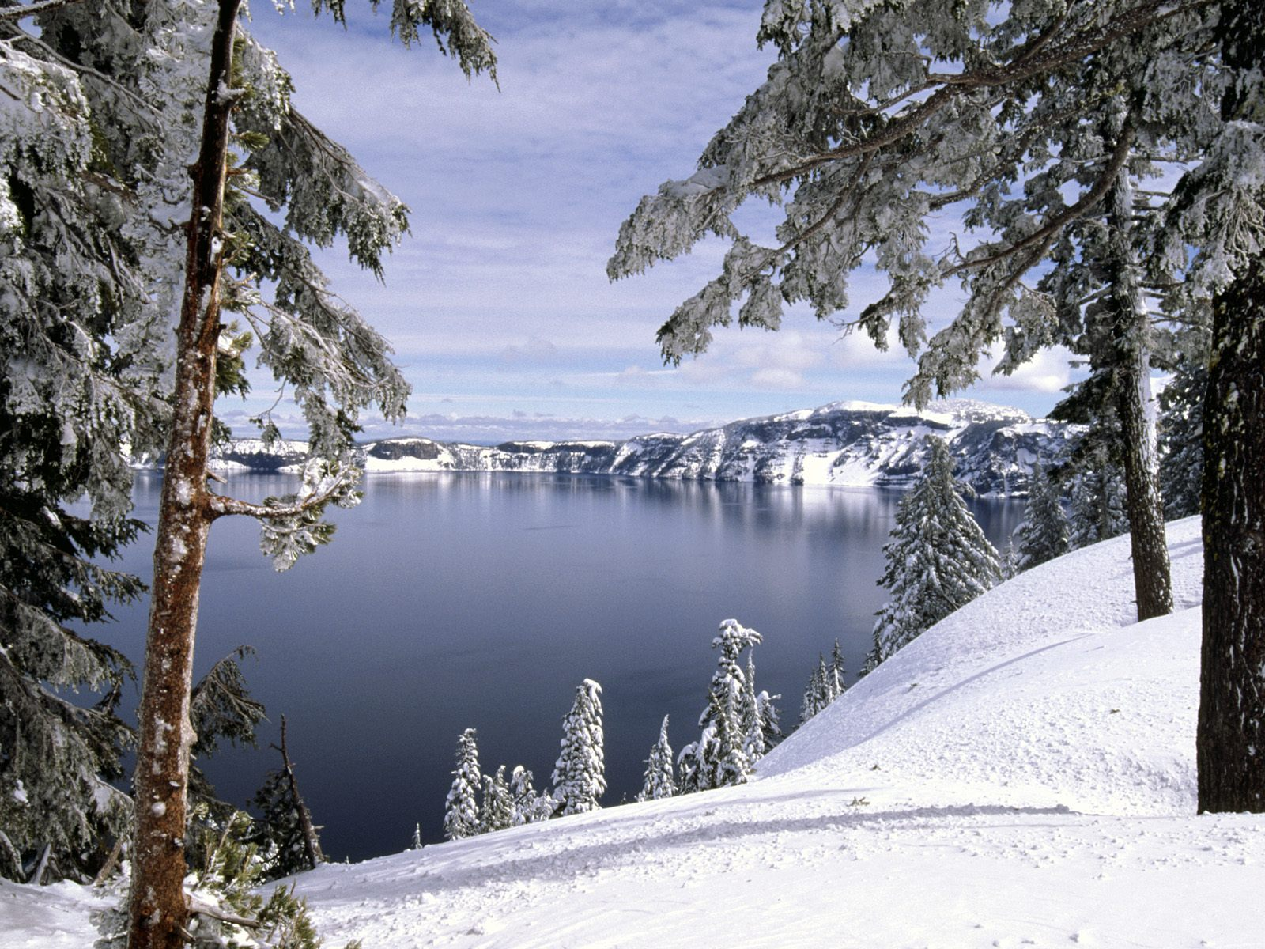
Calderas: Crater Lake Natl Park (Cascade Mountains)
Notes:
Yellowstone National Park is a very large caldera

Slide 47
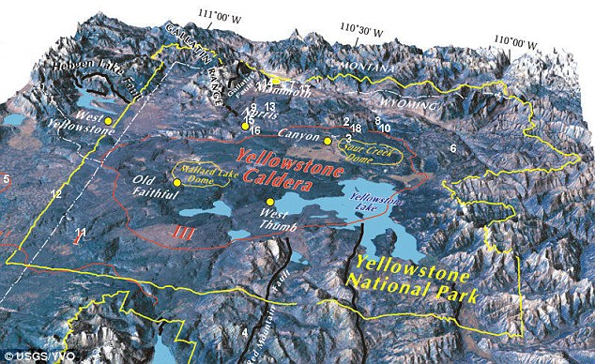
Yellowstone Caldera

Slide 48
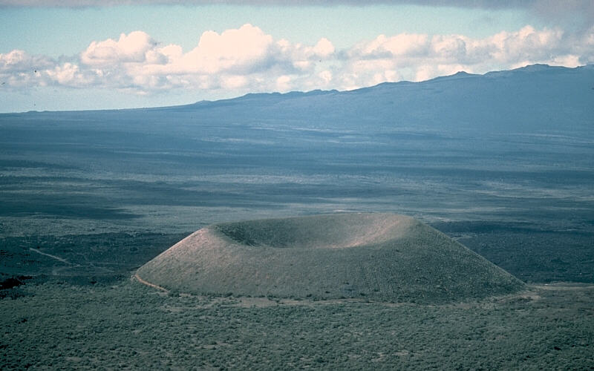
Cinder cone
Notes:
Mauna Loa is in the background Small, steep, cone-shaped volcano with a vent and crater at the top, built of pyroclastic material, chiefly tephra (volcanic ash)

Slide 49
Lahar
Type of volcanic mudflow or debris flow composed of a slurry of pyroclastic material, rocky debris, and water. These flows are extremely dangerous and can travel rapidly down the slopes of a volcano, often following river valleys.
Lahars are triggered by volcanic eruptions, heavy rainfall, earthquakes around an active volcano, as well as gravity-induced slope failure

Slide 50
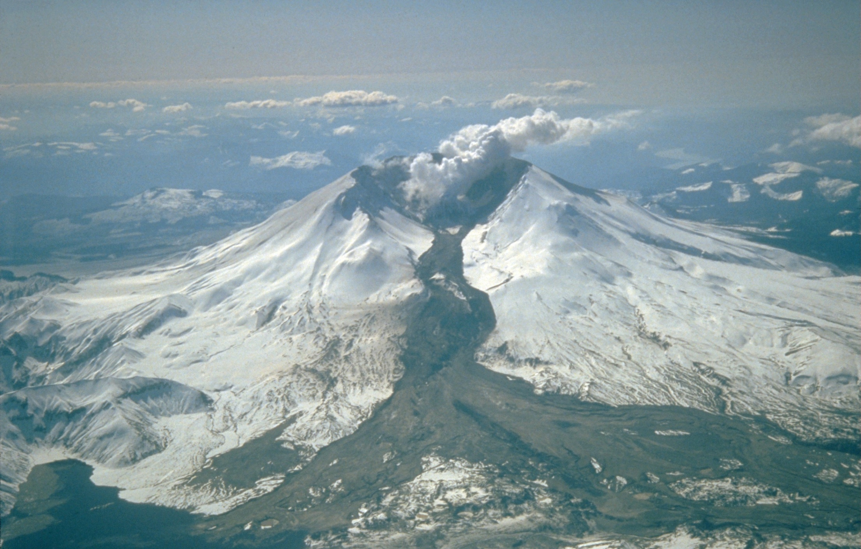
Notes:
Mount St. Helens erupted often between 1980 and 1986. An explosive eruption on March 19, 1982, sent pumice and ash 9 miles into the air, and resulted in a lahar (the dark deposit on the snow) flowing from the crater into the North Fork Toutle River valley

Slide 52
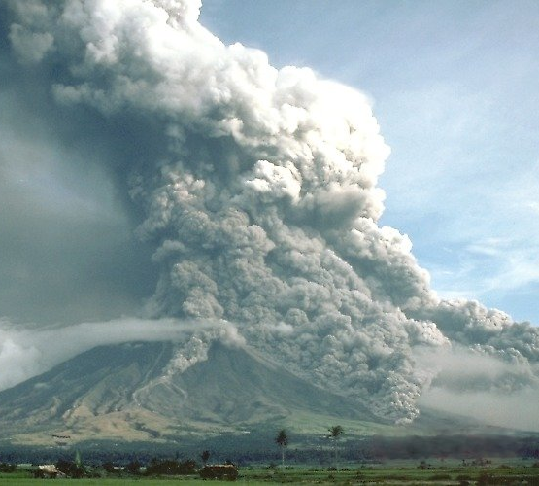
Pyroclastic flows
Fast-moving current of hot gas and volcanic material (collectively known as tephra) that flows along the ground away from a volcano at high rates of speed

