Slide 1
Pecha Kucha or "Ignite"
Presentation
20 x 20
(This first slide is not part of the presentation)
Notes:
Introductory Presentation
Explain what is a "Pecha Kucha" presentation.
Explain the why this tool?
A modeling exercise
New pedagogical tool

Slide 2
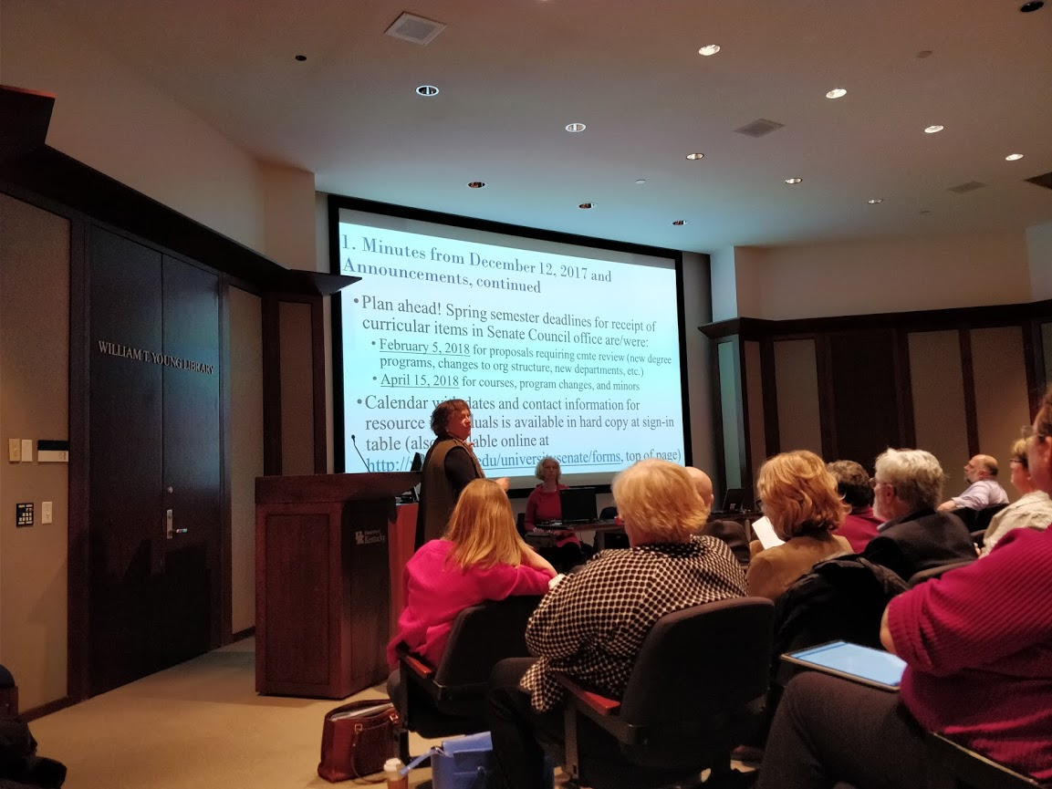
Notes:
Who am I
Bob Sandmeyer
Assistant Professor of Philosophy
Director of Undergraduate Studies, Environmental and Sustainability Studies Program
Founding member of this interdisciplinary program
Picture
UK Senate Meeting
Faculty representative for the College of Arts & Sciences
Faculty Governance of the Academic Mission of the university

Slide 3
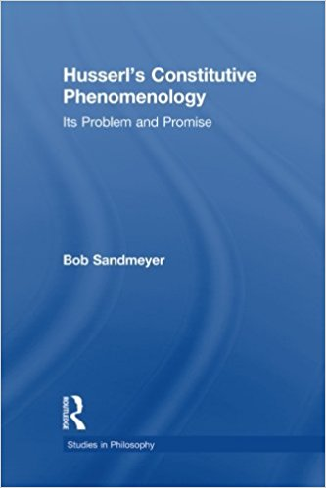
Notes:
Specialization
20th century phenomenological movement
Edmund Husserl's philosophy of transcendental phenomenology
Book published: 2009
Received my degree in 2007 at the University of Kentucky
Highly unusual

Slide 4
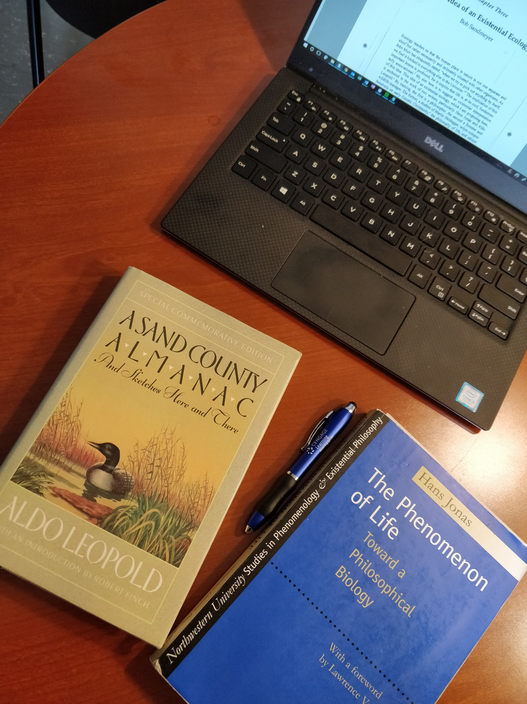
Notes:
Research focus
Existential ecology
The Land Ethic of Aldo Leopold
The Philosophy of Life of Hans Jonas

Slide 5
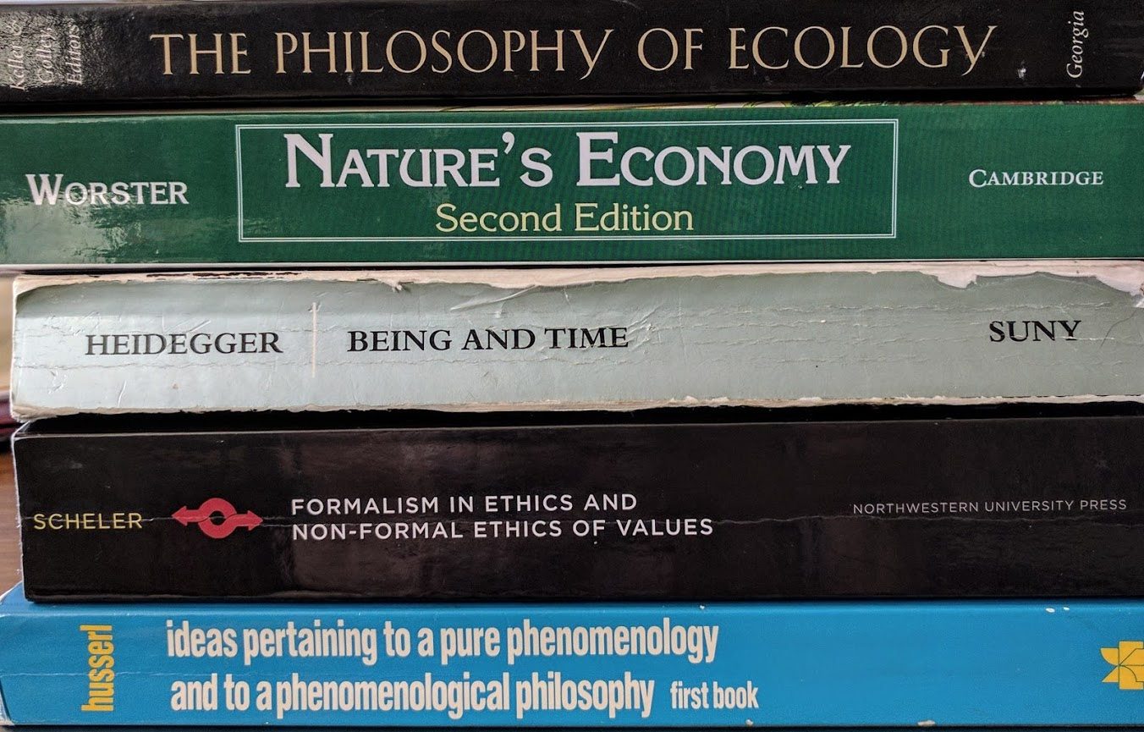
Notes:
Good representation of my interests
Course texts: spring 2017
Bottom three texts:
PHI 516: Phenomenological Directions
Husserl, Scheler, Heidegger
Top two texts:
PHI 300 History and Philosophy of Ecology
Two kinds of courses
Disciplinary
Interdisciplinary

Slide 6
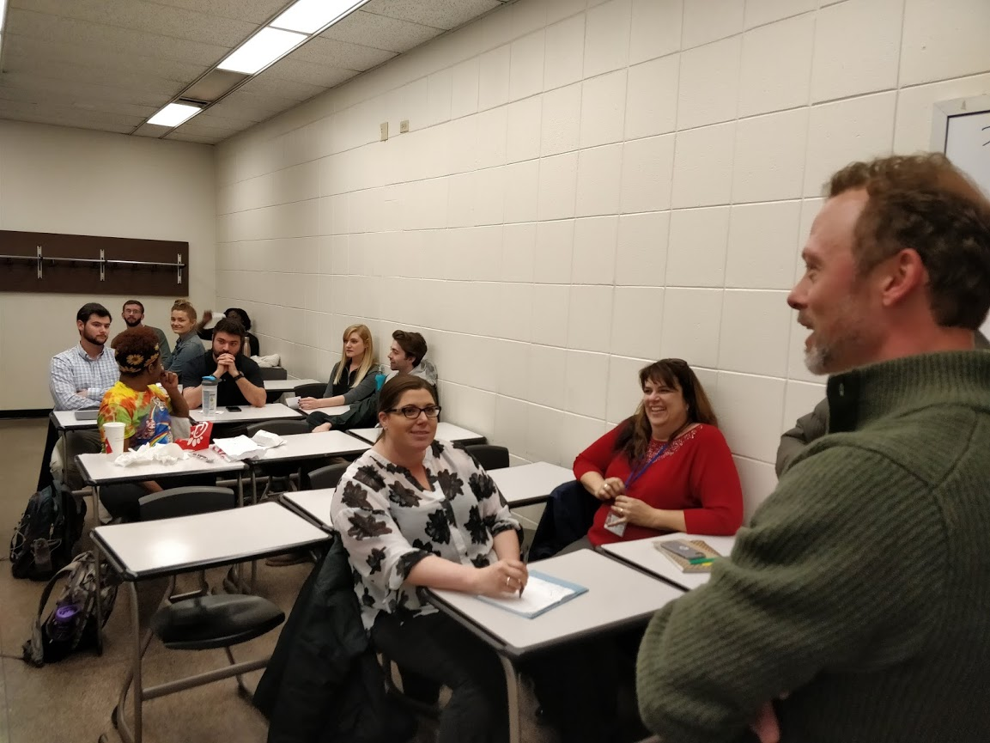
Notes:
Spring 2018:
ENS 400 - Environmental & Sustainability Studies Capstone Class
"Sustainability in Action"
Final Project Presentations
Public invited
Capstone – caps the studies
Seniors in ENS program
Team taught
Shane Tedder, Coordinator of the Office of Sustainability

Slide 7
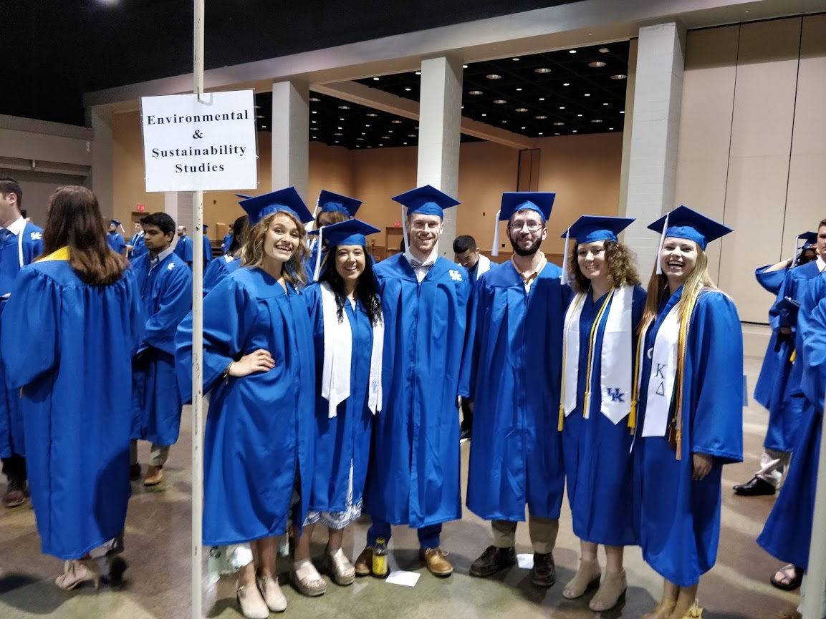
Notes:
Graduating class of 2018
Attended ceremony as part of my duties
Director of Undergraduate Studies, Environmental & Sustainability Studies program
Personal knowledge of each student
ENS 400 Capstone
PHI 336 Environmental Ethics
None of these students are philosophy majors

Slide 8
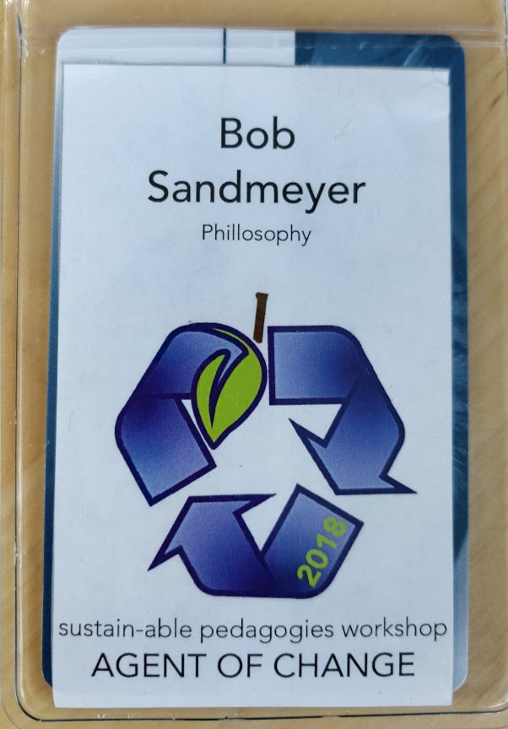
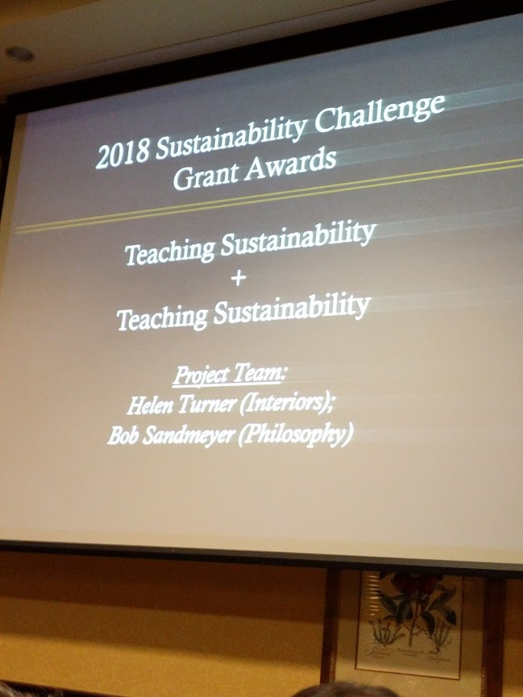
Notes:
sustain-able pedagogies workshop (summer 2018)
Co-organized
Helen Turner (College of Design)
Bob Sandmeyer (College of Arts & Sciences)
Aim: to create a network of faculty on campus dedicated to
Sustainability research and teaching
Interdisciplinary research & teaching
Transdisciplinary

Slide 9
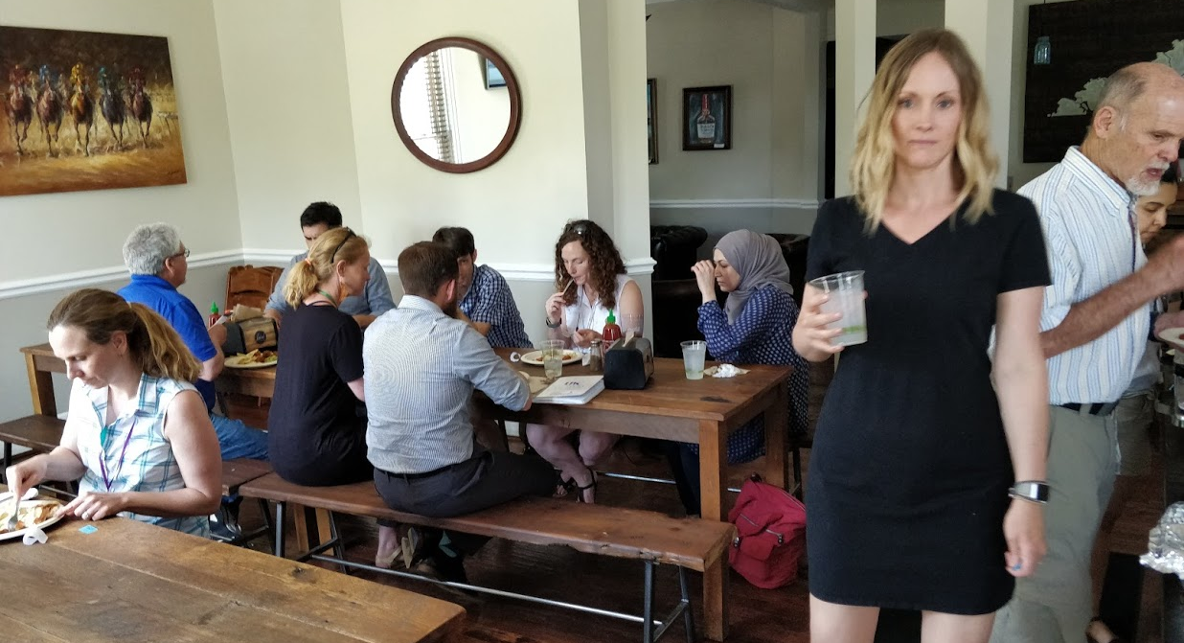

Slide 10
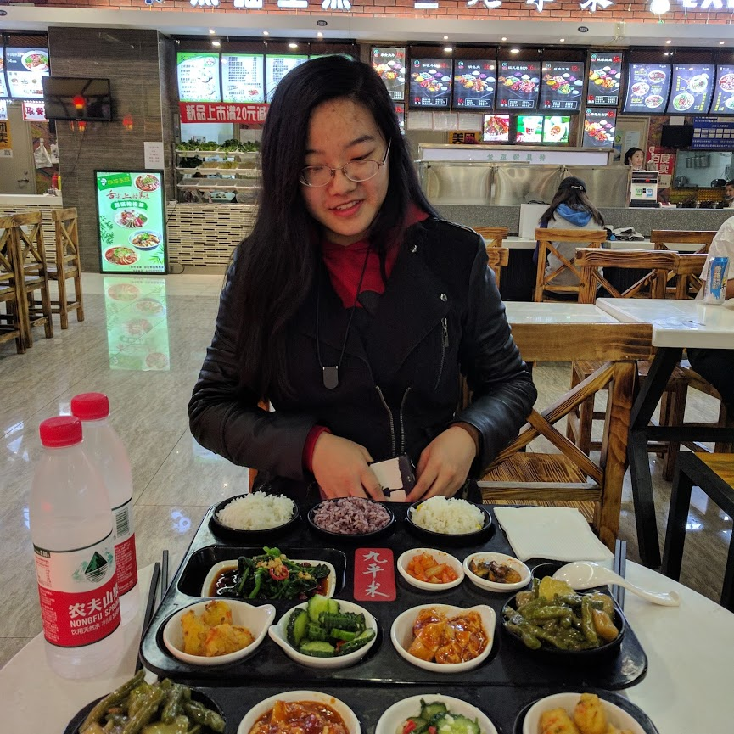
Notes:
Summer 2017 – Teaching at Jilin University in Changchun
An undergraduate course:
American Conservation Philosophy and its Critique
Gu Junyao, my "living assistant"
First meal together

Slide 11
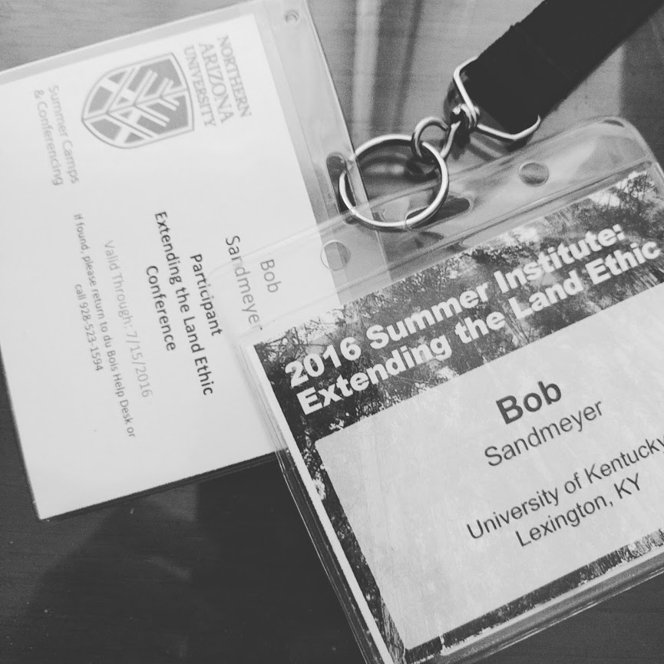
Notes:
Summer 2016 – NEH Summer Institute 4 week course
Faculty – student
2 organizing faculty
4 visiting faculty
History
Ethnobotany
Philosophy
English (creative writing)
"Extending the land ethic"
Personal specialty: the work of Aldo Leopold
A Sand County Almanac
Capstone essay: "The Land Ethic"

Slide 12
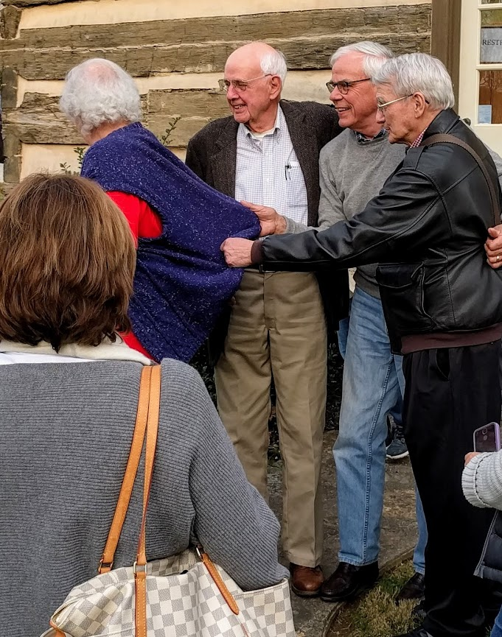
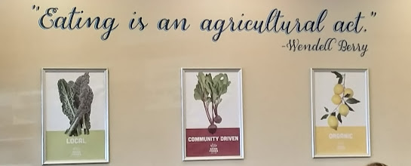
Notes:
Local economy – a preeminent personal, professional, academic
Wendell Berry, "Eating is an agricultural act"
Sign from my local grocery store
An idea central to my course, PHI 205 Food Ethics
Picture of Wendell Berry
The Berry Center event: readings from local writers

Slide 13
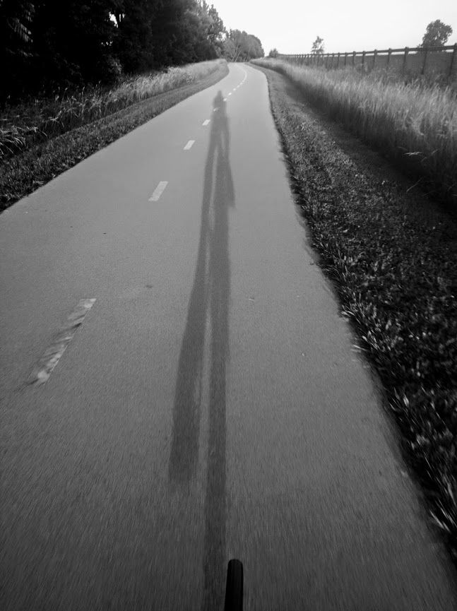
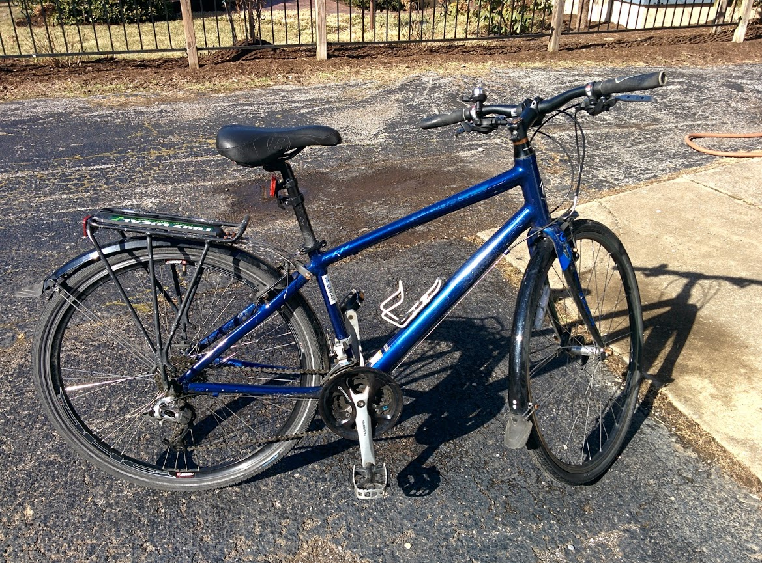
Notes:
On a more personal note
I'm a bike commuter
my

Slide 14
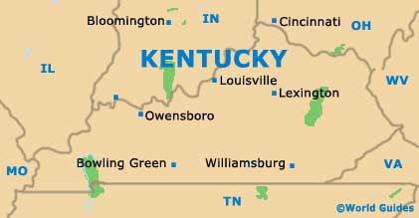
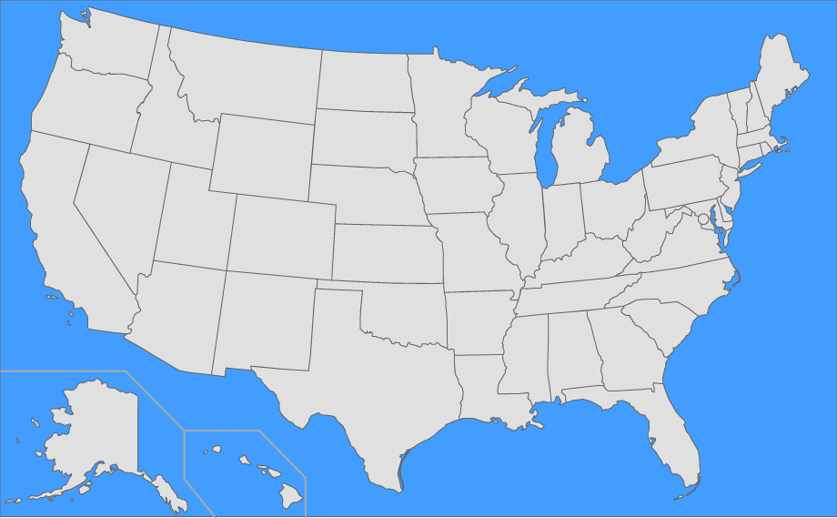
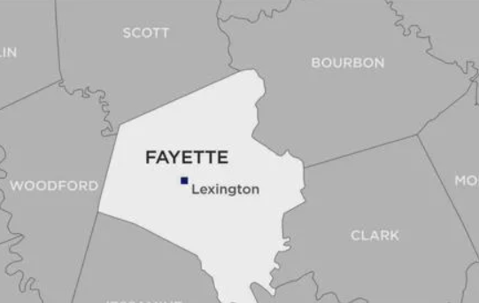

Slide 15
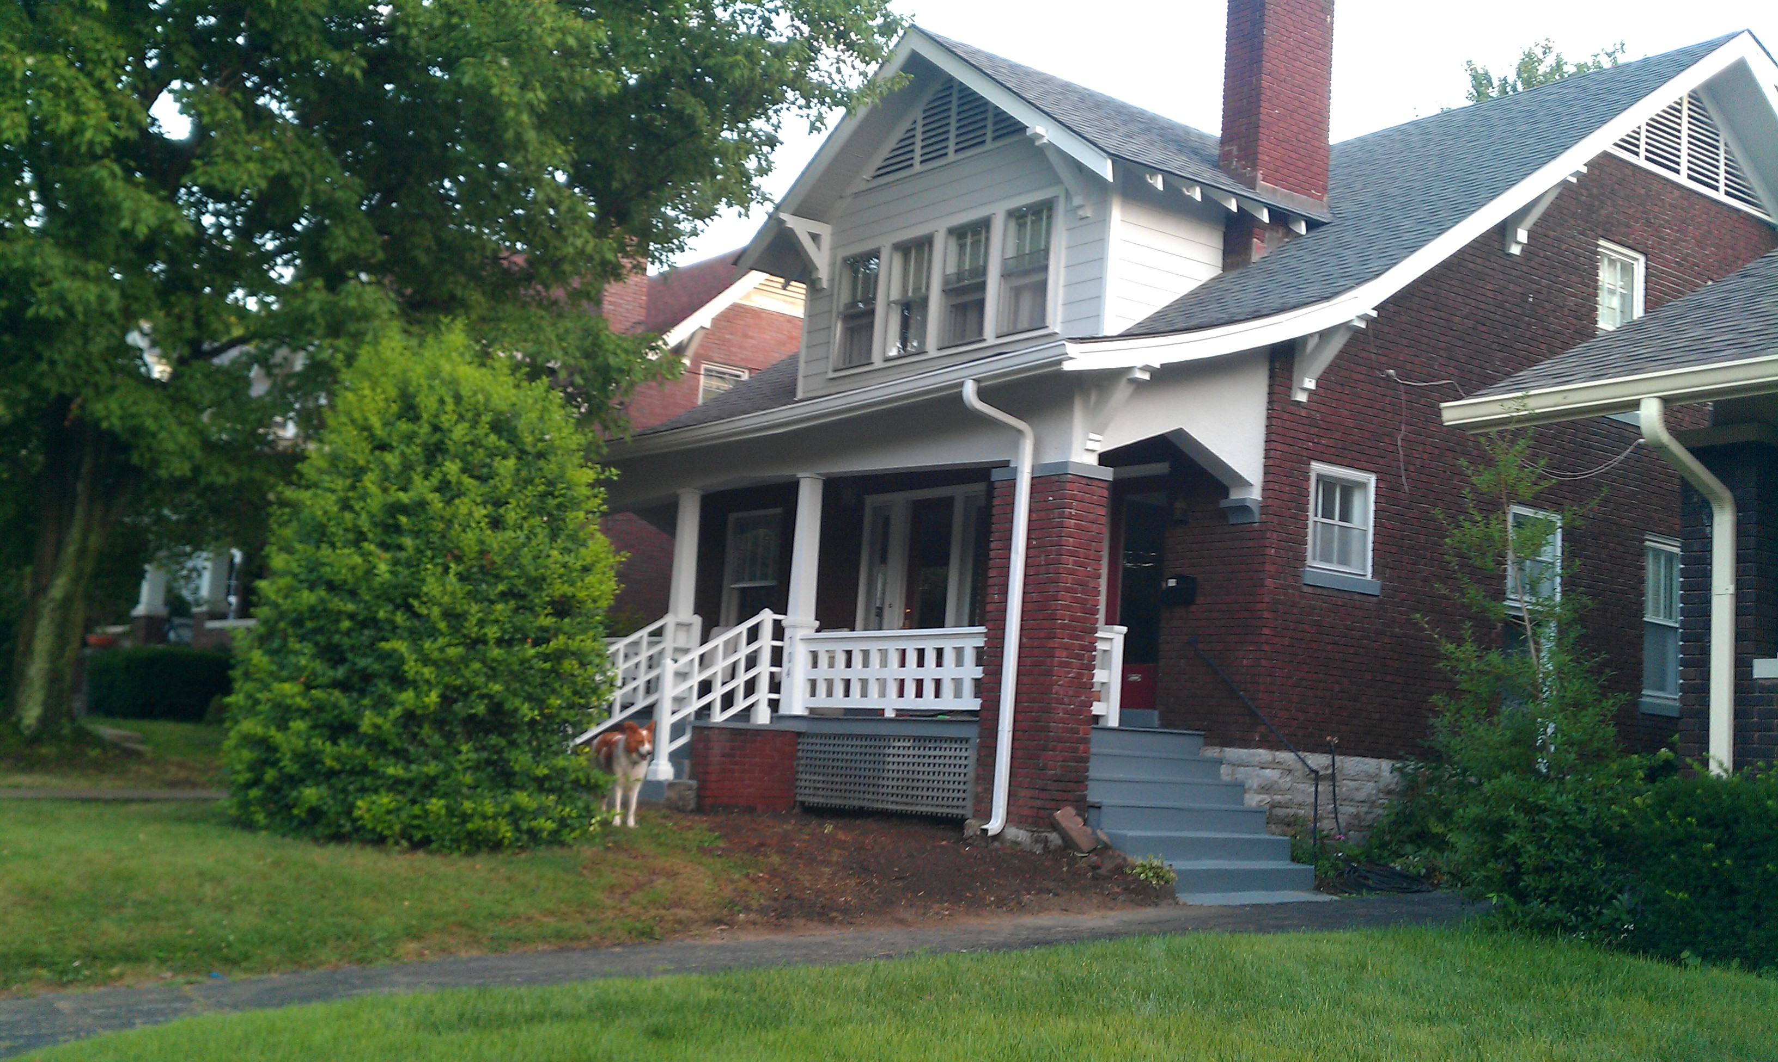

Slide 17
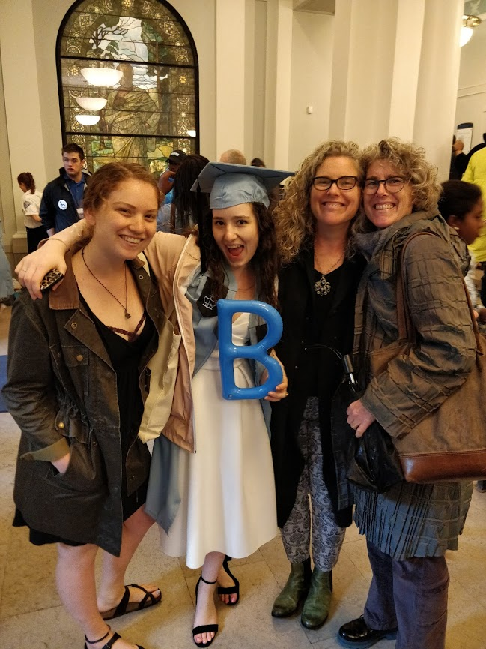
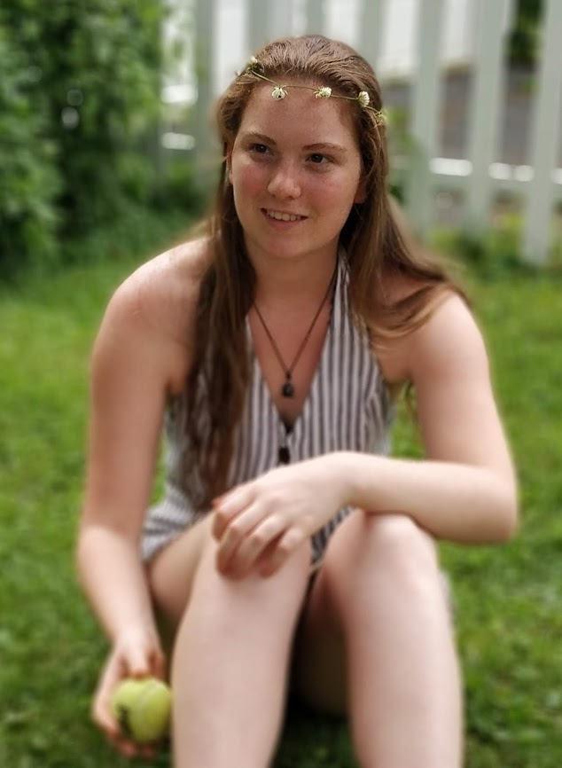
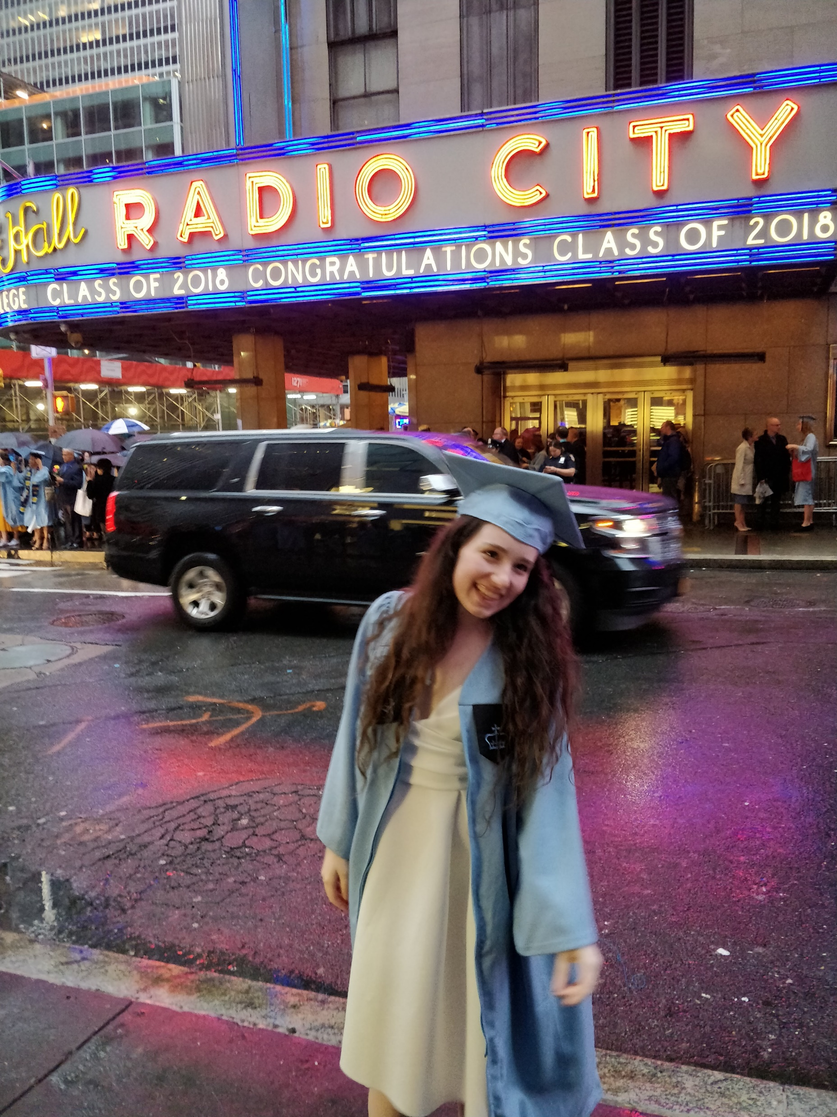

Slide 18
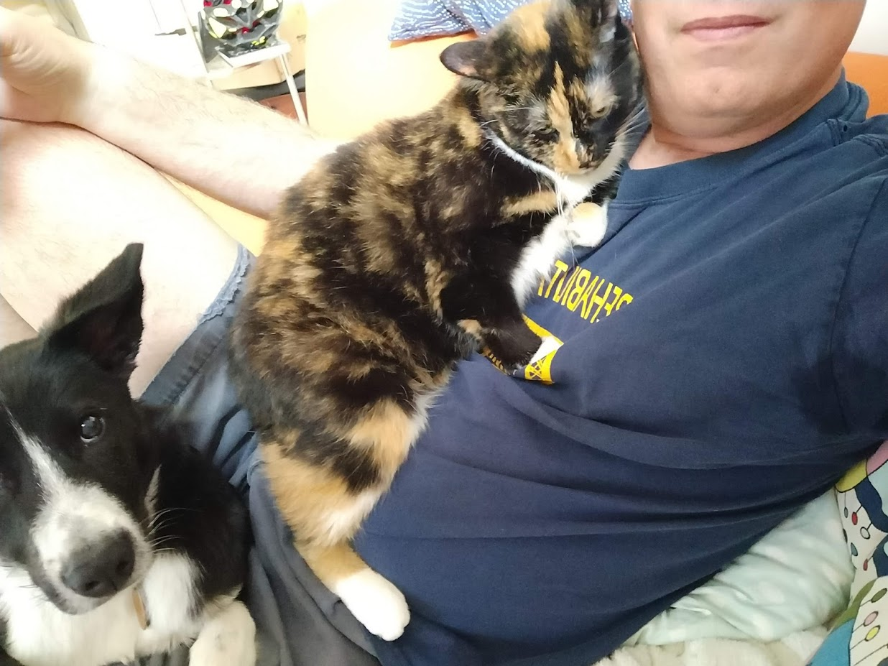

Slide 19
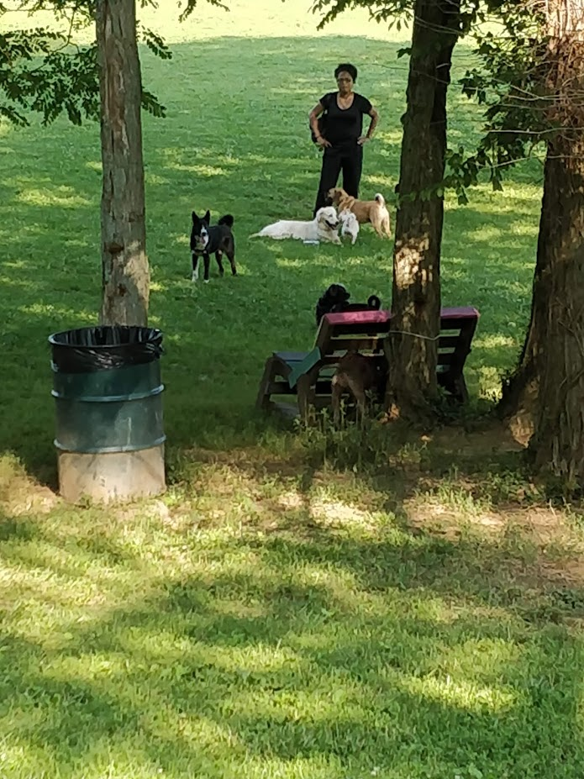

Slide 20
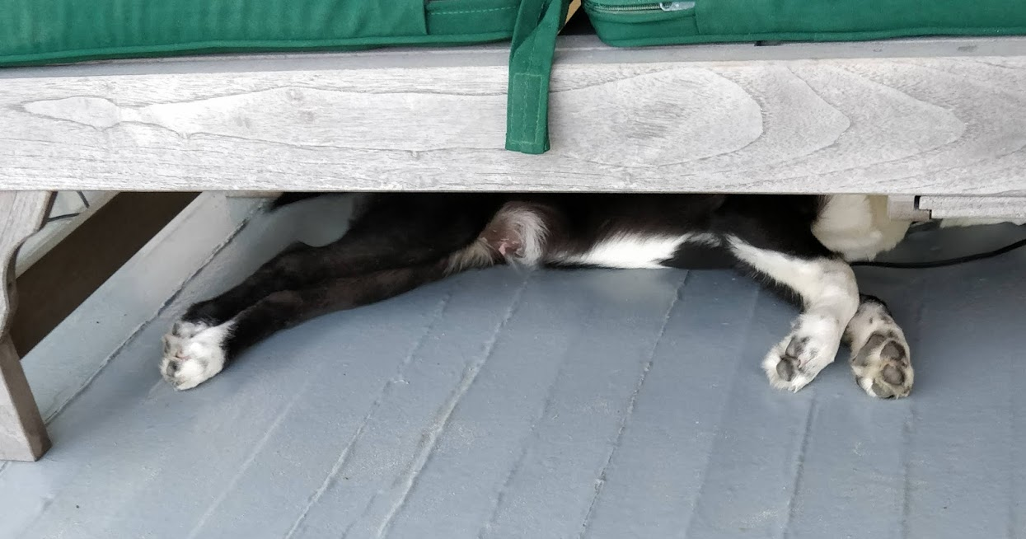

Slide 21
