Slide 1
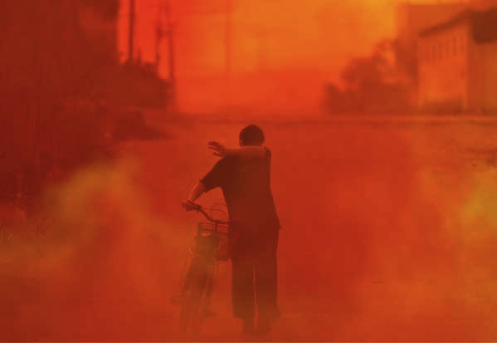

Slide 2
Global Ecological footprint

Slide 7
Aspects of a footprint: We need to consider each
step below to understand how our actions
affect the environment
You are here

Slide 8
99.27%
of naturally
Occurring
Uranium

