Slide 1
GEI commodity chains and the environment

Slide 2
Aspects of a footprint: We need to consider each
step below to understand how our actions
affect the environment
You are here

Slide 3
Energy Use: ‘Primary’ energy consumption – by producers –
Uses one third of global supplies

Slide 4
Production and Energy-Use

Slide 5
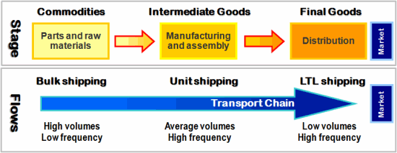
Simple commodity Chain: Not enough complexity, where is the environment?

Slide 6
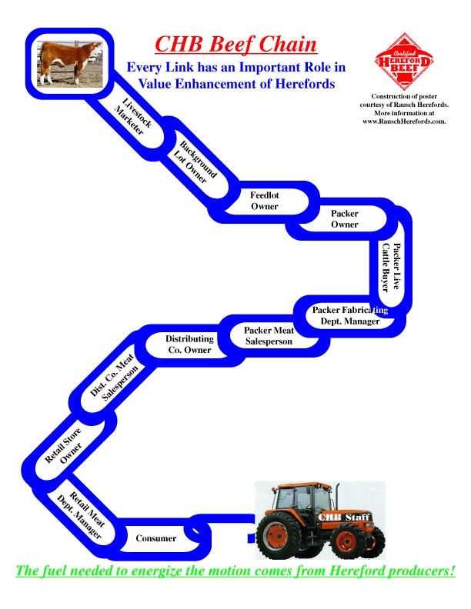
Beef Commodity Chain:
Still not enough complexity,
Side chains and
Environmental impacts
missing

Slide 7
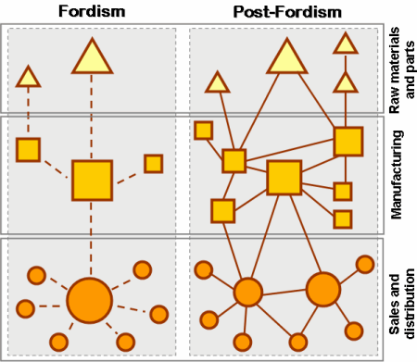
Historical Transformation of Commodity Chains: We are looking mostly at ‘post-Fordist’
Chains, that is to say chains that involve many actors

Slide 8
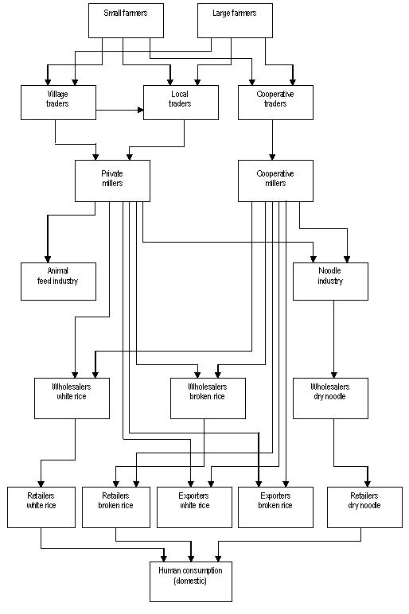
Rice Commodity Chain:
Complexity is good, but
Lacks environmental
impacts and side chains

Slide 9
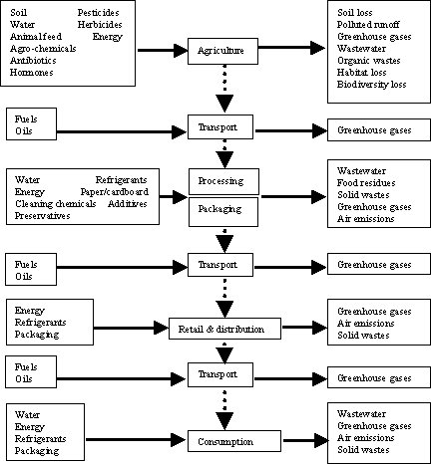
Environment &
The Commodity
Chain:
Adds
environmental
component
but lacks
side chains

