Slide 1
US Midwest versus Africa, Asia
& Latin America in the 19th Century
Global Environmental issues

Slide 2
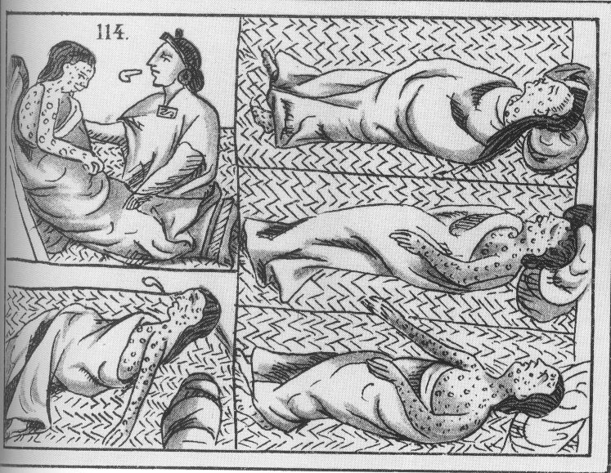
Smallpox epidemic
Death by disease during the Conquest of Mexico

Slide 3
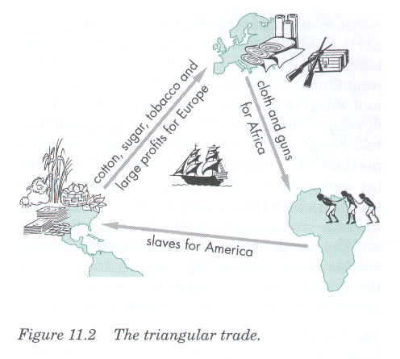
Classic Statement of the Triangle Trade: Mexico, and The Conquest, must be understood as part of an early wave of globalization during the 16th century

Slide 4
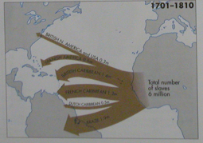
Biodiversity severely reduced
In Carribean
Biodiversity reduced
in places
Biodiversity conserved
In Africa

Slide 5
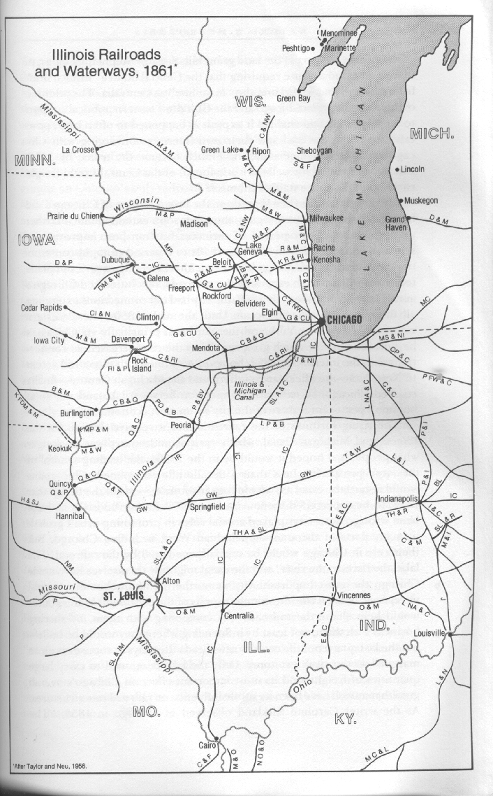
Midwestern
Railways
1861

Slide 6
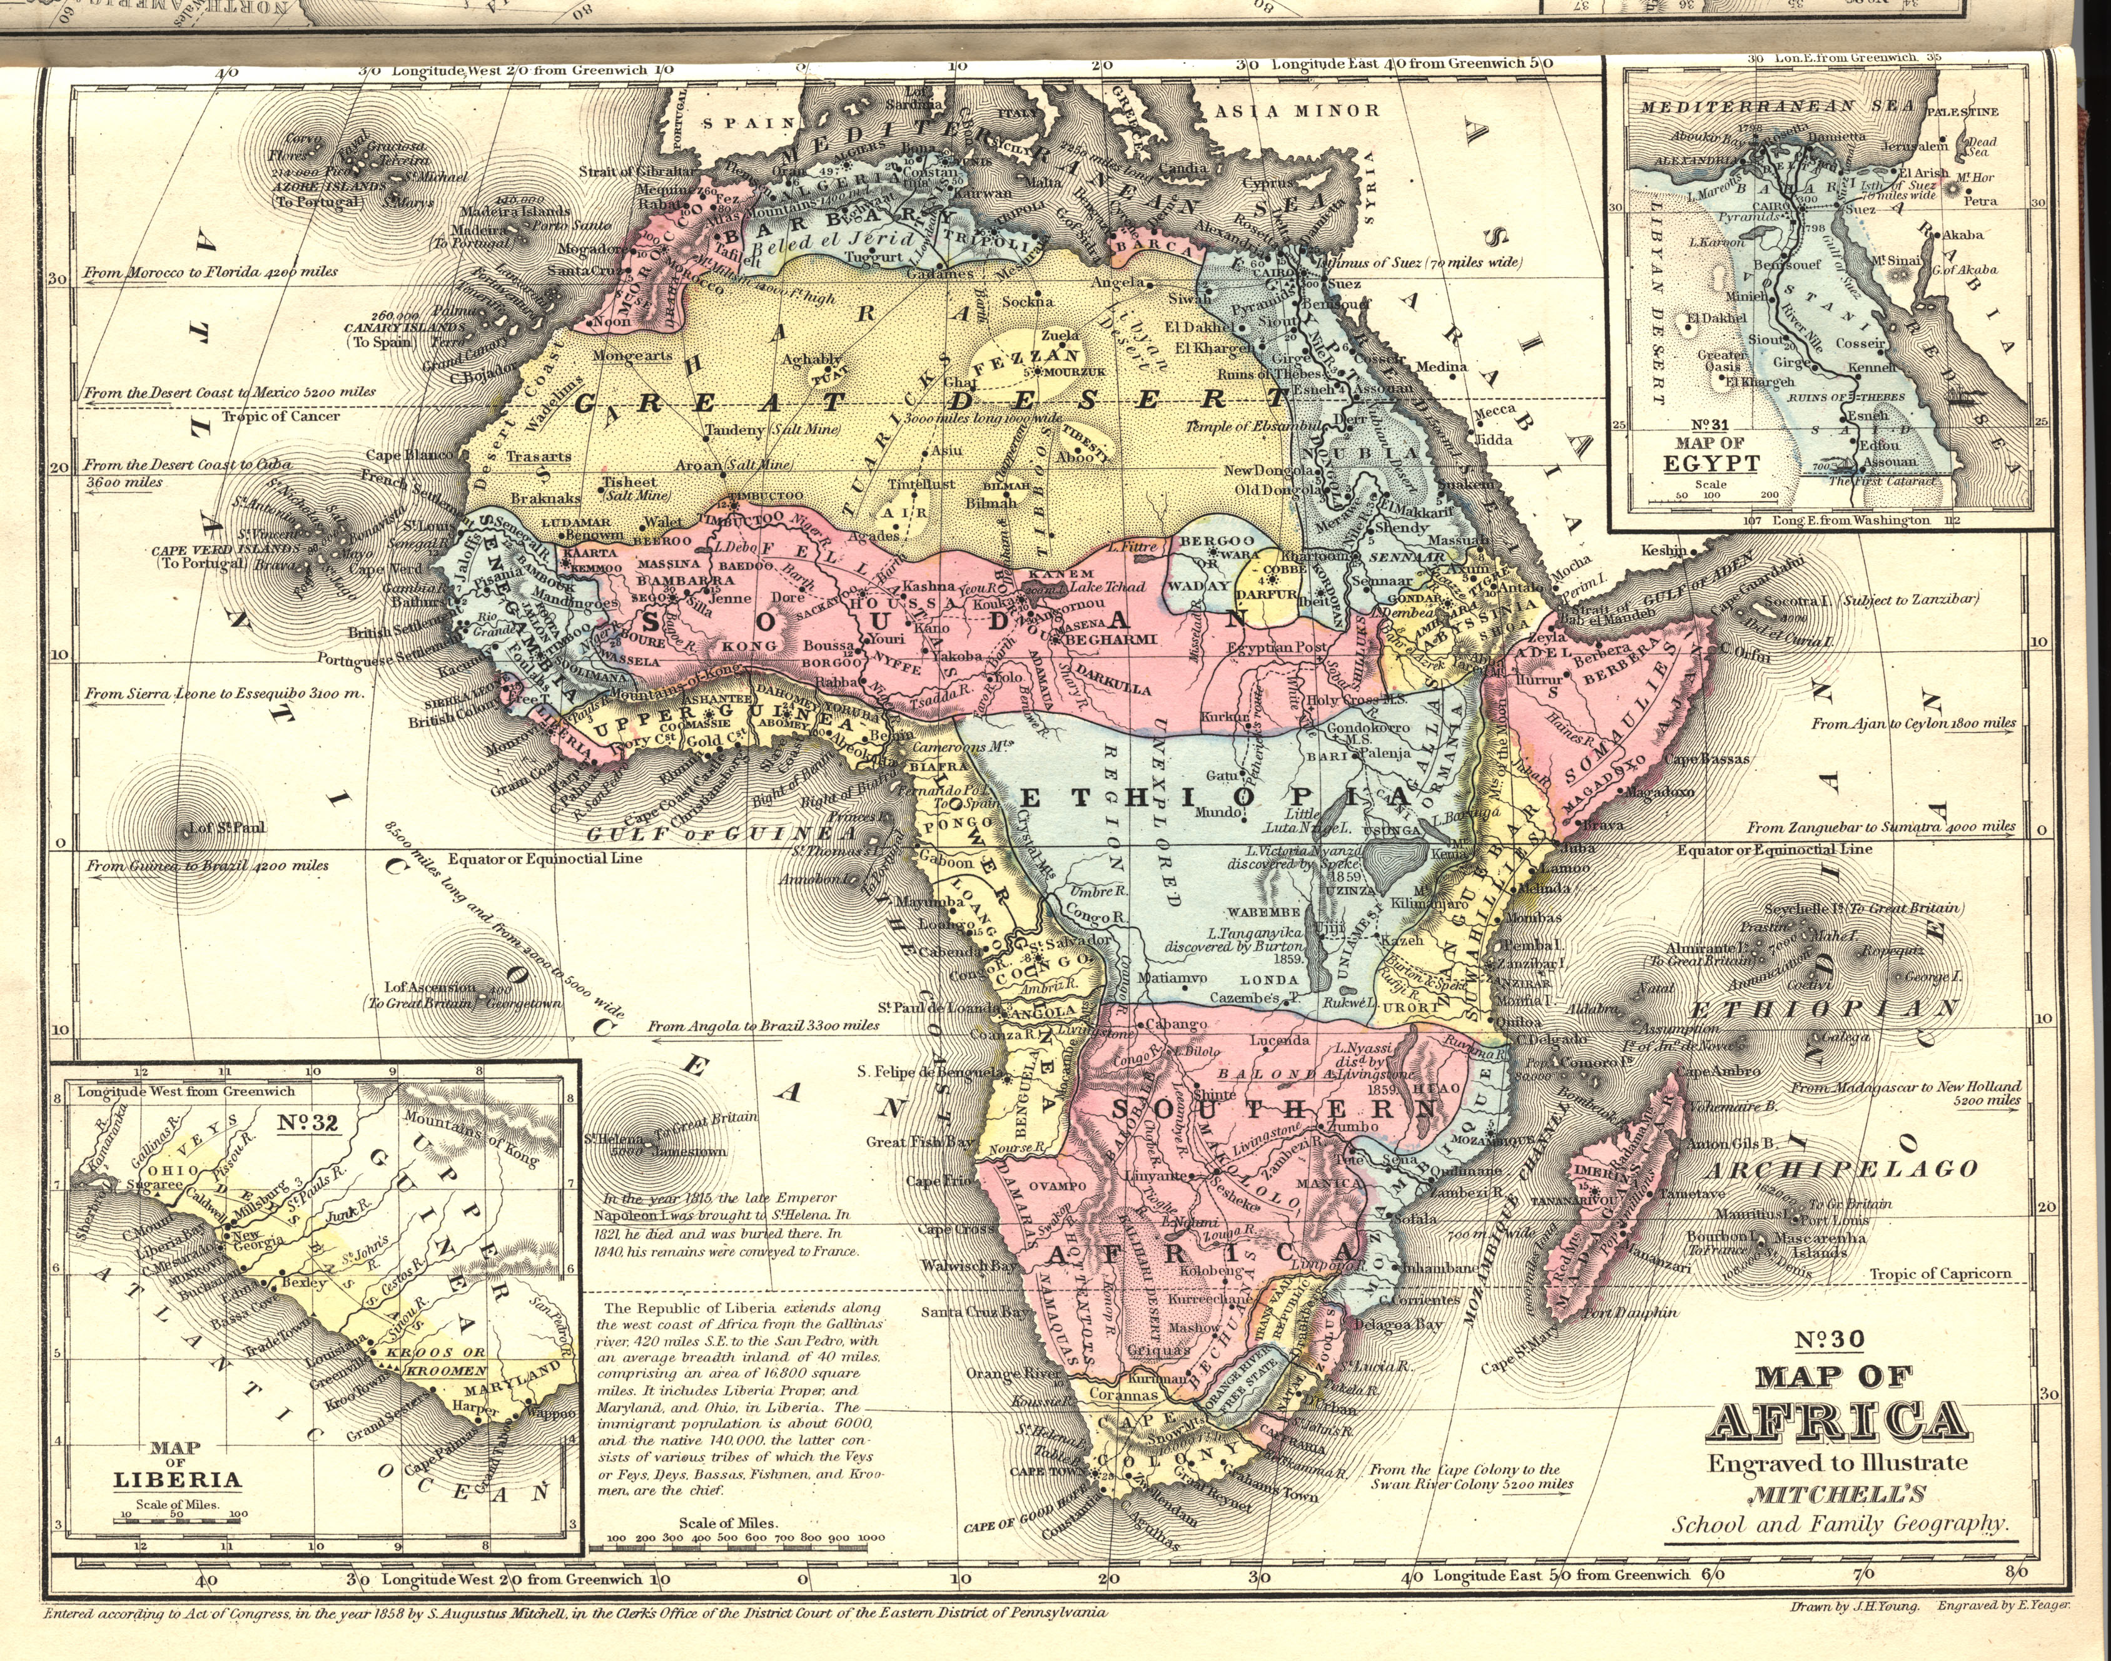
African Railways 1890

Slide 7
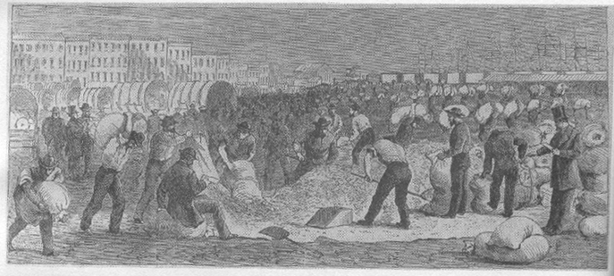
Midwestern Grain Traders
Chicago c. 19th Century
From William Cronon, Nature’s Metropolis

Slide 8
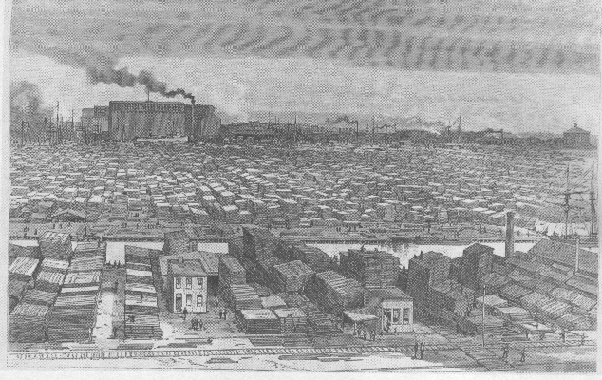
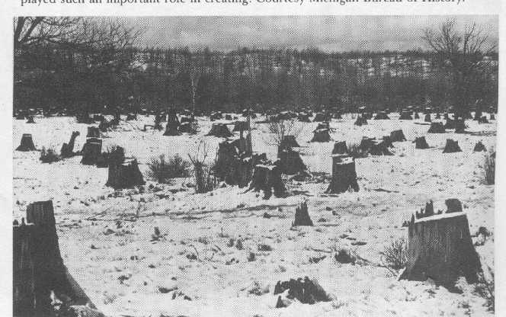
Chicago 19th C. Lumber District
Michigan North Woods

Slide 9
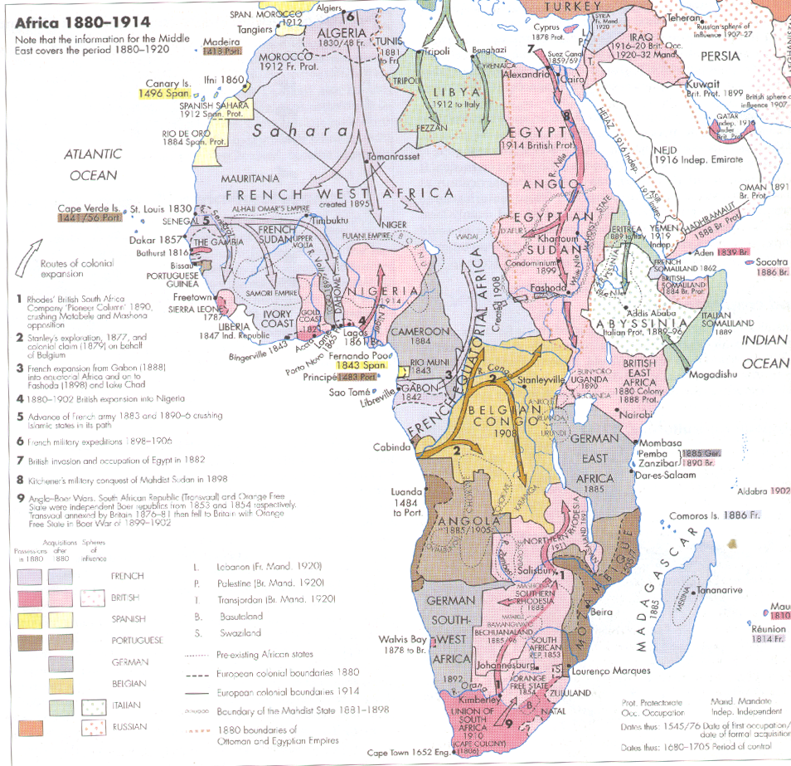
Scramble for Africa,
1880-1914

Slide 10
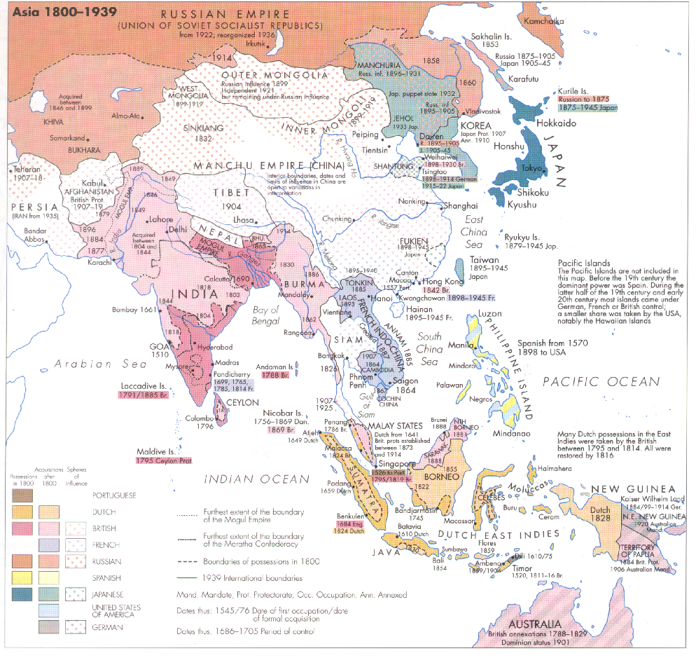
Expansion into
Asia, 1800-1939

Slide 11
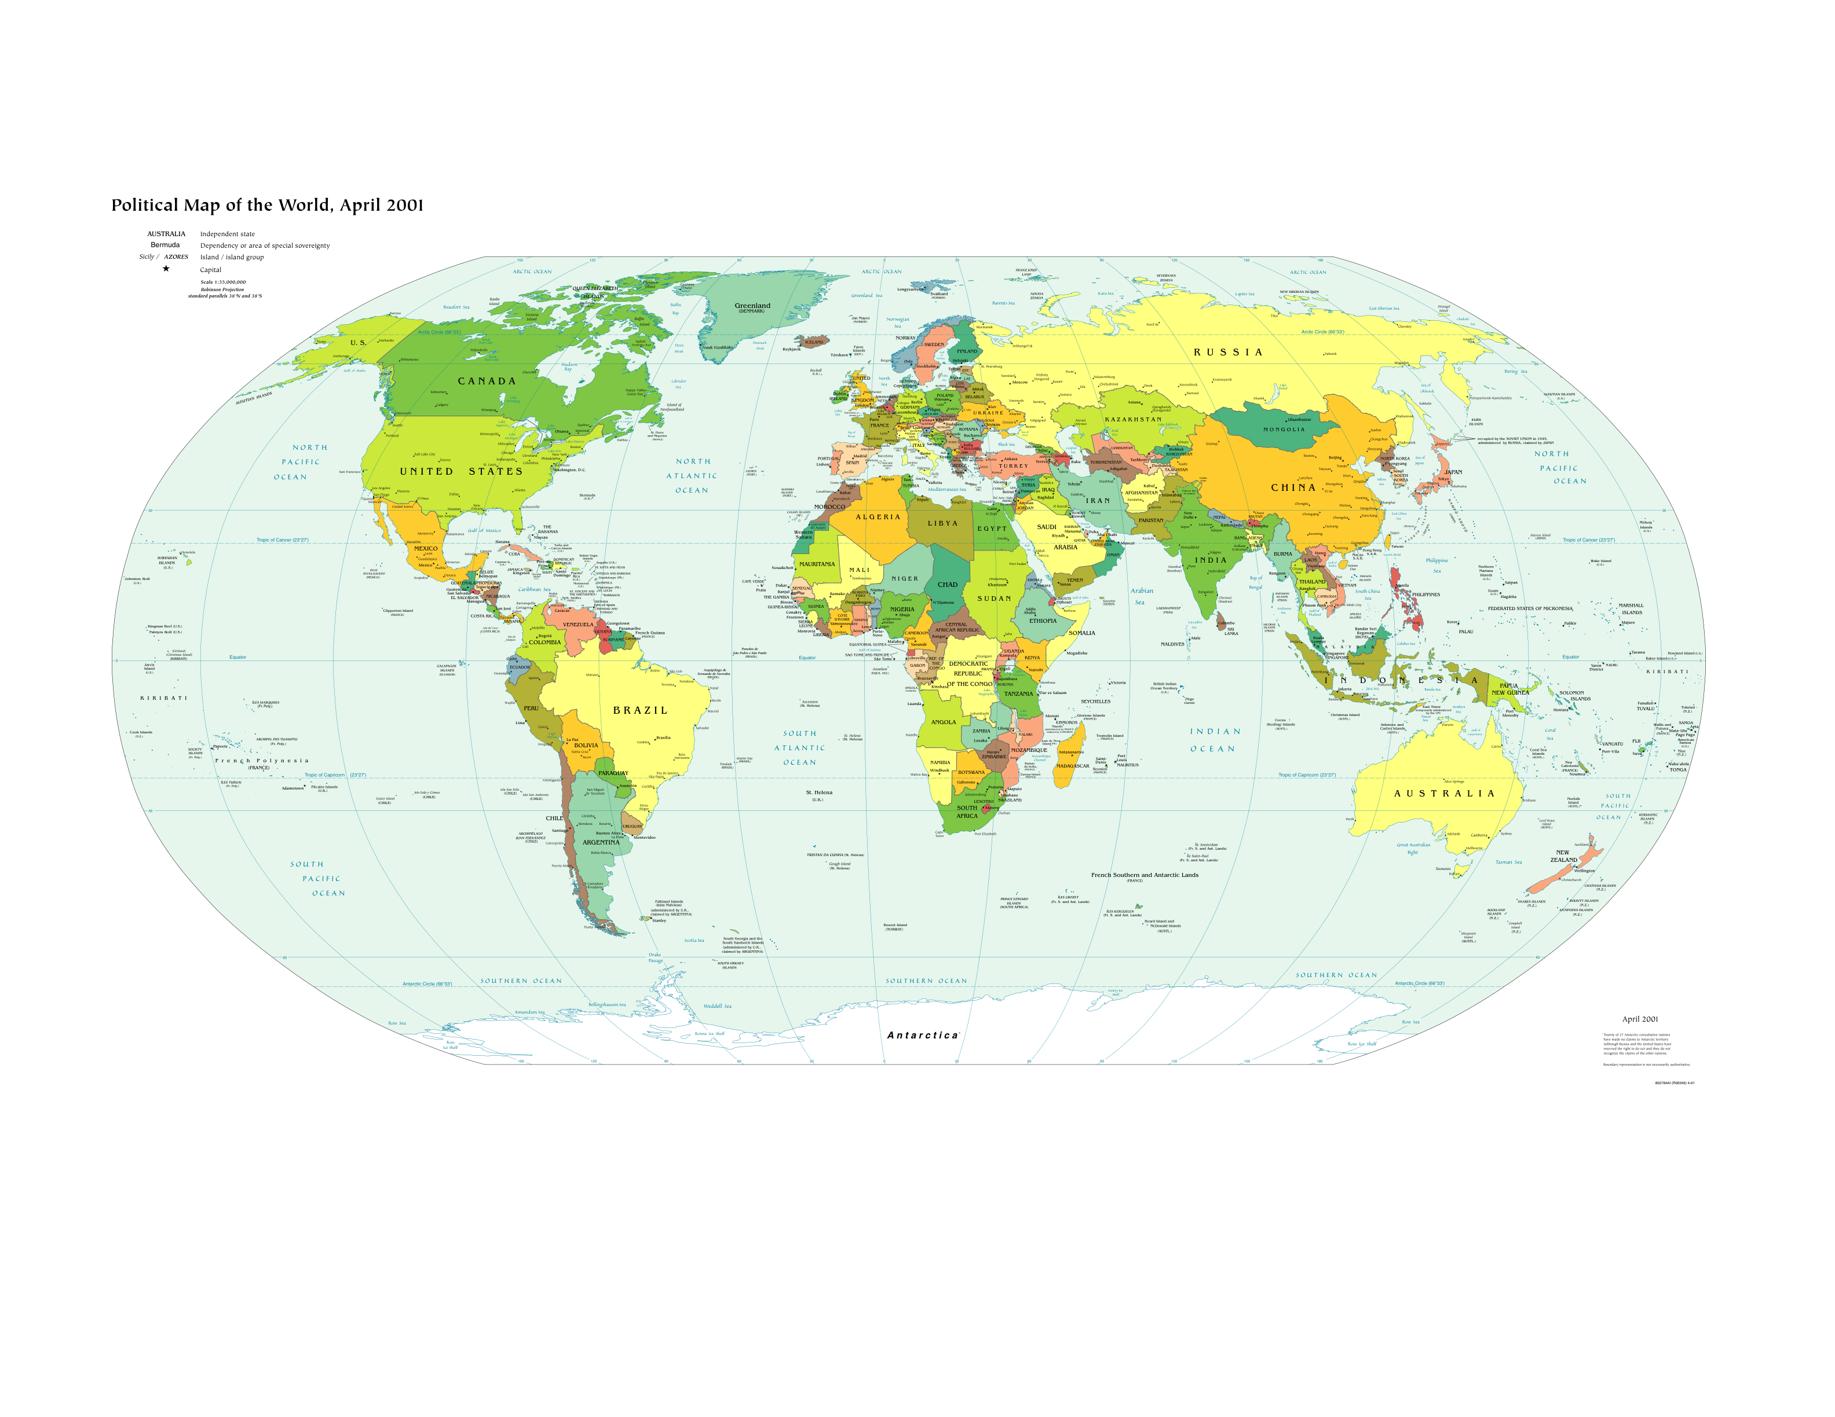

Slide 13
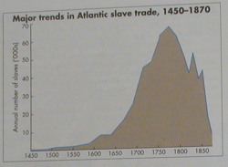

Slide 14
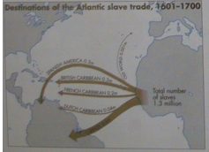

Slide 15
