Slide 1
CO2 Emissions Components
4
40%
3
Oil
36%
Coal
CO₂ emissions (PgC y⁻¹)
2
Gas
1
Cement
0
1990
2000
2010
Le Quéré et al. 2009, Nature Geoscience

Slide 2
Future scenarios?

Slide 3
Fossil Fuel Emissions: Actual vs. IPCC Scenarios
Averages
Full range of IPCC individual scenarios
Raupach et al. 2007, PNAS, updated; Le Quéré et al. 2009, Nature Geoscience; International Monetary Fund 2009
Notes:
The current financial crisis had a small but probably discernable impact on the emissions growth rate in 2008 (growth rate of 2.0% down from 3.4% per year average over the previous 7 years). Despite this slowdown, fossil fuel emissions continue to track the average of the most carbon-intensive scenario of the Intergovermental Panel on Climate Change. In 2009, we project emissions to decline to levels observed in 2007 with negative growth of -2.8%. Positive growth is expected return in 2011 as the change in global Gross Domestic Product goes positive.
We have estimated emissions for 2009 based on the projection of -1.1% GDP growth rate provided by the International Monetary Fund (October 2009) and assuming a continue global decline in the carbon intensity of the GDP as seen over the last 30 years (-1.7% per year).

Slide 4
Sources and Sinks

Slide 5
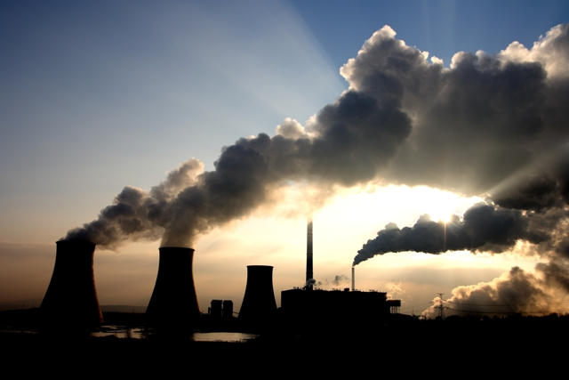
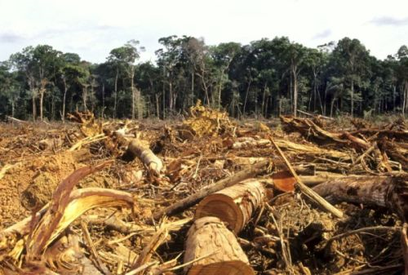
Total Anthropogenic Emissions 2008
Fossil fuel
Land use change

Slide 6

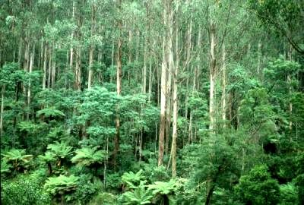

Fate of Anthropogenic CO₂ Emissions (2000-2008)
1.4 PgC y⁻¹
4.1 PgC y⁻¹
45%
+
3.0 PgC y⁻¹
29%
7.7 PgC y⁻¹
26%
2.3 PgC y⁻¹
Le Quéré et al. 2009, Nature Geoscience; Canadell et al. 2007, PNAS, updated
Notes:
Residue is included in the land sink

Slide 7
Net CO₂ Emissions from Land-Use Change (LUC)
in Tropical Countries
2000-2005
600
500
Brazil
60%
400
Indonesia
CO₂ emissions (TgC y⁻¹)
300
Colombia
Cameroon
Venezuela
200
Peru
Nicaragua
Rep.Dem.Congo
India
100
Nigeria
Philippines
Nepal
0
4-2%
2-1%
<1%
RA Houghton 2009, unpublished; Based on FAO Global Forest Resource Assessment
Notes:
Land use change was responsible for estimated net emissions of 1.5 PgC per year over the last 15 years. In 2008, estimated emissions declined to 1.2 Pg C. Wet La Niña con­ditions probably contributed to limited fire use and deforestation rate in Southeast Asia. Emissions from Brazil and Indonesia account for 61% of all emissions from land use change. The contribution of land use change emissions to the total emissions from human activities was 12% in 2008, down from 20% in the 1990s.
CO2 emissions from land use change were calculated by using a book-keeping method with the revised data on land use change from the Food and agriculture Organization of the United Nationals Global Forest Resource Assessment. Emissions after 2005 were extrapolated from the previous 25-year trend of 1.5 PgC per year. Gross emissions from land use change come almost exclusively from deforestation in tropical countries with an estimated 41% from South and Central America, 43% from South and Southeast Asia, and 17% from Africa. We used fire emissions from the Global Fire Emissions Database vs.2 over tropical forests to provide inter-annual variability on emissions over the last three years. Uncertainty of the global estimate of land use emissions is large and considered to be ±0.7 PgC in this analysis. Emission uncertainties at the country level can be large.

Slide 8
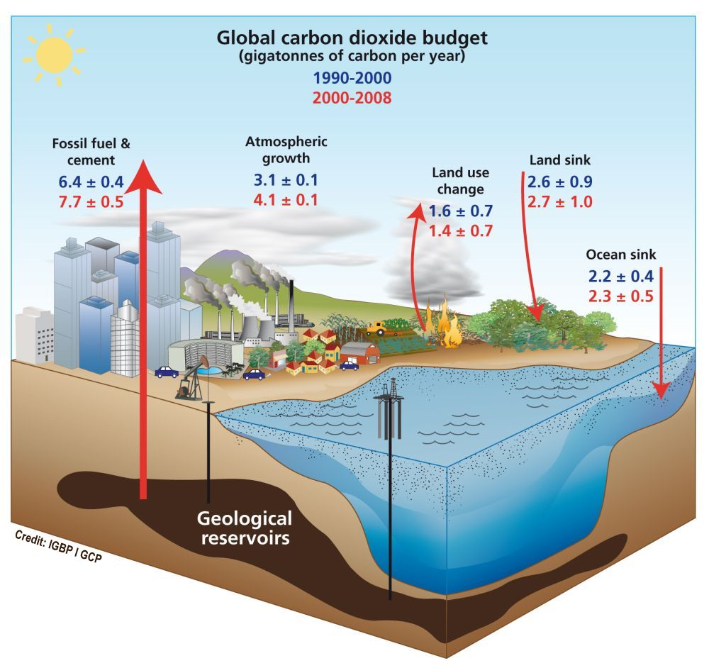
Global Carbon Project 2009

Slide 9
Airborne Fraction
Fraction of total CO₂ emissions that remains in the atmosphere
1.0
Trend: 0.27±0.2 % y⁻¹ (p=0.9)
0.8
45%
40%
0.6
Airborne Fraction
0.4
0.2
1960
1970
1980
1990
2000
2010
Le Quéré et al. 2009, Nature Geoscience; Canadell et al. 2007, PNAS; Raupach et al. 2008, Biogeosciences
Notes:
Natural land and ocean CO2 sinks removed 57% (or 5.3 PgC per year) of all CO2 emitted from human activities during the 1958-2008. During this period the size of the natural sinks has grown but at slower pace than emissions have grown, although year-to-year variability is large. This implies a decline in the efficiency of the sinks in removing atmospheric CO2 over time (from 60% fifty years ago down to 55% in recent years), a trend expected to continue the future. Models suggest the sinks are responding to climate change and variaiblity..
Compared to the last previous three years, the CO2 sink in 2008 was larger on land (in terms of uptake rate) and smaller in the ocean, because El Niño/Southern Oscillation (ENSO) was in a positive (La Niña) state in 2008. Both ocean and land sinks are modelled (see next two sections) but their results need to agree with the closing of the budget, that is all carbon sources should equal all carbon sinks (either measured or modelled). For the period 2000-2008, the difference is 0.3 PgC of the 9.1 PgC per year average emissions during the period. This residual is probably due to errors in the estimate of the land sink.

Slide 10
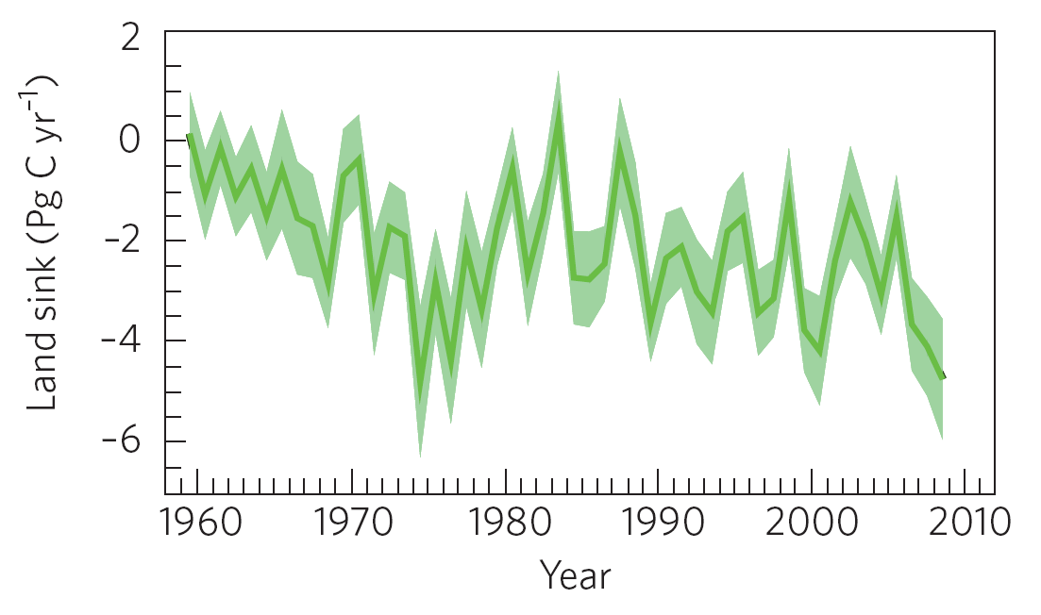
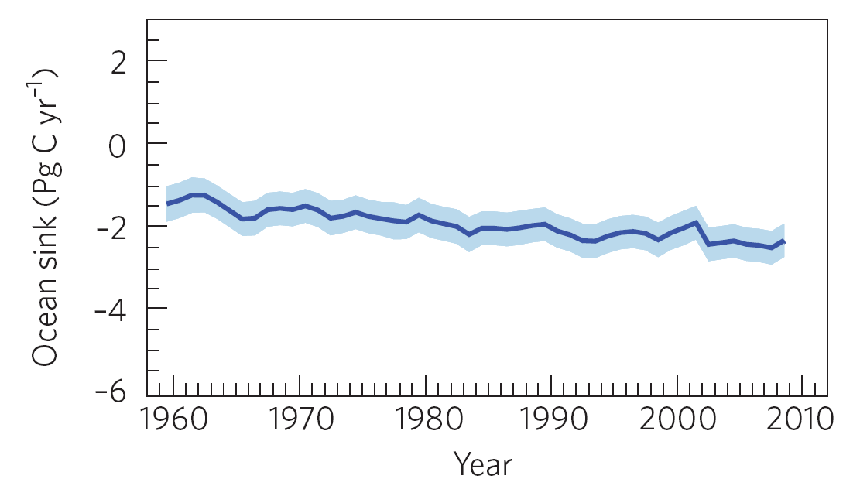
Modelled Natural CO₂ Sinks
Le Quéré et al. 2009, Nature Geoscience
Notes:
Terrestrial CO2 sinks removed 29% of all anthropogenic emissions for the period 2000-2008, equivalent to an average of 3 PgC per year. In 2008, terrestrial ecosystems removed 4.7 PgC, significantly higher than the long term average owing to the wetter conditions brought about by La Niña. An analysis of the long term trend of the terrestrial sink shows a growing size of the CO2 sink over the last 60 years but not discernable change in the efficiency of the sink
The terrestrial sink was estimated using an ensemble of 5 global vegetation models forced by observed CO2 concentration and a combination of meteorological data from the Climatic Research Unit and US National Centers for Environmental Prediction.

Slide 11
Social Aspects of
Greenhouse Gas Production

Slide 12
Per Capita CO₂ Emissions
Developed countries continue to lead with the highest emission per capita
1.3
1.2
1.1
Per Capita Emissions (tC person⁻¹ y⁻¹)
1990 1995 2000 2005 2010
Le Quéré et al. 2009, Nature Geoscience; CDIAC 2009

Slide 13
Fossil Fuel Emissions: Top Emitters (>4% of Total)
2000
China
1600
USA
1200
Carbon Emissions per year
(tons x 1,000,000)
800
Russian Fed.
India
400
Japan
0
1990
03
05
07
99
01
03
05
2008
Time
Global Carbon Project 2009; Data: Gregg Marland, CDIAC 2009
Notes:
Top emitters with a global share bigger than 4%
2008 highlights:
China emissions don’t slow down as a result of the financial crisis
USA emissions show a small decline in total emissions
India overtakes Russia as the third top emitter
Russia emissions still below pre-1990s collapse levels

Slide 14
Fossil Fuel Emissions: Profile Examples (1-4% of Total)
UK
160
Canada
South Africa
120
Carbon Emissions per year
(tons x 1,000,000)
80
Brazil
Australia
Spain
40
Denmark
0
1990
03
05
07
99
01
03
05
2008
Time
Global Carbon Project 2009; Data: Gregg Marland, CDIAC 2009
Notes:
Examples of countries accounting for 1 to 4% of global share of emissions
Young economies such as Canada, South Africa, Spain and Australia show strong growth in emissions while emissions from older economies such as the UK and Denmark show a rather stable or declining levels; some of the decline is due to the outsourcing of CO2 emissions to developing countries. Australia emissions have been steady for the last three years.

Slide 15
Transport of Embodied Emissions
CO₂ emissions (PgC y⁻¹)
Annex B Developed Nations
Global Carbon Project 2009; Le Quéré et al. 2009, Nature Geoscience; Data: Peters & Hetwich 2009; Peters et al. 2008; Weber et al 2008; Guan et al. 2008; CDIAC 2009
Notes:
The right panel shows what happens if carbon emissions from traded products are assigned to the consumers, not to the producers as shown on the left panel.
25% of the emissions growth in developing countries (2000-2008) is due to the manufacturing of products consumed in developed countries.

Slide 16
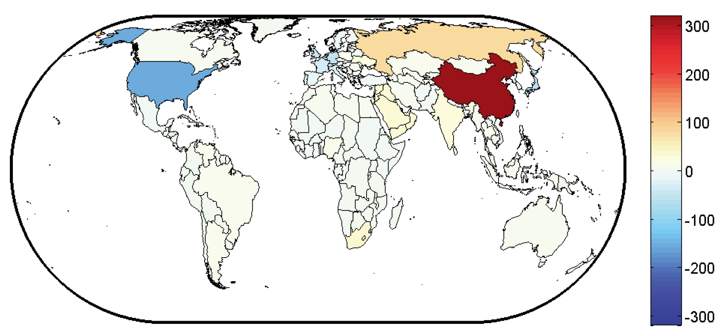
Balance of Emissions Embodied in Trade (BEET)
Year 2004
Warm colors → Net exporters of embodied carbon
Cold colors → Net importers of embodied carbon
MtC
BEET
Peters and Hertwich 2008, Environ, Sci & Tech., updated
Notes:
Increasingly, more developed countries are net importers of carbon embedded in products and services provided by developing countries. In other words, developed countries are partially outsourcing their emissions to developing countries.
Examples of this emissions imbalance created by import/export are:
US (1997-2004): Within country emissions went up by 6%; Consumption based emissions went up +17%. Part of this differences is
Sweden (1992-2004): Within country emissions – 5%; Consumption based emissions +12%
China (2002-2005): Production of Exports was responsible for 50% of the emissions growth; 30% total emissions.

Slide 17
References cited in this ppt
Canadell JG, Raupach MR, Houghton RA (2009) Anthropogenic CO2 emissions in Africa. Biogeosciences 6: 463-468.
International Monetary Fund (2009) World economic outlook. October 2009.
http://www.imf.org/external/pubs/ft/weo/2009/02/index.htm
Le Quéré C, Raupach MR, Canadell JG, Marland G et al. (2009) Trends in the sources and sinks of carbon dioxide. Nature geosciences, doi: 10.1038/ngeo689.
Marland G, Hamal K, Jonas M (2009) How uncertain are estimates of CO2 emissions. Journal of Industrial Ecology 13: 4-7.
Peters GP, Hertwich E G (2008) CO2 embodied in international trade with implications for global climate policy. Environmental Science and Technology 42, 1401-1407.
Raupach MR, Canadell JG, Le Quéré C (2008) Drivers of interannual to interdecadal variability in atmospheric in atmospheric CO2 growth rate and airborne fraction. Biogeosciences 5: 1601–1613.
Sitch S, Huntigford C, Gedney N et al. (2008) Evaluation of the terrestrial carbon cycle, future plant geography and climate-carbon cycle feedbacks using five Dynamic Global Vegetation Models (DGVMs). Global Change Biology 14: 1–25, doi: 10.1111/j.1365-2486.2008.01626.x.
van der Werf GR, Randerson JT, Giglio L, Collatz GL, Kasibhatla PS, Arellano AF, Jr (2006) Interannual variability in global biomass burning emissions from 1997 to 2004. Atmos. Chem. Phys. 6: 3423–3441.

