Slide 1
Benjamin and Nature in
19th century Paris

Slide 2
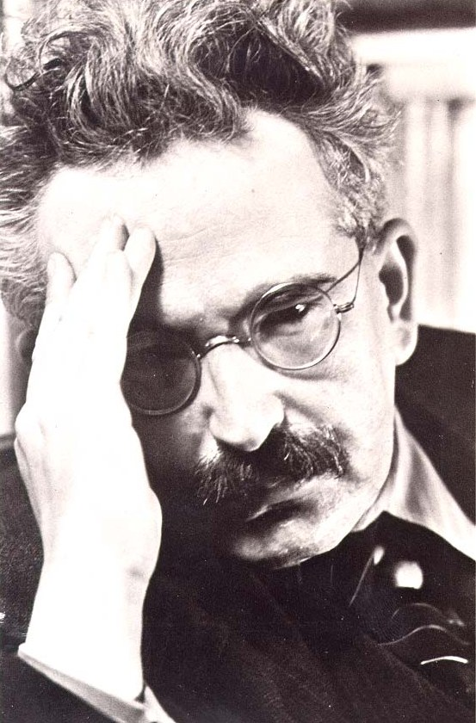
Walter Benjamin

Slide 3
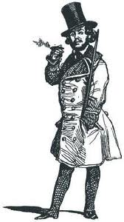
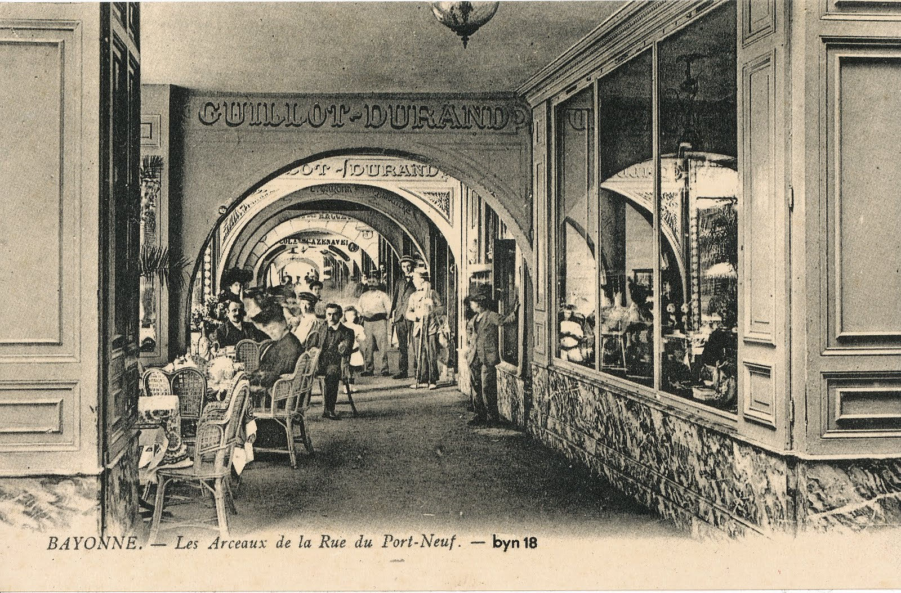

Arcades and Flaneur

Slide 4
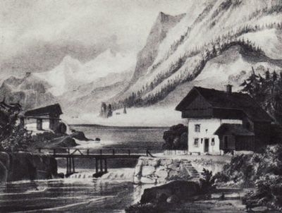
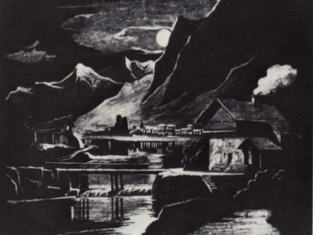
Nature Dioramas
[D]ioramas reached a peak just at the moment when the arcades began to appear. Tireless efforts had been made to render the dioramas, by means of technical artifice, the locus of a perfect imitation of nature.” – Benjamin Paris, Capital of the 19th Century

Slide 5
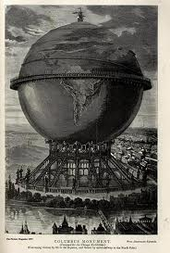
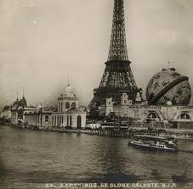
Paris, World Exhibition 1867

Slide 6




