Slide 1
‘The Number is the Beast’:
A Political Economy of Certified Organic Coffee and Producer Unionism
in Oaxaca, Mexico

Slide 2
"I was giving a talk to a new group of [certified] organic producers. I was explaining how they would have a producer number…. Suddenly an elderly individual stood up and said that the ‘number is the beast’. At first I didn’t understand, but then I realized that he was talking about the beast in the bible, that he thought that [the producer number] was some terrible thing….
Now you see what we [inspectors] have to confront."
—Organic Certification Inspector 22 July 2000
[certification] is a class of ecological neocolonialism….."
—Organic extension agent 31 January 2000

Slide 3
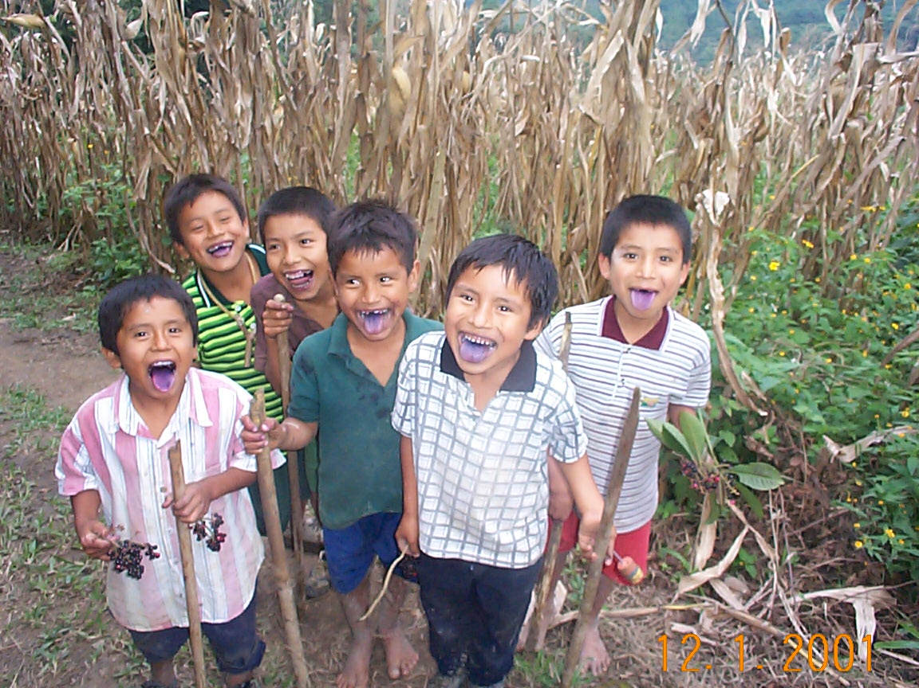
Objetivos del Programa

Slide 4
Certified organic foods sector
$20 billion in worldwide sales in 2002
10.5 million hectares
$60 Billion 2010
30 million hectares (75 million acres)
Products traced from producer field to retail store: transport and way-stations must be certified organic.
Surprise! (Not) Farmers get very little of the returns from organic production
Product Certifiers:
88 in the US (OFRF 2000),
~200 internationally
8 in Mexico
,

Slide 5
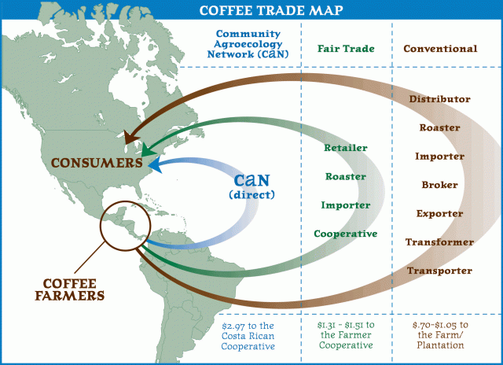

Slide 6
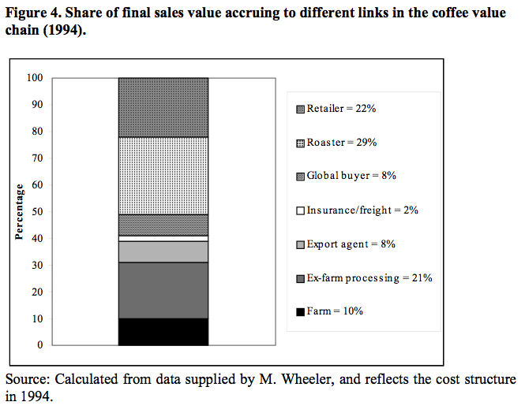
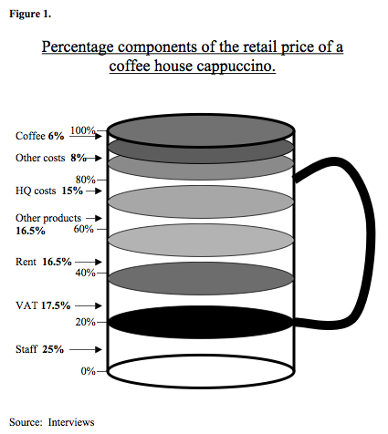

Slide 7
Why produce Organic and Fair Trade Coffee?
Problems and challenges of coffee production: declining prices and the fair-trade organic strategy

Slide 8
Dean’s View
Marias’s View
Notes:
Positionality plays a role in the imagination of prices.
Dean’s view: FT prices are above NYC ‘C’ market rates, giving producers a good deal
Maria’s view: Prices have dropped to 1/4 of their 1960s to mid-80s highs

Slide 10
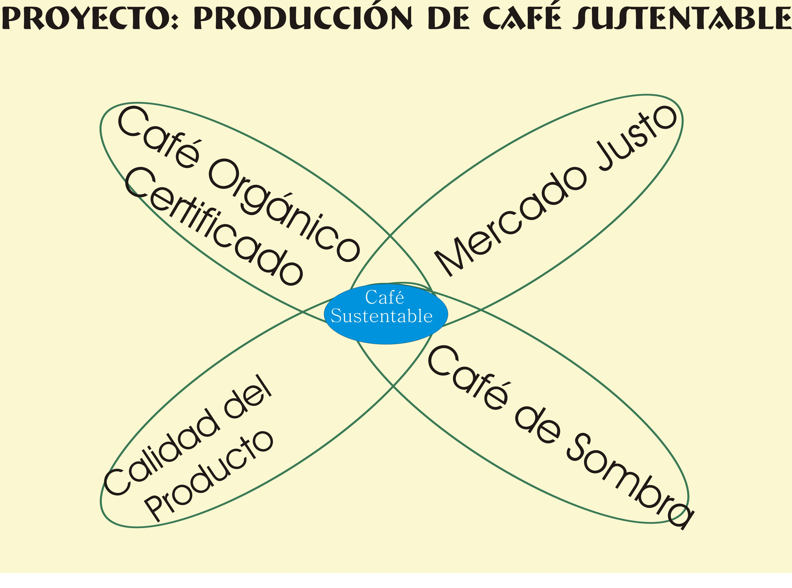
Certified Organic
Coffee
Fair Trade Coffee
High Quality Coffee
Shade-Grown Coffee

Slide 11
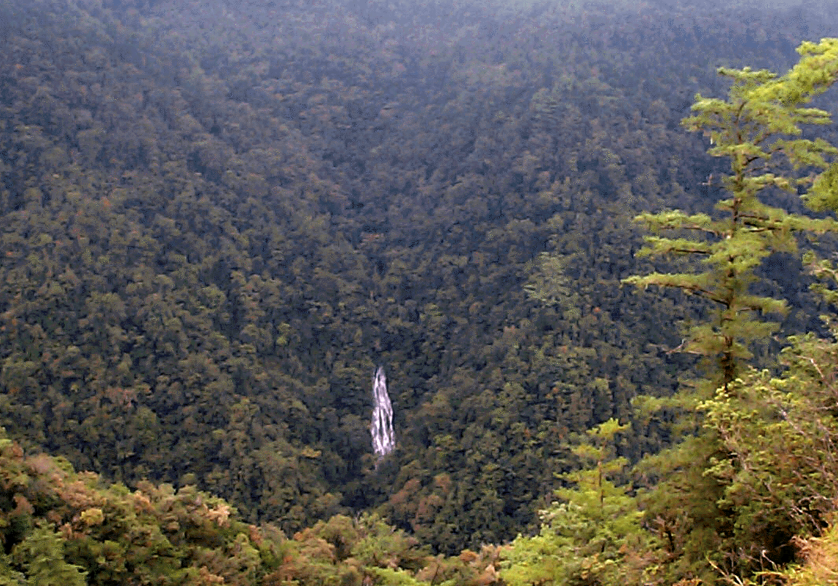
Environmental Services
Clean Water
Species Conservation
Carbon Sequestration
Sao
Fondo Bioclimático
Falls Brook Centre

Slide 12
Coffee Production in Practice:
Oaxaca, Mexico

Slide 13
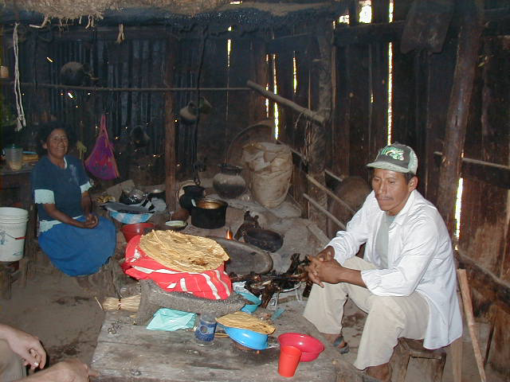
Nuyoo

Slide 14
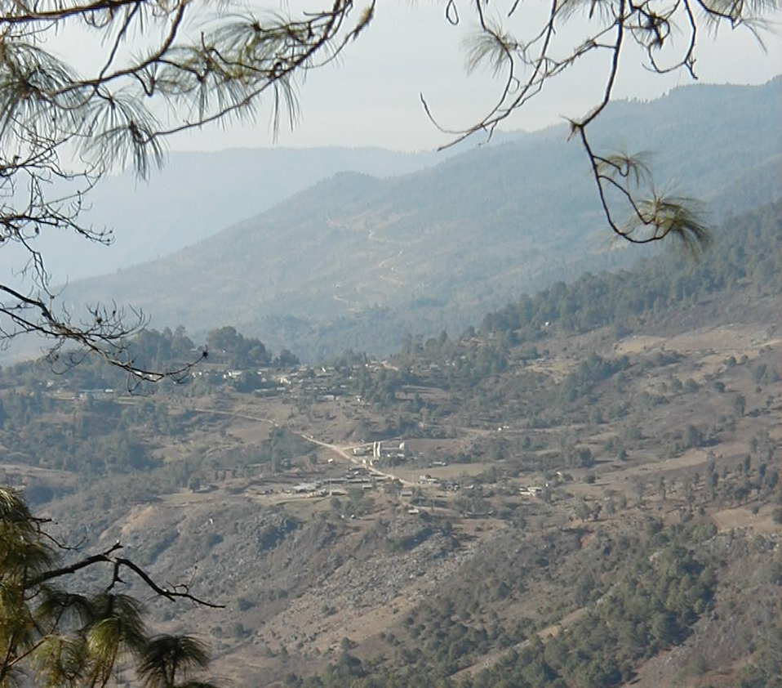
La Itundujia

Slide 15
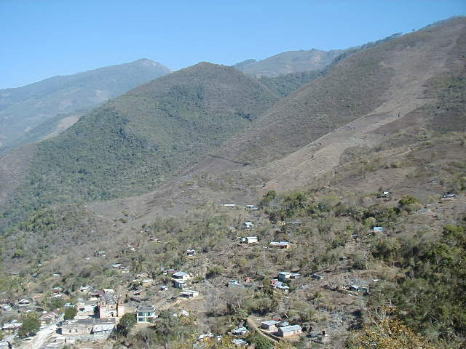
Xanica

Slide 16
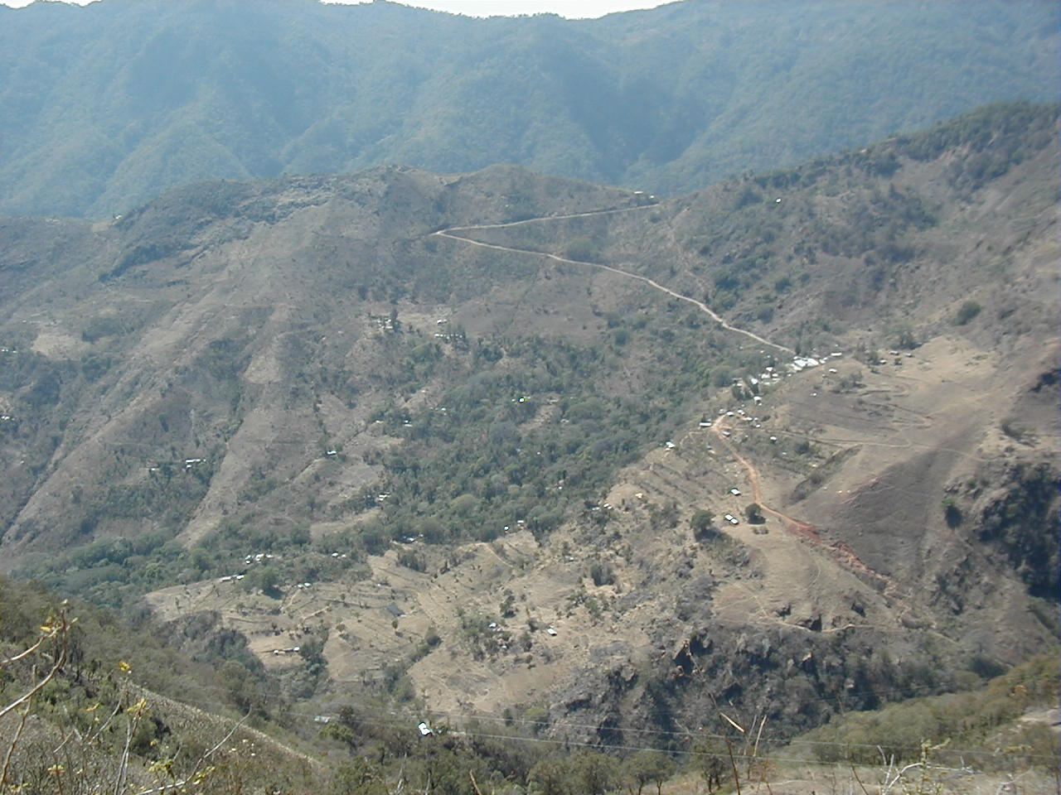
Nuyoo

Slide 17
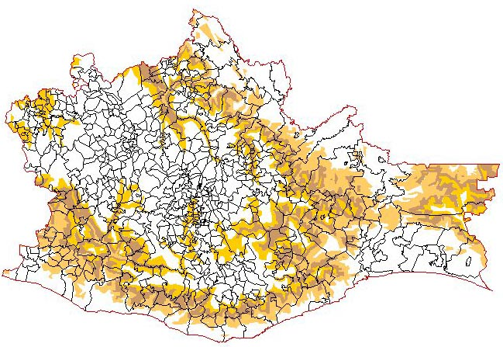
Área de influencia del programa

Slide 18
Coffee Work

Slide 19
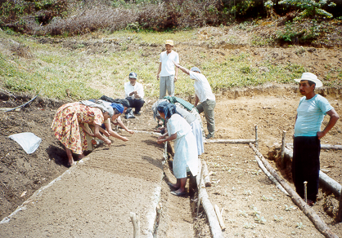
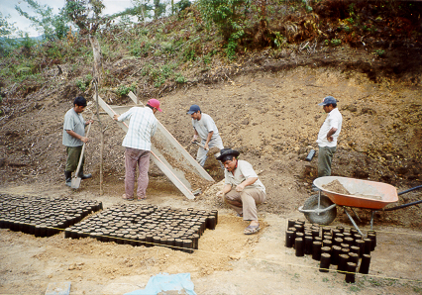

Slide 20
Notes:
Needless to say, the solidarity narrative is presented as a welfare trope. The higher prices from fairtrade and organic premiums allow families to care for their children, in this case allowing ‘Maria’ to get medical attention.

Slide 21
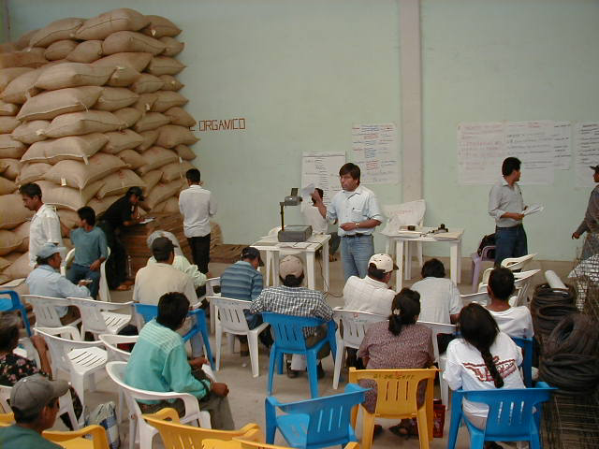
Peasant inspectors/
Community Technical officers training

Slide 22
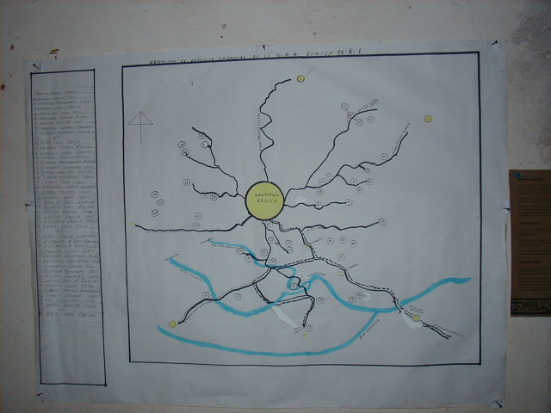
Mapping key to certified organic monitoring

Slide 23
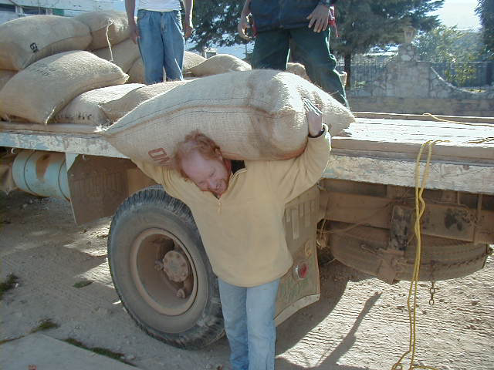
Coffee: A weighty subject

Slide 24
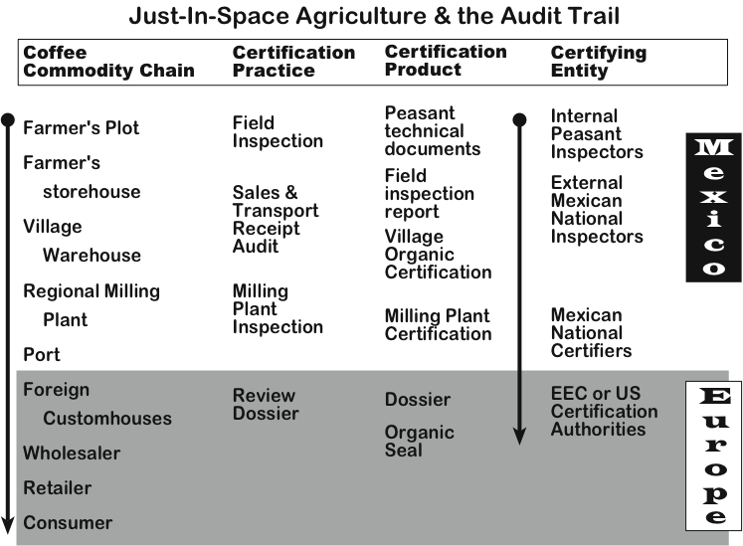

Slide 25
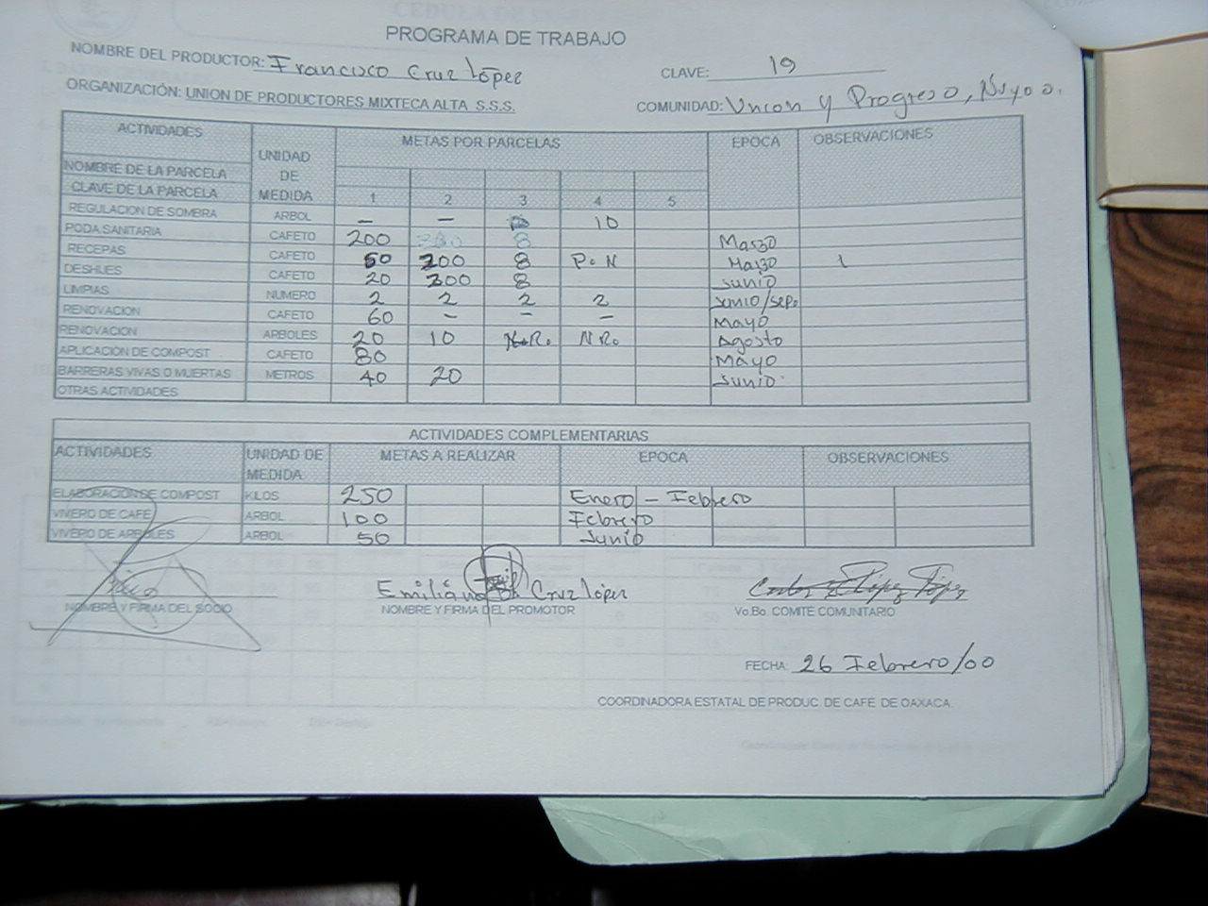
Peasant technical documents

Slide 26
Benefits of fair-trade organic coffee: the accumulation of wealth and knowledge in rural Oaxacan villages

Slide 27
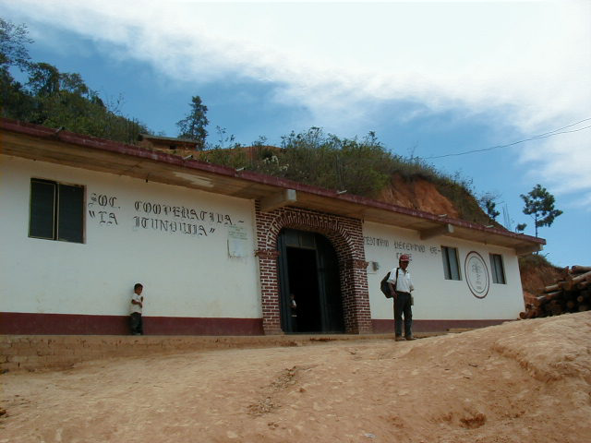
Morelos Coffee Warehouse

Slide 28
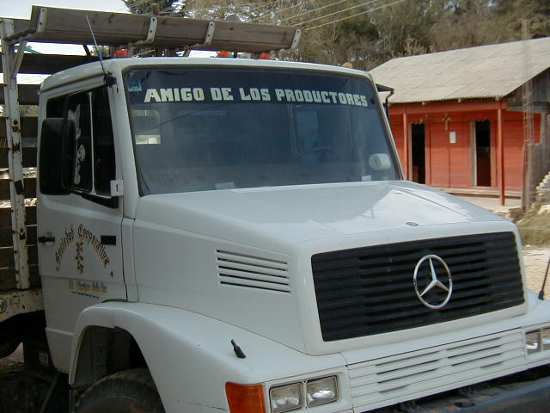
La Itundujia

Slide 29
A problem: Unexpected Consequences of Labor for Cash Agreement: The Administrative burdening of unpaid Village and Regional Organization Leaders
Increase in Yearly Labor Day Outlays to
Manage Internal Certifications
Village and Regional Organization Leaders 40
Peasant Inspectors 20
Village Technical Officers 22
Producer families 3

Slide 30
The downside of Organic and Fair Trade Coffee: lots of work and burnout!

Slide 31
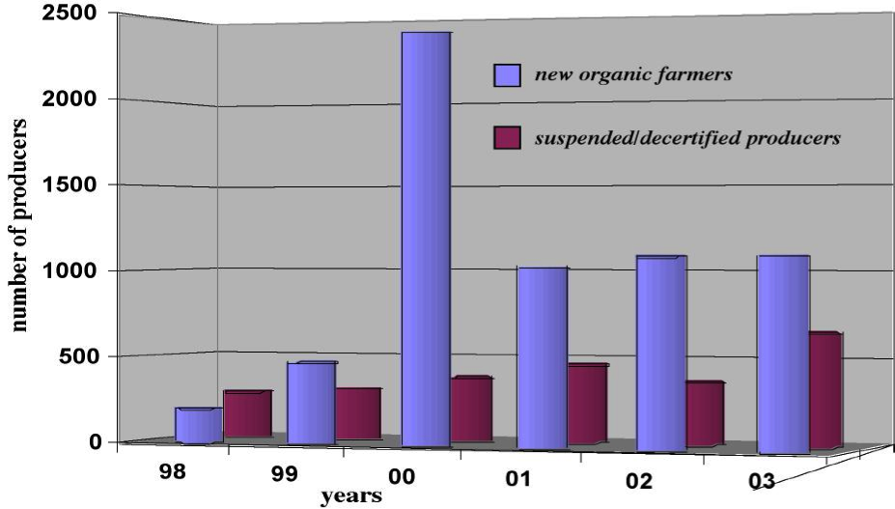

Slide 32
Knowledge Relations in Fairtrade Certification

Slide 33
Quality Labor in FT-Organic

Slide 34
Notes:
Maria’s view: smaller and larger producers leaving -- as a percentage of the group in question
Recruitment is stagnating too, with only middle level producers able to justify entry. Even these are coming from relatively low-wage regions.

Slide 35
Conclusions
The certification process stands to transform peasant economies, organization and perception
The monitoring structure complicates the commodity chain
  Monitoring is very costly for farmers!!
  Transnational certification norms disrupt peasant unions
The Number is the Beast: Changes in governance and economic management
elicit resistance/ resistance complicated by ISO norms

Slide 36
Analytical approach: comparative study of three coffee producing villages in Oaxaca, Mexico
Within the Oaxacan statewide peasant confederation
Certified by OCIA (USA) and
Naturland (EU) certifier/labelers
Within different regional organizations
Differ in terms of property, wealth,
and production relations

Slide 37
i. peasant livelihoods
  a. peasant households
  b. village organizations
ii. peasant organizations
  a. regional organizations
  b. state-level organizations
iii. certification organizations
  a. Mexican national certifiers
  b. Mexican certifier unions
  c. Mexican governmental organizations
  d. International Certifiers

Slide 38
Fetish
Capitalism:
A
Neoliberal
Creed?

Slide 40
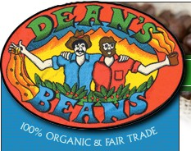
Notes:
This is the image of solidarity in the US. This image embeds two distinct visions of the transnational fairtrade-organic commodity network.
On the one hand, the evocation of a transnational solidarity across a network, fair pay for fair labor, social justcie and equality across a global space. This constitute a discursive construction of a ‘space¡ of solidarity, located in a network. There are many such images, in fact one can see these same images now on supermarket (or at least co-op) bins: ‘member’ faces looking expectantly at the consumer, hoping that they will help out with a coffee purchase.
The other image is of a very unequal network: ‘you pick the coffee and i’ll drink it’. I term this ‘rentier capitalism’ in reference to the underlying dynamic of the network. Dean (the one on the left) sets out an ownership claim, and measures his company performance against the market. An increase in ‘Juan’s’ share cuts either into Dean’s revenue share (if Dean absorbs the price increse) or into Dean’s market share (if Dean passes the cost onto the consumer thereby increasing the product cost: this assumes that consumers will select the cheaper alternative of several competing ‘responsible’ brands).
(Actually, it makes one wonder where indeed Dean is. Is Dean the gringo with the cup? Or is Dean watching from our vantage point: are we Dean?)

Slide 41
Intensification in Transnational Certification:
International Context
European Food Safety Crisis:
e.g., Mad Cow Disease
Consolidation of International
Regulatory Structures:
ISO / WTO / TBT Legislation
EU 2092/91 EN 45011 ISO Guide 65
Rationalization of Transnational Organic
Product Certification: Naturland, OCIA

Slide 42
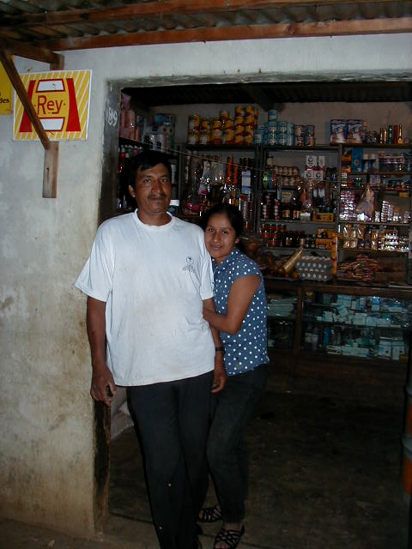
Xanica

