Slide 1
Biodiversity part 2
Global Environmental Issues

Slide 2
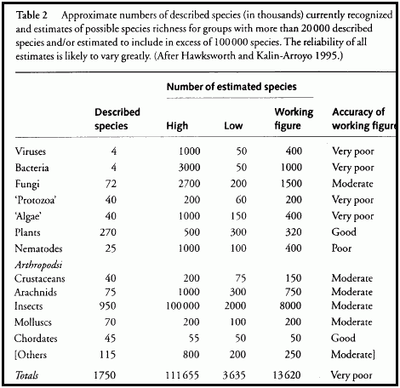
How do we measure biodiversity?
Uncertainty is a central problem
Numbers of species
1.75 million species scientifically identified.
estimated 30 million species on earth.
estimated 40,000 species rendered extinct annually.

Slide 3
what does ‘biodiverse’ mean in practice?
example: different varieties of white oak
versus different species of oaks
versus different genera

Slide 5
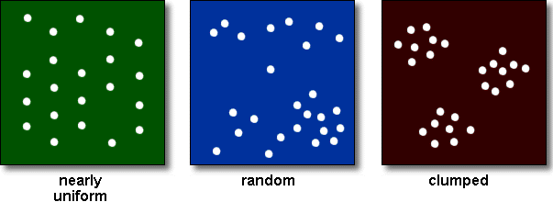
Issue 2: Distribution of populations and sampling problematic

Slide 6
Issue 3: unit of analysis: population? gene pool? Clade? Genera? What is the appropriate unit for biodiversity analysis?

Slide 7
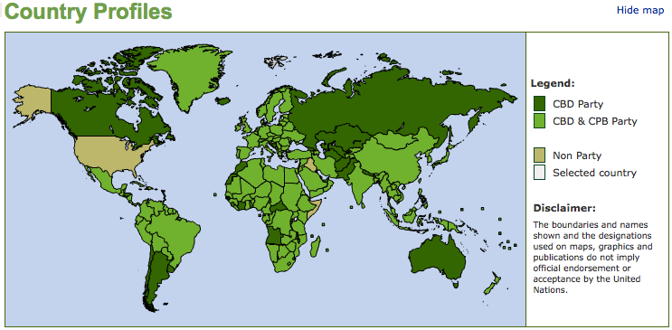
Issue 4: Convention on Biodiversity: the US is supposed to measure biodiversity, but has limited funds for the US Biological Survey and HAS NOT signed the international Convention on Biological Diversity. This has been attributed to an administration unwillingness to fund a program which would almost certainly find new species that would then be subject to protection under the Endangered Species Act.
It takes money to measure biodiversity: Our knowledge is dependent upon the resources we invest in assessing and cataloging biodiversity

Slide 8
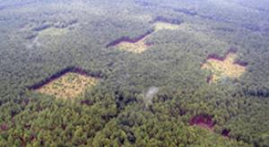
Where does Biodiversity come from?
coevolutionary relationships: mutualism, symbiosis,
allopathy
patchiness in landscape ecology

Slide 9
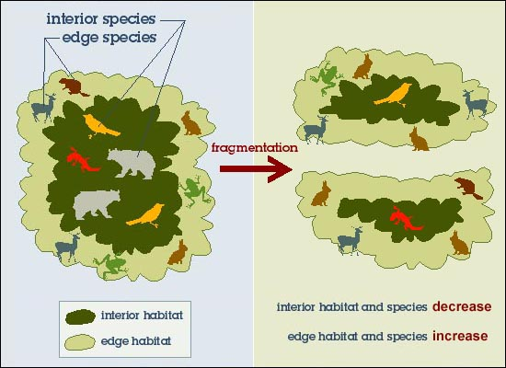
Types of Biodiversity:
landscape biodiversity engenders biodiversity by increasing the complexity of niches across space
alpha biodiversity
rollover biodiversity
is there information in a landscape, and if so how structured?

Slide 10
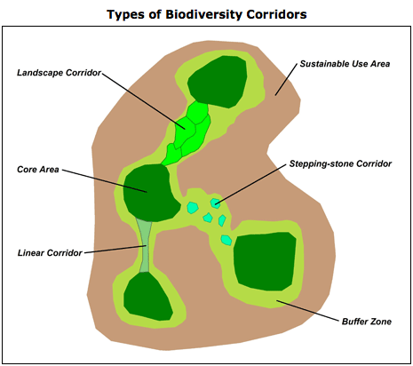
trails, movements of animals and plants, seed dispersals

Slide 11
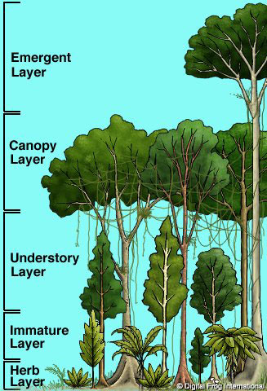
Niche complexity within a patch

Slide 12
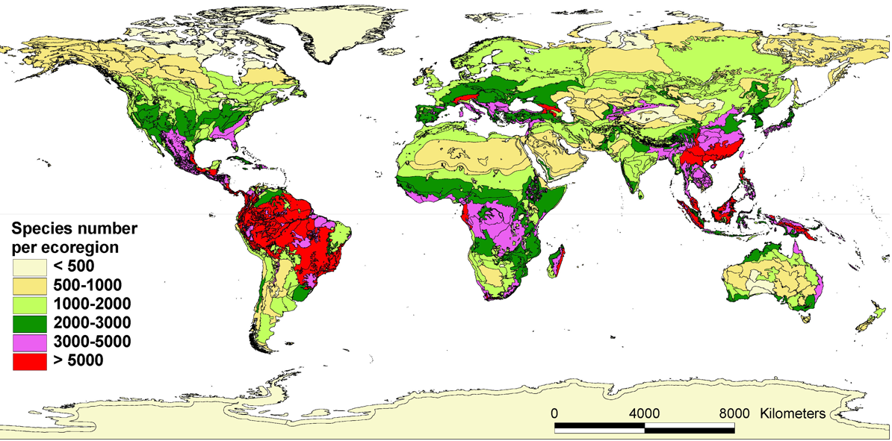
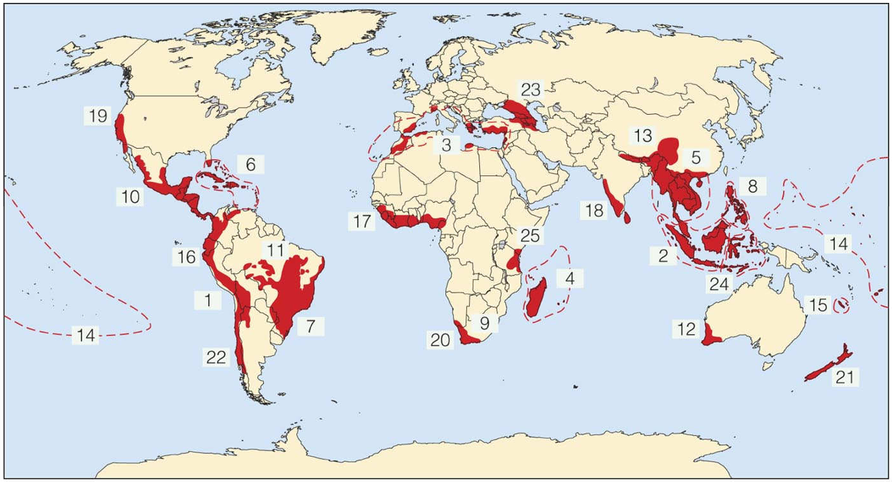
biodiversity hot spots:
what is a biodiversity ‘hot spot’?
how do types of biodiversity and processes of biodiversification create in hot spots?

Slide 13
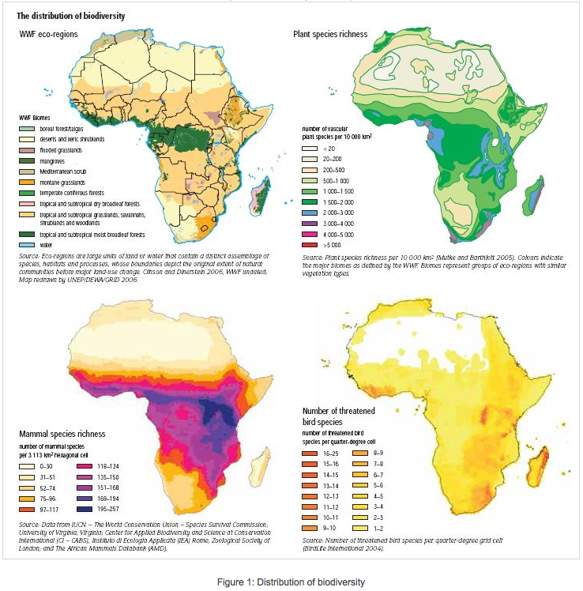

Slide 14
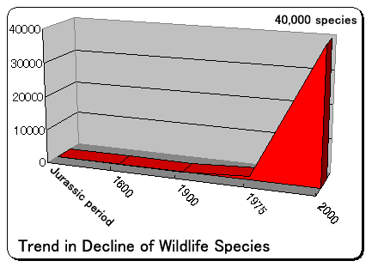
species loss rates
  absolute loss

Slide 15
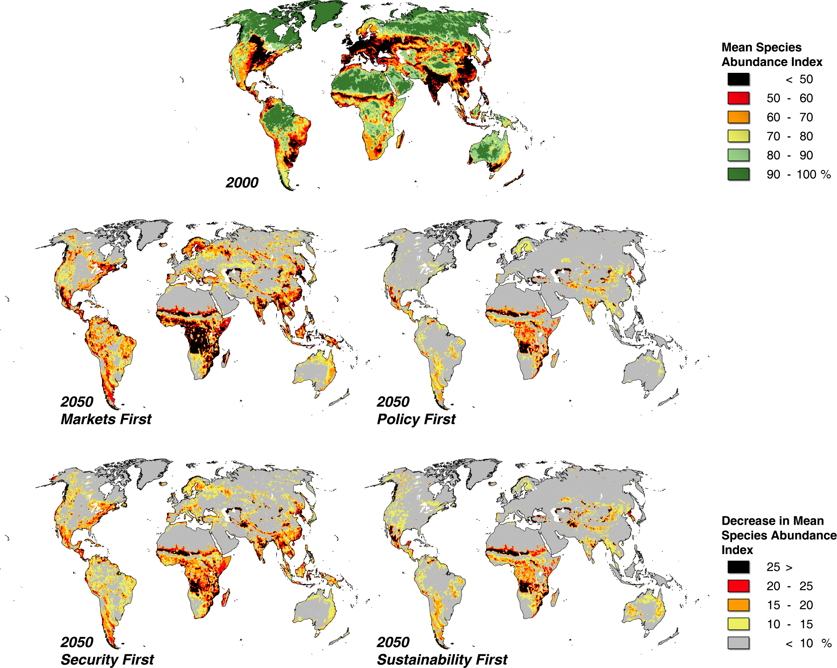
  rates of loss
differ geographically across social and biological contexts
MAP: Biodiversity loss: state and scenarios 2006 and 2050.
greatest losses rank order: Markets First, Security First, Policy First Sustainability First. differences among the regions:
broad-scale land-use changes, especially pastureland and biofuel production infrastructure development,
pollution
climate change,
public policy and conflict
http://www.unep.org/geo/geo4 / http://www.globio.info/region/world/

Slide 16
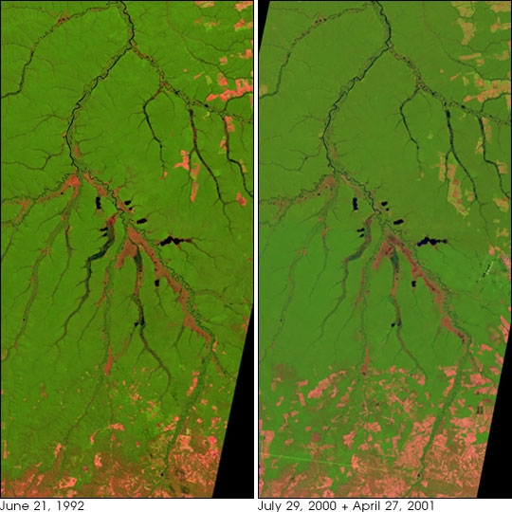
Biodiversity Loss rates also differ by patch utilization: some areas are more amenable, systematically more amenable, to human exploitation

Slide 17
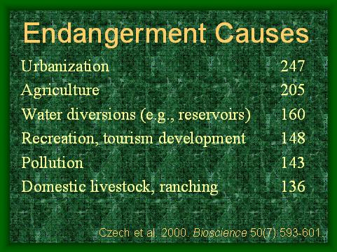
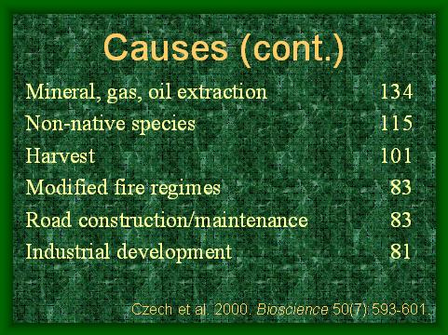
Causes of Biodiversity Loss
Proximate versus Background causes

Slide 18
  Background causes
    consumption of energy and resources
      increasing affluence
      lack of sustainable planning or policies
      population growth
    Toxics, wastes, chemical utilization:
      toxics,
      CO2,
      Erosion
      Fertilizer use
    Unmediated globalization
      exotic species invasions
      Industrial development in biodiversity hot spots

Slide 19
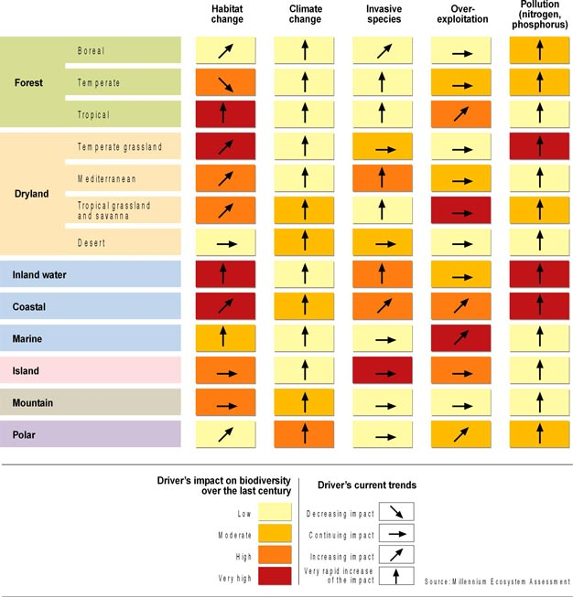
How might we best graph the relation between proximate and background causes of biodiversity loss?
Effect intensity?

Slide 20
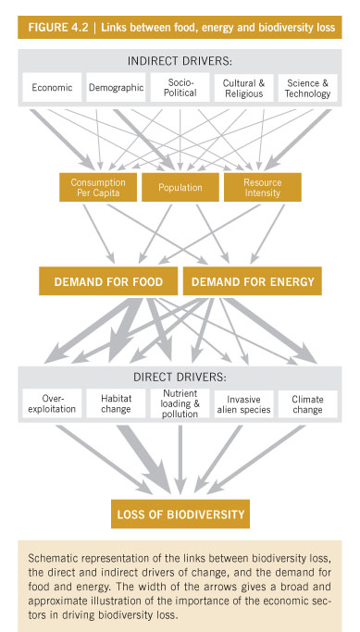
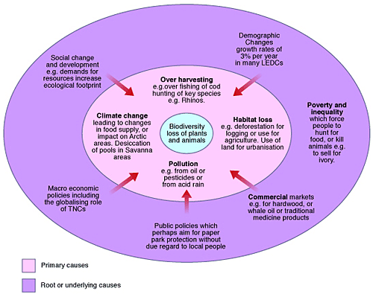
Relational view?

Slide 21
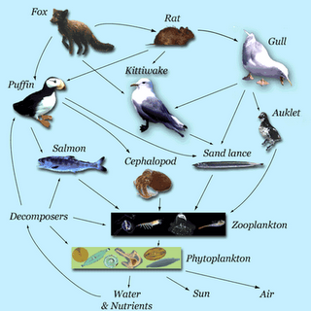
A final concern for biodiversity: Collapse due to ecological dependency or species interrelations

Slide 22
biodiversity hot spots:
what is a biodiversity ‘hot spot’?
how do types of biodiversity and processes of biodiversification create in hot spots?

